Slide 1

CS223: Software Engineering
Software Testing

Slide 2
Objective
After completing this lecture students will be able to
Write test cases of their software
Write unit test report of their software

Slide 3
Definition
Software testing consists of the
dynamic verification that a program
provides expected behaviours on
a finite set of test cases,
suitably selected from the usually infinite execution domain

Slide 4
Explanation: Dynamic
Testing always implies executing the program on selected inputs
The input value alone is not always sufficient to specify a test
Depending on the system state

Slide 5
Explanation: Expected
It must be possible (although not always easy), to
The observed outcomes of program testing are acceptable or not
The testing effort is useless.
The observed behaviour may be checked against
User needs (commonly referred to as testing for validation),
Against a specification (testing for verification),
Against the anticipated behavior from implicit requirements or expectations

Slide 6
Explanation: Finite
A complete test for all possible values may take a lot of time
A complete set of tests can generally be considered infinite
Testing is conducted on a subset of all possible tests
Determined by risk and prioritization criteria.
A trade-off between
Limited resources and schedules
Inherently unlimited test requirements

Slide 7
Explanation: Selected
Test techniques differ essentially in how the test set is selected
Selection criteria → different degrees of effectiveness.
How to identify the most suitable selection criterion ?
Risk analysis techniques and software engineering expertise.

Slide 8
Software Testing
Fundamentals
Test Levels
Test Techniques
Measure
Process
Tools
Terminology
Key Issues
Relationships
Target
Objective
Experience
Domain
Code-based
Fault-based
Model-based
Program
Test
Practical
Activities

Slide 9
Role of Testing
Achieving and assessing the quality of a software product
Improve the quality of the products
Repeat a test–ﬁnd defects–ﬁx cycle during development
Assess how goodness of the system
Perform system-level tests before releasing a product
Two types of activities
Static analysis (no code execution)
Dynamic analysis (code execution)
E.g. code review, inspection, walk-through, algorithm analysis, and proof of correctness

Slide 10
Verification and Validation
Verification
Checks whether the product of a given development phase satisfies the requirements established before the start of that phase.
Intermediate product (requirement specification, design specification, code, user manual), the final product.
Check the correctness of a development phase.
Validation
Confirming that a product meets its intended use.
Focuses on the final product
Establishes whether the product meets user expectations

Slide 11
Terminologies: Failure, error, fault, defect
Failure
A failure is said to occur whenever the external behavior of a system does not conform to that prescribed in the system speciﬁcation.
Error
An error is a state of the system. In the absence of any corrective action by the system, an error state could lead to a failure which would not be attributed to any event subsequent to the error.
Fault
A fault is the adjudged cause of an error.
Defect

Slide 12
An Example
Consider a small organization. Defects in the organization’s staff promotion policies can cause improper promotions, viewed as faults. The resulting ineptitudes & dissatisfactions are errors in the organization’s state. The organization’s personnel or departments probably begin to malfunction as result of the errors, in turn causing an overall degradation of performance. The end result can be the organization’s failure to achieve its goal.
Behrooz Parhami

Slide 13
Key Issues
Test Selection Criteria / Test Adequacy Criteria (Stopping Rules)
Testing Effectiveness / Objectives for Testing
Testing for Defect Discovery
The Oracle Problem
Theoretical and Practical Limitations of Testing
The Problem of Infeasible Paths
Testability
a successful test is one that causes the system to fail
Unambiguous requirements specifications, behavioral models, and code annotations
“program testing can be used to show the presence of bugs, but never to show their absence”, Dijkstra.
Ease with which a given test coverage criterion can be satisfied
Likelihood of exposing failure (if any)

Slide 14
Objectives
It does work
Programmer
It does not work
Test engineers
Reduce the risk of failure
Test engineers
Reduce failure rates
Reduce the cost of testing
Test engineers
Judicial selection of fewer, effective test cases

Slide 15
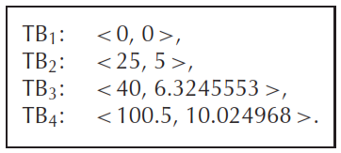
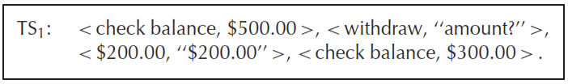
Test case
A test case is a simple pair of <input, expected outcome >
In stateless systems, test case design is easy
In state-oriented systems
Example of a stateless system?
Example of a state-oriented system?

Slide 16
Expected outcome
Outcome of program execution is a complex entity
Values produced by the program
Outputs for local observation
Outputs (messages)
State change
Program
Database
A sequence or set of values which must be interpreted together for the outcome to be valid

Slide 17
I’ve exhaustively tested the program !!
There are no undiscovered faults at the end of the test phase
Complete testing is near impossible
The domain of possible inputs of a program is too large
The design issues may be too complex to completely test
It may not be possible to create all possible execution environments

Slide 18
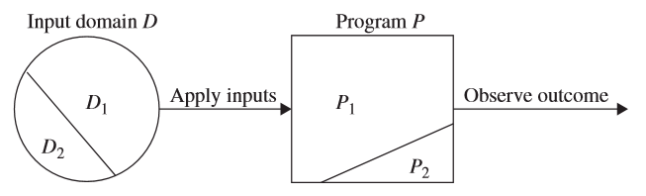
Central issue in testing
Select a subset of the input domain to test a program
Selection of the subset of the input domain must be done in a systematic and careful manner
Deduction is as accurate and complete as possible

Slide 19
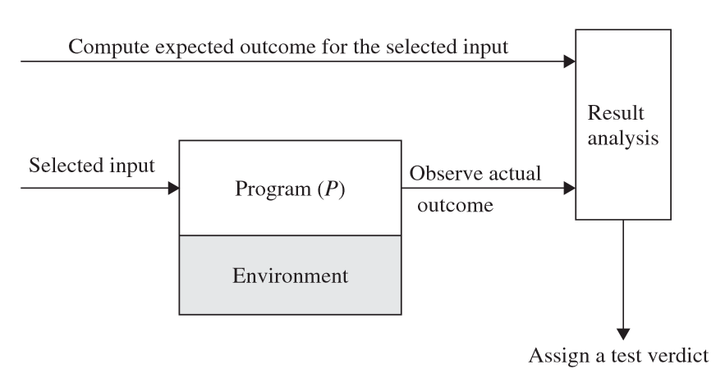
Testing activities
1. Identify an objective to be tested
3. Compute the expected outcome
2. Select Test Inputs
5. Execute the program
4. Set up the execution environment of the program
Pass, Fail, Inconclusive

Slide 20
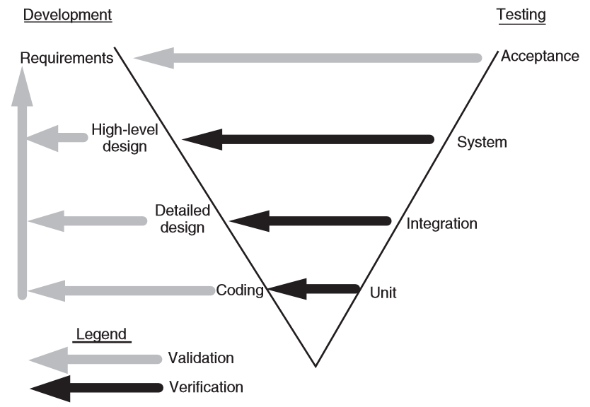
Test levels

Slide 21
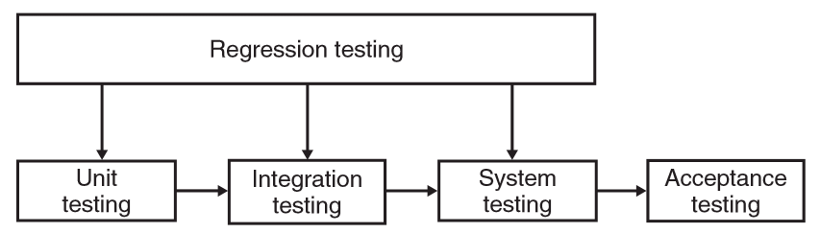
Regression Testing
Performed throughout the life cycle of a system
Performed whenever a component of the system is modiﬁed

Slide 22
Resources for Test case selection
Requirements and functional speciﬁcations
Intended behavior of the system
Source code
Actual behavior of the system
Input and output domains
Special care for input domain
Operational proﬁle
From the observed test results, infer the future reliability
Fault model
Previously encountered faults

Slide 23
Fault model
Error guessing
Assess the situation and guess where and what kinds of faults might exist
Design tests to speciﬁcally expose those kinds of faults
Fault seeding
Known faults are injected into a program
Use of test suites
Mutation Analysis
Similar to fault seeding
Fault simulation
Modify an incorrect program and turn it into a correct program

Slide 24
White-box and Black-box testing
Based on the sources of information for test design
White-box testing → structural testing
Primarily examines source code
Focus on control ﬂow and data ﬂow
Black-box testing → Functional testing
Does not have access to the internal details
Test the part that is accessible outside the program
Functionality and the features found in the program’s speciﬁcation

Slide 25
Testing
Goal of testing:
Maximize the number and severity of defects found
Test early
Limits of testing:
Testing can only determine the presence of defects
Never their absence
Use proofs of correctness to establish “absence”

Slide 26
Testing: the Big Picture
System tests
Integration tests
Module combination
Unit tests
Module
Function

Slide 27
Testing: the Big Picture
System tests
Include use-cases
OOAD
Integration tests
Packages
of classes
Module combination
Unit tests
Combinations of methods in class
Module
Methods
Function

Slide 28
Test automation
Tests are written as executable components before the task is implemented
Testing components should be stand-alone,
Simulate the submission of input to be tested
Check that the result meets the output specification.
An automated test framework is a system that
Makes it easy to write executable tests and submit a set of tests for execution.
A set of tests that can be quickly and easily executed

Slide 29
Unit Testing
The focus is the module a programmer has written
Most often UT is done by the programmer himself
UT will require test cases for the module
UT also requires drivers to be written to actually execute the module with test cases
Besides the driver and test cases, tester needs to know the correct outcome as well

Slide 30
Unit Test Pattern
Good unit tests are difficult to write
"the code is good when it passes the unit tests“
Unit test should be written first, before the code that is to be tested
Challenges
Unit testing must be formalized
Design also must be formally performed

Slide 31
Unit Test Patterns
Pass/fail patterns
Collection management patterns
Data driven patterns
Performance patterns
Simulation patterns
Multithreading patterns
Stress test patterns
Presentation layer patterns
Process patterns

Slide 32
Pass/Fail Patterns
First line of defense to guarantee good code
Simple-Test Pattern
Code-Path Pattern
Parameter-Range Pattern

Slide 33
Simple Test-Pattern
Condition A
Code
Expected Result
Condition B
Expected Failure
Pass/Fail results tell us that
the code under test will work/trap an error given the same input (condition) as in the unit test
No real confidence that the code will work correctly or trap errors with other set of conditions

Slide 34
Code-Path Pattern
Code path A
Code paths
Path result
Code path B
Path result
Emphasizes on conditions that
test the code paths with in the unit rather than conditions that test for pass/fail
Results are compared to expected output of given code path
Caveat: How do you test code-paths if tests are written first?

Slide 35
Parameter-Range Pattern
Success set
Code path A
Code paths
Path result
Code path B
Path result
Failure set
Code-Path pattern with more than a single parameter test

Slide 36
Data Driven Test Patterns
Patterns which enable testing units with a broad range of input output pairs
Simple-Test-Data Pattern
Data-Transformation-Test Pattern

Slide 37
Simple-Test-Data Pattern
Data Set
Input
Output
Unit Test
Computation Code
Verify Result
Reduces complexity of Parameter-Range unit by separating test data from the test.
Test data is generated and modified independent of the test
Results are supplied with the data set.
Candidates for this pattern: Checksum Calculations, algorithims, etc…

Slide 38
Data-Transformation-Test Pattern
Input test data
Validation
Transformation code
Unit test
Measurement
Works with data in which a qualitative measure of the result must be performed.
Typically applied to transformation algorithms such as lossy compression

Slide 39
Data Transaction Patterns
Patterns embracing issues of data persistence and communication
Simple-Data-I/O Pattern
Constraint Data Pattern
The Rollback Pattern

Slide 40
Simple-Data-I/O Pattern
Service
Write test
Read Test
Verifies the read/write functions of the service

Slide 41
Constraint Data Pattern
Nullable
Unique
Default value
Foreign key
Cascading update
Cascading delete
Service
Write test
Constraints
Adds robustness to Simple-Data-I/O pattern by
Testing more aspects of the service
Any rules that the service may incorporate
Unit test verifies the service implementation itself
For example, DB schema, web service, etc…

Slide 42
Rollback Pattern
Rollback
Service
Write test
Write test
Verifies rollback correctness
Most transactional unit tests should incorporate ability to rollback dataset to known state
In order to undo test side effects

Slide 43
Collection Management Patterns
Used to verify that the code is using the correct collection
Collection-Order Pattern
Enumeration Pattern
Collection-Constraint Pattern
Collection-Indexing Pattern

Slide 44
Collection-Order Pattern
Unordered
Code Containing Collection
Unordered data
Sequenced
Ordered
Verifies expected results when given an unordered list
The test validates that the result is as expected
Unordered, ordered or same sequence as input
Provides implementer with information on how the container manages the collections

Slide 45
Enumeration Pattern
Edge test
Code Containing Collection
Expected datum
Enumerator (FWD, REV)
Collection
Verifies issues of enumeration or collection traversal
Important test when connections are non-linear.
E.g. collection tree nodes
Edge conditions (past first or last item) are also important to test

Slide 46
Collection-Constraint Pattern
Write test
Collection container
Nullable
Unique
Constraints
Verifies that the container handles constraint violations
Null values and duplicate keys
Typically applies to key-value pair collections

Slide 47
Collection-Indexing Pattern
Write test
Collection container
Index Key
Out of bound index
Update/ Delete Index
Index test
Verifies and documents indexing methods that the collection must support – by index and/or by key
Verifies that update and delete transactions that utilize indexing are working properly and are protected against missing indexes

Slide 48
Performance Patterns
Used to test non functional requirements as
performance and resource usage
Performance-Test Pattern

Slide 49
Performance-Test Pattern
Pass
Metric at Start
Code
Metric at End
Pass criteria
Fail
Types of performance that can be measured:
Memory usage (physical, cache, virtual)
Resource (handle) utilization
Disk utilization (physical, cache)
Algorithm Performance (insertion, retrieval)

Slide 50
Pattern Summary
Unit Test patterns cover broad aspects of development; not just functional
May promote unit testing to become a more formal engineering discipline
Helps identify the kind of unit tests to write, and its usefulness.
Allows developer to choose how detailed the unit tests need to be

Slide 51
Need for metrics
To determine the quality and progress of testing.
To calculate how much more time is required for the release
To estimate the time needed to fix defects.
To help in deciding the scope of the to be released product
The defect density across modules,
Their importance to customers and
Impact analysis of those defects

Slide 52
Verification
Code has to be verified before it can be used by others
Verification of code written by a programmer
There are many different techniques
unit testing, inspection, and program checking
Program checking can also be used at the system level

Slide 53
Code Inspections
The inspection process can be applied to code with great effectiveness
Inspections held when code has compiled and a few tests passed
Usually static tools are also applied before inspections
Inspection team focuses on finding defects and bugs in code
Checklists are generally used to focus the attention on defects

Slide 54
Code Inspections…
Some items in a checklist
Do all pointers point to something
Are all variables and pointers initialized
Are all array indexes within bounds
Will all loops always terminate
Any security flaws
Is input data being checked
Obvious inefficiencies

Slide 55
Code inspections…
Are very effective and are widely used in industry (many require all critical code segments to be inspected)
Is also expensive; for non critical code one person inspection may be used
Code reading is self inspection
A structured approach where code is read inside-out
Is also very effective

Slide 56
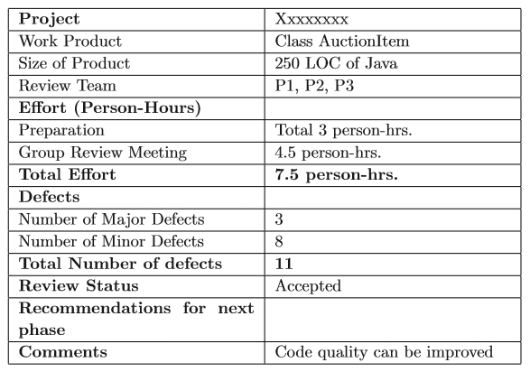
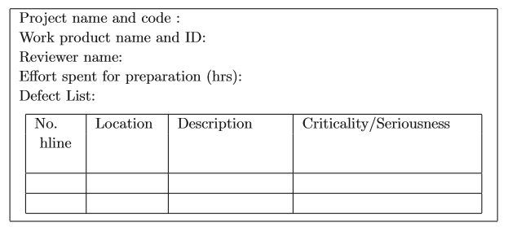
Best practice

Slide 57
Static Analysis
These are tools to analyze program sources and check for problems
It cannot find all bugs and often cannot be sure of the bugs it finds as it is not executing the code
So there is noise in their output
Many different tools available that use different techniques
They are effective in finding bugs like memory leak, dead code, dangling pointers,..

Slide 58
Formal Verification
These approaches aim to prove the correctness of the program
I.e. the program implements its specifications
Require formal specifications for the program, as well as rules to interpret the program
Was an active area of research
Scalability issues became the bottleneck
Used mostly in very critical situations, as an additional approach

Slide 59
Metrics for Size
LOC or KLOC
Non-commented, non blank lines is a standard definition
Generally only new or modified lines are counted
Used heavily, though has shortcomings
Depends heavily on the language used
Depends on how lines are counted.

Slide 60
Metrics for Size…
Halstead’s Volume
n1: no of distinct operators
n2: no of distinct operands
N1: total occurrences of operators
N2: Total occurrences of operands
Vocabulary, n = n1 + n2
Length, N = N1 + N2
Volume, V = N log₂(n)
The minimum number of bits necessary to represent the program.

Slide 61
Metrics for Complexity
Cyclomatic Complexity is perhaps the most widely used measure
Represents the program by its control flow graph with e edges, n nodes, and p parts
Cyclomatic complexity is defined as V(G) = e-n+p
This is same as the number of linearly independent cycles in the graph
Number of decisions (conditionals) in the program plus one

Slide 62
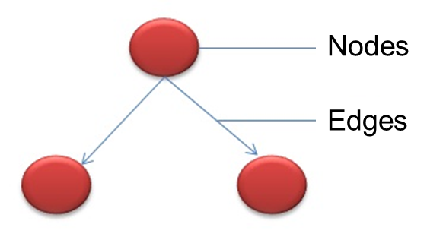
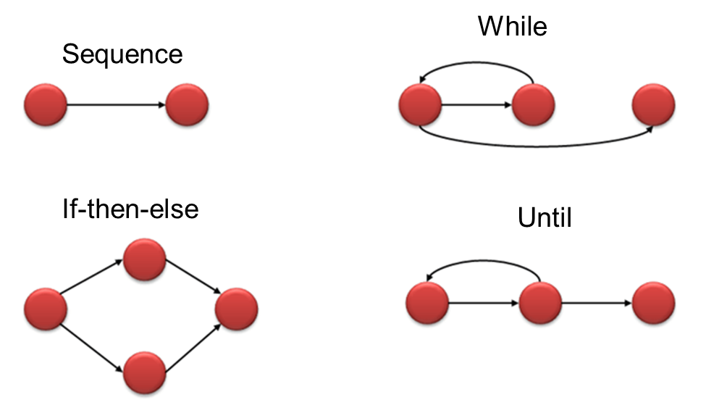
Flow graph of a program

Slide 63
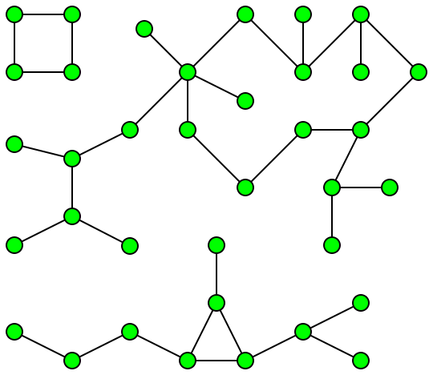
Connected component

Slide 64
Cyclomatic complexity example…
{
i=1;
while (i<=n) {
J=1;
while(j <= i) {
If (A[i]<A[j])
Swap(A[i], A[j]);
J=j+1;}
i = i+1;}
}

Slide 65
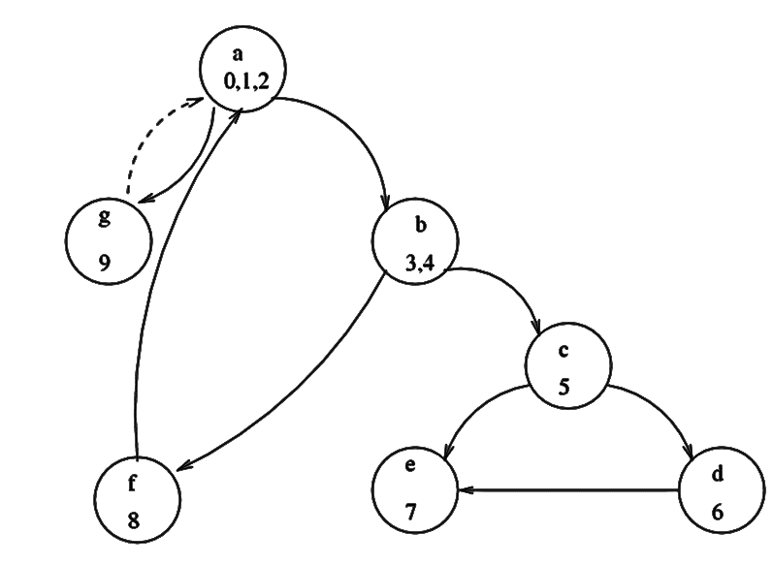
Example…

Slide 66
Example…
V(G) = 10-7+1 = 4
Independent circuits
b c e b
b c d e b
a b f a
a g a
No of decisions is 3 (while, while, if); complexity is 3+1 = 4

Slide 67
Outline of control flow testing
Inputs
The source code of a program unit
A set of path selection criteria
Examples of path selection criteria
Select paths such that every statement is executed at least once
Select paths such that every conditional statement evaluates to true and false at least once on different occasions

Slide 68
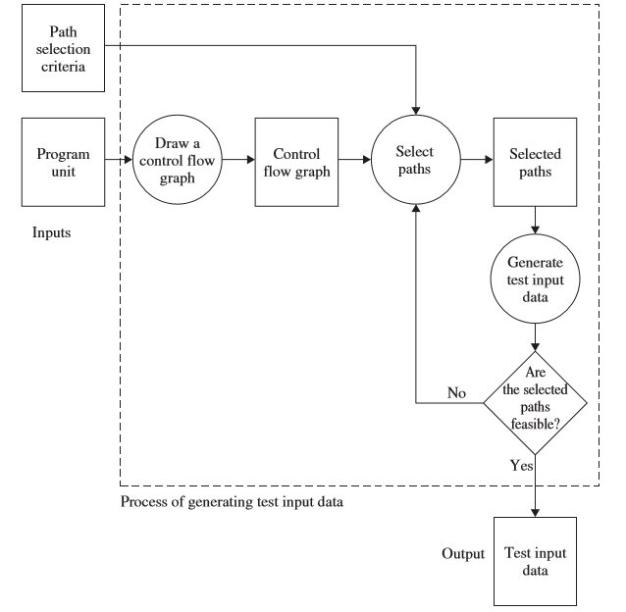
Control flow graph

Slide 69
Control Flow Graph (CFG)
FILE *fptr1, *fptr2, *fptr3; /* These are global variables.*/
int openfiles(){
/* This function tries to open files "file1", "file2", and "file3" for read access, and returns the number of files successfully opened. The file pointers of the opened files are put in the global variables. */
int i = 0;
if(
((( fptr1 = fopen("file1", "r")) != NULL) && (i++) &&
(0)) ||
((( fptr2 = fopen("file2", "r")) != NULL) && (i++) && (0)) ||
((( fptr3 = fopen("file3", "r")) != NULL) && (i++))
);
return(i);
}

Slide 70
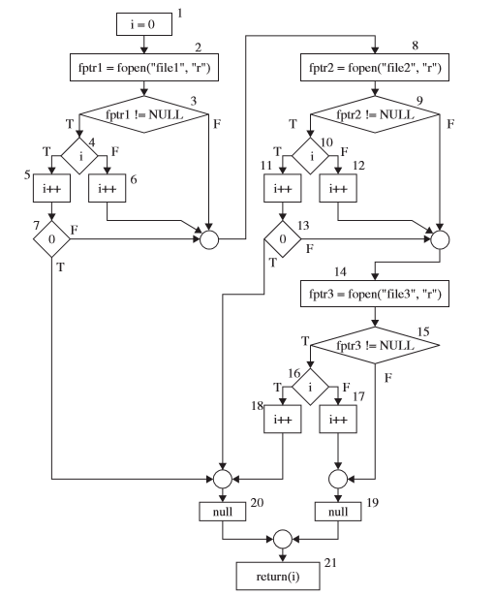
CFG

Slide 71
Complexity metrics…
The basic use of these is to reduce the complexity of modules
Cyclomatic complexity should be less than 10
Another use is to identify high complexity modules and then see if their logic can be simplified

Slide 72
Range of Cyclomatic Complexity
Value | Meaning
1-10 | Structured and well written code High Testability Cost and Effort is less
10-20 | Complex Code Medium Testability Cost and effort is Medium
20-40 | Very complex Code Low Testability Cost and Effort are high
>40 | Not at all testable Very high Cost and Effort

Slide 73
Tools
Name | Language support | Description
OCLint | C, C++ | Static code analysis
devMetrics | C# | Analyzing metrics
Reflector | .NET | Code metrics
GMetrics | Java | Find metrics in Java related applications
NDepends | Java | Metrics in Java applications

Slide 74
Advantages of Cyclomatic Complexity
Helps developers and testers to determine independent path executions
Developers can assure that all the paths have been tested at least once
Helps us to focus more on the uncovered paths
Improve code coverage
Evaluate the risk associated with the application or program
Using these metrics early in the cycle reduces more risk of the program

Slide 75
Other Metrics
Halstead’s Measure
Live Variables and span
Maintainablity Index
Depth of Inheritance (Depth in Inheritance Tree (DIT))
Number of Children (NOC)

Slide 76
Depth in Inheritance Tree (DIT)
The DIT is the depth of inheritance of the class
i.e. number of ancestors in direct lineage in the object-oriented paradigm.
DIT is a measure of how many ancestor classes can potentially affect this class.
The deeper a class is in the hierarchy,
The greater the number of methods it is likely to inherit,
Makes it more complex to predict its behavior.
Deeper trees constitute
Greater design complexity
Greater the potential reuse of inherited methods.

Slide 77
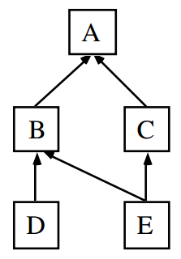
Example of DIT

Slide 78
Number Of Children (NOC)
It is the number of immediate subclasses to a class in the class hierarchy
How many subclass is going to inherit a method of the base class
Greater the number of children
Greater the potential reuse
Greater the chance of improper abstraction of the base class
Greater the potential influence

Slide 79
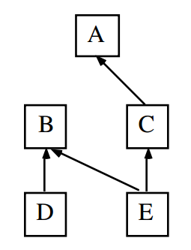
NOC Example

Slide 80
Summary
Goal of coding is to convert a design into easy to read code with few bugs
Good programming practices like structured programming, information hiding, etc can help
There are many methods to verify the code of a module – unit testing and inspections are most commonly used
Size and complexity measures are defined and often used; common ones are LOC and cyclomatic complexity

Slide 81
Some Best Practices
Naming standards for unit tests
Test coverage and testing angles
When should a unit test be removed or changed?
Tests should reflect required reality
What should assert messages say?
Avoid multiple asserts in a single unit test
Mock Objects Usage
Making tests withstand design and interface changes – remove code duplication

Slide 82
Thank you
Next Lecture: Control Flow Testing

