Slide 1

CS322: Database Systems
Creating Database Triggers

Slide 2
Outline
Describe different types of triggers
Describe database triggers and their use
Create database triggers
Describe database trigger firing rules
Remove database triggers

Slide 3
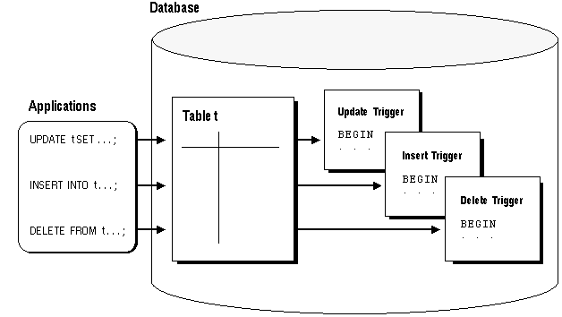
Introduction

Slide 4
Types of Triggers
A trigger:
Is a PL/SQL block or a PL/SQL procedure associated with a table, view, schema, or the database
Executes implicitly whenever a particular event takes place
Can be either:
Application trigger: Fires whenever an event occurs with a particular application
Database trigger: Fires whenever a data event (such as DML) or system event (such as logon or shutdown) occurs on a schema or database

Slide 5
Guidelines for Designing Triggers
Design triggers to:
Perform related actions
Centralize global operations
Do not design triggers:
Where functionality is already built into the Oracle server
That duplicate other triggers
Create stored procedures and invoke them in a trigger, if the PL/SQL code is very lengthy
The excessive use of triggers can result in complex interdependencies, which may be difficult to maintain in large applications

Slide 6
Database Trigger: Example
Application
Insert into Marks values …
Check_Marks Trigger
Couse_Id | Marks | … | …

Slide 7
Creating DML Triggers
A triggering statement contains:
Trigger timing
For table: before, after
For view: instead of
Triggering event: insert, update, or delete
Table name: On table, view
Trigger type: Row or statement
WHEN clause: Restricting condition
Trigger body: PL/SQL block

Slide 8
DML Trigger Components: Trigger timing
When should the trigger fire?
BEFORE: Execute the trigger body before the triggering DML event on a table.
AFTER: Execute the trigger body after the triggering DML event on a table.
INSTEAD OF: Execute the trigger body instead of the triggering statement. This is used for views that are not otherwise modifiable.

Slide 9
DML Trigger Components: Triggering user event
Which DML statement causes the trigger to execute?
INSERT
UPDATE (specify a column list )
DELETE

Slide 10
DML Trigger Components: Trigger type
Should the trigger body execute for each row the statement affects or only once?
Statement
The trigger body executes once for the triggering event.
This is the default.
A statement trigger fires once, even if no rows are affected at all.
Row:
The trigger body executes once for each row affected by the triggering event.
A row trigger is not executed if the triggering event affects no rows.

Slide 11
DML Trigger Components: Trigger body
What action should the trigger perform?
The trigger body is a PL/SQL block or a call to a procedure.
Row triggers use correlation names to access the old and new column values of the row being processed by the trigger.

Slide 12
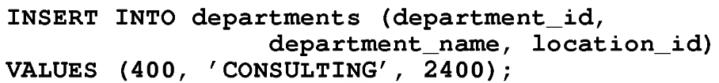
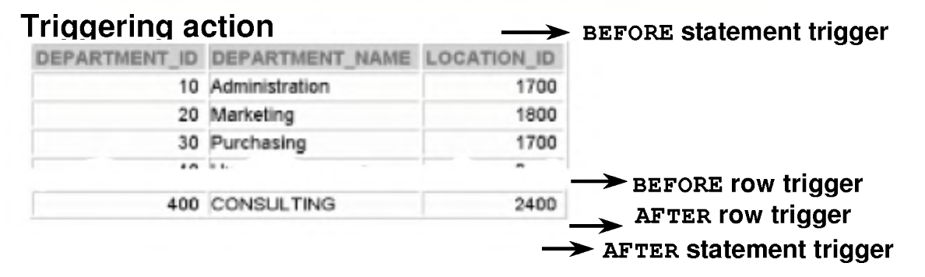
Firing Sequence
Use the following firing sequence for a trigger on a table, when a single row is manipulated:

Slide 13
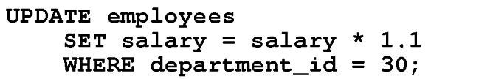
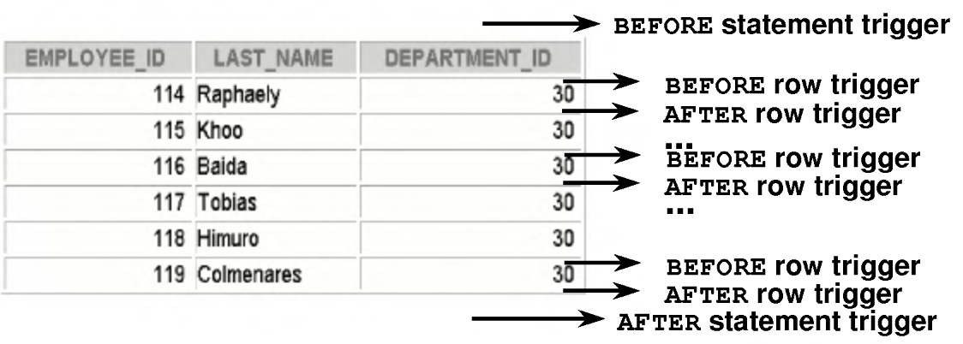
Firing Sequence
Use the following firing sequence for a trigger on a table, when many rows are manipulated:

Slide 14
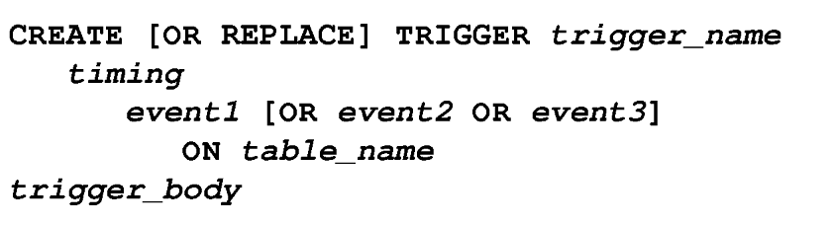
Creating DML Statement Triggers
When the trigger fires
Name of the trigger
Cause of Trigger Firing
Table/ View associated with the trigger
Trigger names must be unique with respect to
other triggers in the same schema.

Slide 15
Example
CREATE OR REPLACE TRIGGER secure_emp
BEFORE INSERT ON employees
BEGIN
IF (TO_CHAR(SYSDATE,'DY') IN (' SAT' , ' SUN' ) ) OR
(TO_CHAR(SYSDATE,'HH2 4:MI') NOT BETWEEN '08:00' AND '18:00')
THEN
RAISE_APPLICATION_ERROR (-20500,'You may
insert into EMPLOYEES table only
during business hours.');
END IF;
END;
INSERT INTO employees (employee_id, last_name,
first_name, email, hire_date, job_id, salary, department_id)
VALUES (300, 'Smith', 'Rob', 'RSMITH', SYSDATE, 'IT_PROG', 4500, 60);

Slide 16
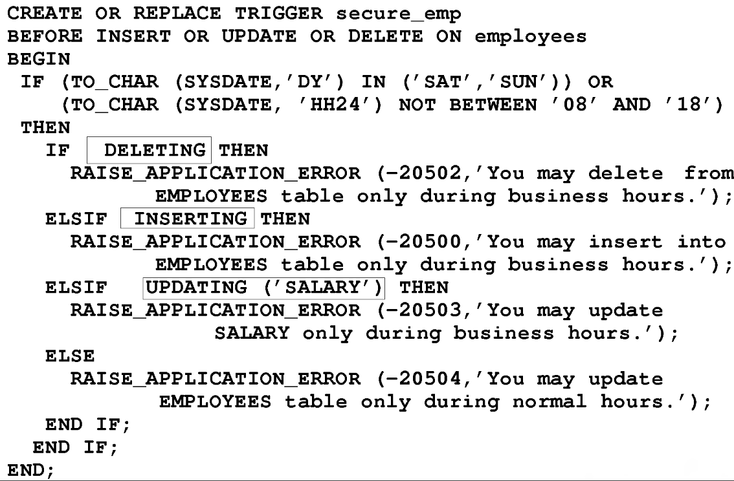
Using Conditional Predicates

Slide 17
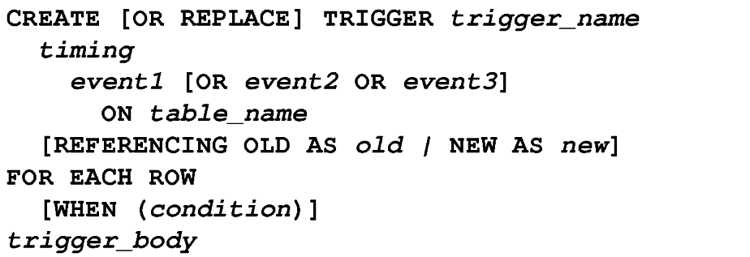
Creating a DML Row Trigger
Specifies correlation names for the old and new values of the current row
(The default values are OLD and NEW)
Designates that the trigger is a row trigger
Specifies the trigger restriction

Slide 18
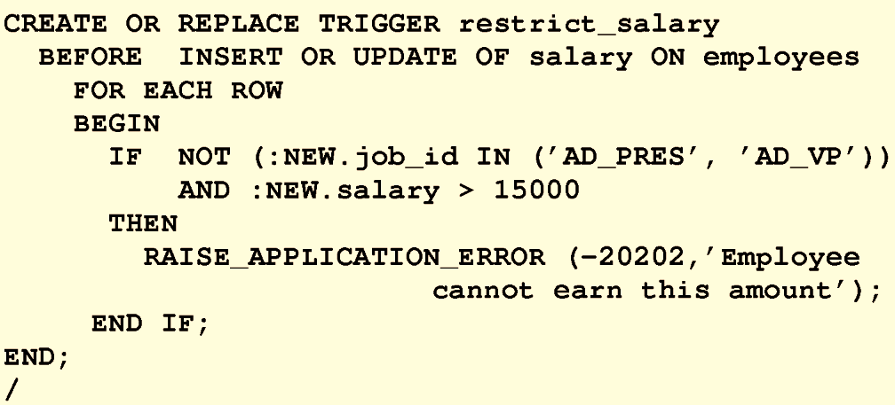
Example
You can create a BEFORE row trigger in order to prevent the triggering operation from succeeding if a certain condition is violated.
Create a trigger to allow only certain employees to be able to earn a salary of more than 15,000.

Slide 19
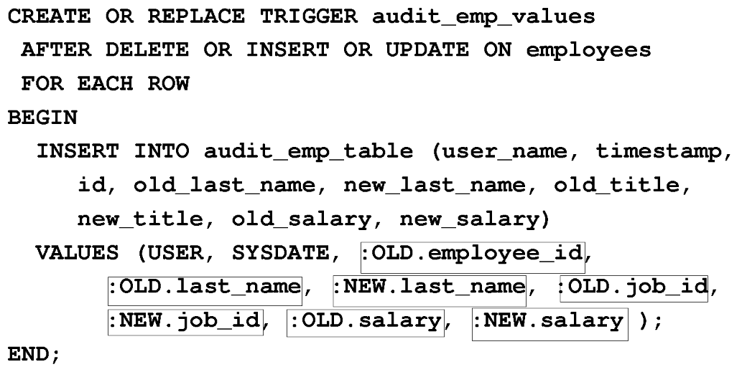
Using old and new Qualifiers

Slide 20
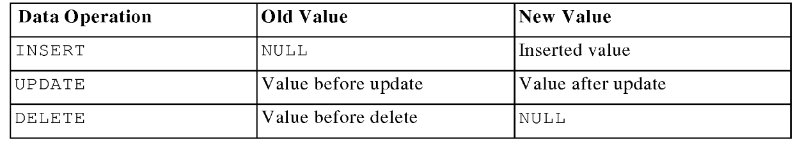
Using old and new Qualifiers
• The OLD and NEW qualifiers are available only in ROW triggers.
• Prefix these qualifiers with a colon (:) in every SQL and PL/SQL statement.
• There is no colon (:) prefix if the qualifiers are referenced in the WHEN restricting condition.

Slide 21
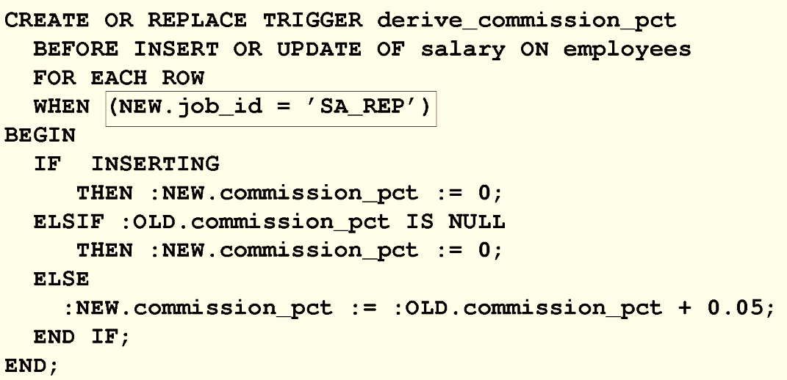
Restricting a Row Trigger
To restrict the trigger action to those rows that satisfy a certain condition
The NEW qualifier cannot be prefixed with a colon in the WHEN clause because the WHEN clause is outside the PL/SQL blocks.

Slide 22
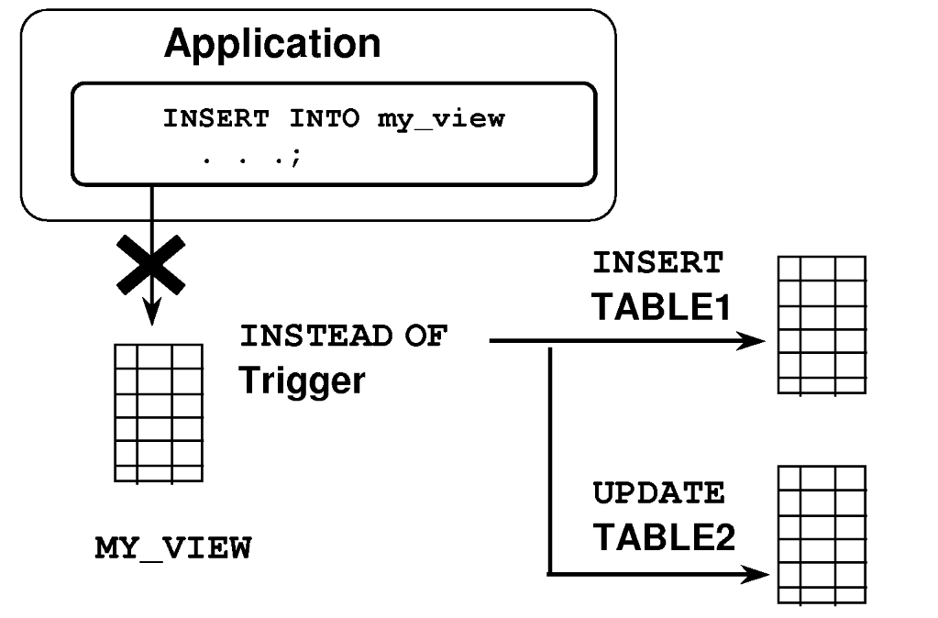
INSTEAD of Triggers
Use INSTEAD OF triggers to modify data in which the DML statement has been issued against an inherently non-updatable view.

Slide 23
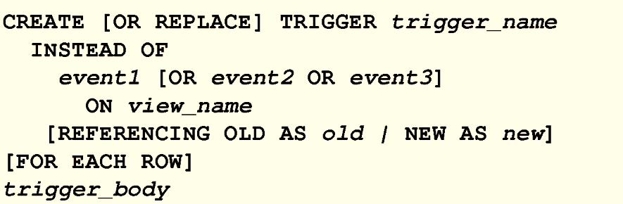
Creating an INSTEAD OF Trigger
Indicates that the trigger belongs to a view
Indicates the view associated with trigger
Designates the trigger to be a row trigger

Slide 24
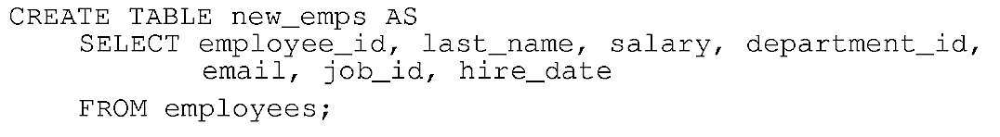
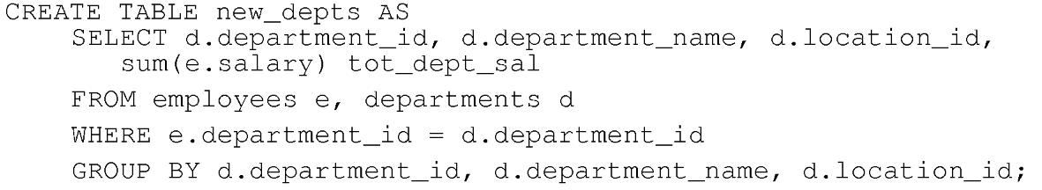
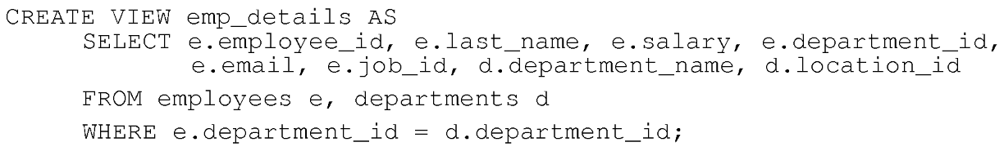
Example

Slide 25
CREATE OR REPLACE TRIGGER new_emp_dept
INSTEAD OF INSERT OR UPDATE OR DELETE ON emp_details
FOR EACH ROW
BEGIN
IF INSERTING THEN
INSERT INTO new_emps VALUES (:NEW.employee_id, :NEW.last_name, :NEW.salary, :NEW.department_id, :NEW.email, :New.job_id, SYSDATE);
UPDATE new_depts SET tot_dept_sal = tot_dept_sal + :NEW.salary WHERE department_id = :NEW.department_id;
ELSIF DELETING THEN
DELETE FROM new_emps WHERE employee_id = :OLD.employee_id;
UPDATE new_depts SET tot_dept_sal = tot_dept_sal - :OLD.salary WHERE department_id = :OLD.department_id;
ELSIF UPDATING ('salary') THEN
UPDATE new_emps SET salary = :NEW.salary WHERE employee_id = :OLD.employee_id;
UPDATE new_depts SET tot_dept_sal = tot_dept_sal + (:NEW.salary - :OLD.salary) WHERE department_id = :OLD.department_id;
ELSIF UPDATING ('department_id') THEN
UPDATE new_emps SET department_id = :NEW.department_id WHERE employee_id = :OLD.employee_id;
UPDATE new_depts SET tot_dept_sal = tot_dept_sal - :OLD.salary WHERE department_id = :OLD.department_id;
UPDATE new_depts SET tot_dept_sal = tot_dept_sal + :NEW.salary WHERE department_id = :NEW.department_id;
END IF;
END;

Slide 26
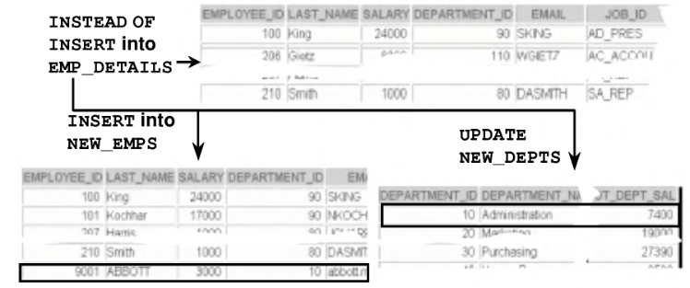
Illustration: INSTEAD OF
Insert into emp_details that is based on employees and DEPARTMENTS tables

Slide 27
Database Triggers Vs. Stored Procedures
Triggers
Procedures
Defined with create trigger
Data dictionary contains source code in user_triggers
Implicitly invoked
commit, savepoint, and rollback are not allowed
Defined with create procedure
Data dictionary contains source code in user_source
Explicitly invoked
COMMIT, SAVEPOINT, and ROLLBACK are allowed

Slide 28
Managing Triggers
Disable or reenable a database trigger:
Disable or re-enable all triggers for a table:
Recompile a trigger for a table:

Slide 29

DROP TRIGGER Syntax
To remove a trigger from the database, use the drop trigger syntax:
Example:
All triggers on a table are dropped when the table is dropped.

Slide 30
Trigger Test Cases
Test each triggering data operation, as well as non-triggering data operations.
Test each case of the WHEN clause.
Cause the trigger to fire directly from a basic data operation, as well as indirectly from a procedure.
Test the effect of the trigger upon other triggers.
Test the effect of other triggers upon the trigger.

Slide 31
Trigger Execution Model and Constraint Checking
Execute all before statement triggers.
Loop for each row affected:
Execute all before row triggers.
Execute all after row triggers.
Execute the DML statement and perform integrity constraint checking.
Execute all after statement triggers.

Slide 32
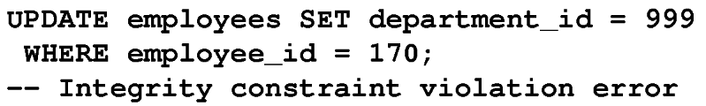
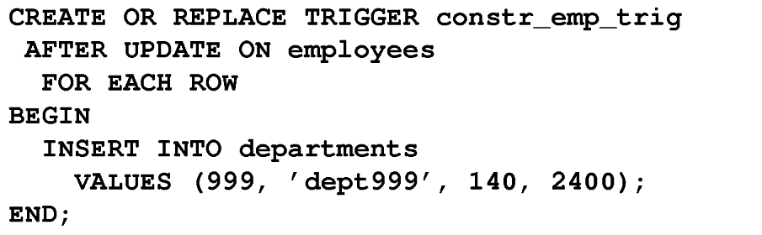
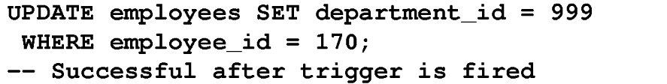
Example

Slide 33
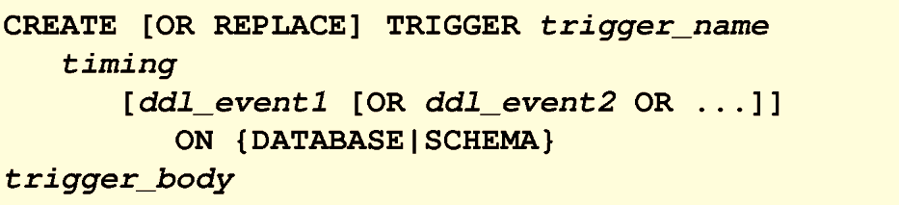
Creating Triggers on DDL Statements
Fire the trigger whenever a CREATE statement adds a new database object to the dictionary

Slide 34
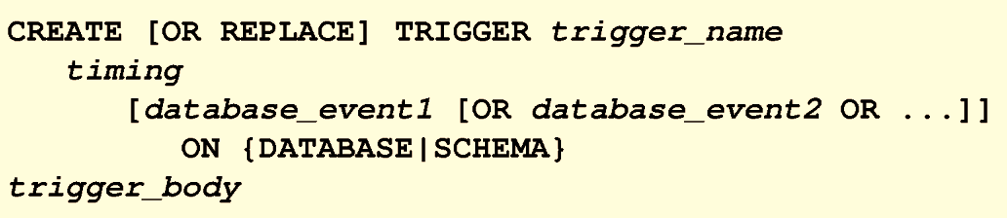
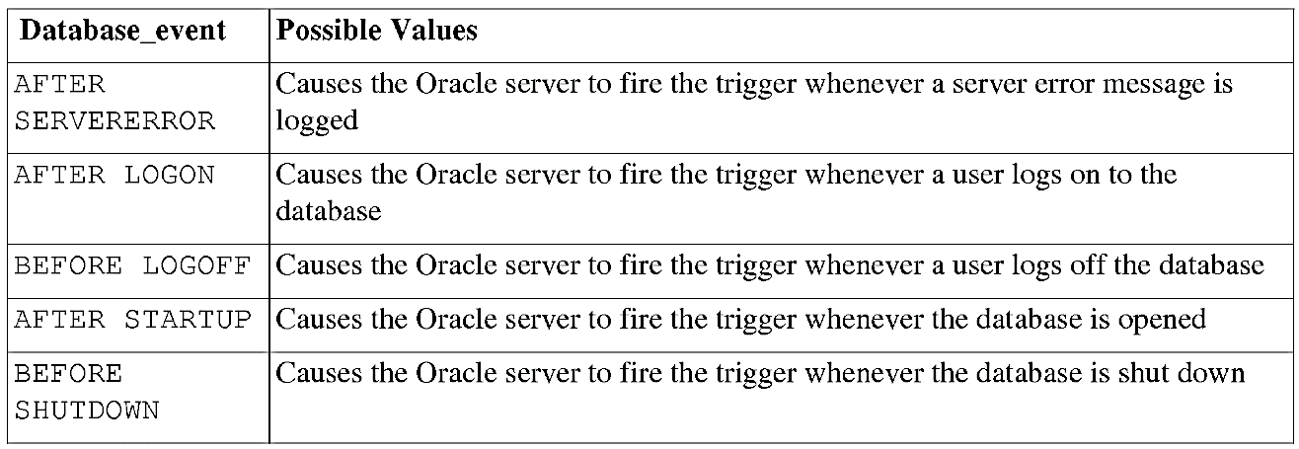
Creating Triggers on System Events

Slide 35
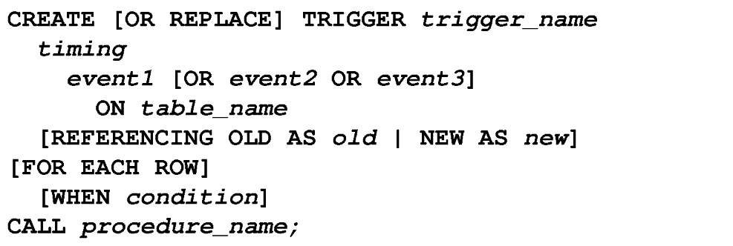
CALL Statement
CREATE TRIGGER salary_check
BEFORE UPDATE OF salary, job_id ON employees
FOR EACH ROW
WHEN (NEW.job_id <> 'AD_PRES')
CALL check_sal(:NEW.job_id, :NEW.salary)
There is no semicolon at the end of the CALL statement.

Slide 36
Mutating Table
A mutating table is a table that is currently being modified by an UPDATE, DELETE, or INSERT statement
A table that might need to be updated by the effects of a declarative DELETE CASCADE referential integrity action.
A table is not considered mutating for STATEMENT triggers.
The triggered table itself is a mutating table, as well as any table referencing it with the FOREIGN KEY constraint.
This restriction prevents a row trigger from seeing an inconsistent set of data.

Slide 37
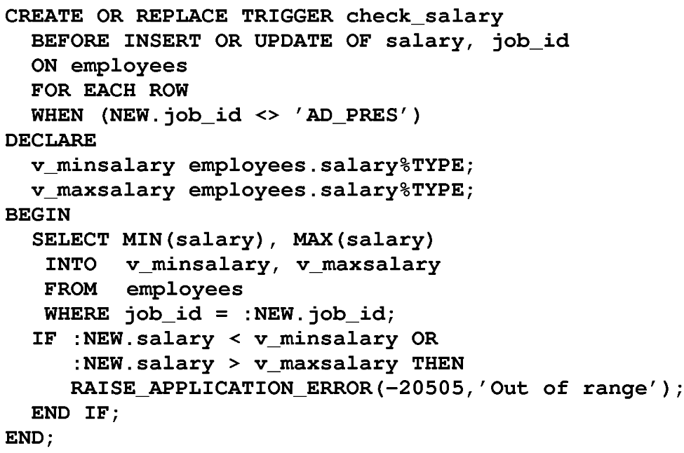
Example
Guarantee that whenever a new employee is
added to the EMPLOYEES table or whenever an existing employee's salary or job ID is changed, the employee's salary falls within the established salary range for the employee's job.
When an employee record is updated, the CHECK_SALARY trigger is fired for each row that is updated. The trigger code queries the same table that is being updated, i.e. EMPLOYEES table is mutating table.

Slide 38
Implementing Triggers
Security
Auditing
Data integrity
Referential integrity
Table replication
Computing derived data automatically
Event logging

Slide 39
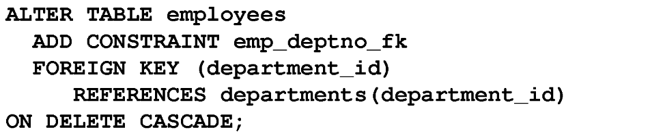
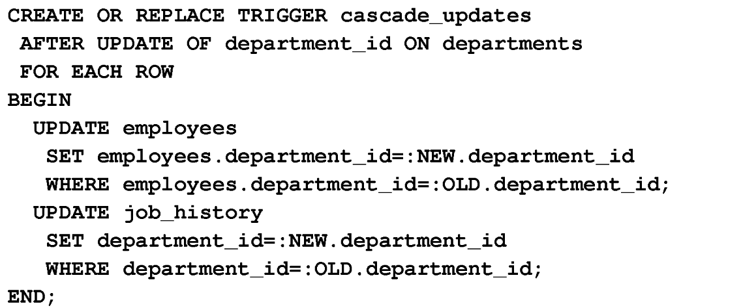
Enforcing Referential Integrity within the Server

Slide 40
Benefits of Database Triggers
Improved data security:
Provide enhanced and complex security checks
Provide enhanced and complex auditing
Improved data integrity:
Enforce dynamic data integrity constraints
Enforce complex referential integrity constraints
Ensure that related operations are performed together implicitly

Slide 41
Viewing Trigger Information
You can view the following trigger information:
user_objects data dictionary view: Object information
user_triggers data dictionary view: The text of the trigger
user_errors data dictionary view: PL/SQL syntax errors (compilation errors) of the trigger

Slide 42
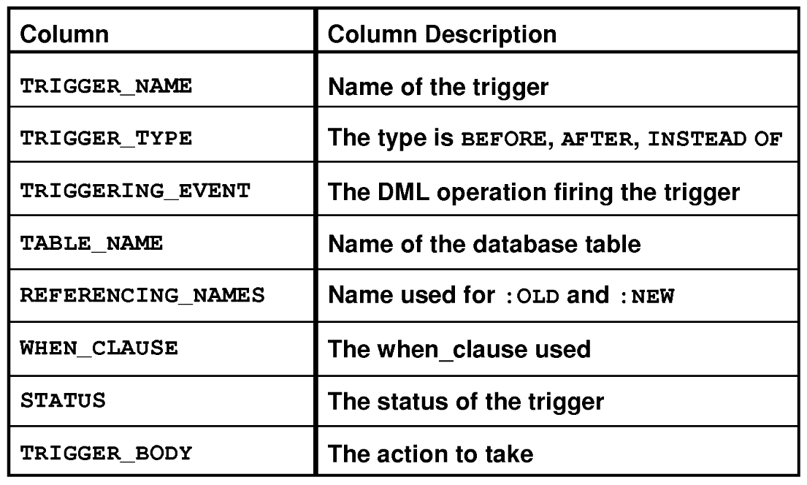
Using USER_TRIGGERS

Slide 43
Thank you

