Slide 1

CS322: Database Systems
PL/ SQL
PL/SQL by Ivan Bayross

Slide 2
About PL/ SQL
PL/SQL is the procedural extension to SQL with design features of programming languages.
Data manipulation and query statements of SQL are included within procedural units of code.

Slide 3
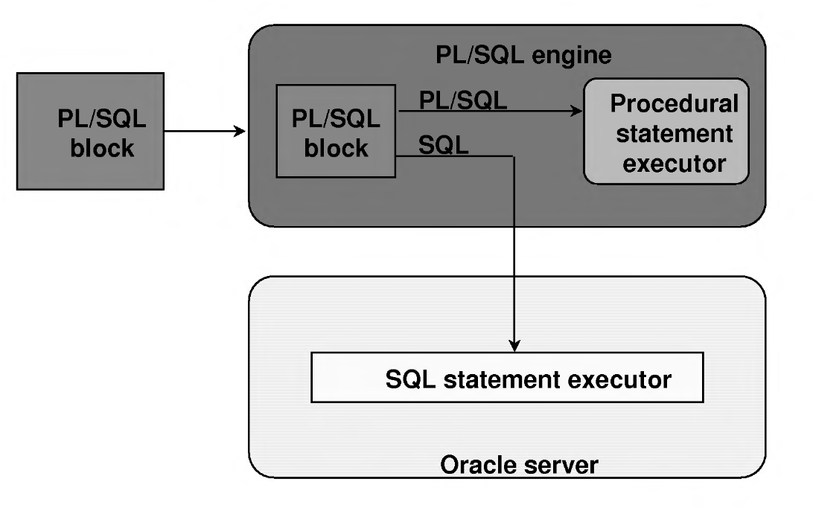
PL/SQL Environment

Slide 4
Key Points
PL/SQL is an extension to SQL.
Blocks of PL/SQL code are passed to and processed by a PL/SQL engine.
Benefits of PL/SQL:
Integration
Improved performance
Portability
Modularity of program development
Subprograms are named PL/SQL blocks
Declared as either procedures or functions.
Invoke subprograms from different environments.

Slide 5
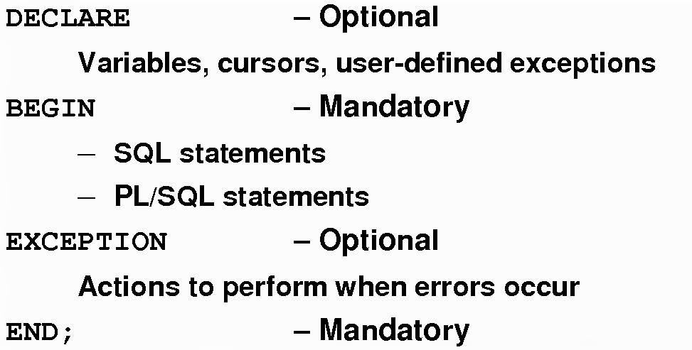
PL/SQL Block Structure
Contains all variables, constants, cursors, and user- defined exceptions that are referenced in the executable and declarative sections
SQL statements to manipulate data in the database and PL/SQL statements to manipulate data in the block
The actions to perform when errors and abnormal conditions arise in the executable section

Slide 6
Executing Statements and PL/SQL Blocks
DECLARE
v_variable VARCHAR2(5);
BEGIN
SELECT column_name
INTO v_variable
FROM table_name;
EXCEPTION
WHEN exception_name THEN
…
END;

Slide 7
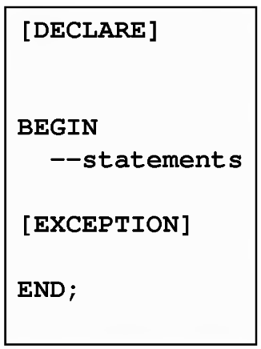
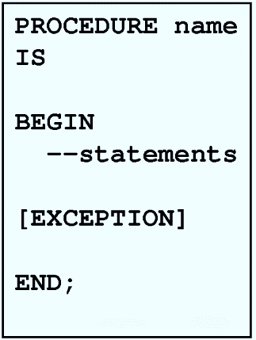
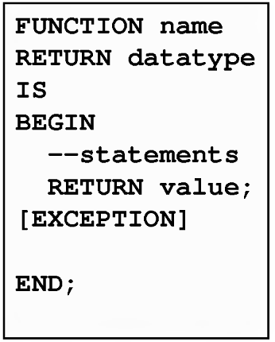
Block Types

Slide 8
Program Constructs
Tools
Anonymous blocks
Database Server
Anonymous blocks
Application procedures
Application packages
Application triggers
Object types
Stored procedures
Stored packages
Database triggers
Object types

Slide 9
Use of Variables
Temporary storage of data
Manipulation of stored values
Reusability
Ease of maintenance
Declare and initialize variables in the declaration section.
Assign new values to variables in the executable section.
Pass values into PL/SQL blocks through parameters.
View results through output variables.

Slide 10
More on variables
PL/SQL variables:
Scalar
Composite
Reference
lob (large objects)
Non-PL/SQL variables: Bind and host variables
PL/SQL does not have input or output capability of its own.
Reference substitution variables within a PL/SQL block with a preceding ampersand.
iSQL*Plus host (or "bind") variables can be used to pass run time values out of the PL/SQL block back to the iSQL*Plus environment.

Slide 11
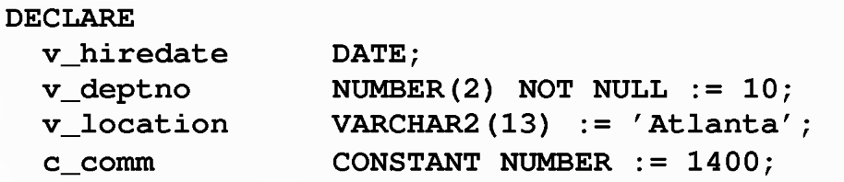
Declaring PL/SQL Variables
identifier [CONSTANT] datatype [NOT NULL] [:= | DEFAULT expr];

Slide 12

Variable Initialization and Keywords
Assignment operator (: =)
default keyword
NOT NULL constraint
If there is a single quotation mark in the string, use a single quotation mark twice

Slide 13
Scalar Data Type
CHAR [(maximum_length)]
VARCHAR2 (maxlmum_length)
LONG
LONG RAW
NUMBER [(precision, scale)]
BINARY_INTEGER
PLS_INTEGER
BOOLEAN
DATE
TIMESTAMP
TIMESTAMP WITH TIME ZONE
TIMESTAMP WITH LOCAL TIME ZONE
INTERVAL YEAR TO MONTH
INTERVAL DAY TO SECOND

Slide 14
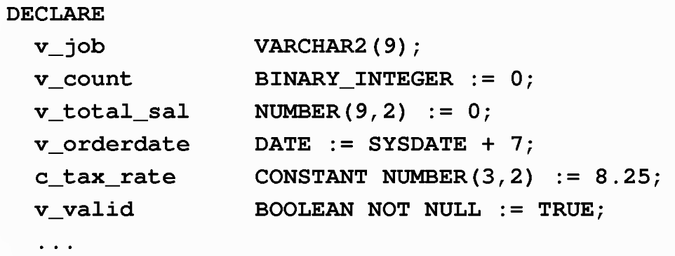
How to Declare The Variable

Slide 15
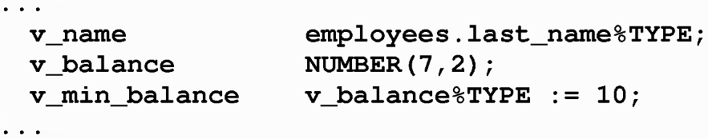
The %type Attribute
Declare a variable according to:
A database column definition
Another previously declared variable
Prefix %type with:
The database table and column
The previously declared variable name
Syntax:
identifier Table.column_name%TYPE;

Slide 16
Declaring Boolean Variables
Only the values true, false, and null can be assigned to a Boolean variable.
The variables are compared by the logical operators and, or, and not.
The variables always yield true, false, or null.
Arithmetic, character, and date expressions can be used to return a Boolean value.

Slide 17
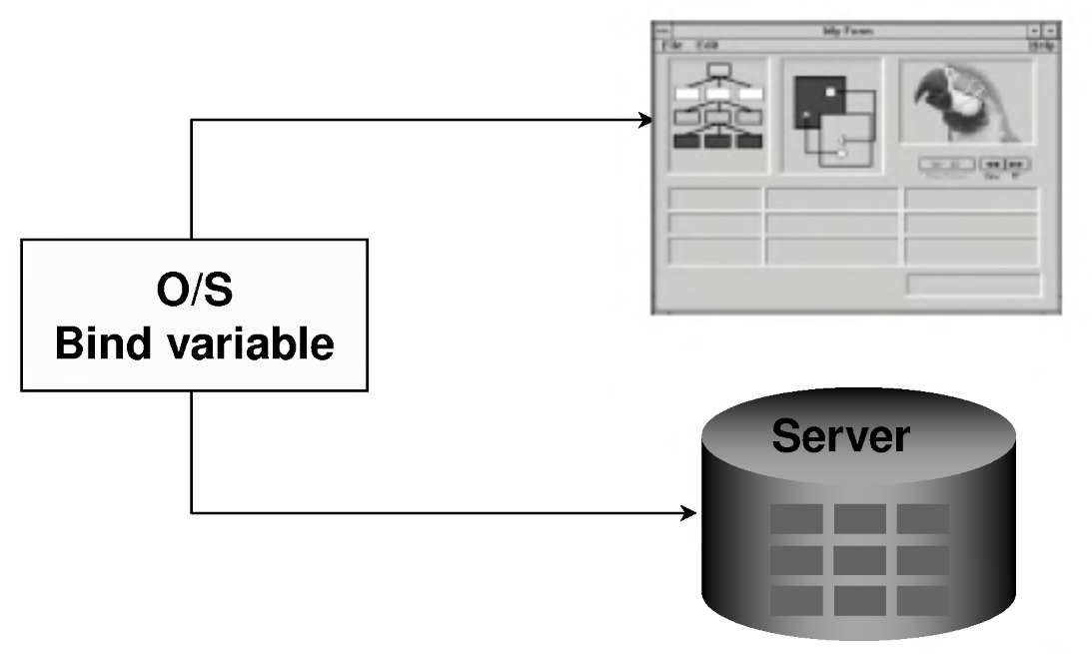
Bind Variables
A bind variable is a variable that you declare in a host environment.
VARIABLE return_code NUMBER
VARIABLE return_msg VARCHAR2(30)
These variables should be preceded by a colon. E.g. : return_code

Slide 18
DBMS_OUTPUT.PUT_LINE
An Oracle-supplied packaged procedure
An alternative for displaying data from a PL/SQL block
Must be enabled in iSQL*Plus with SET SERVEROUTPUT ON
SET SERVEROUTPUT ON
declare
v_sal number(9,2) := 6000;
BEGIN
v_sal := v_sal/12;
DBMS_OUTPUT.PUT_LINE ('The monthly salary is ' || TO_CHAR(v_sal));
END;
/

Slide 19
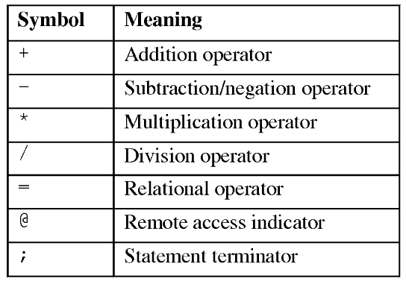
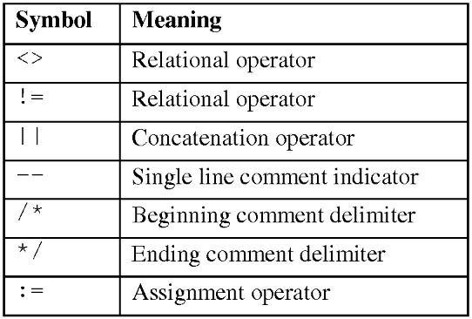
Operators
Prefix single-line comments with two dashes (--)
Place multiple-line comments between the symbols /*and */

Slide 20
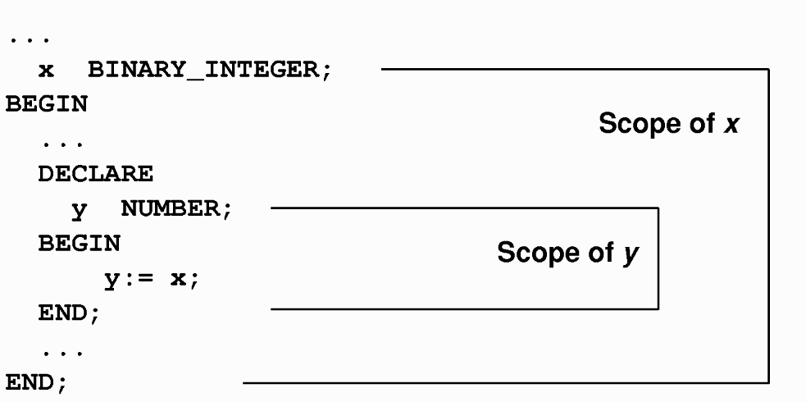
Nested Blocks and Variable Scope
A block can look up to the enclosing block.
A block cannot look down to enclosed blocks.

Slide 21
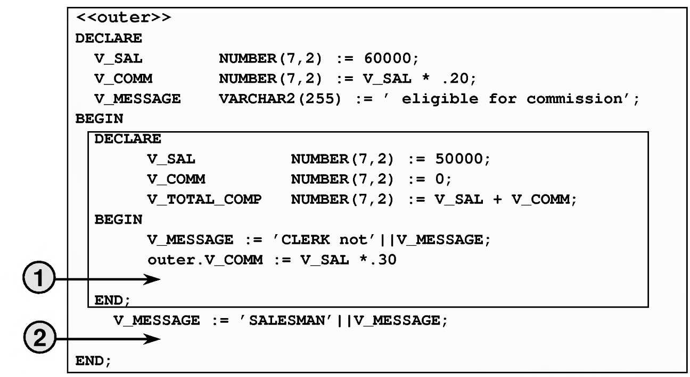
Exercise
V_MESSAGE, V_COMM, OUTER.V_COMM ??
V_TOTAL_COMP, V_COMM, V_MESSAGE ??

Slide 22
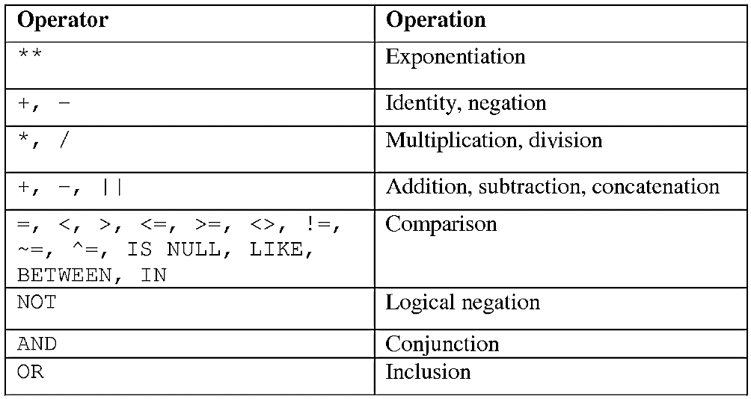
Order of Operations

Slide 23
SQL Statements in PL/SQL
Extract a row of data from the database by using the select command.
Make changes to rows in the database by using DML commands.
Control a transaction with the commit, rollback, or savepoint command.
Determine DML outcome with implicit cursor attributes.

Slide 24
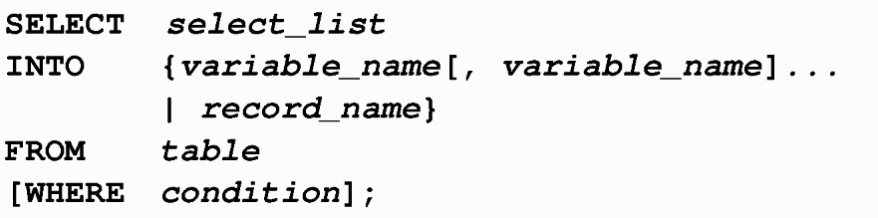
select Statements in PL/SQL
Retrieve data from the database with a select statement.
This is mandatory
Queries must return one and only one row.
Specify the same number of variables in the INTO clause as database columns in the SELECT clause.
Be sure that they correspond positionally and that their data types are compatible.
Use group functions, such as SUM, in a SQL statement, because group functions apply to groups of rows in a table.

Slide 25
Naming Conventions
The names of database columns take precedence over the names of local variables.

Slide 26
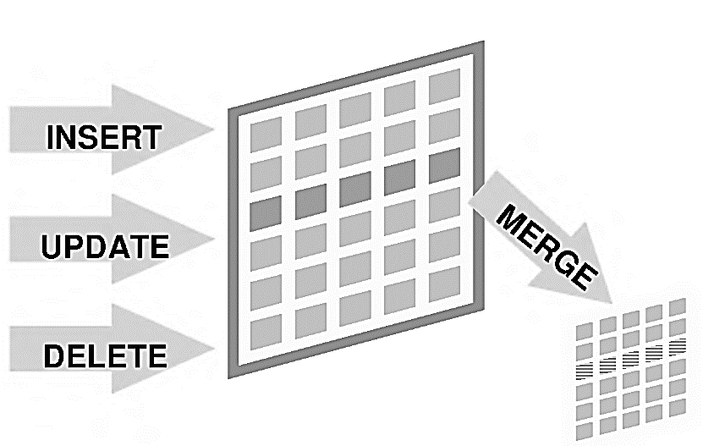
Manipulating Data Using PL/SQL
Make changes to database tables by using DML commands:

Slide 27
Inserting Data
Add new employee information to the employees table.
BEGIN
INSERT INTO employees
(employee_id, first_name, last_name, email, hire_date, job_id, salary)
VALUES
(employees_seq.NEXTVAL, 'Ruth', 'Cores', 'RCORES', sysdate, 'AD_ASST', 4000);
END;

Slide 28
Updating Data
Increase the salary of all employees who are stock clerks.
DECLARE
v_sal_increase employees.salary%TYPE := 800;
BEGIN
UPDATE employees
SET salary = salary + v_sal_increase
WHERE job_id = 'ST_CLERK';
END;
PL/SQL variable assignments always use : =, and SQL column assignments always use =.
If no rows are modified, no error occurs, unlike the SELECT statement in PL/SQL.

Slide 29
Deleting Data
Delete rows that belong to department 10 from the employees table.
DECLARE
v_deptno employees.department_id%TYPE :
BEGIN
DELETE FROM employees
WHERE department_id = v_deptno;
END;

Slide 30
Merging Rows
Inserts or updates rows in one table, using data from another table.
Each row is inserted or updated in the target table, depending upon an equijoin condition.
Example

Slide 31
Example
DECLARE
v_empno EMPLOYEES.EMPLOYEE_ID%TYPE := 100;
BEGIN
MERGE INTO copy_emp c
USING employees e
ON (c.employee_id = v_empno)
WHEN MATCHED THEN
UPDATE SET
c.first_name = e.first_name,
c.last_name = e.last_name,
c.email = e.email,
c.phone_number = e.phone_number,
c.hire_date = e.hire_date,
c.job_id = e.job_id,
c.salary = e.salary,
c.commission_pct = e.commission_pct,
c.manager_id = e.manager_id,
c.department_id = e.department_id
WHEN NOT MATCHED THEN
INSERT VALUES(e.employee_id, e.first_name, e.last_name, e.email, e.phone_number, e.hire_date, e.job_id, e.salary, e.commission_pct, e.manager_id, e.department_id);
END;

Slide 32
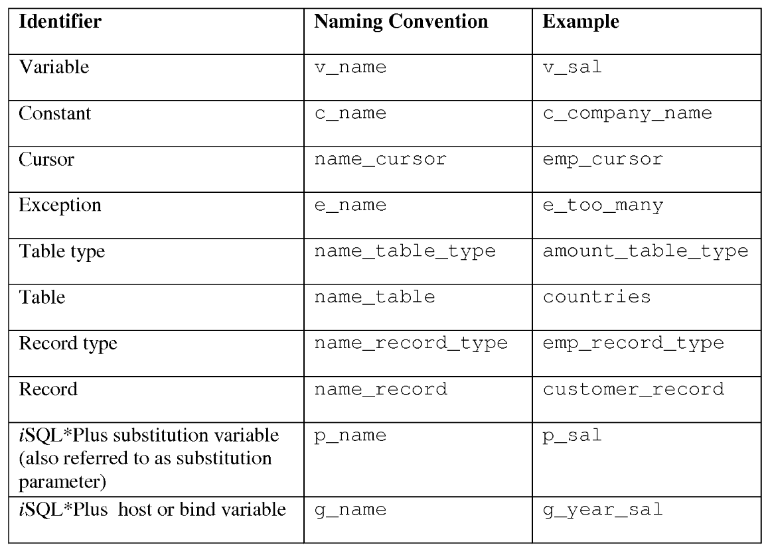
Naming Convensions

Slide 33
SQL Cursor
A cursor is a private SQL work area.
There are two types of cursors:
Implicit cursors
Explicit cursors
The Oracle server uses implicit cursors to parse and execute your SQL statements.
Explicit cursors are explicitly declared by the programmer.

Slide 34
SQL Cursor Attributes
Using SQL cursor attributes, you can test the outcome of your SQL statements.
SQL%ROWCOUNT | Number of rows affected by the most recent SQL statement (an integer value)
SQL%FOUND | Boolean attribute that evaluates to true if the most recent SQL statement affects one or more rows
SQL%NOTFOUND | Boolean attribute that evaluates to true if the most recent SQL statement does not affect any rows
SQL%ISOPEN | Always evaluates to false because PL/SQL closes implicit cursors immediately after they are executed

Slide 35
SQL Cursor Attributes
Delete rows that have the specified employee ID from the employees table. Print the number of rows deleted.
VARIABLE rows_deleted VARCHAR2(30)
DECLARE
v_employee_id employees.employee_id%TYPE
BEGIN
DELETE FROM employees
WHERE employee_id = v_employee_id;
:rows_deleted := (SQL%ROWCOUNT || ' row deleted.');
END;
/
PRINT rows_deleted

Slide 36
Controlling PL/SQL Flow of Execution
Change the logical execution of statements using
conditional if statements and
IF-THEN-END IF
IF-THEN-ELSE-END IF
IF-THEN-ELSIF-END IF
CASE
Loop control structures.
Basic loop
for loop
WHILE lOOp

Slide 37
if Statements
Syntax
IF condition THEN
statements;
[ELSIF condition THEN
statements;]
[ELSE
statements;]
END IF;
When possible, use the ELS IF clause instead of nesting IF statements.
If the action in the ELSE clause consists purely of another IF statement, it is more convenient to use the ELS IF clause.
Any arithmetic expression containing null values evaluates to null.

Slide 38
case Expressions
A case expression selects a result and returns it.
To select the result, the case expression uses an expression whose value is used to select one of several alternatives.
CASE selector
WHEN expression 1 THEN result 1
WHEN expression 2 THEN result 2
…
WHEN expression N THEN result N
[ELSE resultN+1;]
END;

Slide 39
Example
SET SERVEROUTPUT ON
DEFINE p_grade = a
DECLARE
v_grade CHAR(1) := UPPER('&p_grade' ) ;
v_appraisal VARCHAR2(20);
BEGIN
v_appraisal :=
CASE v_grade
WHEN 'A' THEN 'Excellent'
WHEN 'B' THEN 'Very Good'
WHEN 'C’ THEN 'Good'
ELSE 'No such grade'
END;
DBMS_OUTPUT.PUT_LINE ('Grade: '|| v_grade || ' Appraisal ' || v_appraisal);
END;

Slide 40
Handling Nulls
Avoid some common mistakes by keeping in mind the following rules:
Simple comparisons involving nulls always yield NULL.
Applying the logical operator not to a null yields NULL.
In conditional control statements,
if the condition yields null, its associated sequence of statements is not executed.

Slide 41
Logic Tables
AND | TRUE | FALSE | NULL
TRUE | TRUE | FALSE | NULL
FALSE | FALSE | FALSE | FALSE
NULL | NULL | FALSE | NULL
OR | TRUE | FALSE | NULL
TRUE | TRUE | TRUE | TRUE
FALSE | TRUE | FALSE | NULL
NULL | TRUE | NULL | NULL
NOT
TRUE | FALSE
FALSE | TRUE
NULL | NULL

Slide 42
Iterative Control: loop Statements
Basic loop
for loop
WHILE lOOp

Slide 43
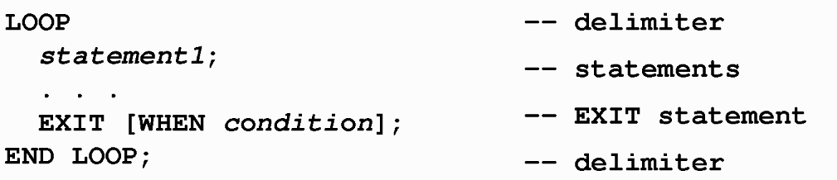
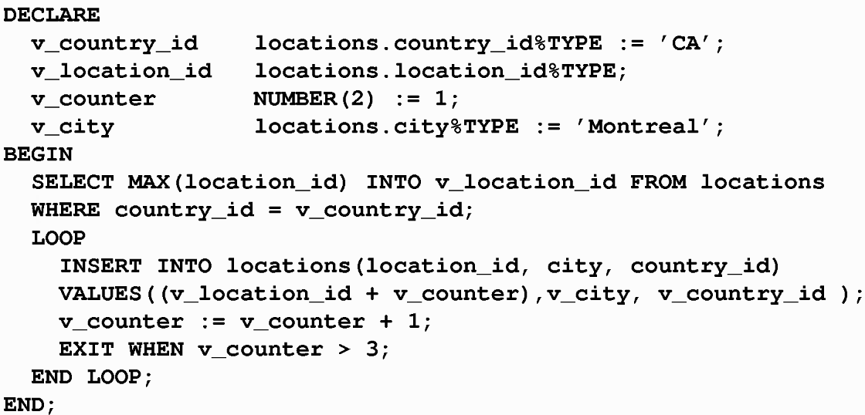
Basic Loops

Slide 44
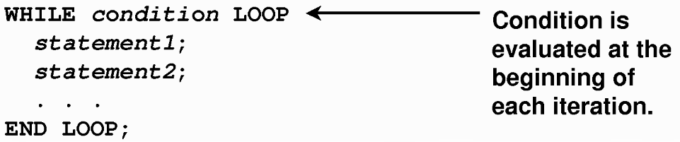
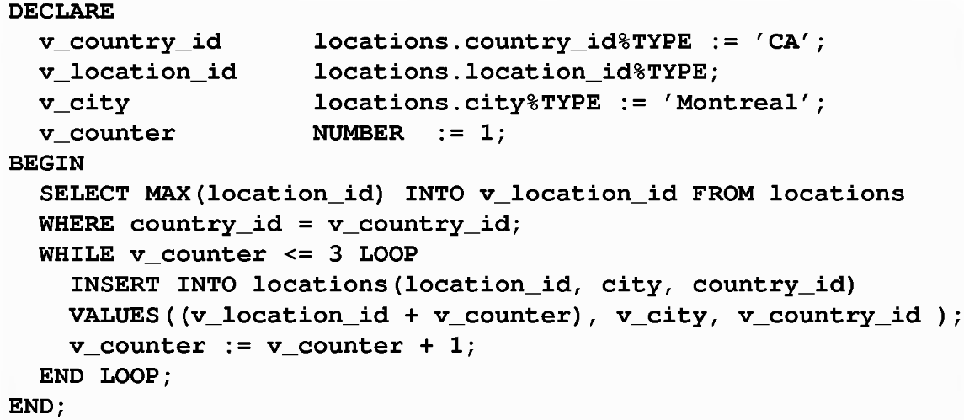
WHILE LOOPS

Slide 45
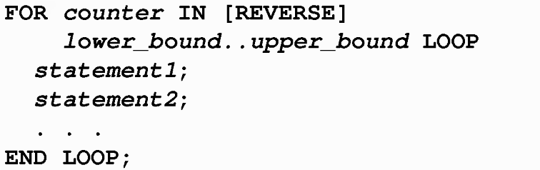
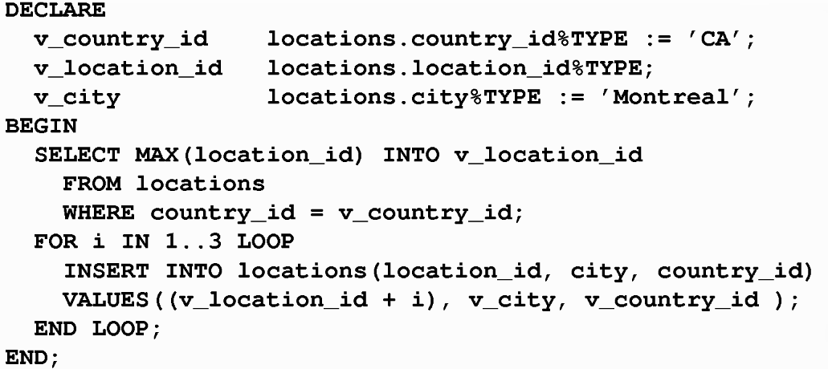
FOR LOOPS

Slide 46
Guidelines While Using Loops
Use the basic loop when the statements inside the loop must execute at least once.
Use the while loop if the condition has to be evaluated at the start of each iteration.
Use a for loop if the number of iterations is known.

Slide 47
Thank you
Next Lecture: Transactions

