Slide 1

CS322: Database Systems
PL/ SQL
PL/SQL by Ivan Bayross

Slide 2
Outline
Working with Composite Datatype
More on Cursor
Exception Handling
Creating Function/ Procedures/ Subprograms

Slide 3
Working with Composite Datatype
Are of two types:
PL/SQL RECORDS
PL/SQL Collections
index by Table
Nested Table
VARRAY
Contain internal components
Are reusable

Slide 4
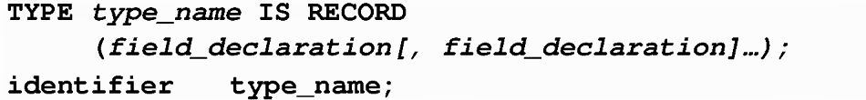
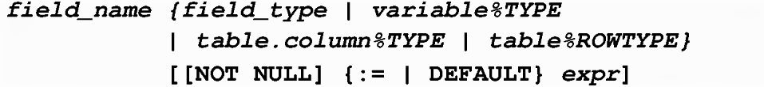
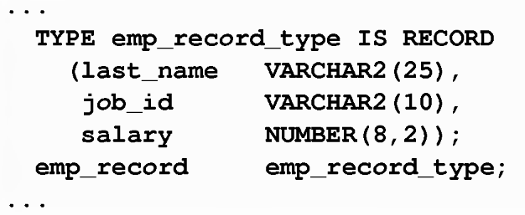
PL/SQL RECORDS
Where field_declaration is:
Use dot notation
emp_record.job_id ...
Example

Slide 5
The %rowtype Attribute
Declare a variable according to a collection of columns in a database table or view.
Prefix %rowtype with the database table.
Fields in the record take their names and data types from the columns of the table or view.
DECLARE
identifier reference%ROWTYPE;
…
emp_record employees%ROWTYPE;

Slide 6
Index by Tables
An associative array (also called an index-by table)
A set of key-value pairs.
Each key is unique, and is used to locate the corresponding value.
The key can be either an integer or a string.
Using a key-value pair for the first time adds that pair to the associative array.
Using the same key with a different value changes the value.

Slide 7
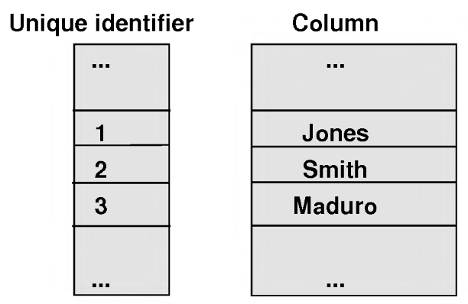
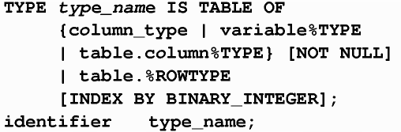
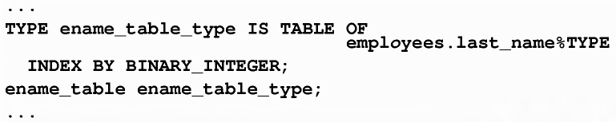
Index by Tables

Slide 8
Example
SQL> DECLARE
2 -- Associative array indexed by string:
3
4 TYPE population IS TABLE OF NUMBER -- Associative array type
5 INDEX BY VARCHAR2(64);
6
7 city_population population; -- Associative array variable
8 i VARCHAR2(64);
9
10 BEGIN
11 -- Add new elements to associative array:
12
13 city_population('Smallville') := 2000;
14 city_population('Midland') := 750000;
15 city_population('Megalopolis') := 1000000;
16
17 -- Change value associated with key 'Smallville':
18
19 city_population('Smallville') := 2001;
20
21 -- Print associative array:
22
23 i := city_population.FIRST;
24
25 WHILE i IS NOT NULL LOOP
26 DBMS_Output.PUT_LINE
27 ('Population of ' || i || ' is ' || TO_CHAR(city_population(i)));
28 i := city_population.NEXT(i);
29 END LOOP;
30 END;
31 /

Slide 9
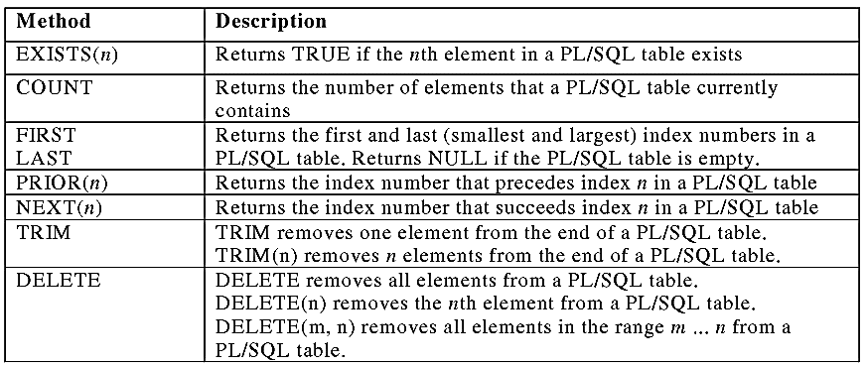
Using index by Table Methods

Slide 10
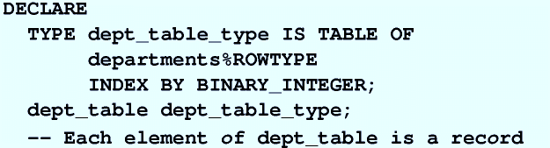
Index by Table of Records
Define a table variable with a permitted PL/SQL data type.
Declare a PL/SQL variable to hold department information.

Slide 11
Example
DECLARE
TYPE stud_table_type is table of
student%ROWTYPE INDEX BY BINARY_INTEGER;
my_stud_table stud_table_type;
v_count NUMBER(9):= 550156548;
BEGIN
FOR i IN 550156548..v_count LOOP
SELECT * INTO my_stud_table(i) FROM student
WHERE snum = i;
END LOOP;
FOR i IN my_stud_table.FIRST..my_stud_table.LAST LOOP
DBMS_OUTPUT.PUT_LINE(my_stud_table(i).sname);
END LOOP;
END;

Slide 12
Cursors
Every SQL statement executed by the Oracle Server has an individual cursor associated with it:
Implicit cursors: Declared for all DML and PL/SQL select statements
Explicit cursors: Declared and named by the programmer

Slide 13


Implicit Cursor
Oracle Engine explicitly opens a cursor
Server
Oracle Engine HDD
PL/SQL Code Block on Client Machine
Cursor Opened on the Server
Rows retrieved
Cursor Attributes: %ISOPEN, %FOUND, %NOTFOUND, %ROWCOUNT
Usage: SQL%ROWCOUNT

Slide 14
Explicit Cursor
Use explicit cursors to individually process each row returned by a multiple-row SELECT statement.
Declare
Create a named SQL area
Open
Identify the Active Set
Fetch
Load the current row into variables
Close
Release the active set if empty
Verify
Check whether empty or not

Slide 15


Explicit Cursor Working Principle
Server
Oracle Engine HDD
Open <CursorName>
Fetch <CursorName> INTO …
Client Machine
Client RAM
Fetch One row at a time
Server RAM
V1
V2
V3
V4
C1 | C2 | C3 | C4
Active Data Set
Advance the cursor

Slide 16

Declaring the Cursor
Do not include the into clause in the cursor declaration.
If processing rows in a specific sequence is required use the order by clause in the query.
DECLARE
CURSOR emp_cursor IS
SELECT employee_id, FROM employees;
CURSOR dept_cursor IS
SELECT * FROM departments WHERE location_id = 170;
BEGIN
…

Slide 17

Opening the Cursor
Open the cursor to execute the query and identify the active set.
If the query returns no rows, no exception is raised.
Use cursor attributes to test the outcome after a fetch.
Dynamically allocates memory for a context area that eventually contains crucial processing information.
Parses the SELECT statement.
Binds the input variables—sets the value for the input variables by obtaining their memory addresses.
Identifies the active set—the set of rows that satisfy the search criteria. Rows in the active set are not retrieved into variables when the OPEN statement is executed. Rather, the FETCH statement retrieves the rows.
Positions the pointer just before the first row in the active set.

Slide 18
Fetching Data from the Cursor
Retrieve the current row values into variables.
Include the same number of variables.
Match each variable to correspond to the columns positionally.
Test to see whether the cursor contains rows.

Slide 19
Example
SET SERVEROUTPUT ON
DECLARE
v_empno employees.employee_id%TYPE;
v_ename employees.last_name%TYPE;
CURSOR emp_cursor IS
SELECT employee_id, last_name FROM employees;
BEGIN
OPEN emp_cursor;
FOR i IN 1..10 LOOP
FETCH emp_cursor INTO v_empno, v_ename;
DBMS_OUTPUT.PUT_LINE (TO_CHAR(v_empno) II' 'II v_ename);
END LOOP;
END ;

Slide 20

Closing the Cursor
Close the cursor after completing the processing of the rows.
Reopen the cursor, if required.
Do not attempt to fetch data from a cursor after it has been closed.

Slide 21
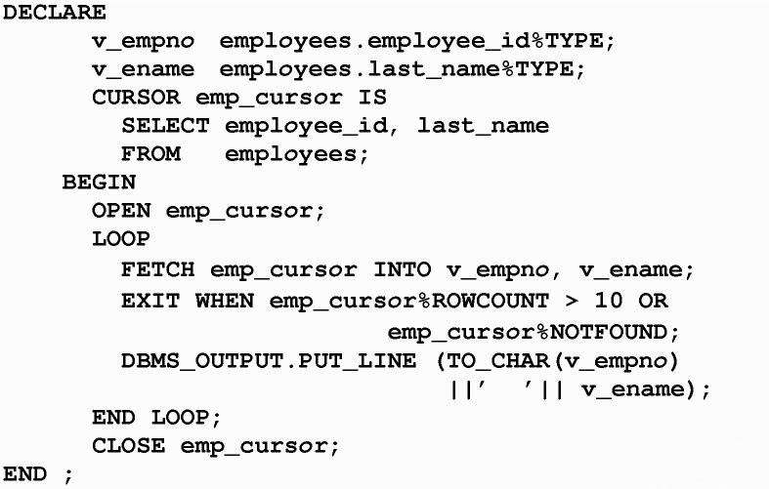
More Example

Slide 22
Example
DECLARE
CURSOR emp_cursor IS
SELECT employee_id, last_name FROM employees;
emp_record emp_cursor%ROWTYPE;
BEGIN
OPEN emp_cursor;
LOOP
FETCH emp_cursor INTO emp_record;
EXIT WHEN emp_cursor%NOTFOUND;
INSERT INTO temp_list (empid, empname) VALUES (emp_record.employee_id, emp_record.last_name);
END LOOP;
COMMIT;
CLOSE emp_cursor;
END;

Slide 23
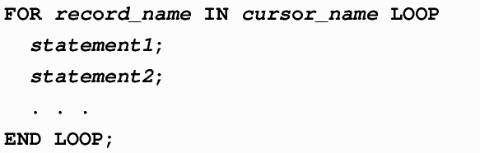
Cursor for Loops
The cursor for loop is a shortcut to process explicit cursors.
Implicit open, fetch, exit, and close occur.
The record is implicitly declared.

Slide 24
Example
DECLARE
CURSOR emp_cursor IS
SELECT last_name, department_id
FROM employees;
BEGIN
FOR emp_record IN emp_cursor LOOP
—implicit open and implicit fetch occur
IF emp_record.department_id = 80 THEN
DBMS_OUTPUT.PUT_LINE ('Employee ' || emp_record.last_name
|| ' works in the Sales Dept. ');
END IF;
END LOOP; --implicit close and implicit loop exit
END ;

Slide 25
DECLARE
v_employee_id employees.employee_id%TYPE;
v_job_id employees.job_id%TYPE;
v_start_date DATE;
v_end_date DATE;
CURSOR emp_cursor IS
SELECT employee_id, job_id, start_date, end_date
FROM job_history
ORDER BY employee_id;
BEGIN
OPEN emp_cursor;
LOOP
FETCH emp_cursor
INTO v_employee_id, v_job_id, v_start_date, v_end_date;
DBMS_OUTPUT.PUT_LINE ('Employee #: ' || v_employee_id ||
' held the job of ' || v_job_id || ' FROM ' || v_start_date | | ' TO ' I I v_end_date);
EXIT WHEN emp_cursor%ROWCOUNT > 4 OR
emp_cursor%NOTFOUND;
END LOOP;
CLOSE emp_cursor;
END;

Slide 26
Handling Exceptions with PL/SQL
An Exception is an identifier in PL/SQL that is raised during execution.
How is it raised?
An Oracle error occurs.
You raise it explicitly.
How do you handle it?
Trap it with a handler.
Propagate it to the calling environment.

Slide 27
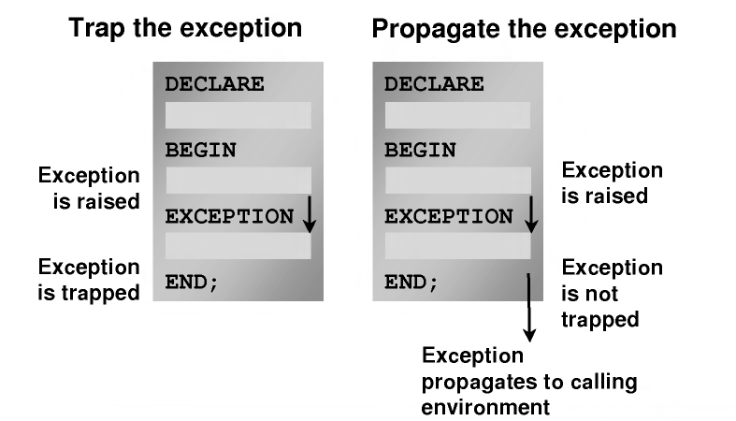
Handling Exception

Slide 28
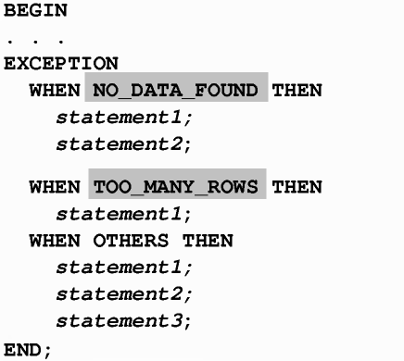
Example
Predefined Exceptions

Slide 29
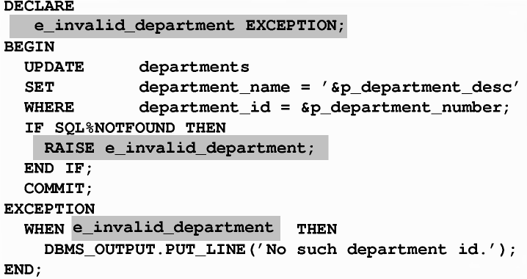
User Defined Exception

Slide 30
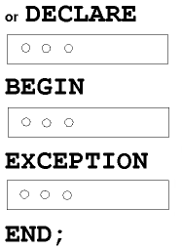
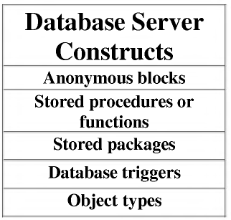
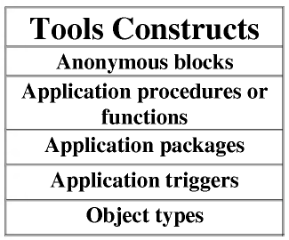
PL/SQL Program Constructs

Slide 31
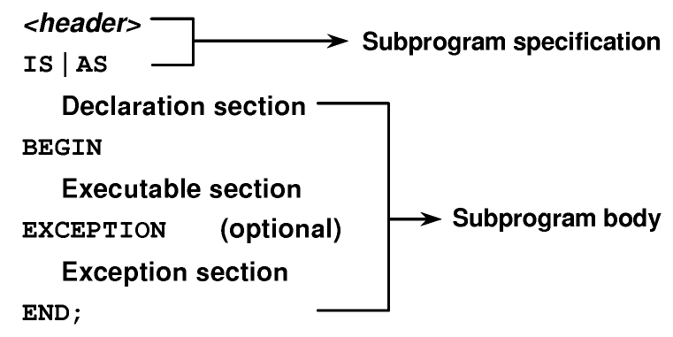
Block Structure for PL/SQL Subprograms
- The PL/SQL subprogram type, that is, either a procedure or a function
- The name of the subprogram
- The parameter list, if one exists
- The RETURN clause, which applies only to functions
The IS or AS keyword is mandatory.
The keyword DECLARE is not used

Slide 32
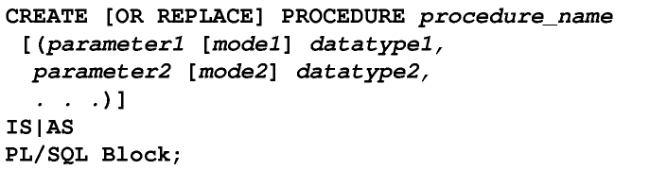
Procedure
The replace option indicates that if the procedure exists, it will be dropped and replaced with the new version created by the statement.
PL/SQL block starts with either begin or the declaration of local variables and ends with either end or end procedure_name.
Type of argument: IN (default) , OUT , IN OUT

Slide 33
Formal Versus Actual Parameters
CREATE PROCEDURE raise_sal (p_id NUMBER, p_amount NUMBER)
…
END raise_sal;
raise_sal(v_id, 2000)

Slide 34
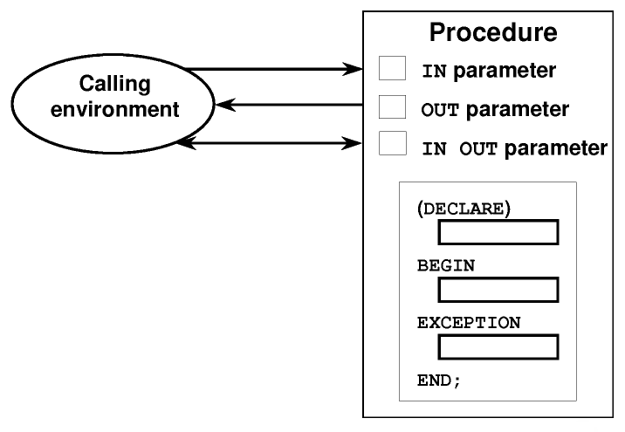
Procedure Parameter Model
Attempts to change the value of an IN parameter will result in an error.

Slide 35
Creating Procedures with Parameters
IN | OUT | IN OUT
Default mode | Must be specified | Must be specified
Value is passed into subprogram | Returned to calling environment | Passed into subprogram; returned to calling environment
Formal parameter acts as a constant | Uninitialized variable | Initialized variable
Actual parameter can be a literal, expression, constant, or initialized variable | Must be a variable | Must be a variable
Can be assigned a default value | Cannot be assigned a default value | Cannot be assigned a default value

Slide 36
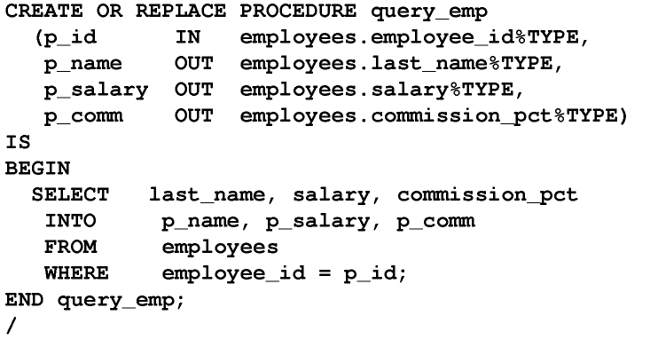
In, Out Parameters: Example

Slide 37
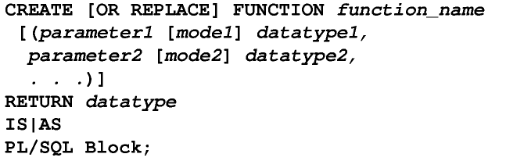
Functions
The RETURN data type must not include a size specification.
There must be at least one RETURN (expression)

Slide 38
CREATE OR REPLACE Function IncomeLevel
( name_in IN varchar2 )
RETURN varchar2
IS
monthly_value number(6);
ILevel varchar2(20);
cursor c1 is SELECT SAL FROM scott.EMP WHERE ename = name_in;
BEGIN
open c1;
fetch c1 into monthly_value;
close c1;
IF monthly_value <= 1000 THEN
ILevel := 'Low Income';
ELSIF monthly_value > 1000 and monthly_value <= 2000 THEN ILevel := 'Avg Income';
ELSIF monthly_value > 2000 and monthly_value <= 3000 THEN ILevel := 'Moderate Income';
ELSE ILevel := 'High Income';
END IF;
RETURN ILevel;
END;

Slide 39
Locations to Call User-Defined Functions
Select list of a select command
Condition of the where and having clauses
CONNECT BY, START WITH, ORDER BY, and GROUP by clauses
values clause of the insert command
set clause of the update command
E.g. select empno, IncomeLevel(ename) as Income from scott.EMP where ename='KING'

Slide 40
Restrictions
To be callable from SQL expressions, a user-defined function must:
Be a stored function
Accept only in parameters
Accept only valid SQL data types, not PL/SQL specific types, as parameters
Return data types that are valid SQL data types, not PL/SQL specific types
Functions called from SQL expressions cannot contain DML statements.

Slide 41
Restrictions
To be callable from SQL expressions, a user-defined function must:
Functions called from update/delete statements on a table T cannot contain DML on the same table T.
Functions called from a DML statement on a table T cannot query the same table.
Functions called from SQL statements cannot contain statements that end the transactions.
Calls to subprograms that break the previous restriction are not allowed in the function.

Slide 42
Comparing Procedures and Functions
Procedure | Function
Execute as a PL/SQL statement | Invoke as part of an expression
No return clause in the header | Must contain a return clause in the header
Can return none, one, or many values | Must return a single value
Can contain a return statement | Must contain at least one return statement

Slide 43
Thank you
Next Lecture: Transactions

