Slide 1

CS552: Computer Graphics
Lecture 10: Perspective Projection

Slide 2
Recap
Perspective Projection
Generic expressions for perspective projection
Special cases of perspective projection
Positioning of the view plane and center of projection

Slide 3
Objective
After completing today’s lecture, students will be able to
Derive mathematical expressions related to
View pyramid in case of perspective projection
Explain orthographic projection
Derive mathematical expressions related to orthographic projections

Slide 4
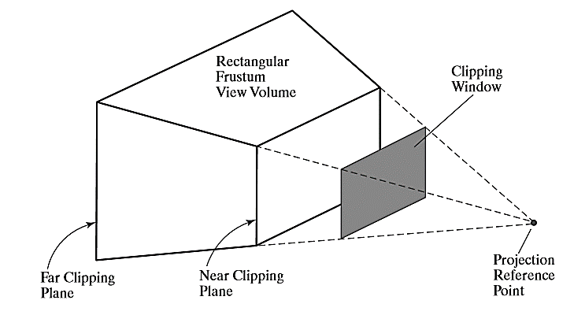
Frustum

Slide 5
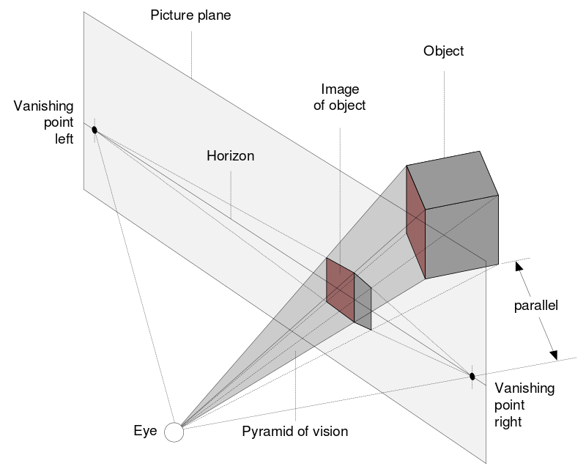
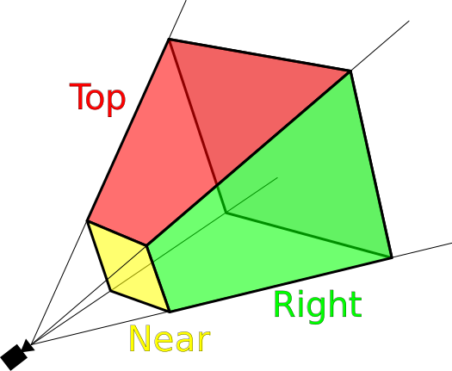
Frustum

Slide 6


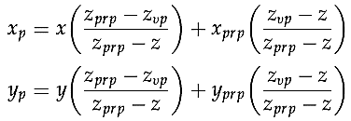
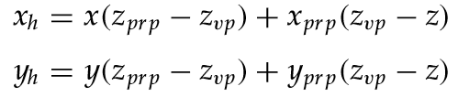
Perspective-Projection Transformation Matrix
Homogeneous-coordinate representation to express the perspective-projection equations in the form
where
We’ve already derived the expressions for x and y
Homogeneous coordinate representation is given by

Slide 7

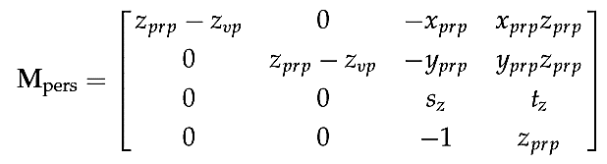
Perspective-Projection Transformation Matrix
Homogeneous coordinates using the perspective-transformation matrix can be written as:
Frustum view volume can have any orientation
How to handle that?

Slide 8
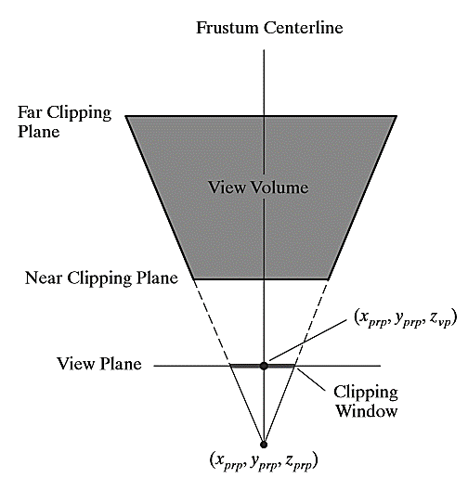
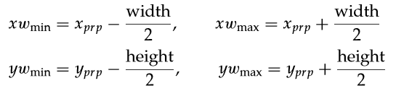
Symmetric Perspective-Projection Frustum
Clipping window can be represented as:

Slide 9
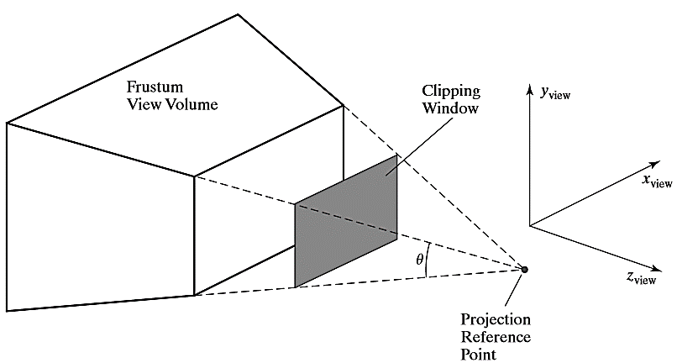
Field of view angle

Slide 10
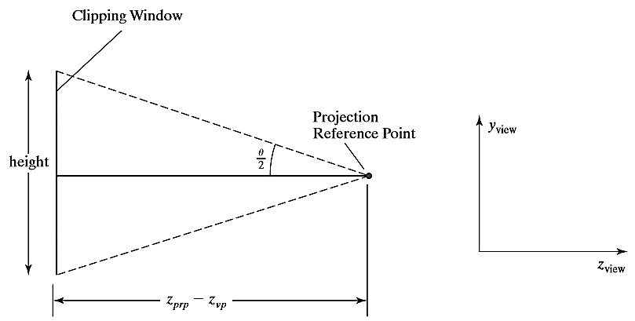

Clipping w.r.to Field of View

Slide 11
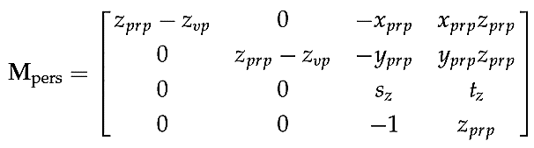
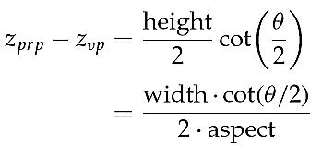
Clipping w.r.to Field of View

Slide 12
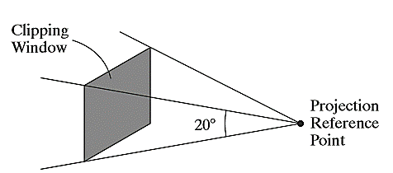
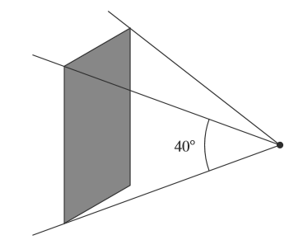
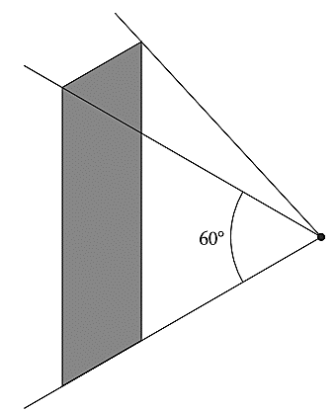
Effect of field of view angle
Increasing the size of the ﬁeld-of-view angle increases the height of the clipping window and increases the perspective-projection foreshortening.

Slide 13
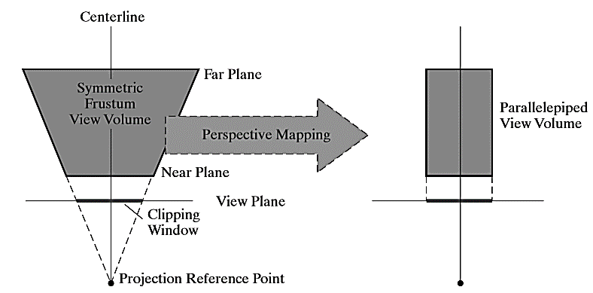
Mapping of points within the frustum

Slide 14
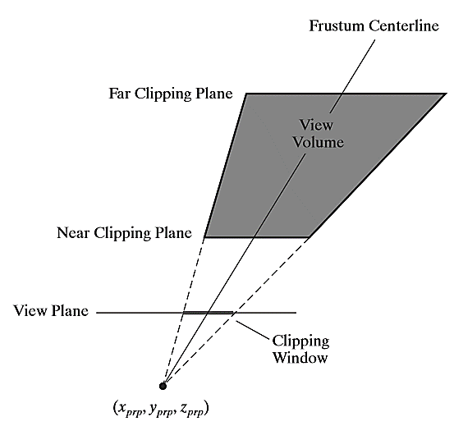
Oblique Perspective-Projection Frustum
The centre line of a perspective-projection view volume is not perpendicular to the view plane
Oblique frustum

Slide 15
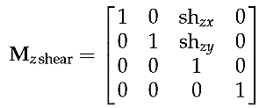
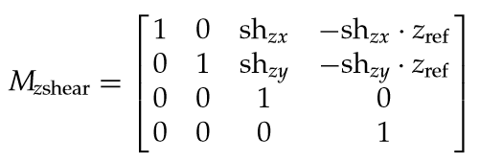
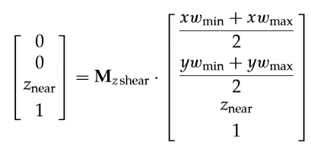
Oblique → Symmetric Frustum
Taking the projection reference point as
To move the center of the clipping window to coordinates

Slide 16
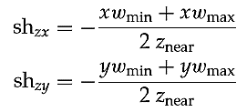
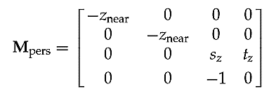
Oblique → Symmetric Frustum
The parameters for this shearing transformation are
The projection reference point at the viewing-coordinate origin and with the near clipping plane as the view plane

Slide 17
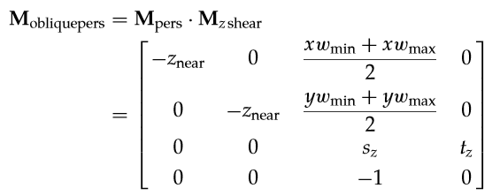
Oblique → Symmetric Frustum
Oblique perspective-projection matrix for converting coordinate positions in a scene to homogeneous orthogonal projection coordinates

Slide 18
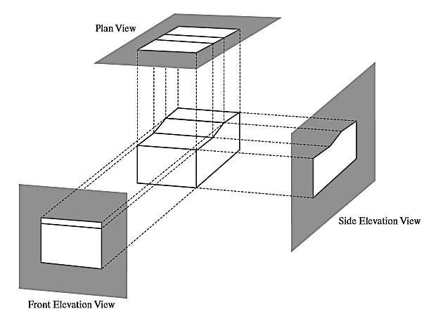
Orthogonal Projection
Plan view
Side Elevation view
Front Elevation view

Slide 19
Thank you
Next Lecture: Projection Geometry

