Slide 1

CS552: Computer Graphics
Lecture 11: Orthographic Projection

Slide 2
Recap
3D Projection
View volume
Symmetric
Oblique
Introduction to parallel projection

Slide 3
Objective
After completing today’s lecture, students will be able to
Derive mathematical expressions related to
Parallel projection
Normalize coordinate transform in case of
Perspective
Orthographic
Oblique projection

Slide 4
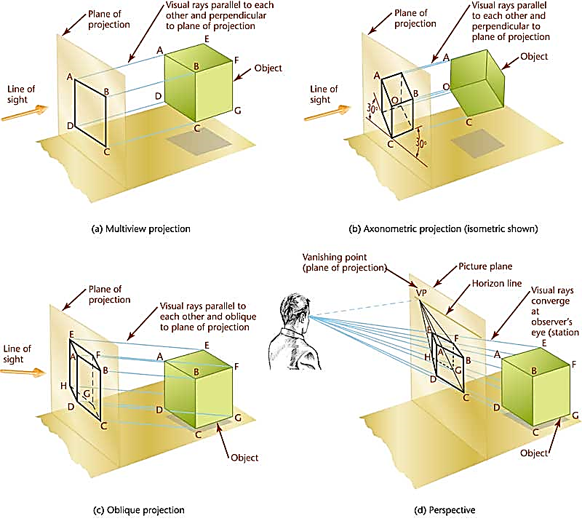
Projection
Multiview projection
Axonometric
Oblique
Perspective

Slide 5
Parallel projection

Slide 6
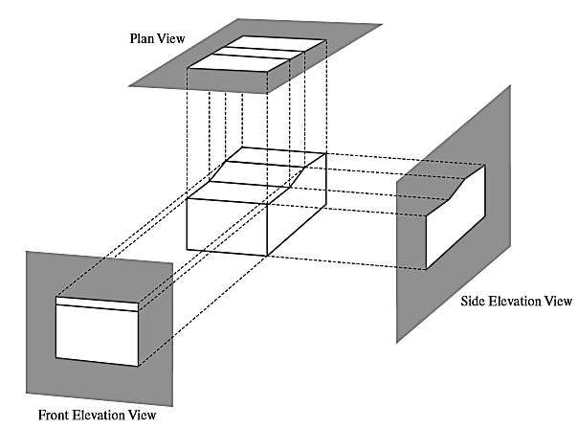
Orthogonal Projection
Plan view
Side Elevation view
Front Elevation view

Slide 7
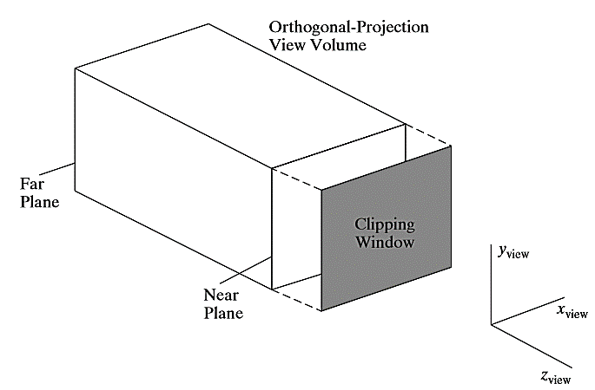
View volume

Slide 8
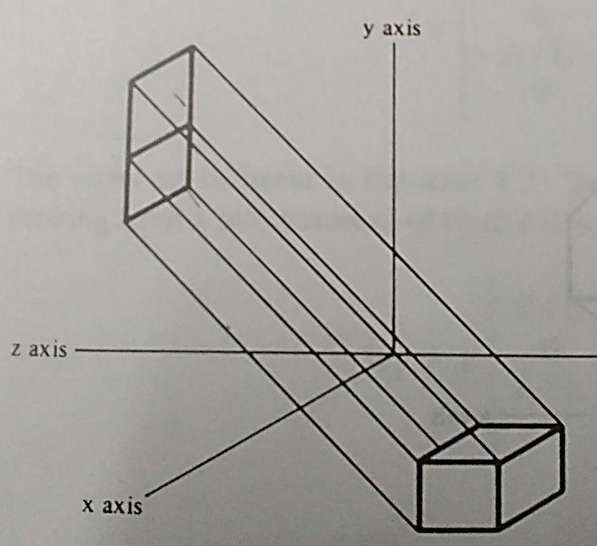




Parallel Projection
Direction projection vector
$$\left[{x_{p} y}_{p} z_{p}\right]$$
$$x=x_{1}+x_{p}u$$
$$y=y_{1}+y_{p}u$$
$$z=z_{1}+z_{p}u$$

Slide 9
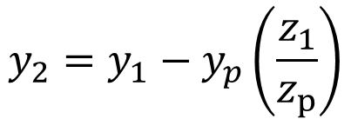

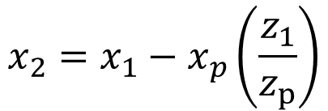

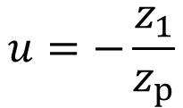


Parallel Projection
Where does this line intersect the $xy$plane?
$$x=x_{1}+x_{p}u$$
$$y=y_{1}+y_{p}u$$
$$z=z_{1}+z_{p}u$$
$$u=−\frac{z_{1}}{z_{p}}$$
From the third equation we can say
$$x_{2}=x_{1}−x_{p}\left(\frac{z_{1}}{z_{p}}\right)$$
$$y_{2}=y_{1}−y_{p}\left(\frac{z_{1}}{z_{p}}\right)$$

Slide 10
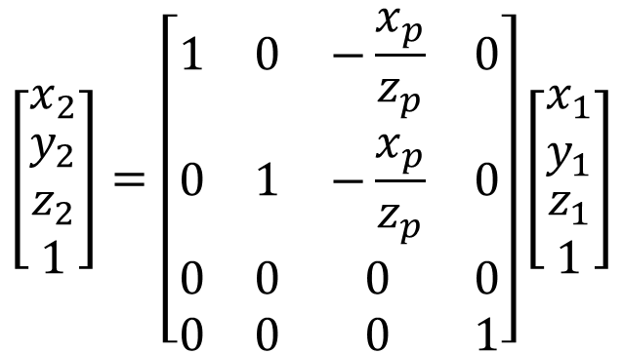
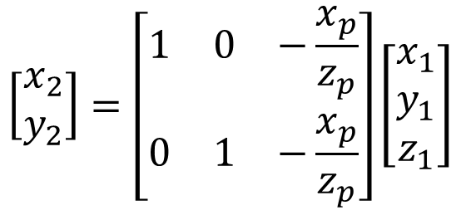
Parallel Projection
$$\left[\begin{matrix}x_{2} \\ y_{2}\end{matrix}\right]=\left[\begin{matrix}1 & 0 & −\frac{x_{p}}{z_{p}} \\ 0 & 1 & −\frac{x_{p}}{z_{p}}\end{matrix}\right]\left[\begin{matrix}x_{1} \\ y_{1} \\ z_{1}\end{matrix}\right]$$
The projection formula
$$\left[\begin{matrix}x_{2} \\ \begin{aligned}y_{2} \\ z_{2} \\ 1\end{aligned}\end{matrix}\right]=\left[\begin{matrix}1 & 0 & −\frac{x_{p}}{z_{p}} & 0 \\ 0 & 1 & −\frac{x_{p}}{z_{p}} & 0 \\ 0 & 0 & 0 & 0 \\ 0 & 0 & 0 & 1\end{matrix}\right]\left[\begin{matrix}x_{1} \\ y_{1} \\ \begin{aligned}z_{1} \\ 1\end{aligned}\end{matrix}\right]$$
In homogeneous representation

Slide 11
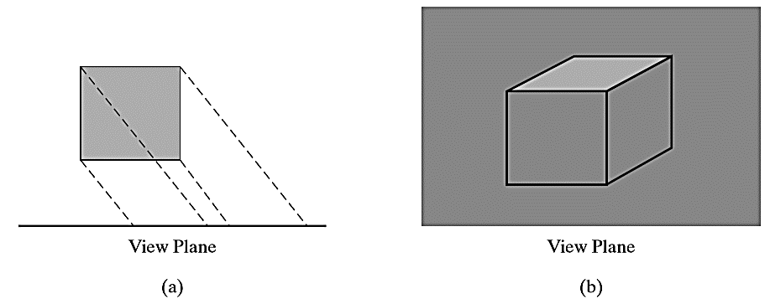
Oblique Parallel Projection

Slide 12
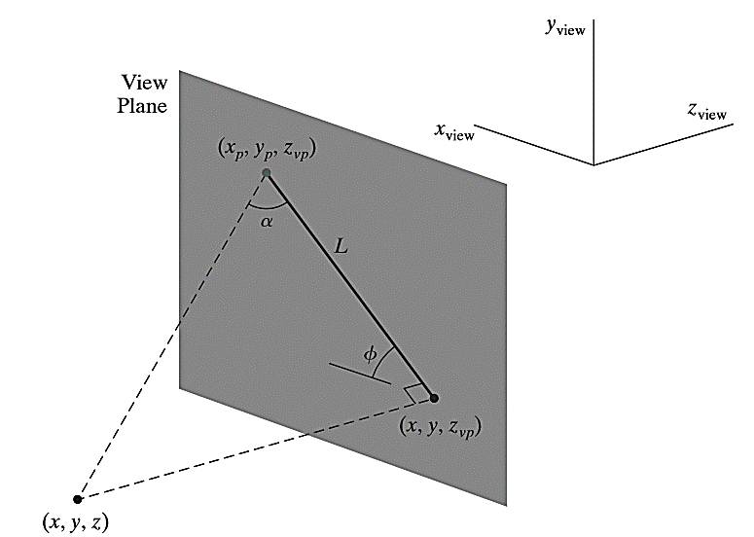

Oblique Parallel Projection
Range of $α,φ$?

Slide 13
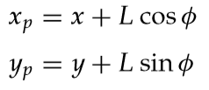

Oblique parallel projection equation
Length L depends on the
angle α and
the perpendicular distance of the point (x, y, z) from the view plane
The oblique parallel projection equations
Relationship with Orthogonal projection?

Slide 14
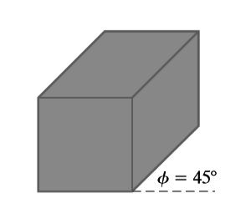
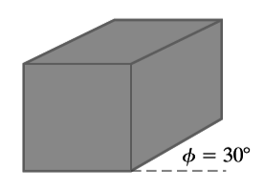
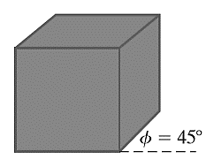
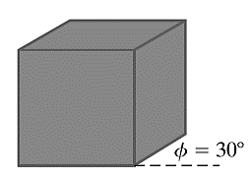


Cavalier and Cabinet
All lines perpendicular to the projection plane are projected with no change in length
$$\tan{α}=1$$
Cavalier projections
All lines perpendicular to the projection plane are projected half of its length
Cabinet projections
$$\tan{α}=2$$

Slide 15
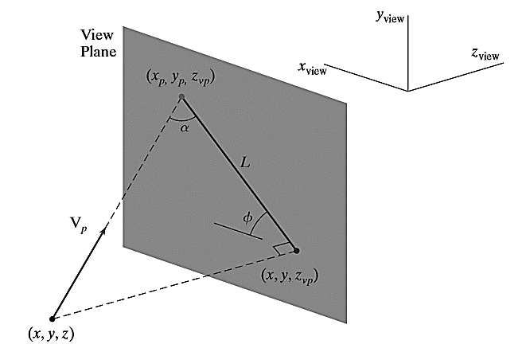
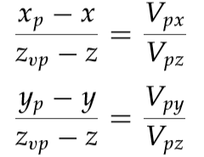
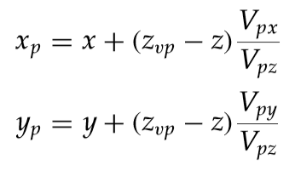


Oblique Parallel-Projection Vector

Slide 16
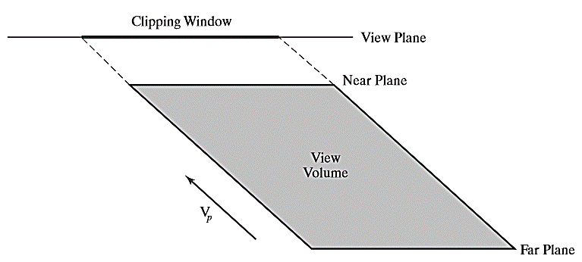
Clipping Window and Oblique Parallel-Projection View Volume

Slide 17
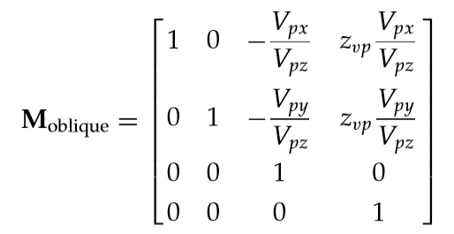
Oblique Parallel-Projection Transformation Matrix
Location of the view plane?
What happens in case of orthographic projection?

Slide 18
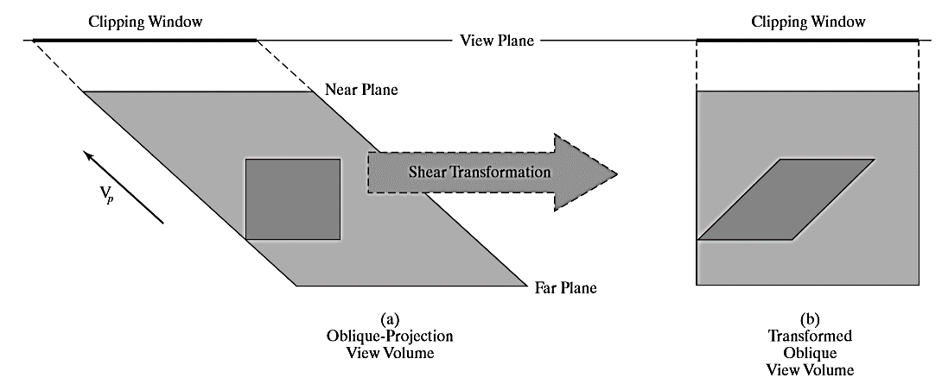
Oblique Parallel-Projection

Slide 19
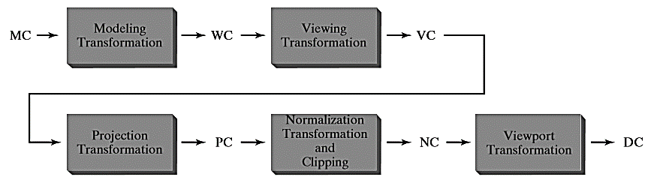
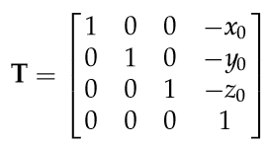
3D Viewing pipeline
1. Translate the viewing-coordinate origin to the origin of the world coordinate system

Slide 20
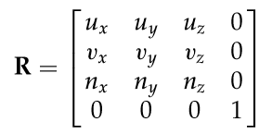
3D Viewing pipeline
2. Apply rotations to align the view coordinate axis to world coordinate axis

Slide 21
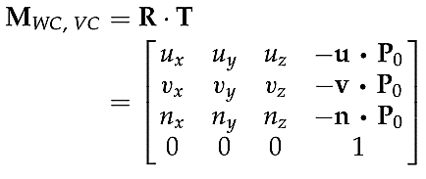
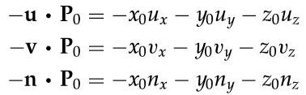
3D Viewing pipeline
The coordinate transformation matrix is then obtained as:

Slide 22
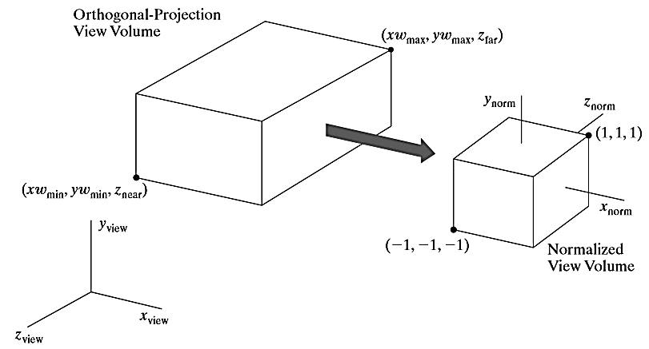
Normalization transform

Slide 23
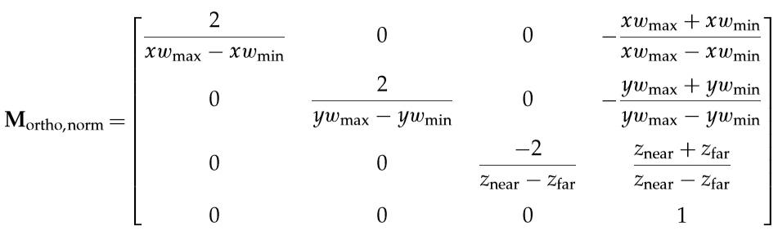
Normalization Transformation Orthogonal Projection

Slide 24

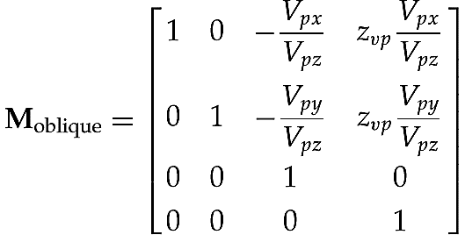
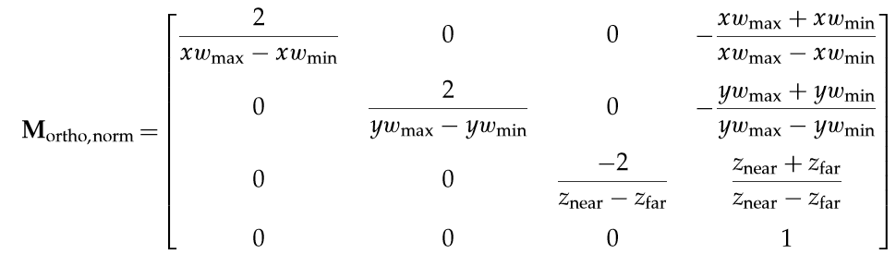
Normalization Transformation: Oblique Parallel Projection

Slide 25
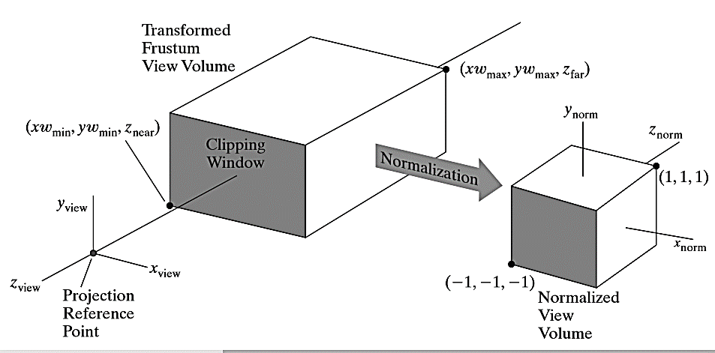
Normalized Perspective-Projection Transformation
Mapping of the parallelepiped to a normalized view volume.

Slide 26
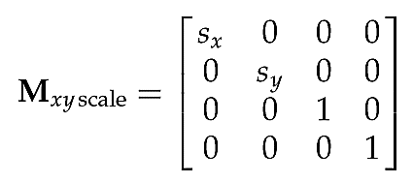
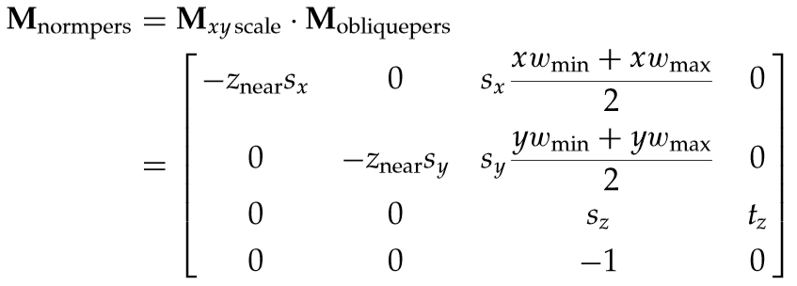

Normalized Perspective-Projection Transformation
The scaling matrix for accomplishing the $xy$normalization is

Slide 27
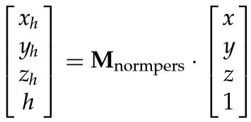
Normalized Perspective-Projection Transformation
The homogeneous coordinates can be obtained as:

Slide 28
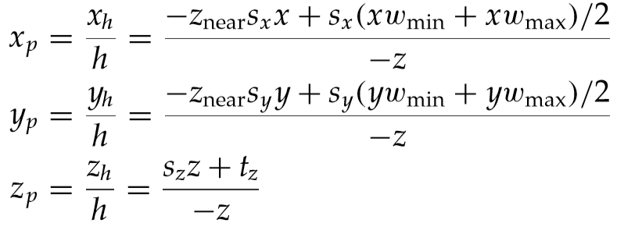
Normalized Perspective-Projection Transformation
Projection coordinated are

Slide 29
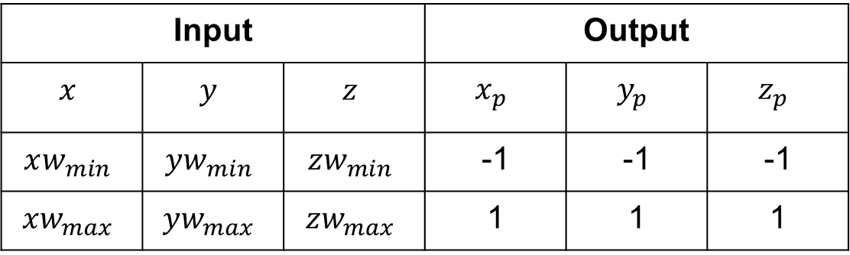
Normalization criteria
Input |  |  | Output
$$x$$ | $$y$$ | $$z$$ | $$x_{p}$$ | $$y_{p}$$ | $$z_{p}$$
$$xw_{min}$$ | $$yw_{min}$$ | $$zw_{min}$$ | -1 | -1 | -1
$$xw_{max}$$ | $$yw_{max}$$ | $$zw_{max}$$ | 1 | 1 | 1

Slide 30
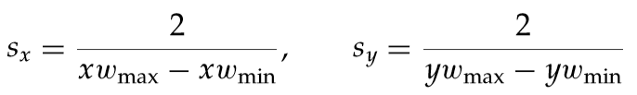

Normalization parameters

Slide 31
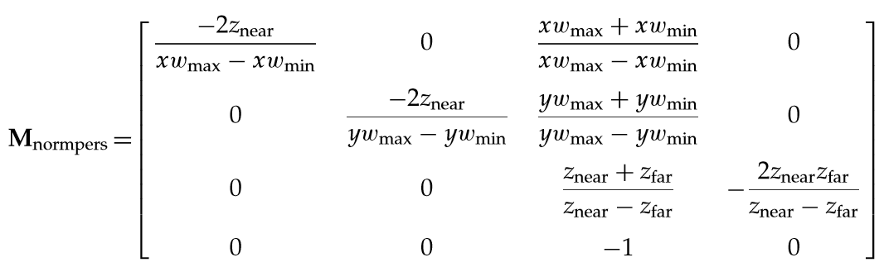
Normalized transformation matrix

Slide 32

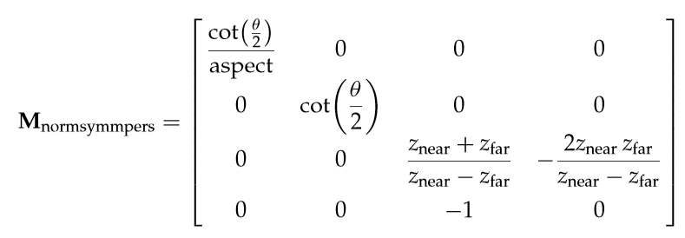
Using field-of-view angle
PRP at the origin VP at the position of the near clipping plane

Slide 33
Graphics TPA
Human Face Rendering
Geometric representation of Hand drawn objects
Realistic rendering of indoor scenes
3D reconstruction from contours
Modeling of Object Deformation
Simulate cutting of soft objects
Chemical formula visualizer

Slide 34
Thank you
Next Lecture: Projection Geometry

