Slide 1

CS552: Computer Graphics
Lecture 12: 3D Clipping

Slide 2
Recap
Parallel projection
Normalized coordinate transformation
Orthographic
Oblique
Perspective

Slide 3
Objective
After completing this lecture students will be able to
Extend 2D clipping algorithm for 3D
Solve mathematical problems on 3D clipping

Slide 4
When Do We Clip?
We perform clipping after the projection transformation and normalisation are complete
So, we have the following:
We apply all clipping to these homogeneous coordinates

Slide 5
Dividing Up The World
Similar to the case in two dimensions, we divide the world into regions
This time we use a 6-bit region code to give us 27 different region codes
The bits in these regions codes are as follows:
bit 6 Far | bit 5 Near | bit 4 Top | bit 3 Bottom | bit 2 Right | bit 1 Left

Slide 6
Dividing Up The World (cont..)
Because we have a normalised clipping volume we can test for these regions as follows:
Rearranging these we get:

Slide 7
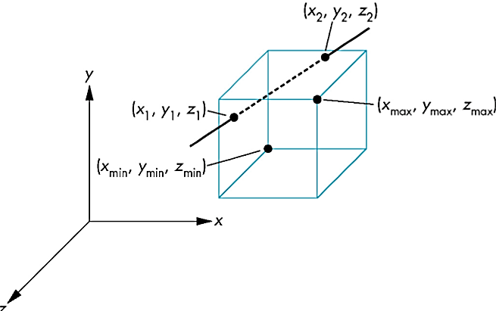
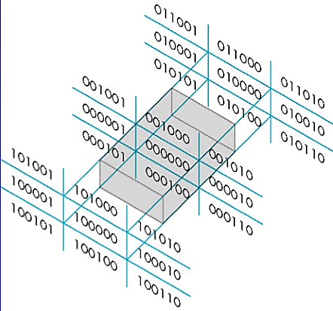
Region Codes
Far | Near | Top | Bottom | Right | Left

Slide 8
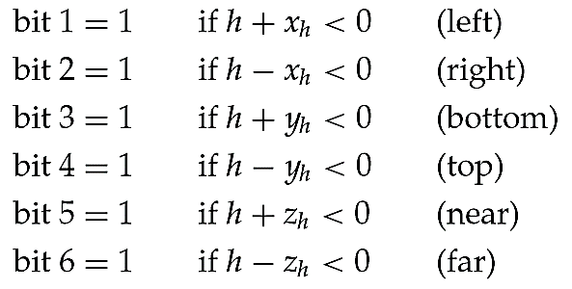
Different test cases

Slide 9
Line Clipping
To clip lines we first label all end points with the appropriate region codes
We can trivially accept all lines with both end-points in the [000000] region
We can trivially reject all lines whose end points share a common bit in any position
This is just like the 2 dimensional case as these lines can never cross the viewing volume
In the example that follows the line from P₃[010101] to P₄[100110] can be rejected

Slide 10

The Equation Of The Line For 3D Clipping
For clipping equations for three dimensional line segments are given in their parametric form
For a line segment with end points $P_{1}\left(x1h, y1h, z1h, h1\right)$and $P_{2}\left(x2h, y2h, z2h, h2\right)$the parametric equation describing any point on the line is:

Slide 11
The Equation Of The Line For 3D Clipping
From this parametric equation of a line we can generate the equations for the homogeneous coordinates:

Slide 12
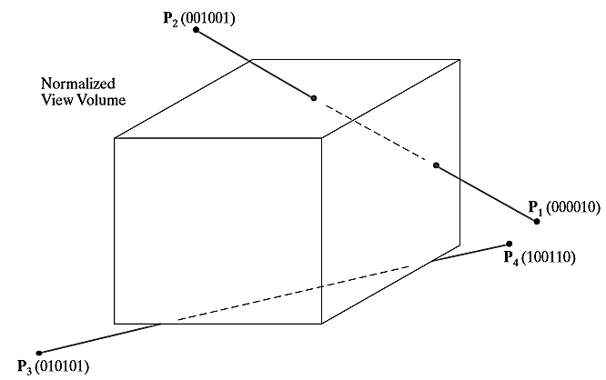
3D Line Clipping Example
Consider the line P₁[000010] to P₂[001001]
Because the lines have different values in bit 2 we know the line crosses the right boundary

Slide 13

3D Line Clipping Example
Since the right boundary is at x = 1 we now know the following holds:
which we can solve for u as follows:
Using this value for u we can then solve for $yp$and $zp$ similarly

Slide 14
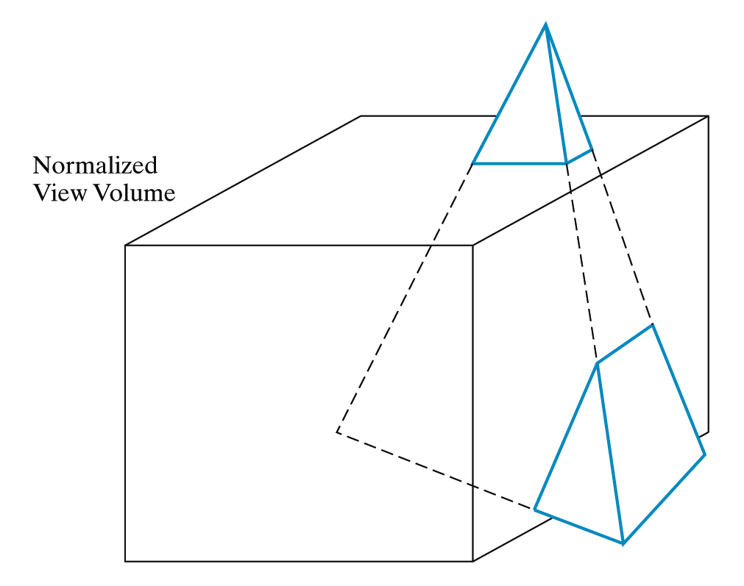
3D Polygon Clipping
However the most common case in 3D clipping is that we are clipping graphics objects made up of polygons

Slide 15
3D Polygon Clipping
In this case we first try to eliminate the entire object using its bounding volume
Next we perform clipping on the individual polygons using the Sutherland-Hodgman algorithm we studied previously

Slide 16

Arbitrary Clipping Planes
To clip a three-dimensional scene using additional planes that can be speciﬁed in any spatial orientation
Objects behind the plane are to be clipped

Slide 17
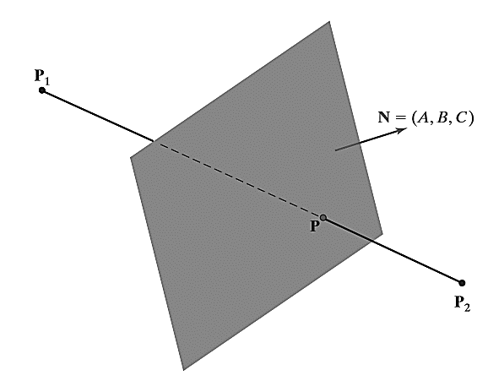



Line clipping
Case 1:
Clip the entire line if both endpoints satisfy
Case 3:
Point P is on the clipping plane if it satisﬁes the plane equation
Case 2:
Save the entire line if both endpoints satisfy

Slide 18
Thank you
Next Lecture: Raster Graphics

