Slide 1

CS552: Computer Graphics
Lecture 15: Raster Graphics and Scan Conversion

Slide 2
Recap
Issues related to scan converting a line
Generalized line drawing algorithm
Mid point circle drawing algorithm

Slide 3
Objective
After completing this lecture students will be able to
Derive mathematical expression for drawing am ellipse
Write programs to implement ellipse drawing algorithm
Explain polygon filling algorithms

Slide 4
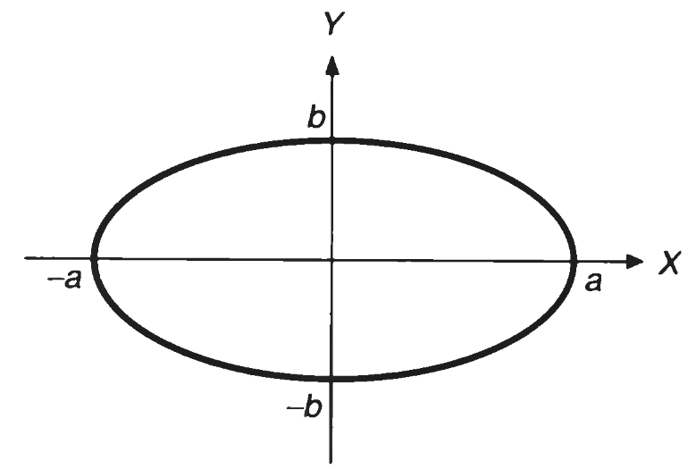

Ellipse
$$\frac{x^{2}}{a^{2}}+\frac{y^{2}}{b^{2}}=1$$
$$F\left(x,y\right)= b^{2}x^{2}+a^{2}y^{2}−a^{2}b^{2}=0$$
Minor axis
(0,0)
Major axis

Slide 5
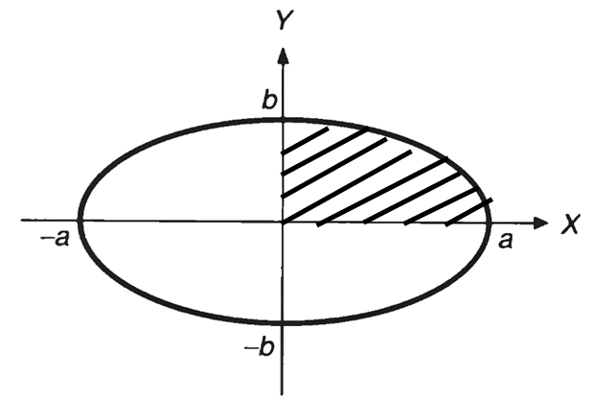
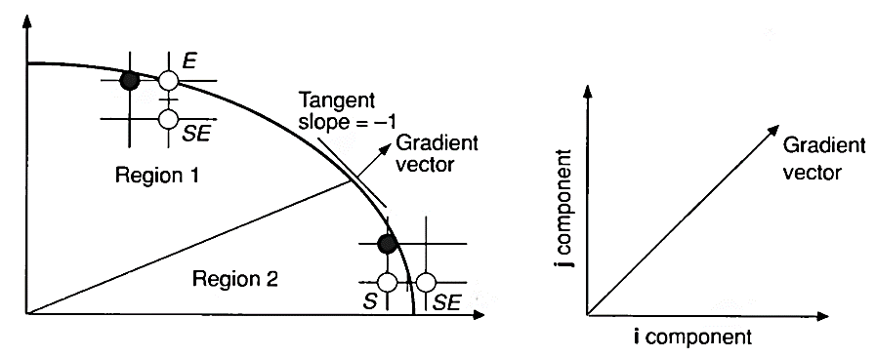
Four way symmetry in ellipse

Slide 6
Filling rectangles
The task of filling primitives can be broken into two parts:
the decision of which pixels to fill
shape of the primitive
with what value to fill them.

Slide 7
Filling rectangles
for (y=YMIN; y<YMAX; y++) // by scan line
{
for (x=XMIN; x<XMAX; x++) // by pixel in span
{
WritePixel(x,y,color);
}
}

Slide 8
Polygons
A polygon is a many-sided planar figure composed of vertices and edges. A polygon is bounded (finite area) and closed (includes boundary).
Vertices are represented by points (x,y).
Edges are represented as line segments which connect two points, (x1,y1) and (x2,y2).
P = { (x_{i} , y_{i} ) } i=1,n
(x1,y1)
E1
(x2,y2)
E3
E2
(x3,y3)

Slide 9
Polygons: Complex vs Simple
A simple polygon – edges only intersect a vertices, no coincident vertices
A complex polygon – edges intersect and/or coincident vertices
C
C
H
E
G
A
D
E
F
A
B
C
B
A
B
C
A
B,E
C
F
D

Slide 10
Simple Polygons: Convex and Concave
Convex Polygon - For any two points P₁, P₂ inside the polygon, all points on the line segment which connects P₁ and P₂ are inside the polygon.
All points P = uP₁ + (1-u)P₂, u in [0,1] are inside the polygon provided that P₁ and P₂ are inside the polygon.
Concave Polygon - A polygon which is not convex.

Slide 11
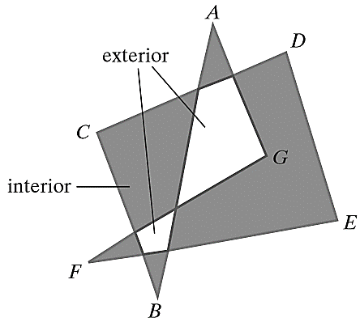
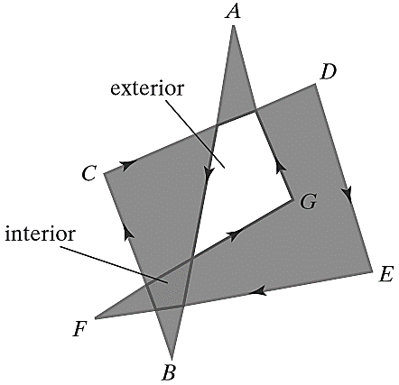
Inside-Outside Tests
Identifying the interior of a simple object
Odd-Even Rule
Non-zero winding number Rule

Slide 12
Filled- Area Primitives
A standard output primitive in general graphics packages is a solid-color or patterned polygon area.
The scan-line approach
Determine the overlap intervals for scan lines that cross the area.
Typically used in general graphics packages to fill polygons, circles, ellipses
Filling approaches
Start from a given interior position and paint outward from this point until we encounter the specified boundary conditions.
Useful with more complex boundaries and in interactive painting systems.

Slide 13
Scan-Line Polygon-Fill
For each scan line crossing a polygon
Locate the intersection points of the scan line with the polygon edges.
These intersection points are then
sorted from left to right,
the corresponding frame-buffer positions between each intersection pair are set to the specified fill color.

Slide 14
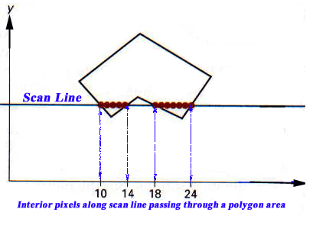
Example

Slide 15
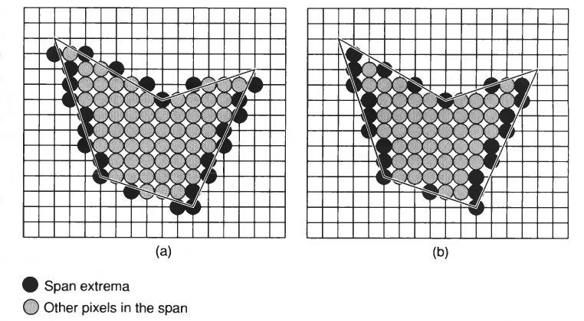
Issues

Slide 16
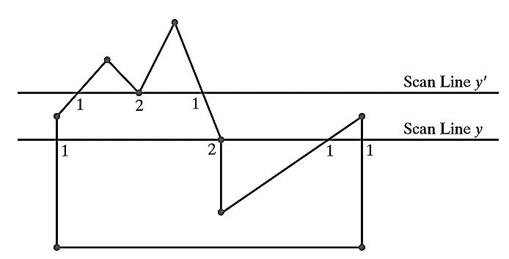
Issues

Slide 17
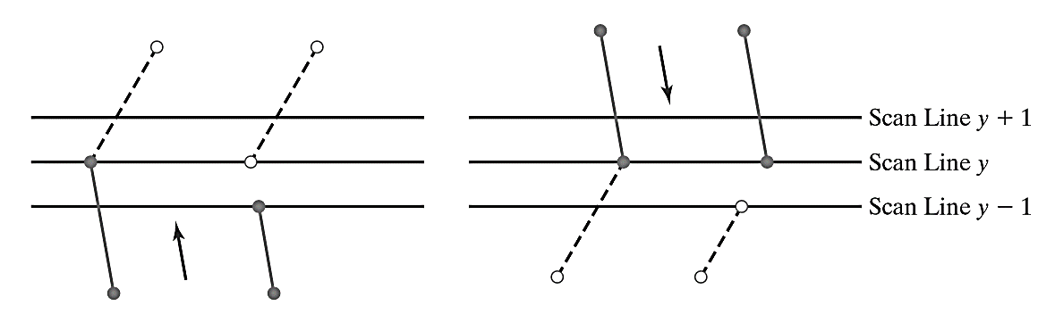
Adjust end point calculation

Slide 18
Filled- Area Primitives (cont.)
Scan-conversion algorithms typically take advantage of various coherence properties of a scene
Coherence is simply that
the properties of one part of a scene are related in some way to other parts of the scene
so that the relationship can be used to reduce processing.
Coherence methods often involve
incremental calculations applied along a single scan line
between successive scan lines.

Slide 19
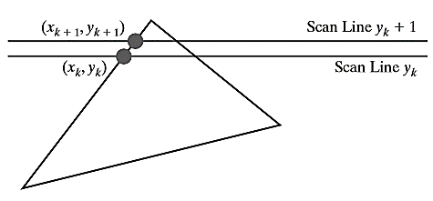


Coherence Example
Slope of the edge
Change in y coordinates between the two scan lines is ?
Given the current x-intercept, the next x-intercept coordinate =

Slide 20
Different situations while scanning
Intersection point change by the amount of the slope of the line
Edges may start / end
Tracking of intersection points is the key
Vertices
Edges
Active Edge Table (AET)

Slide 21
Thank you
Next Lecture: Scan Line Filling Algorithm

