Slide 1

CS552: Computer Graphics
Lecture 16: Polygon Filling

Slide 2
Recap
Midpoint ellipse drawing algorithm
Inside-Outside Test
Filling rectangle
Issues related to polygon filling

Slide 3
Objective
After completing this lecture students will be able to
Describe different polygon filling algorithm
Solve numerical problems

Slide 4
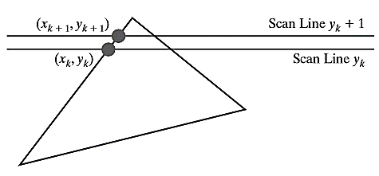


Coherence Example
Slope of the edge
Change in y coordinates between the two scan lines is ?
Given the current x-intercept, the next x-intercept coordinate =

Slide 5
Different situations while scanning
Intersection point change by the amount of the slope of the line
Edges may start / end
Tracking of intersection points is the key
Vertices
Edges
Edge table (ET), Active Edge Table (AET)

Slide 6

Scan Line Polygon Filling Algorithm
Pixels within the boundary of a polygon belong to the polygon
Moving from bottom to top up the polygon
Starting at a left edge, fill pixels in spans until a right edge is reached
Once we have an intersection
Incrementally compute the next intersection from the current one.

Slide 7
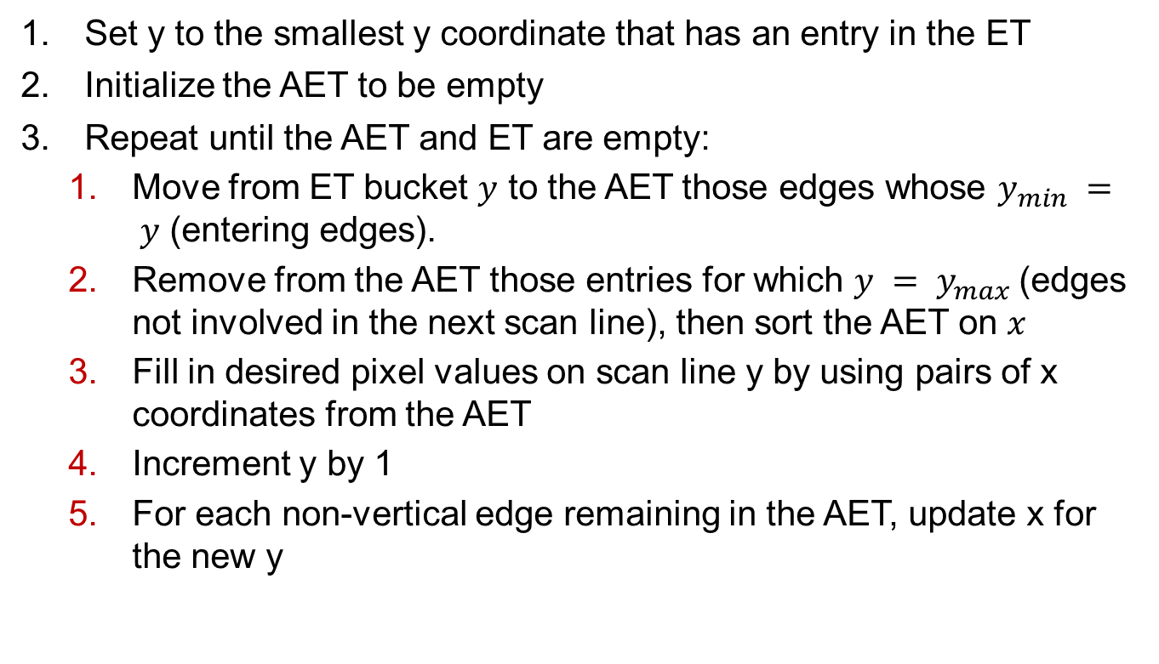
Algorithm
Set y to the smallest y coordinate that has an entry in the ET
Initialize the AET to be empty
Repeat until the AET and ET are empty:
Move from ET bucket $y$ to the AET those edges whose $y_{min} = y$ (entering edges).
Remove from the AET those entries for which $y = y_{max}$(edges not involved in the next scan line), then sort the AET on $x$
Fill in desired pixel values on scan line y by using pairs of x coordinates from the AET
Increment y by 1
For each non-vertical edge remaining in the AET, update x for the new y

Slide 8
Example
(10,50)
(40,40)
(40,20)
(10,10)
(70,10)

Slide 9
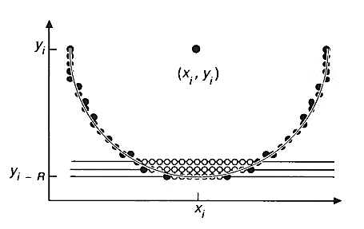
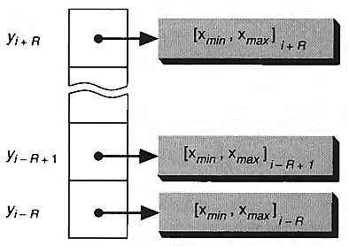
Filling Ellipse Arcs
The Same general strategy works here too
Span table

Slide 10
Boundary Fill Algorithm
Start at a point inside a region and paint the interior outward toward the boundary.
If the boundary is specified in a single color,
the fill algorithm processed outward pixel by pixel
until the boundary color is encountered.
Input: the coordinate of the interior point (x, y), a fill color, and a boundary color.

Slide 11
Algorithm
Start from an interior point.
If the current pixel is not already filled and if it is not an edge point, then
Set the pixel with the fill color,
Store its neighbouring pixels (4 or 8-connected) in the stack for processing.
Store only neighboring pixel that is not already filled and is not an edge point.
Select the next pixel from the stack, and continue with step 2.

Slide 12
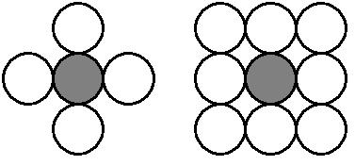
Boundary Fill Algorithm
The order of pixels that should be added to stack using
4-connected
above, below, left, and right.
8-connected is above, below, left, right, above-left, above-right, below-left, and below-right.

Slide 13
Boundary Fill Algorithm
4-connected (Example)
Start Position

Slide 14
Boundary Fill Algorithm
4-connected (Example)
3
2
1
1
2
3

Slide 15
Boundary Fill Algorithm
4-connected (Example)
4
2
1
1
4
2

Slide 16
Boundary Fill Algorithm
4-connected (Example)
2
1
1
2

Slide 17
Boundary Fill Algorithm
4-connected (Example)
5
1
5
1

Slide 18
Boundary Fill Algorithm
4-connected (Example)
1
1

Slide 19
Boundary Fill Algorithm
4-connected (Example)

Slide 20
Boundary Fill Algorithm
8-connected (Example)
Start Position

Slide 21
Boundary Fill Algorithm
8-connected (Example)
5
4
3
2
1
4
1
5
2
3

Slide 22
Boundary Fill Algorithm
8-connected (Example)
6
4
3
2
1
6
4
1
2
3

Slide 23
Boundary Fill Algorithm
8-connected (Example)
8
7
4
3
2
1
7
8
4
1
2
3

Slide 24
Boundary Fill Algorithm
8-connected (Example)
12
11
10
9
7
4
3
2
1
11
9
12
7
10
4
1
2
3

Slide 25
Boundary Fill Algorithm
8-connected (Example)
11
10
9
7
4
3
2
1
11
9
7
10
4
1
2
3

Slide 26
Boundary Fill Algorithm
8-connected (Example)
10
9
7
4
3
2
1
9
7
10
4
1
2
3

Slide 27
Boundary Fill Algorithm
8-connected (Example)
9
7
4
3
2
1
9
7
4
1
2
3

Slide 28
Boundary Fill Algorithm
8-connected (Example)
7
4
3
2
1
7
4
1
2
3

Slide 29
Boundary Fill Algorithm
8-connected (Example)
4
3
2
1
4
1
2
3

Slide 30
Boundary Fill Algorithm
8-connected (Example)
3
2
1
1
2
3

Slide 31
Boundary Fill Algorithm
8-connected (Example)
2
1
1
2

Slide 32
Boundary Fill Algorithm
8-connected (Example)
1
1

Slide 33
Boundary Fill Algorithm
8-connected (Example)

Slide 34
Boundary Fill Algorithm
Considerable stacking of neighboring pixels was required
Fill horizontal pixel spans across scan lines
Only stack a beginning position for each horizontal pixel spans

Slide 35
Algorithm
Starting from the initial interior pixel, then fill in the contiguous span of pixels on this starting scan line.
Locate and stack starting positions for spans on the adjacent scan lines, where spans are defined as the contiguous horizontal string of positions bounded by pixels displayed in the area border color.
At each subsequent step, unstack the next start position and repeat the process.

Slide 36
Span Flood-Fill Algorithm (example)
11
10
9
8
7
6
5
S
4
3
2
1
0
0
1
2
3
4
5
6
7
8
9
10
11
12
13
14

Slide 37
Span Flood-Fill Algorithm (example)
11
10
9
8
2
1
7
6
2
5
S
4
1
3
2
1
0
0
1
2
3
4
5
6
7
8
9
10
11
12
13
14

Slide 38
Span Flood-Fill Algorithm (example)
11
10
9
8
3
1
7
3
6
2
5
S
4
1
3
2
1
0
0
1
2
3
4
5
6
7
8
9
10
11
12
13
14

Slide 39
Span Flood-Fill Algorithm (example)
11
10
9
8
5
6
6
5
4
1
7
3
6
4
2
5
S
4
1
3
2
1
0
0
1
2
3
4
5
6
7
8
9
10
11
12
13
14

Slide 40
Span Flood-Fill Algorithm (example)
11
10
9
7
8
5
6
7
5
4
1
7
3
6
4
2
5
S
4
1
3
2
1
0
0
1
2
3
4
5
6
7
8
9
10
11
12
13
14

Slide 41
Span Flood-Fill Algorithm (example)
11
10
9
7
8
5
6
5
4
1
7
3
6
4
2
5
S
4
1
3
2
1
0
0
1
2
3
4
5
6
7
8
9
10
11
12
13
14

Slide 42
Span Flood-Fill Algorithm (example)
11
10
9
8
7
8
5
6
8
4
1
7
3
6
4
2
5
S
4
1
3
2
1
0
0
1
2
3
4
5
6
7
8
9
10
11
12
13
14

Slide 43
Span Flood-Fill Algorithm (example)
11
10
9
8
7
8
5
6
4
1
7
3
6
4
2
5
S
4
1
3
2
1
0
0
1
2
3
4
5
6
7
8
9
10
11
12
13
14

Slide 44
Span Flood-Fill Algorithm (example)
11
10
9
8
7
8
5
6
9
1
7
3
6
4
2
5
9
S
4
1
3
2
1
0
0
1
2
3
4
5
6
7
8
9
10
11
12
13
14

Slide 45
Span Flood-Fill Algorithm (example)
11
10
9
8
7
8
5
6
10
1
7
3
6
4
2
5
9
S
4
10
1
3
2
1
0
0
1
2
3
4
5
6
7
8
9
10
11
12
13
14

Slide 46
Span Flood-Fill Algorithm (example)
11
10
9
8
7
8
5
6
11
1
7
3
6
4
2
5
9
S
4
10
1
3
11
2
1
0
0
1
2
3
4
5
6
7
8
9
10
11
12
13
14

Slide 47
Span Flood-Fill Algorithm (example)
11
10
9
8
7
8
5
6
12
1
7
3
6
4
2
5
9
S
4
10
1
3
11
2
12
1
0
0
1
2
3
4
5
6
7
8
9
10
11
12
13
14

Slide 48
Span Flood-Fill Algorithm (example)
11
10
9
8
7
8
5
6
1
7
3
6
4
2
5
9
S
4
10
1
3
11
2
12
1
0
0
1
2
3
4
5
6
7
8
9
10
11
12
13
14

Slide 49
Span Flood-Fill Algorithm (example)
11
10
9
8
7
8
5
6
7
3
6
4
2
5
9
S
4
10
1
3
11
2
12
1
0
0
1
2
3
4
5
6
7
8
9
10
11
12
13
14

Slide 50
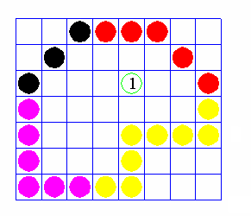
Flood Fill Algorithm
Fill in (recolor) an area that is not defined within a single color boundary.
Replace a specified interior color instead of searching for a boundary color value.
This approach is called a flood-fill algorithm.

Slide 51
Flood Fill Algorithm
Start from a specified interior pixel (x, y) and reassign all pixel values that are currently set to a given interior color with the desired fill color.
If the area has more than one interior color, we can first reassign pixel values so that all interior pixels have the same color.
Using either 4-connected or 8-connected approach, we then step through pixel positions until all interior pixels have been repainted.

Slide 52
Thank you
Next Lecture: Scan Converting Patterns

