Slide 1

CS552: Computer Graphics
Lecture 17: Scan Conversion (Special Cases)

Slide 2
Recap
Rasterization
Scan converting geometric primitives
Lines
Circle
Ellipse
Filling
Rectangle
Polygon
Scan line, seed fill, flood fill

Slide 3
Objective
After completing this lecture students will be able to
Describe the process of
Rendering characters
Patterning
Explain the importance of
Antialiasing
Half toning
Dithering

Slide 4
Introduction
The main aim of computer graphics is to
display an arbitrary surface so that it looks real.
The ﬁrst step toward this goal is an understanding of curves
Once we have an algorithm to calculate and display any curve
We may try to extend it to a surface.

Slide 5
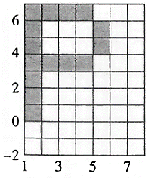
Character Display
Alphanumeric characters are written to the frame buffer using a mask.
Mask is a small raster which contains
the relative locations of the pixels representing the character

Slide 6
The Mask
It contains
Binary values indicating what a particular pixel in the mask represents
The character or symbol shape.
1 indicates that a pixel is used in the representation
0 indicates that it is the background
For color displays additional bits are used for representation

Slide 7
Algorithm
Mask insertion into the frame buffer
Xmin, Xmax, Ymin, Ymax are the limits of the mask
xo, yo is the location in the frame buffer
for j = Ymin to Ymax - 1
for i = Xmin to Xmax - 1
if Mask(i, j) <> 0 then
write Mask(i,j) to the frame buffer at (xo + i, yo + j)
end if
next i
next j
finish

Slide 8
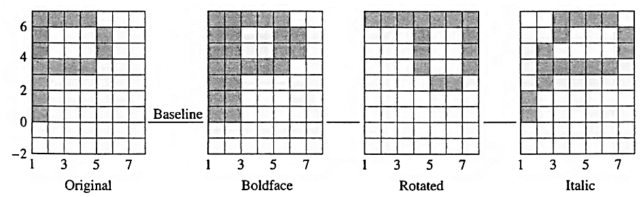
Style and orientation

Slide 9
Aliasing effect
A continuous signal is sampled at discreet points
Those samples are then used to reconstruct a new signal, that is intended to represent the original signal
The reconstructed signals are a false representation (alias) of the original signals
In computer graphics usually results in visually distracting artifacts
Antialiasing: to reduce the aliasing effect

Slide 10
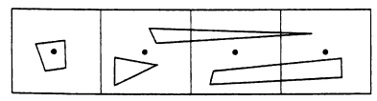
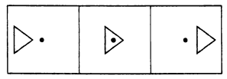
Small Triangles
Problem happens with very small triangles
Pixel properties are determined at the center of the pixel
This has the potential to miss small objects
If we have small, moving triangles, they may cause pixels to flicker on and off as they cross the pixel centers
A related problem can be seen when very thin triangles cause pixel gaps

Slide 11
Stairstepping
The jagged right angle patterns we see at the edges of triangles?
Known as the stairstepping problem, also affectionately known as “the jaggies”
These can be visually distracting, especially for high contrast edges near horizontal or vertical
Stairstepping is another form of aliasing

Slide 12
Antialiasing techniques
Increase the sample rate
Super-sampling
Consider pixels as a finite area rather than a point
Pre-filtering

Slide 13
Super-sampling
Physical raster (original image), pseudo-raster (higher resolution)
Pseudo-raster is superimposed on the physical raster.
Entities of interest
Lines
Edges
Interiors

Slide 14
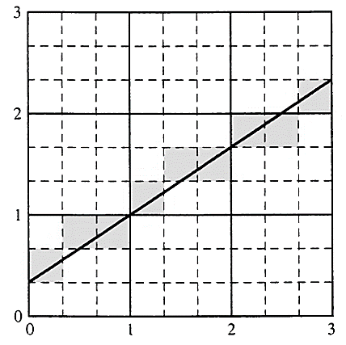
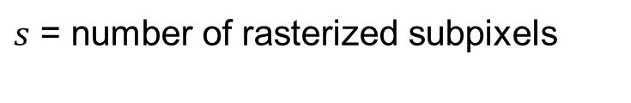
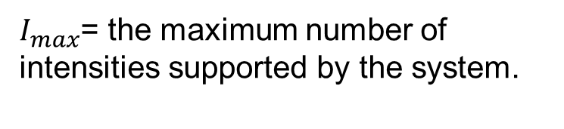
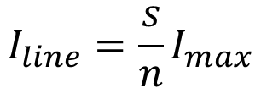
Straight Lines
n
The intensity of the physical pixel is
Proportional to the
Ratio of the number of
Activated subpixels to the
Total number of possible activated subpixels in a physical pixel.
n
$$I_{line}=\frac{s}{n}I_{max}$$
$s$ = number of rasterized subpixels
$I_{max}$= the maximum number of intensities supported by the system.

Slide 15
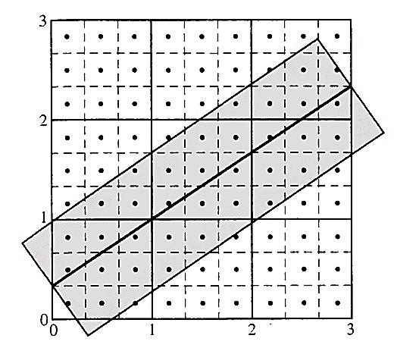
Alternate approach

Slide 16
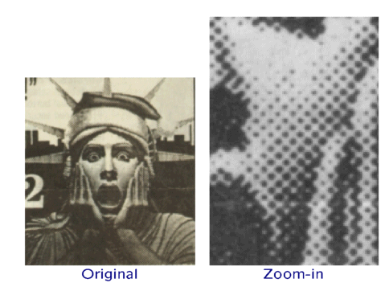
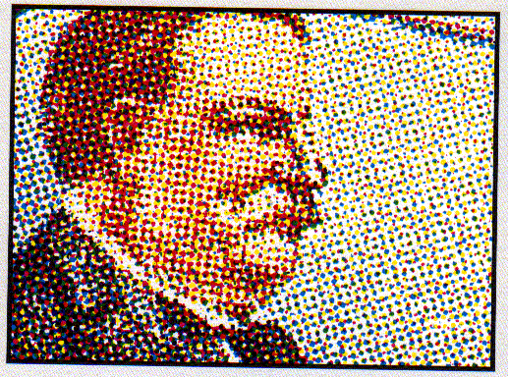
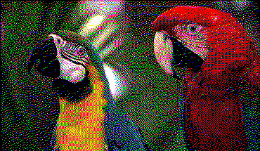
Halftoning
It is a technique for using a minimum number of intensity levels to obtain increased visual resolution

Slide 17
Halftoning patterns

Slide 18
Thank you
Next Lecture: Representing curves

