Slide 1

CS552: Computer Graphics
Lecture 17: Representing Curves

Slide 2
Recap
Polygon filling (special case)
Character rendering
Half toning
Filling patterns

Slide 3
Objective
After completing this lecture students will be able to
Represent curves using piecewise polynomials
Solve related mathematical problems

Slide 4
Introduction
The main aim of computer graphics is to
display an arbitrary surface so that it looks real.
The ﬁrst step toward this goal is an understanding of curves
Once we have an algorithm to calculate and display any curve
We may try to extend it to a surface.

Slide 5
Practical scenario
Curves (and surfaces) are speciﬁed by the user in terms of points
User gives the coordinates of points
The user may want to modify its shape by
moving, adding, or deleting points.
Two scenarios
Interpolation
Control points

Slide 6
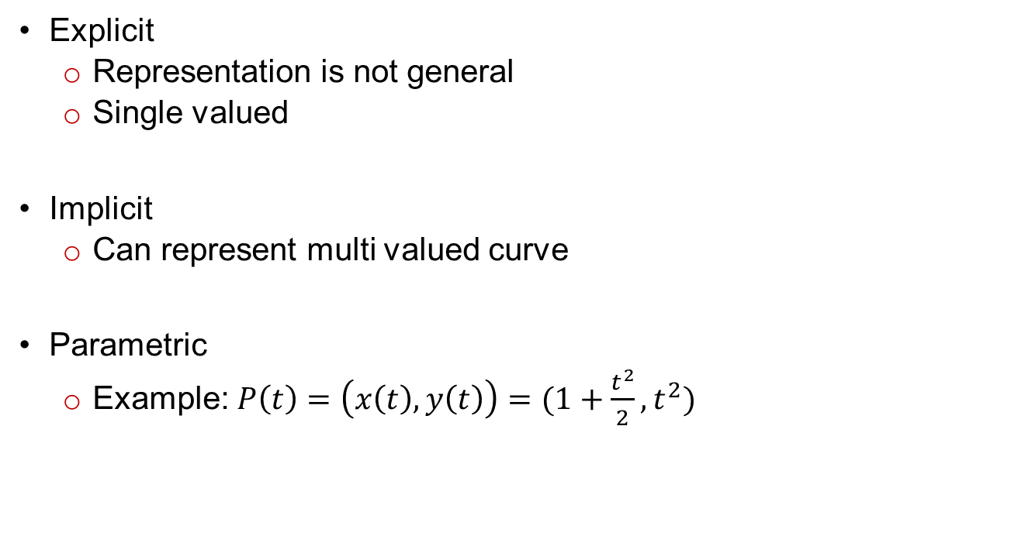
Representing curves
Explicit
Representation is not general
Single valued
Implicit
Can represent multi valued curve
Parametric
Example: $P\left(t\right)=\left(x\left(t\right),y\left(t\right)\right)=(1+\frac{t^{2}}{2},t^{2})$

Slide 7
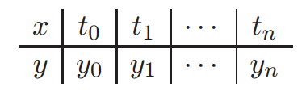
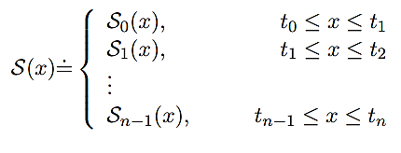

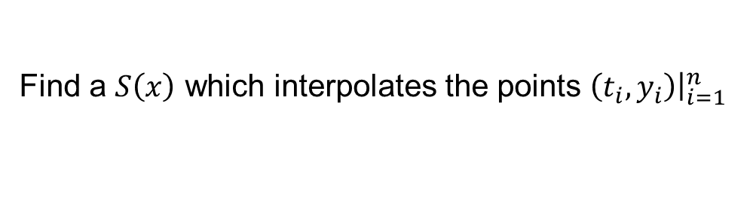
Problem setting
Find a $S\left(x\right)$ which interpolates the points $\left(t_{i},y_{i}\right){\left.​\right|}_{i=1}^{n}$
$S\left(x\right)$ consists of piecewise polynomials

Slide 8
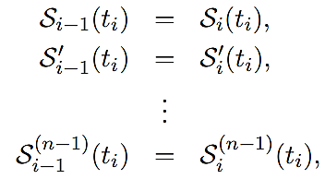


Spline of degree n
$S\left(x\right)$ is called a spline of degree n if
$S_{i}\left(x\right)$ is polynomial of degree n
$S\left(x\right)$ is (n-1) times continuously differentiable
$$i=1,2,…, n−1$$

Slide 9
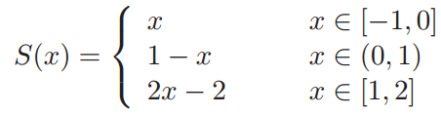
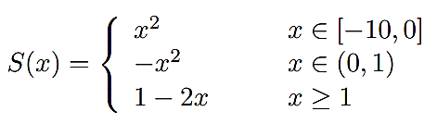
Examples
Is this linear ?
Is this a quadratic spline?

Slide 10




Parametric cubic spline segment
$$P\left(t\right)=\sum_{i=1}^{n}{B_{i}t^{i−1};t_{1}≤t≤t_{2}}$$
$$t=Parameter$$
How to determine $B_{i}^{′}s ?$
$$B_{1}=P1$$
$$B_{2}=P1^{′}$$
$$B_{3} =\frac{3(P_{2}−P_{1})}{t_{2}^{2}}−\frac{2P_{1}′}{t_{2}}−\frac{P_{2}^{′}}{t_{2}}$$
$$B_{4}=\frac{2\left(P_{1}−P_{2}\right)}{t_{2}^{3}}+\frac{P_{1}^{′}}{t_{2}^{2}}+\frac{P_{2}^{′}}{t_{2}^{2}}$$

Slide 11
Parametric cubic spline segment
$$P\left(t\right)=P_{1}+P_{1}^{′}t+\left[\frac{3(P_{2}−P_{1})}{t_{2}^{2}}−\frac{2P_{1}′}{t_{2}}−\frac{P_{2}^{′}}{t_{2}}\right]t^{2}+\left[\frac{2\left(P_{1}−P_{2}\right)}{t_{2}^{3}}+\frac{P_{1}^{′}}{t_{2}^{2}}+\frac{P_{2}^{′}}{t_{2}^{2}}\right]t^{3}$$
If we generalize this for two consecutive segment $P_{K}\left(t\right),P_{K+1}\left(t\right);1≤K≤n−2$
Assume, n=3
Given; $P_{1},P_{2}, P_{3}$ and the tangent vectors at the end points $P_{1}^{′}\& P_{3}′$
Constant curvature at the internal joint between the two spans.

Slide 12

Parametric cubic spline segment
Assume second order continuity at the junctions
The segments are defined as
$0≤t≤t2$
$0≤t≤t3$
Target: Calculate the tangent vector at the junction point
$$t_{3}P_{1}^{′}+2\left(t_{3}+t_{2}\right)P_{2}′+t_{2}P_{3}^{′}=\frac{3}{t_{2}t_{3}}\left[t_{2}^{2}\left(P_{3}−P_{2}\right)+t_{3}^{2}(P_{2}−P_{1})\right]$$

Slide 13

Piecewise spline
$$\left[\begin{matrix}t_{3} & 2(t_{2}+t_{3}) & t_{2} & 0 & & \\ & t_{4} & 2(t_{3}+t_{4}) & t_{3} & & \\ & & t_{5} & 2(t_{4}+t_{5}) & t_{4} & \\ & & & . & . & . \\ & & & & . & . \\ & & & & & .\end{matrix}\right]\left[\begin{matrix}P_{1}′ \\ P_{2}′ \\ P_{3}′ \\ . \\ . \\ P_{n}′\end{matrix}\right]=$$
$$\left[\begin{matrix}\frac{3}{t_{2}t_{3}}\left[t_{2}^{2}\left(P_{3}−P_{2}\right)+t_{3}^{2}(P_{2}−P_{1})\right] \\ . \\ . \\ . \\ . \\ \frac{3}{t_{n−1}t_{n}}\left[t_{n−1}^{2}\left(P_{n}−P_{n−1}\right)+t_{n}^{2}(P_{n−1}−P_{n−2})\right]\end{matrix}\right]$$

Slide 14
Thank you
Next Lecture: Representing curves

