Slide 1

CS552: Computer Graphics
Lecture 18: Representing Cubic Splines

Slide 2
Recap
Parametric cubic spline
Spline of order n
Piecewise polynomial
Cubic spline
One segment: end points and its tangent
Two segments: end points of each segment, tangent at the terminal points
K segments

Slide 3
Objective
After completing this lecture students will be able to
Generalize cubic spline with K segments
Solve numerical problems

Slide 4
Parametric cubic spline segment
$$P\left(t\right)=P_{1}+P_{1}^{′}t+\left[\frac{3(P_{2}−P_{1})}{t_{2}^{2}}−\frac{2P_{1}′}{t_{2}}−\frac{P_{2}^{′}}{t_{2}}\right]t^{2}+\left[\frac{2\left(P_{1}−P_{2}\right)}{t_{2}^{3}}+\frac{P_{1}^{′}}{t_{2}^{2}}+\frac{P_{2}^{′}}{t_{2}^{2}}\right]t^{3}$$
If we generalize this for two consecutive segment $P_{K}\left(t\right),P_{K+1}\left(t\right);1≤K≤n−2$
Assume, n=3
Given; $P_{1},P_{2}, P_{3}$ and the tangent vectors at the end points $P_{1}^{′}\& P_{3}′$
Constant curvature at the internal joint between the two spans.

Slide 5

Parametric cubic spline segment
Assume second order continuity at the junctions
The segments are defined as
$0≤t≤t2$
$0≤t≤t3$
Target: Calculate the tangent vector at the junction point
$$t_{3}P_{1}^{′}+2\left(t_{3}+t_{2}\right)P_{2}′+t_{2}P_{3}^{′}=\frac{3}{t_{2}t_{3}}\left[t_{2}^{2}\left(P_{3}−P_{2}\right)+t_{3}^{2}(P_{2}−P_{1})\right]$$

Slide 6

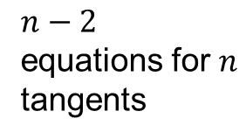
Piecewise spline
$$\left[\begin{matrix}t_{3} & 2(t_{2}+t_{3}) & t_{2} & 0 & & \\ & t_{4} & 2(t_{3}+t_{4}) & t_{3} & & \\ & & t_{5} & 2(t_{4}+t_{5}) & t_{4} & \\ & & & . & . & . \\ & & & & . & . \\ & & & & & .\end{matrix}\right]\left[\begin{matrix}P_{1}′ \\ P_{2}′ \\ P_{3}′ \\ . \\ . \\ P_{n}′\end{matrix}\right]=$$
$$\left[\begin{matrix}\frac{3}{t_{2}t_{3}}\left[t_{2}^{2}\left(P_{3}−P_{2}\right)+t_{3}^{2}(P_{2}−P_{1})\right] \\ . \\ . \\ . \\ . \\ \frac{3}{t_{n−1}t_{n}}\left[t_{n−1}^{2}\left(P_{n}−P_{n−1}\right)+t_{n}^{2}(P_{n−1}−P_{n−2})\right]\end{matrix}\right]$$
$n−2$ equations for $n$ tangents

Slide 7
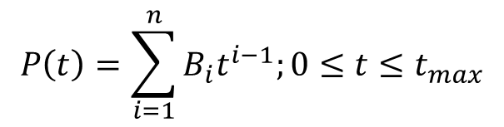
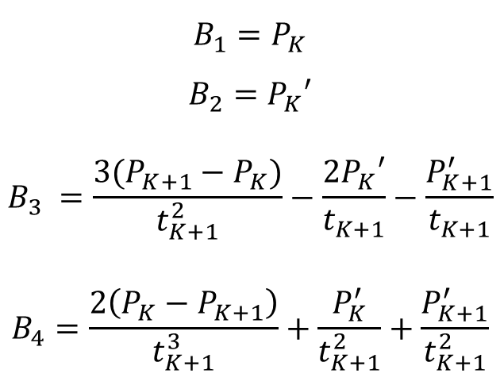
Basis functions
$$B_{1}=P_{K}$$
$$B_{2}=P_{K}′$$
$$B_{3} =\frac{3(P_{K+1}−P_{K})}{t_{K+1}^{2}}−\frac{2P_{K}′}{t_{K+1}}−\frac{P_{K+1}^{′}}{t_{K+1}}$$
$$B_{4}=\frac{2\left(P_{K}−P_{K+1}\right)}{t_{K+1}^{3}}+\frac{P_{K}^{′}}{t_{K+1}^{2}}+\frac{P_{K+1}^{′}}{t_{K+1}^{2}}$$
To generate the cubic spline curve
$$P\left(t\right)=\sum_{i=1}^{n}{B_{i}t^{i−1};0≤t≤t_{max}}$$
The magnitude of the tangent vectors is changed,
the slope of the cubic segments between data points is changed.
On the other hand, the direction of the tangent vectors controls
the shape of the cubic segments at their points.

Slide 8


Normalized Parameters
Normalized parameter ranges for all cubic segments
$0≤t≤1$ for each segment
$$\left[\begin{matrix}4 & 1 & 0 & 0 & & \\ 1 & 4 & 1 & 0 & & \\ 0 & 1 & 4 & 1 & 0 & \\ & & & . & . & . \\ & & & & . & . \\ & & & 0 & 1 & 4\end{matrix}\right]\left[\begin{matrix}P_{2}′ \\ P_{3}′ \\ . \\ . \\ . \\ P_{n−1}′\end{matrix}\right]=\left[\begin{matrix}3\left(P_{3}−P_{1}\right)−P_{1}′ \\ 3\left(P_{4}−P_{2}\right) \\ 3(P_{5}−P_{3}) \\ . \\ . \\ 3\left(P_{n}−P_{n−2}\right)−{P′}_{n−2}\end{matrix}\right]$$

Slide 9
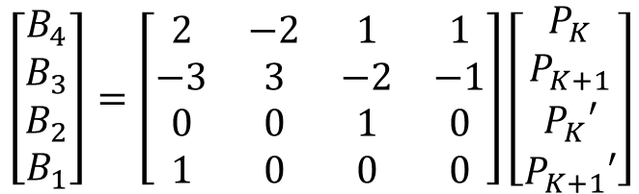
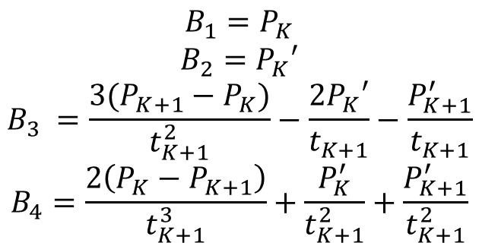

Coefficient matrix
$$B_{1}=P_{K}$$
$$B_{2}=P_{K}′$$
$$B_{3} =\frac{3(P_{K+1}−P_{K})}{t_{K+1}^{2}}−\frac{2P_{K}′}{t_{K+1}}−\frac{P_{K+1}^{′}}{t_{K+1}}$$
$$B_{4}=\frac{2\left(P_{K}−P_{K+1}\right)}{t_{K+1}^{3}}+\frac{P_{K}^{′}}{t_{K+1}^{2}}+\frac{P_{K+1}^{′}}{t_{K+1}^{2}}$$
$$\left[\begin{aligned}B_{4} \\ B_{3} \\ B_{2} \\ B_{1}\end{aligned}\right]=\left[\begin{matrix}2 & −2 & 1 & 1 \\ −3 & 3 & −2 & −1 \\ 0 & 0 & 1 & 0 \\ 1 & 0 & 0 & 0\end{matrix}\right]\left[\begin{matrix}P_{K} \\ P_{K+1} \\ P_{K}′ \\ P_{K+1}′\end{matrix}\right]$$
$$1≤K≤n−1$$

Slide 10


Normalized Parameters
$$\left[\begin{matrix}t_{3} & 2(t_{2}+t_{3}) & t_{2} & 0 & & \\ & t_{4} & 2(t_{3}+t_{4}) & t_{3} & & \\ & & t_{5} & 2(t_{4}+t_{5}) & t_{4} & \\ & & & . & . & . \\ & & & & . & . \\ & & & & & .\end{matrix}\right]\left[\begin{matrix}P_{1}′ \\ P_{2}′ \\ P_{3}′ \\ . \\ . \\ P_{n}′\end{matrix}\right]=$$
$$\left[\begin{matrix}\frac{3}{t_{2}t_{3}}\left[t_{2}^{2}\left(P_{3}−P_{2}\right)+t_{3}^{2}(P_{2}−P_{1})\right] \\ . \\ . \\ . \\ . \\ \frac{3}{t_{n−1}t_{n}}\left[t_{n−1}^{2}\left(P_{n}−P_{n−1}\right)+t_{n}^{2}(P_{n−1}−P_{n−2})\right]\end{matrix}\right]$$
$$MP^{′}=B$$
Dimensions of these matrices?

Slide 11
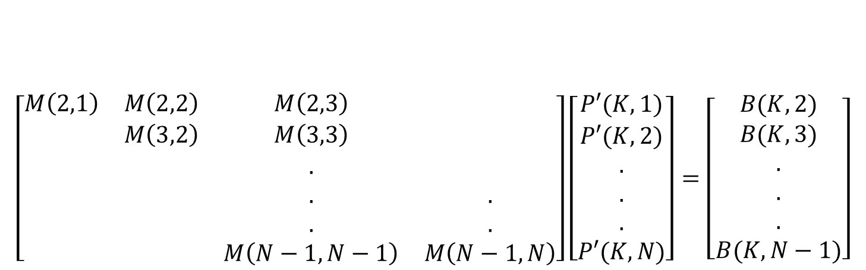
Normalized Parameters
$$\left[\begin{matrix}M\left(2,1\right) & M\left(2,2\right) & M\left(2,3\right) & \\ & M\left(3,2\right) & M\left(3,3\right) & \\ & & . & \\ & & . & . \\ & & . & . \\ & & M\left(N−1,N−1\right) & M\left(N−1,N\right)\end{matrix}\right]\left[\begin{matrix}P′(K,1) \\ P′(K,2) \\ . \\ . \\ . \\ P′(K,N)\end{matrix}\right]=\left[\begin{matrix}B(K,2) \\ B(K,3) \\ . \\ . \\ . \\ B(K,N−1)\end{matrix}\right]$$
Non-zero terms in the M matrix are at the indices
How to make M a square matrix?

Slide 12
Choice of boundary condition
The choice of boundary condition depends upon
if only a few data points are known
if physical constraints require accurate control of the curve shape at the ends.
Specify the two end tangent vectors

Slide 13
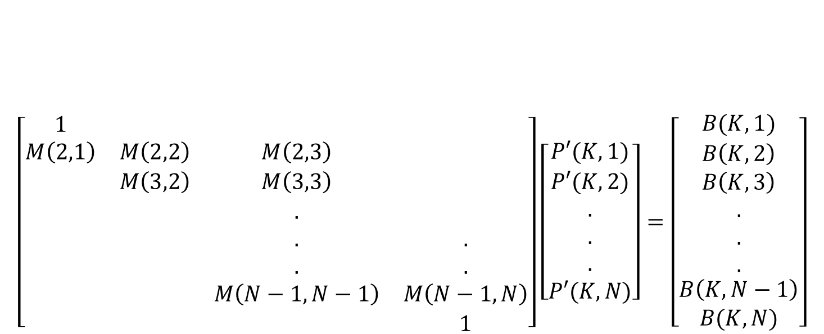
Boundary condition
$$\left[\begin{matrix}1 & & & \\ M\left(2,1\right) & M\left(2,2\right) & M\left(2,3\right) & \\ & M\left(3,2\right) & M\left(3,3\right) & \\ & & . & \\ & & . & . \\ & & . & . \\ & & M\left(N−1,N−1\right) & M\left(N−1,N\right) \\ & & & 1\end{matrix}\right]\left[\begin{matrix}P′(K,1) \\ P′(K,2) \\ . \\ . \\ . \\ P′(K,N)\end{matrix}\right]=\left[\begin{matrix}B(K,1) \\ B\left(K,2\right) \\ B\left(K,3\right) \\ . \\ . \\ . \\ \begin{aligned}B\left(K,N−1\right) \\ B(K,N)\end{aligned}\end{matrix}\right]$$

Slide 14
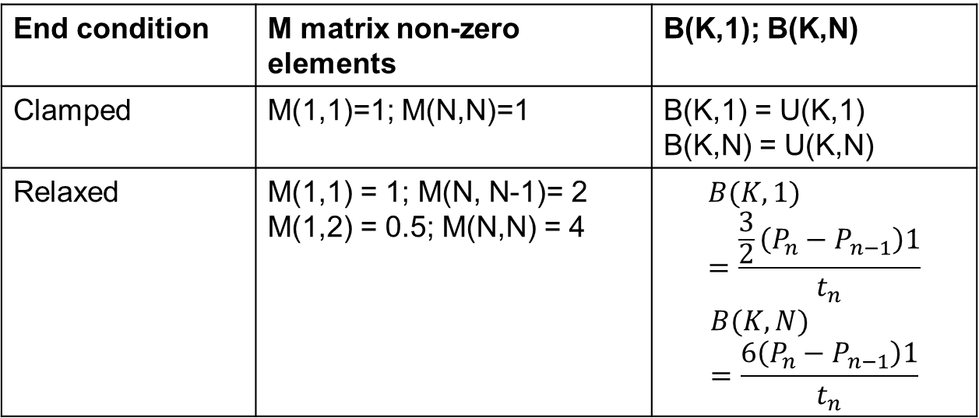
End conditions
End condition | M matrix non-zero elements | B(K,1); B(K,N)
Clamped | M(1,1)=1; M(N,N)=1 | B(K,1) = U(K,1) B(K,N) = U(K,N)
Relaxed | M(1,1) = 1; M(N, N-1)= 2 M(1,2) = 0.5; M(N,N) = 4 | $$B(K,1) =\frac{\frac{3}{2}\left(P_{n}−P_{n−1}\right)1}{t_{n}}$$ $$B(K,N) =\frac{6\left(P_{n}−P_{n−1}\right)1}{t_{n}}$$

Slide 15


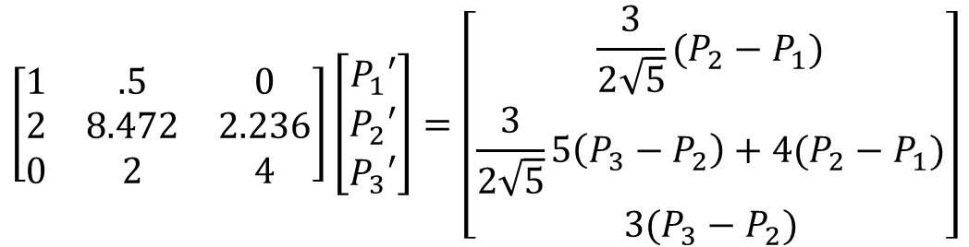
Numerical Problem
Assume that the three position vectors
$$P_{1}\left(0,0\right);P_{2}\left(1,2\right);P_{3}(3,2)$$
We wish to determine a cubic spline fit through these points using relaxed end conditions, i.e. $\frac{d^{2}P}{dt^{2}}=0$.
$$\left[\begin{matrix}1 & .5 & 0 \\ 2 & 8.472 & 2.236 \\ 0 & 2 & 4\end{matrix}\right]\left[\begin{matrix}P_{1}′ \\ P_{2}′ \\ P_{3}′\end{matrix}\right]=\left[\begin{matrix}\frac{3}{2\sqrt{5}}(P_{2}−P_{1}) \\ \frac{3}{2\sqrt{5}}5\left(P_{3}−P_{2}\right)+4(P_{2}−P_{1}) \\ 3(P_{3}−P_{2})\end{matrix}\right]$$

Slide 16
Thank you
Next Lecture: Bezier Curve

