Slide 1

CS552: Computer Graphics
Lecture 19: Bezier Curves

Slide 2
Recap
Cubic polynomial
Properties of cubic polynomials

Slide 3
Objective
After completing this lecture students will be able to
Differentiate between Cubic spline and Bezier curves
Prove important properties of Bezier curve

Slide 4
Bezier Curves
Different choices of basis functions give different curves
Choice of basis determines how the control points influence the curve
In Hermite case, two control points define endpoints, and two more define parametric derivatives
For Bezier curves, two control points define endpoints, and two control the tangents at the endpoints in a geometric way

Slide 5
Bezier Curves
The user supplies d control points, p_{i}
Write the curve as:
The functions B_{i}^{d} are the Bernstein polynomials of degree d
This equation can be written as a matrix equation also

Slide 6
Bezier Basis Functions for d=3

Slide 7
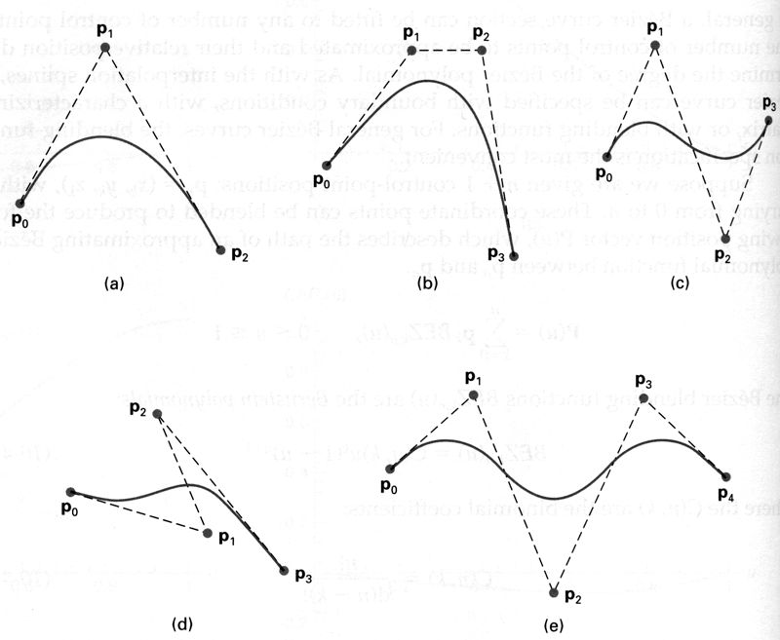
Some Bezier Curves

Slide 8
Bezier Curve Properties
The first and last control points are interpolated
Affine invariant
The curve lies entirely within the convex hull of its control points
The tangent to the curve at the first control point is along the line joining the first and second control points
The tangent at the last control point is along the line joining the second last and last control points

Slide 9
Thank you
Next Lecture: Bezier Curve

