Slide 1

CS552: Computer Graphics
Lecture 20: Bezier Curves

Slide 2
Recap
Bezier curve
Properties of Bezier curve

Slide 3
Objective
After completing this lecture students will be able to
Explain de Casteljau’s Algorithm
Derive mathematical formulation for
Splitting a Bezier curve
Elevating its degree
Joining a pair of curves
Solve numerical problems

Slide 4



Bézier Curve
$$P\left(t\right)= \sum_{i=0}^{n}{P_{i}B_{i}^{n}(t)}$$
Bézier equation
$P_{i}$= Control points
$B_{i}^{n}(t)$= Bernstein Basis = $\left({n \atop i}\right)t^{i}{\left(1−t\right)}^{n−i}$
Construction of Bézier Curves
Properties of Bézier Curves
Interpolation property
Invariance property
Gradient property
Convexity

Slide 5
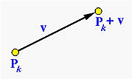
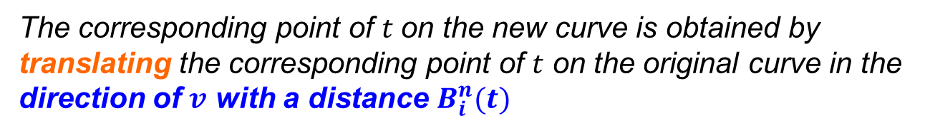




Movement of the Control Point
$Pk$ is moved to a new position $Pk+v$
$$P\left(t\right)= \sum_{i=0}^{n}{P_{i}B_{i}^{n}(t)}$$
$$P_{0}, P_{1}, …, P_{k}, …, P_{n}$$
$$P_{0}, P_{1}, …, P_{k+v}, …, P_{n}$$
What can we say for the transformed curve $P′\left(t\right)$ ?
The corresponding point of $t$on the new curve is obtained by translating the corresponding point of $t$ on the original curve in the direction of $v$ with a distance $B_{i}^{n}(t)$
Show Animation

Slide 6
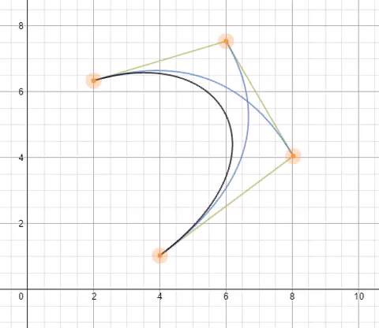
Example

Slide 7
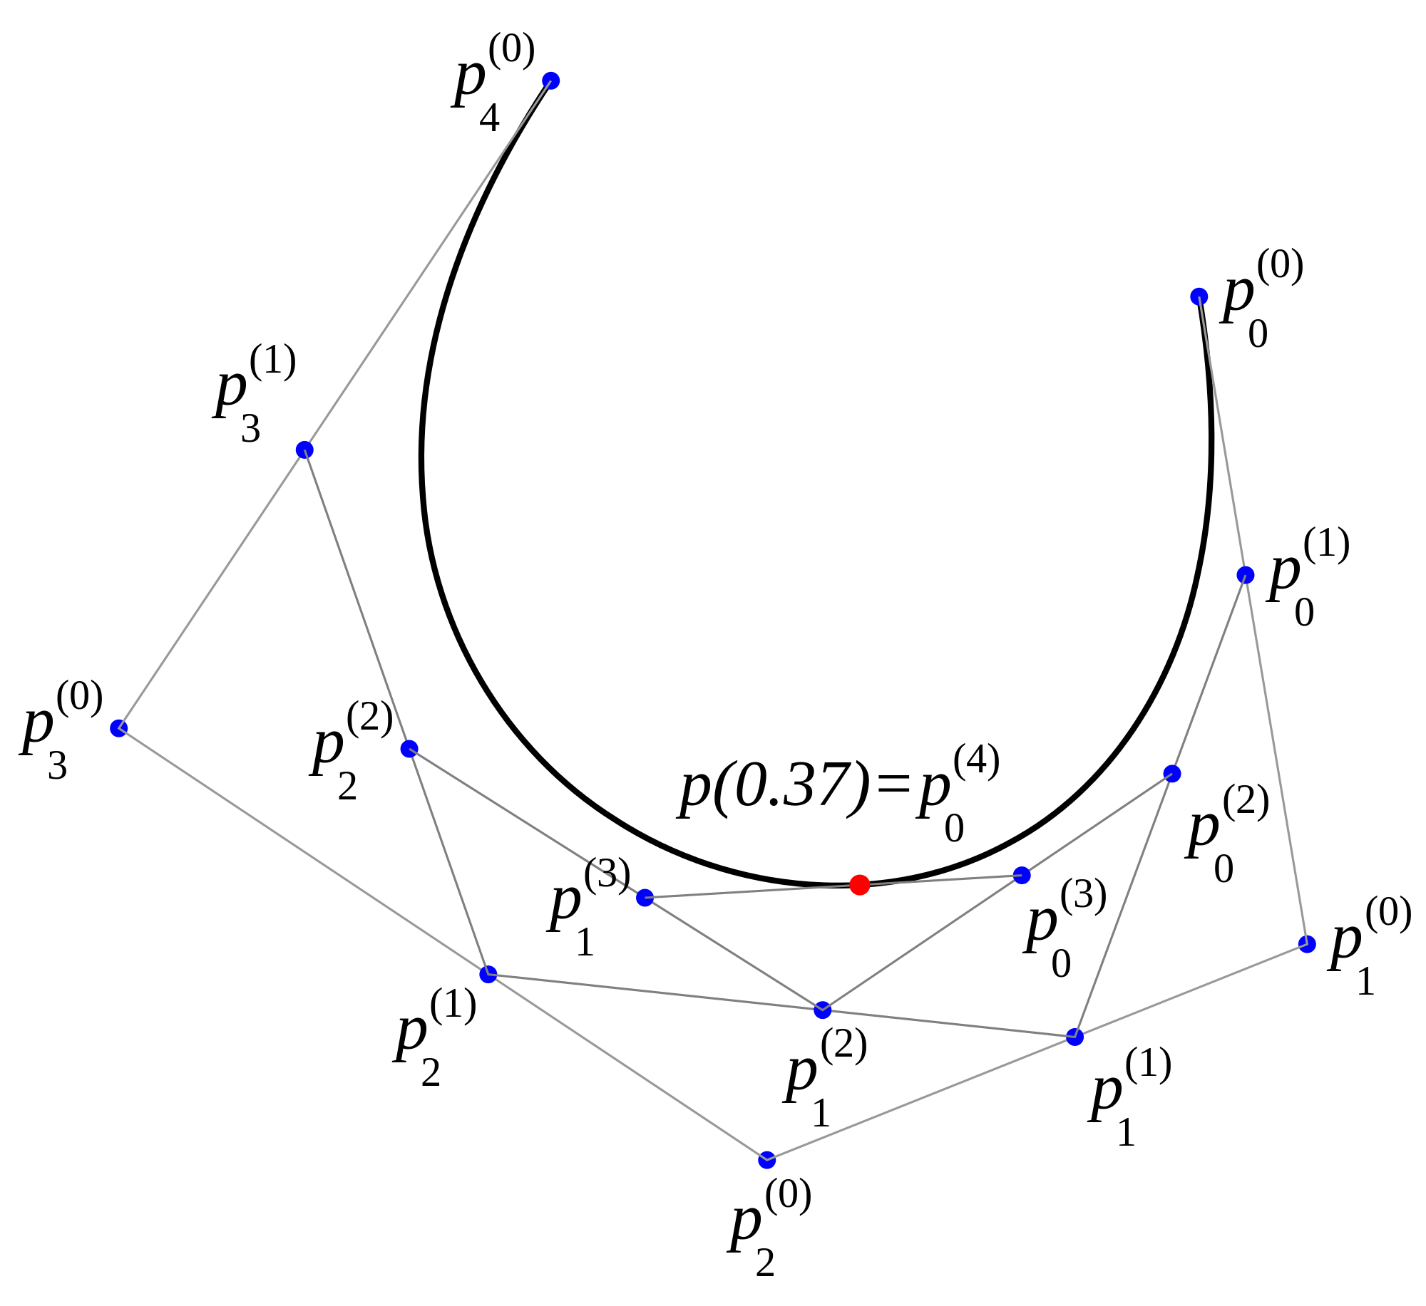
De Casteljau's Algorithm: Illustration
Play Animation

Slide 8


De Casteljau's Algorithm
Task is to find the point $P(t)$ on the curve for a particular t
Input: Array $P[0:n]$ of $n+1$points and real number $t$ in $[0,1]$
Output: Point on curve, $P(t)$
Working: Point array $Q[0:n]$
for i = 0 to n do
Q[i] = P[i]; // save input
for r = 1 to n do
for i = 0 to n - r do
Q[i] = (1 - u)Q[i] + u Q[i + 1];
return Q[0];

Slide 9
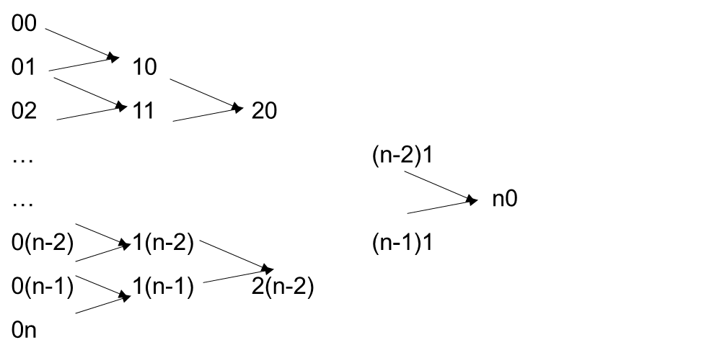

De Casteljau's Algorithm: Recurrence
$P_{i,j}=\left(1−t\right)P_{i−1,j}+uP_{i−1,j+1}$
for $i=1,…,n;j=1,…,n−i$
function deCasteljau(i,j) begin if i = 0 then return P_{0,j} else return (1-u)*
deCasteljau(i-1,j)
+
u* deCasteljau(i-1,j+1)
end

Slide 10
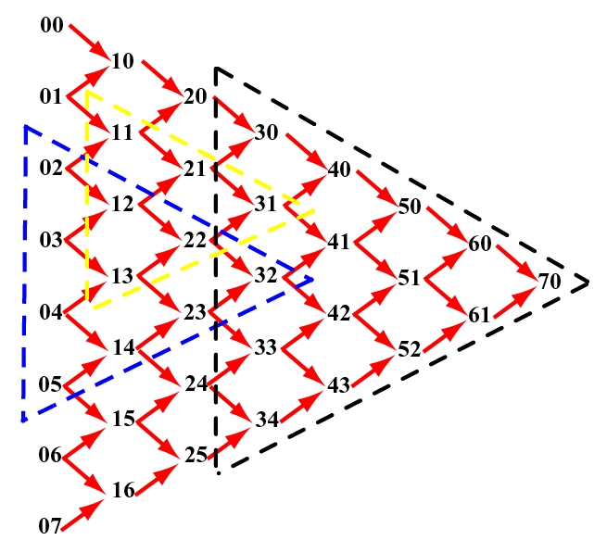
De Casteljau's Algorithm

Slide 11
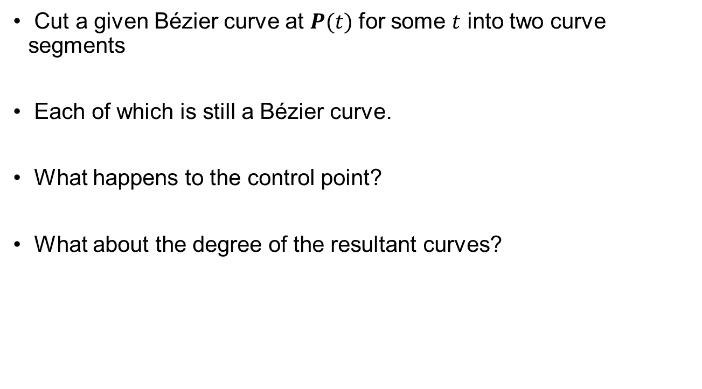
Subdividing a Bézier Curve
Cut a given Bézier curve at $P(t)$for some $t$ into two curve segments
Each of which is still a Bézier curve.
What happens to the control point?
What about the degree of the resultant curves?

Slide 12
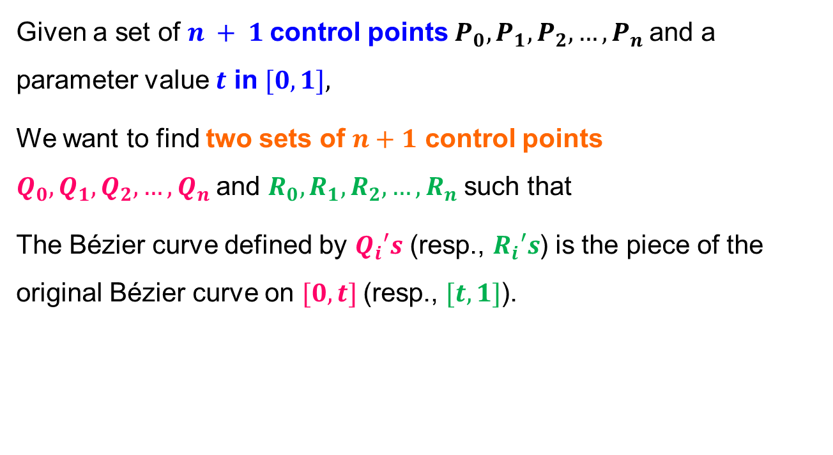
Problem statement
Given a set of $n + 1$control points $P_{0}, P_{1}, P_{2}, …, P_{n}$and a parameter value $t$ in $[0,1],$
We want to find two sets of $n+1$ control points $Q_{0}, Q_{1}, Q_{2}, …, Q_{n}$and $R_{0}, R_{1}, R_{2}, …, R_{n}$such that
The Bézier curve defined by $Q_{i}′s$ (resp., $R_{i}′s$) is the piece of the original Bézier curve on $[0,t]$(resp., $[t,1]$).

Slide 13
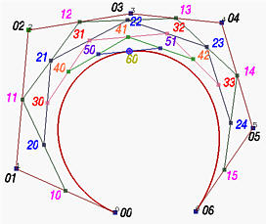
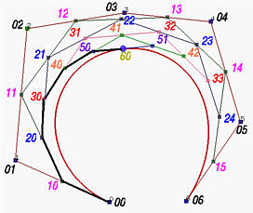
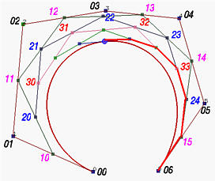
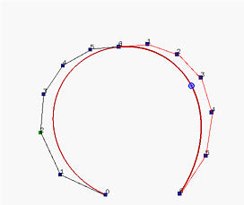
Subdividing Bezier Curve
Play Animation

Slide 14
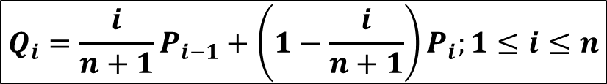
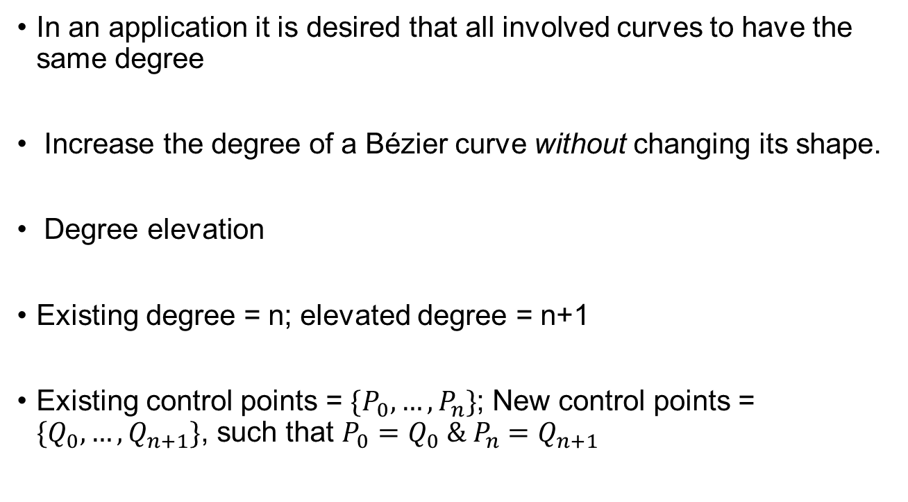
Degree Elevation
In an application it is desired that all involved curves to have the same degree
Increase the degree of a Bézier curve without changing its shape.
Degree elevation
Existing degree = n; elevated degree = n+1
Existing control points = $\{P_{0},…, P_{n}\}$; New control points = $\{Q_{0},…, Q_{n+1}\}$, such that $P_{0}=Q_{0} \& P_{n}=Q_{n+1}$
$$Q_{i}=\frac{i}{n+1}P_{i−1}+\left(1−\frac{i}{n+1}\right)P_{i};1≤i≤n$$

Slide 15
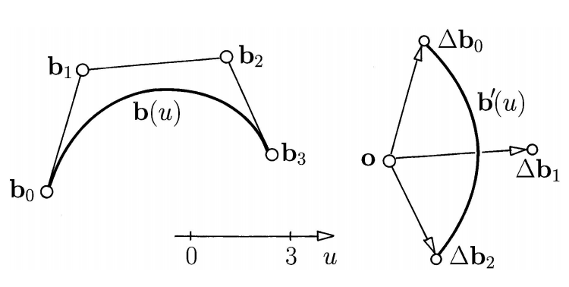
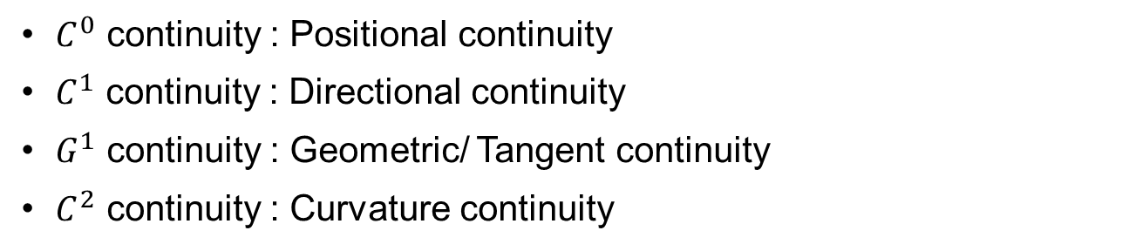
Joining of Two Bezier Curves
Hodograph
$C^{0}$ continuity : Positional continuity
$C^{1}$ continuity : Directional continuity
$G^{1}$ continuity : Geometric/ Tangent continuity
$C^{2}$ continuity : Curvature continuity

Slide 16
Thank you
Next Lecture: B Splines

