Slide 1

CS552: Computer Graphics
Lecture 21: B Spline Curve

Slide 2

Recap
Bezier curve
Properties
Rendering
De Casteljau's Algorithm
Subdividing Bezier Curve
Continuity of curve
$C^{0}$
$C^{1}$
$C^{2}$

Slide 3
Objective
After completing this lecture, students will be able to
Explain the issues with Bezier curve representation
Explain the advantage of B spline curve
Calculate the B-spline basis of different degrees and knot intervals

Slide 4
Bezier Curves: Issues
No local control
Degree of curve is fixed by the number of control points

Slide 5
B Spline
Each control point has a unique basis function
Local control is facilitated

Slide 6
B spline Curves
The user supplies: the degree p, n+1 control points, and m+1 knot vectors
Write the curve as:
The functions N_{i}^{p} are the B-Spline basis functions
B-Spline Animation

Slide 7

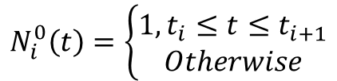
B Spline Basis
The domain is subdivided by knots, and
Basis functions are not non-zero on the entire interval.
Some knot spans may not exist (Repeat)
Simple / Multiple Knots
Uniform/ Non-Uniform Knots
The i-th B-spline basis function of degree p
$$N_{i}^{0}\left(t\right)=\left\{\begin{aligned}1, t_{i}≤t≤t_{i+1} \\ Otherwise\end{aligned}\right.$$
B-Spline Basis Plots
$$N_{i}^{p}\left(t\right)=\frac{{t− t}_{i}}{t_{i+p}−t_{i}}N_{i}^{p−1}\left(t\right)+\frac{t_{i+p+1}−t}{t_{i+p+1}−t_{i}}N_{i+1}^{p−1}\left(t\right)$$
Cox-de Boor recursion formula

Slide 8
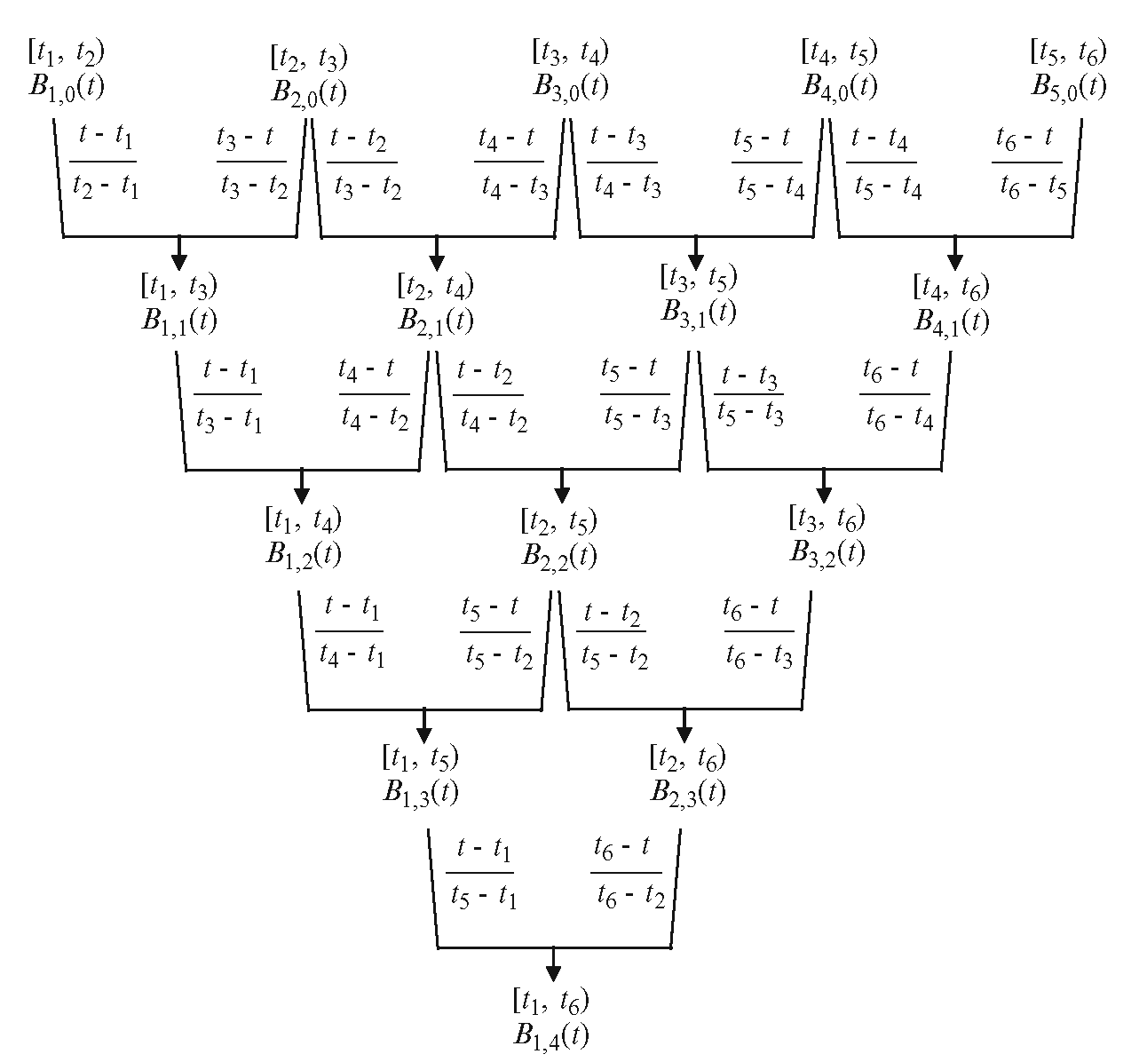

B Spline Basis: Observations 1
Non-zero domain of a basis function
Basis function $Ni,p(u)$ is non-zero on $[ti, t_{i+p+1})$

Slide 9









B Spline Basis: Observations 2
Influence of the basis function coefficients
$$t$$
$$t_{i}$$
$$t_{i+1}$$
$$t_{i+p}$$
$$t_{i+p+1}$$
$$t_{i+p}−t_{i}$$
$$t−t_{i}$$
$$t_{i+p+1}−t$$
$$t_{i+p+1}−t_{i+1}$$
Linear combination of two intervals, where both are linear in $u$

Slide 10







Example
Suppose the knot vector is U = { 0, 0.25, 0.5, 0.75, 1 }.
Hence, m = 4 and u₀ = 0, u₁ = 0.25, u₂ = 0.5, u₃ = 0.75 and u₄ = 1.
Degree | Basis Function | Range | Equation
0
1
$$N_{0}^{0}$$
$$N_{1}^{0}$$
$$N_{2}^{0}$$
$$N_{3}^{0}$$
$$N_{0}^{1}$$
$$N_{1}^{1}$$
$$N_{2}^{1}$$

Slide 11
Thank you
Next Lecture: B-Spline Curve

