Slide 1

CS552: Computer Graphics
Lecture 22: B Spline Curve Properties

Slide 2
Recap
B Spline
Degree
Knots
Local control
B Spline Basis functions
Interval
Derivative

Slide 3
Objective
After completing this lecture, students will be able to
Derive mathematical expressions for different properties of the B-Spline curve
Solve problems related to B Splines

Slide 4
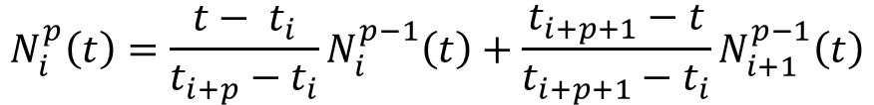
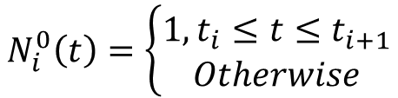
B spline Curves
The user supplies: the degree p, n+1 control points, and m+1 knot vectors
Write the curve as:
The functions N_{i}^{p} are the B-Spline basis functions
$$N_{i}^{0}\left(t\right)=\left\{\begin{aligned}1, t_{i}≤t≤t_{i+1} \\ Otherwise\end{aligned}\right.$$
Cox-de Boor recursion formula
$$N_{i}^{p}\left(t\right)=\frac{{t− t}_{i}}{t_{i+p}−t_{i}}N_{i}^{p−1}\left(t\right)+\frac{t_{i+p+1}−t}{t_{i+p+1}−t_{i}}N_{i+1}^{p−1}\left(t\right)$$

Slide 5
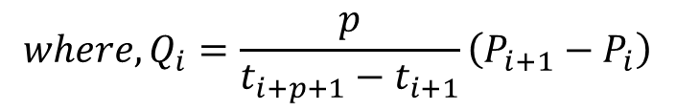
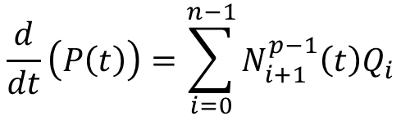
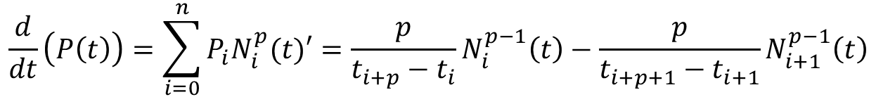
Derivatives of B Spline Curve
The derivative of each of these basis functions can be computed as follows:
$$\frac{d}{dt}\left(P\left(t\right)\right)=\sum_{i=0}^{n}{P_{i}N_{i}^{p}(t)′}=\frac{p}{t_{i+p}−t_{i}}N_{i}^{p−1}\left(t\right)−\frac{p}{t_{i+p+1}−t_{i+1}}N_{i+1}^{p−1}\left(t\right)$$
Plugging these derivatives back
$$\frac{d}{dt}\left(P\left(t\right)\right)=\sum_{i=0}^{n−1}{N_{i+1}^{p−1}\left(t\right)Q_{i}}$$
$${where, Q}_{i}=\frac{p}{t_{i+p+1}−t_{i+1}}\left(P_{i+1}−P_{i}\right)$$
Derivative of a B-spline curve is another B-spline curve of degree $p − 1$on the original knot vector with a new set of $n$control points, $Q_{0},Q_{1},…, Q_{n−1}$

Slide 6
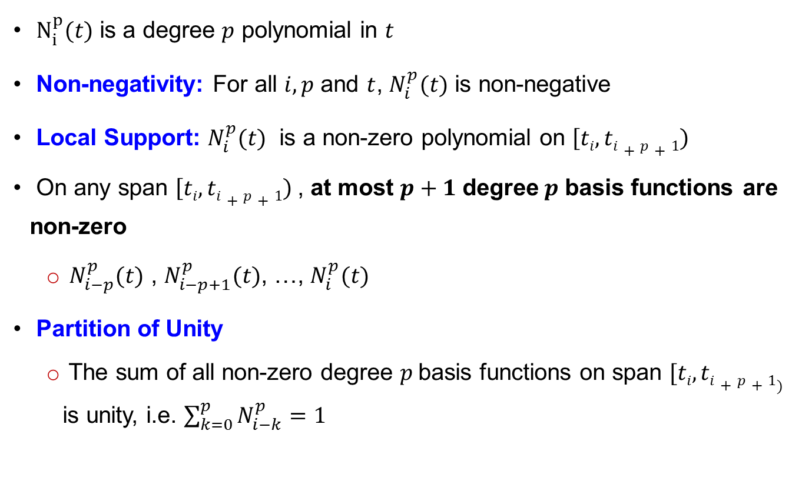
Properties of B-Spline
$N_{i}^{p}(t)$ is a degree $p$ polynomial in $t$
Non-negativity: For all $i, p$ and $t$, $N_{i}^{p}(t)$ is non-negative
Local Support: $N_{i}^{p}(t)$ is a non-zero polynomial on $\left[ti,ti+p+1\right)$
On any span $\left[ti,ti+p+1\right)$, at most $p+1$ degree$p$ basis functions are non-zero
$N_{i−p}^{p}(t)$ , $N_{i−p+1}^{p}(t)$, …, $N_{i}^{p}(t)$
Partition of Unity
The sum of all non-zero degree $p$basis functions on span $[ti, ti+p+1)$ is unity, i.e. $\sum_{k=0}^{p}{N_{i−k}^{p}=1}$

Slide 7
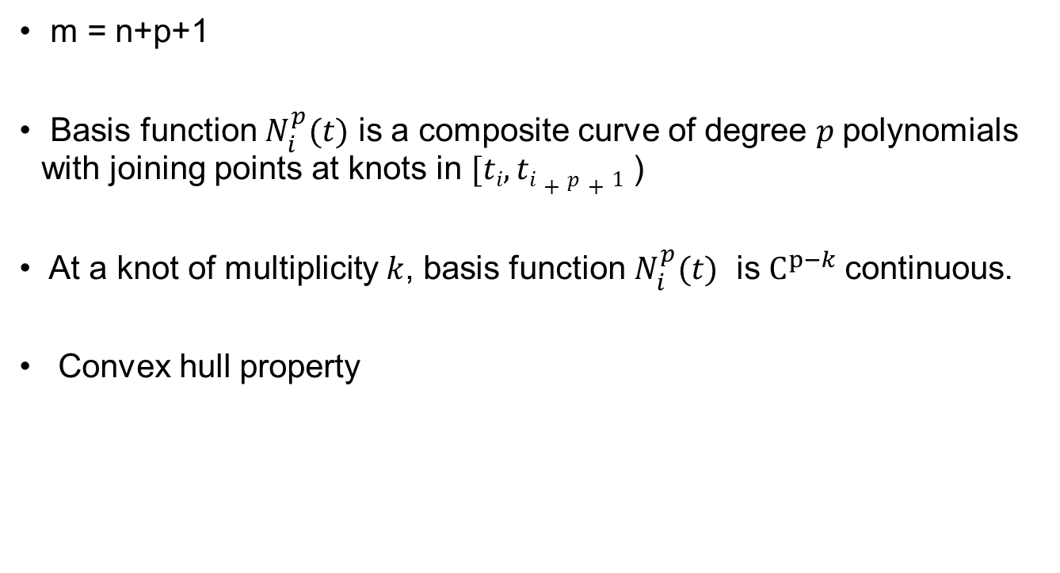
Properties of B-Spline
m = n+p+1
Basis function $N_{i}^{p}(t)$ is a composite curve of degree $p$polynomials with joining points at knots in $[ti, ti+p+1$ )
At a knot of multiplicity $k$, basis function $N_{i}^{p}(t)$ is $C^{p−k}$continuous.
Convex hull property

Slide 8
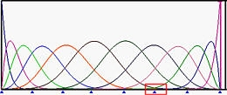
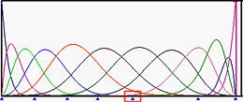
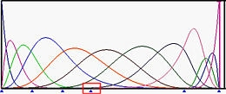
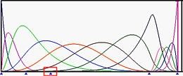
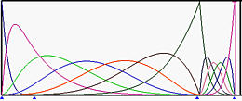

Impact of Multiple Knots
Significant impact on the computation of basis functions
Counting properties
Each knot of multiplicity $k$reduces at most $k−1$ basis functions' non-zero domain.

Slide 9
Impact of Multiple Knots
At each internal knot of multiplicity k, the number of non-zero basis functions is at most p - k + 1, where p is the degree of the basis functions.

Slide 10
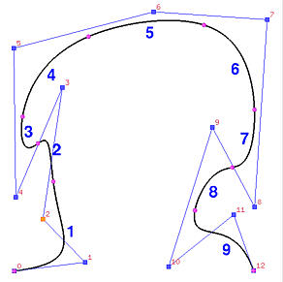
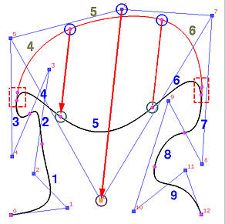
B Spline Moving Control Points
Local control scheme
p=4, n=12, m=17
Span | $$[t_{4},t_{5})$$ | $$[t_{5},t_{6})$$ | $$[t_{6},t_{7})$$ | $$[t_{7},t_{8})$$ | $$[t_{8},t_{9})$$ | $$[t_{9},t_{10})$$ | $$[t_{10},t_{11})$$ | $$[t_{11},t_{12})$$ | $$[t_{12},t_{13})$$
Segment | 1 | 2 | 3 | 4 | 5 | 6 | 7 | 8 | 9

Slide 11
B-spline Curves: Knot insertion
Adding a new knot into the existing knot vector
Without changing the shape of the curve.
m = n + p + 1
Inserting a new knot causes a new control point to be added
Some existing control points are removed and replaced with new ones by corner cutting.

Slide 12
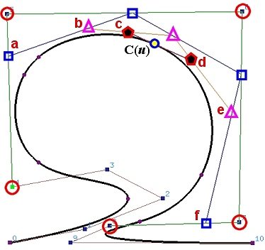
Sub-division
Follows exactly the same procedure for subdividing a Bézier curve.

Slide 13
Thank you
Next Lecture: Surface

