Slide 1

CS552: Computer Graphics
Lecture 23: Surface Representation

Slide 2
Recap
Curves
Cubic spline
Bezier
B spline

Slide 3
Objective
After completing this lecture, students will be able to
Mathematically represent a surface patches
Planar Surface
Curved Surface
Bi-linear Surface
Lofted or Ruled Surface
Solve related mathematical problems

Slide 4
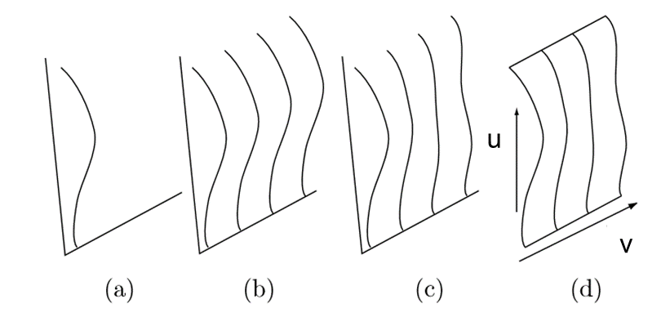
Surface
Representation of surface
Explicit
Implicit
Parametric

Slide 5
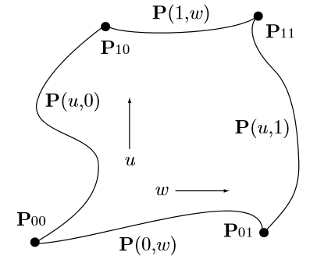



A Surface Patch
$$P(1,v)$$
Boundary curves
$$v$$
$$P(0,v)$$

Slide 6
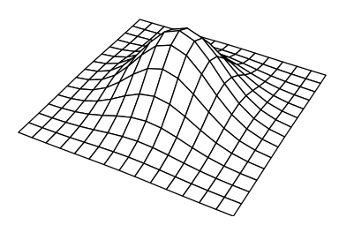
Displaying a Surface Patch
A surface patch can be displayed either as a wire frame

Slide 7
Plane Surfaces
It is possible to express points which fall on a surface in terms of two parameters (u,v)
Boundary conditions are to be specified
The derivatives of the point functions are ?
In matrix form?
Represents differential change in the uv-plane to the corresponding differential change in the xy-plane.

Slide 8
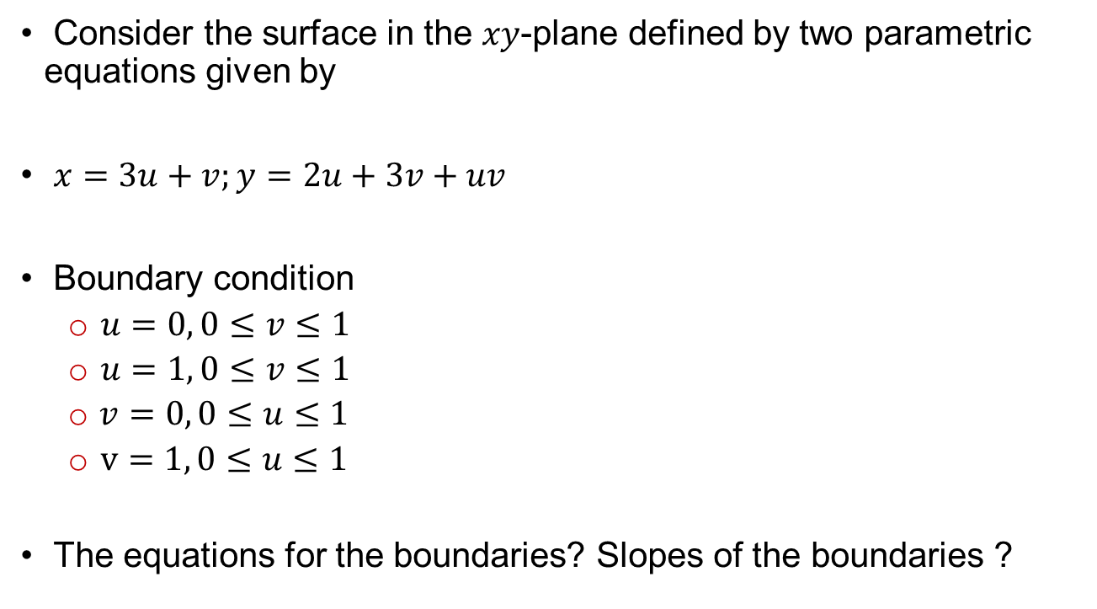
Example
Consider the surface in the $xy$-plane defined by two parametric equations given by
$x=3u+v;y=2u+3v+uv$
Boundary condition
$u=0, 0≤v≤1$
$u=1, 0≤v≤1$
$v=0, 0≤u≤1$
$v=1, 0≤u≤1$
The equations for the boundaries? Slopes of the boundaries ?

Slide 9
Curved Surface Representation
A curve is represented as a vector valued function of a single variable
A surface is represented by a bivariate vector-valued function
How to represent a curve on the surface?
How a point on the surface may be represented?

Slide 10
Bilinear Surfaces
One of the simplest surfaces is the bilinear surface.
Four comer points of the surface are given in the u,v-plane
P(0,0)
P(0,1)
P(1,0)
P(1,1)
Expression for the parametric surface?

Slide 11
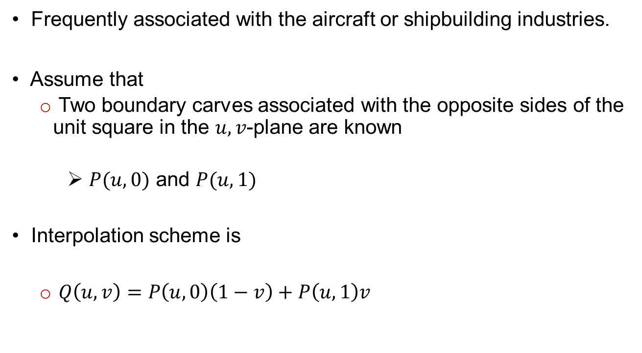
Lofted or Ruled Surfaces
Frequently associated with the aircraft or shipbuilding industries.
Assume that
Two boundary carves associated with the opposite sides of the unit square in the $u,v$-plane are known
$P(u,0)$ and $P(u,1)$
Interpolation scheme is
$Q\left(u,v\right)=P\left(u,0\right)\left(1−v\right)+P\left(u,1\right)v$

Slide 12
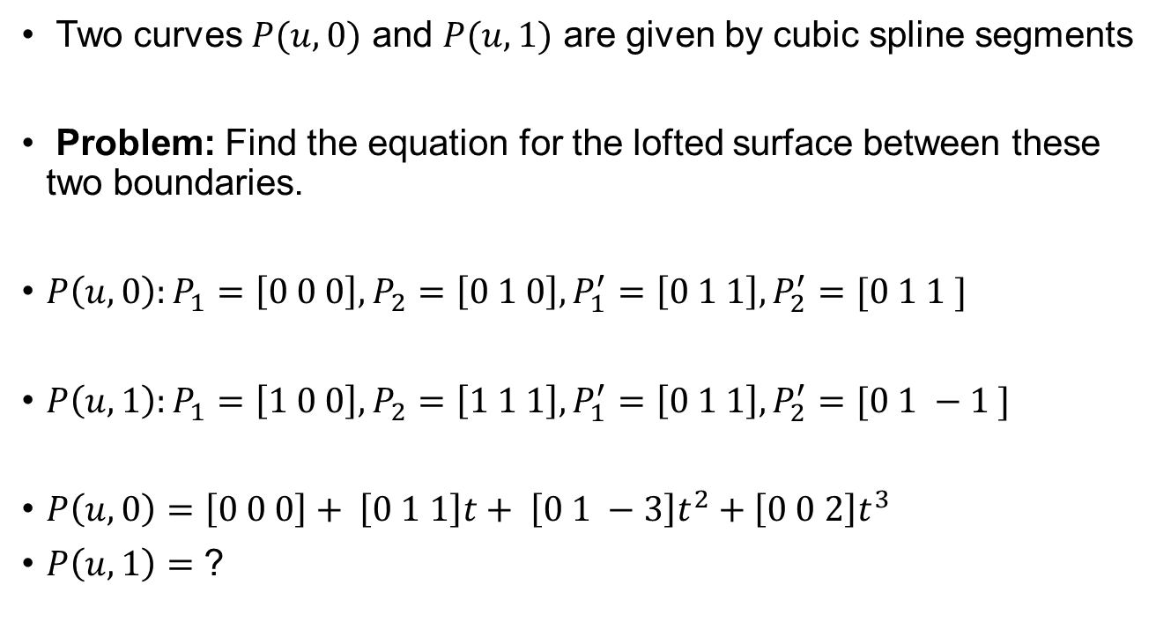
Example
Two curves $P(u,0)$ and $P(u,1)$ are given by cubic spline segments
Problem: Find the equation for the lofted surface between these two boundaries.
$P\left(u,0\right):P_{1}=\left[0 0 0\right], P_{2}=\left[0 1 0\right], P_{1}^{′}=\left[0 1 1\right], P_{2}^{′}=[0 1 1 ]$
$P\left(u,1\right):P_{1}=\left[1 0 0\right], P_{2}=\left[1 1 1\right], P_{1}^{′}=\left[0 1 1\right], P_{2}^{′}=[0 1 −1 ]$
$P\left(u,0\right)=\left[0 0 0\right]+ \left[0 1 1\right]t+ \left[0 1 −3\right]t^{2}+\left[0 0 2\right]t^{3}$
$P\left(u,1\right)=$ ?

Slide 13
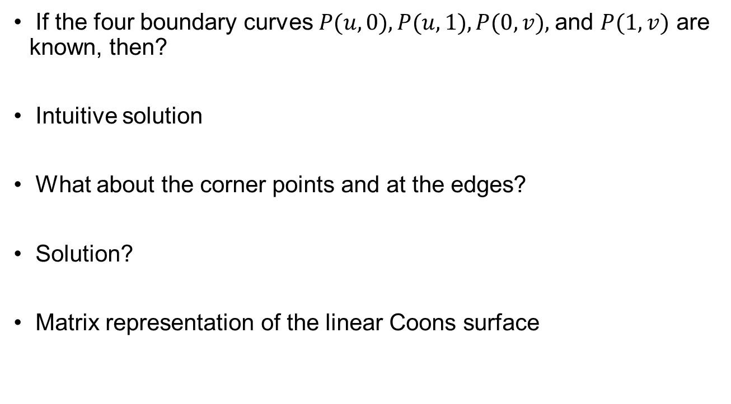
Linear Coons Surface
If the four boundary curves $P(u,0), P(u,1), P(0,v),$and $P(1,v)$ are known, then?
Intuitive solution
What about the corner points and at the edges?
Solution?
Matrix representation of the linear Coons surface

Slide 14








Example
$$Q(0.5,0.5)$$
$$z$$
$$P(u,1)$$
$$P(0,v)$$
$$P(u,0)$$
$$P(1,v)$$
$$y$$
$$x$$

Slide 15
Thank you
Next Lecture: Surface representation

