Slide 1

CS552: Computer Graphics
Lecture 25: Surface Representation

Slide 2
Recap
Bi-Cubic Surface representation
u- edge
v- edge
Combination with correction
Subdividing bi-cubic surface
Representing with a new set of control points
Limits can be specified

Slide 3
Objective
After completing this lecture, students will be able to
Derive the mathematical expressions for
Bezier surface
B-spline surface
Construct Bezier surface
Calculate expressions for
Surface subdivision
Degree elevation

Slide 4


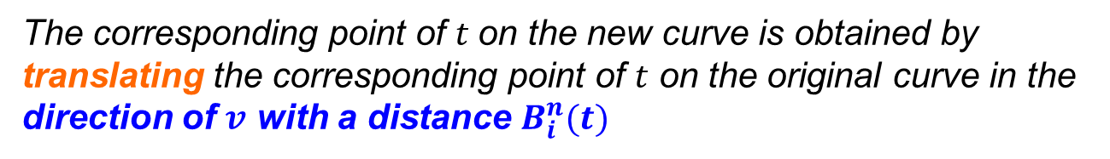

Bézier Curve
Bézier equation
$$P\left(t\right)= \sum_{i=0}^{n}{P_{i}B_{i}^{n}(t)}$$
$B_{i}^{n}(t)$= Bernstein Basis = $\left({n \atop i}\right)t^{i}{\left(1−t\right)}^{n−i}$
$P_{i}$= Control points
The corresponding point of $t$on the new curve is obtained by translating the corresponding point of $t$ on the original curve in the direction of $v$ with a distance $B_{i}^{n}(t)$

Slide 5

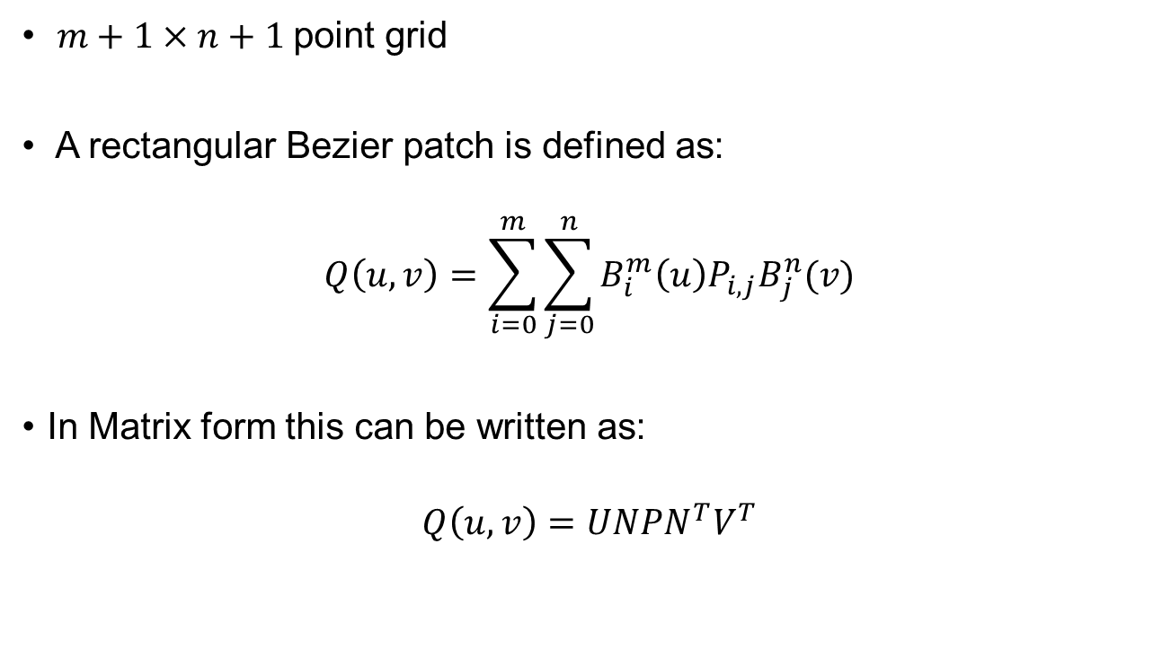


Bezier Surface
$m+1×n+1$point grid
A rectangular Bezier patch is defined as:
$$Q\left(u,v\right)=\sum_{i=0}^{m}{\sum_{j=0}^{n}{B_{i}^{m}\left(u\right){P_{i,j}B}_{j}^{n}(v)}}$$
In Matrix form this can be written as:
$$Q\left(u,v\right)=UNPN^{T}V^{T}$$
$$U=[u^{m},u^{m−1},…, u,1]$$
$$V=[v^{n},v^{n−1},…, v,1]$$
$$N=?$$

Slide 6

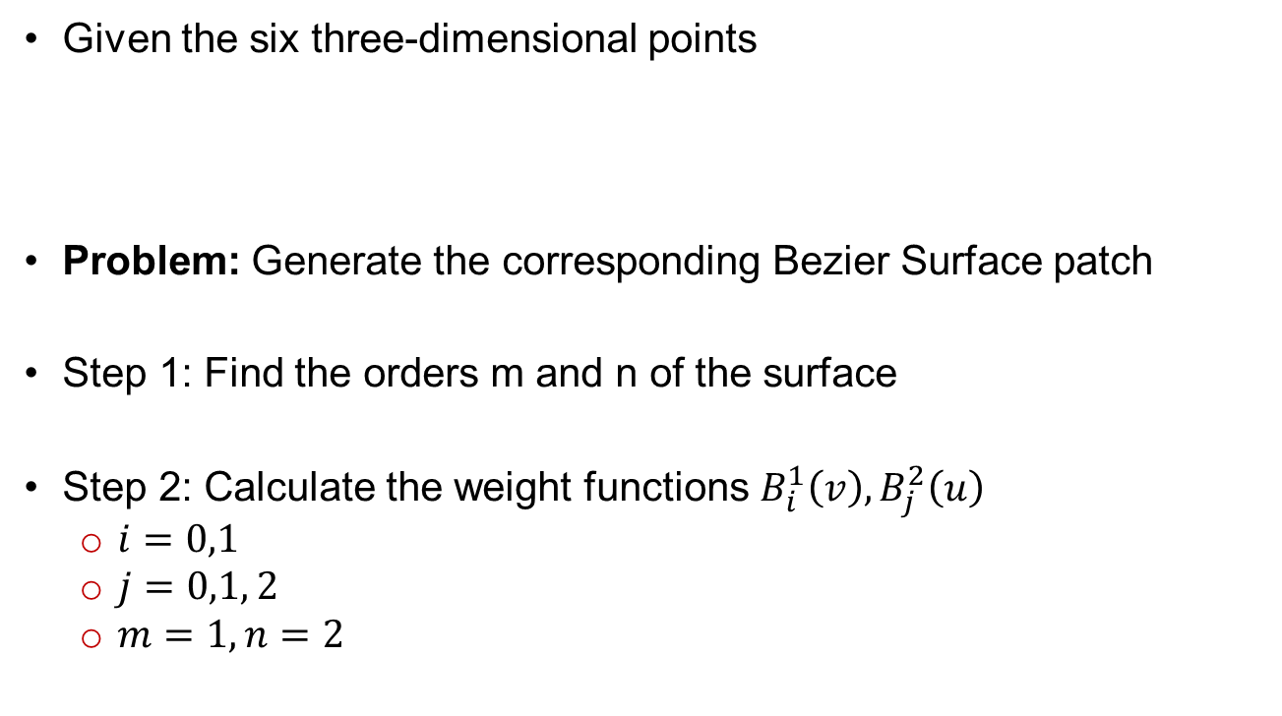
Example
Given the six three-dimensional points
Problem: Generate the corresponding Bezier Surface patch
Step 1: Find the orders m and n of the surface
Step 2: Calculate the weight functions $B_{i}^{1}\left(v\right), B_{j}^{2}\left(u\right)$
$i=0,1$
$j=0,1, 2$
$m=1, n=2$

Slide 7
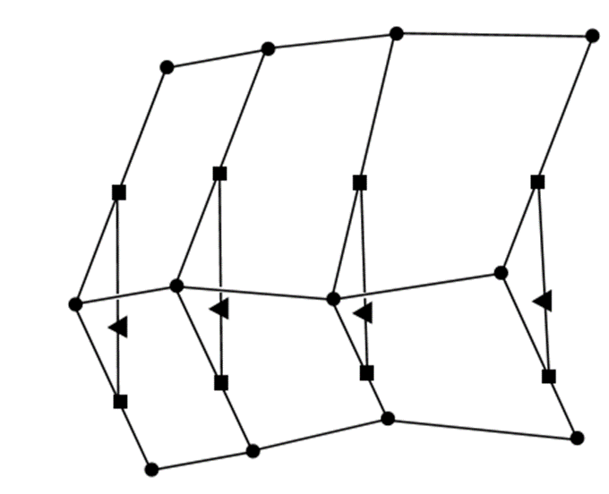
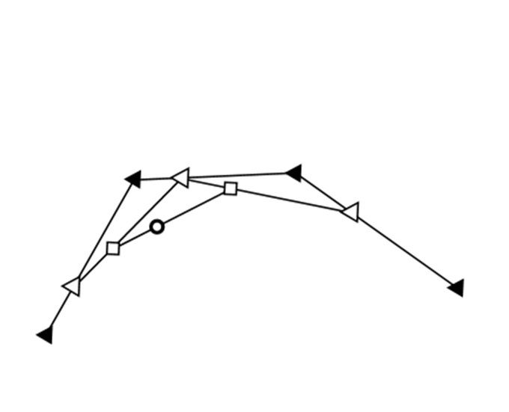
Scaﬀolding Construction
The scaﬀolding construction (or de Casteljau algorithm)
Extension of the idea discussed in Bezier curves

Slide 8
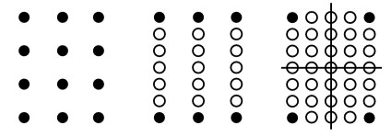
Subdividing Rectangular Patches
To change the surface shape, if there are not enough points
Just adding points is not a good solution because
this changes the shape of the surface
A better solution is to subdivide the patch into four connected surface patches
Step 1: Select values for u and w
Step 2: Apply de Casteljau Algo (column wise)
Step 3: Apply de Casteljau Algo (row wise)

Slide 9
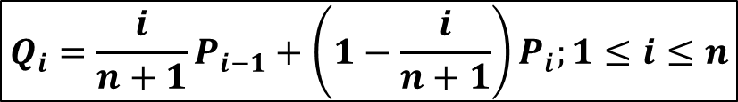
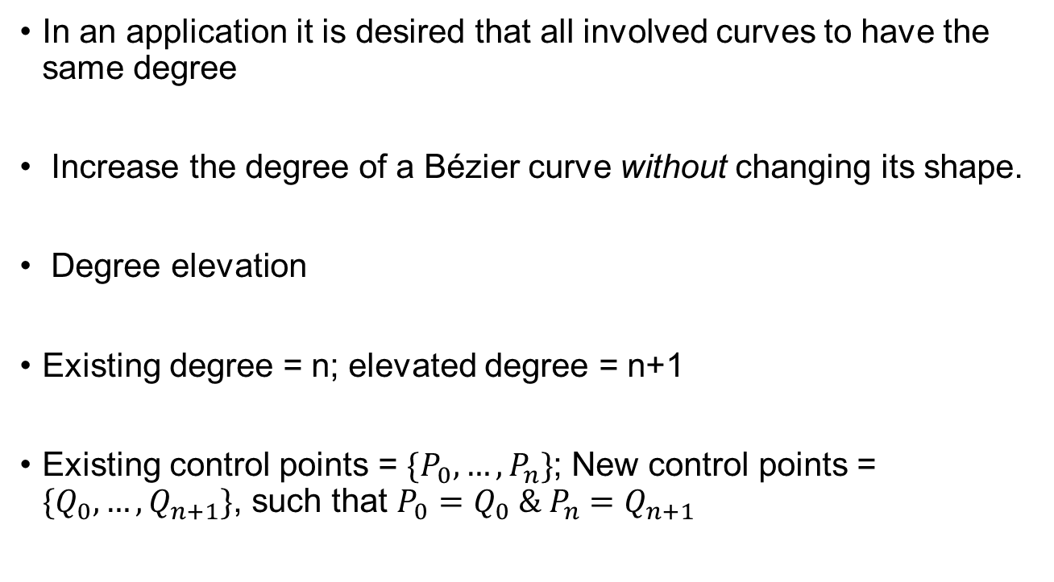
Degree Elevation
In an application it is desired that all involved curves to have the same degree
Increase the degree of a Bézier curve without changing its shape.
Degree elevation
Existing degree = n; elevated degree = n+1
Existing control points = $\{P_{0},…, P_{n}\}$; New control points = $\{Q_{0},…, Q_{n+1}\}$, such that $P_{0}=Q_{0} \& P_{n}=Q_{n+1}$
$$Q_{i}=\frac{i}{n+1}P_{i−1}+\left(1−\frac{i}{n+1}\right)P_{i};1≤i≤n$$

Slide 10
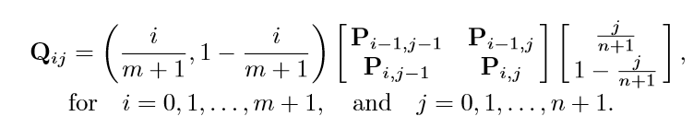
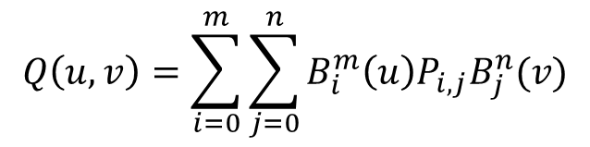

Degree Elevation for Surface
Extension of the idea discussed in case of curves
Bezier patch of degree $m×n$
Definition:
Degree elevated patch is defined by (m+2), (n+2) control points
$$Q\left(u,v\right)=\sum_{i=0}^{m}{\sum_{j=0}^{n}{B_{i}^{m}\left(u\right){P_{i,j}B}_{j}^{n}(v)}}$$

Slide 11

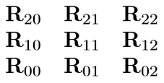
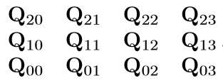

Example
Starting with the 2×3 control points
Elevation: 1×2 to 2×3

Slide 12
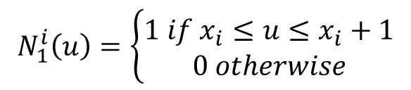

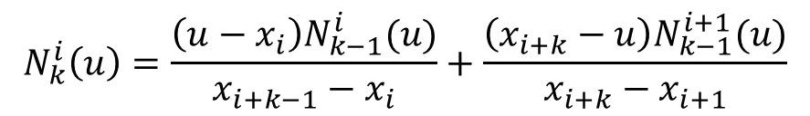
B-Spline Surface
B-Spline surface can be represented as:
$$Q\left(u,v\right)=\sum_{i=0}^{m}{\sum_{j=0}^{n}{B_{j+1}^{i+1}N_{k}^{i}\left(u\right)M_{L}^{j}\left(v\right)}}$$
$$N_{1}^{i}\left(u\right)=\left\{\begin{aligned}1 if x_{i}≤u≤x_{i}+1 \\ 0 otherwise\end{aligned}\right.$$
$$N_{k}^{i}\left(u\right)=\frac{\left(u−x_{i}\right)N_{k−1}^{i}(u)}{x_{i+k−1}−x_{i}}+\frac{\left(x_{i+k}−u\right)N_{k−1}^{i+1}(u)}{x_{i+k}−x_{i+1}}$$

Slide 13
Thank you
Next Lecture: Surface Representation

