Slide 1

CS552: Computer Graphics
Lecture 27: Solid Modeling

Slide 2
Recap
Curves and Surfaces
Parametric representation
Control points
Basis functions
Local and global control
Smoothness
Sub-division
Degree elevation
Sweep/ Revolution

Slide 3
Objective
After completing this lecture, students will be able to
Explain different ways of representing solid objects
Solve mathematical problems

Slide 4
What is solid modeling?
It is a consistent set of principles for mathematical and computer modeling of three-dimensional solids.
It is different from related areas of geometric modeling and computer graphics by its emphasis on physical fidelity.
Together, the principles of geometric and solid modeling
Form the foundation of computer-aided design (CAD)
Support the creation, exchange, visualization, animation, interrogation, and annotation of digital models of physical objects.

Slide 5
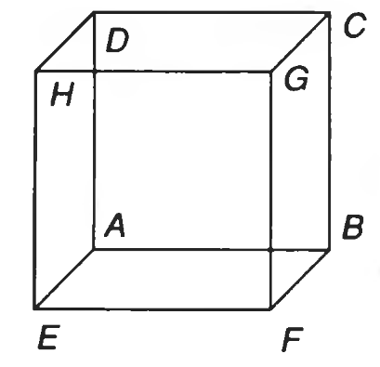
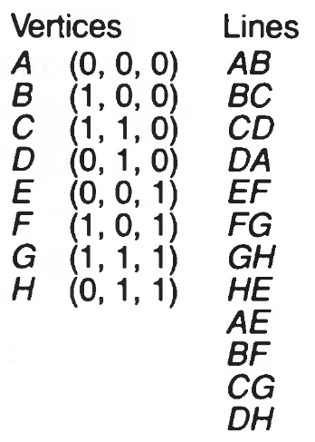
Representing Solids
Solid objects may not be adequately represented by the primitives

Slide 6
Properties of solid representation
Domain of representation
Representation should ideally be unambiguous
Complete
Unique
Accurate
Closure
Compact

Slide 7
Various representation techniques
Regularized Boolean set operations
Primitive instancing
Sweep representations
B-reps
Spatial-partitioning
Constructive Solid Geometry (CSG)

Slide 8
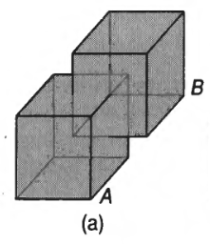
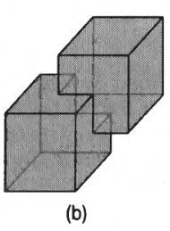
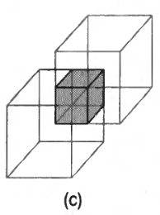
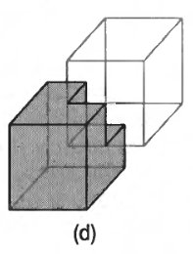
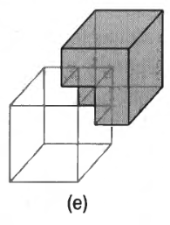
Regularized Boolean set operations

Slide 9
Intersection of two cubes

Slide 10
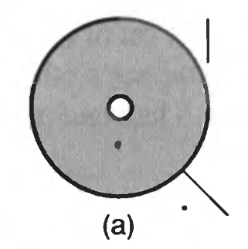
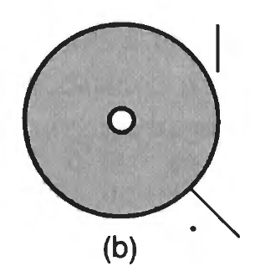
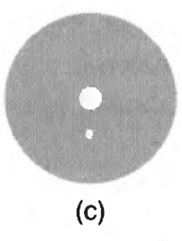
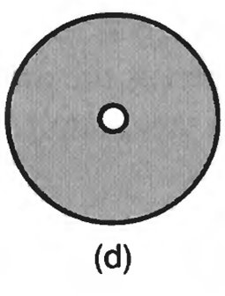

Regularized Boolean Set Operators
The regularized Boolean set operators (RBSOs) are denoted as:
$∪^{∗}, { ∩}^{∗},−^{∗}$
Difference between RBSO and BSO
Interior points
Boundary points
Set’s closure
Regularization
Closed set
Open set
the closure of the set’s interior points

Slide 11
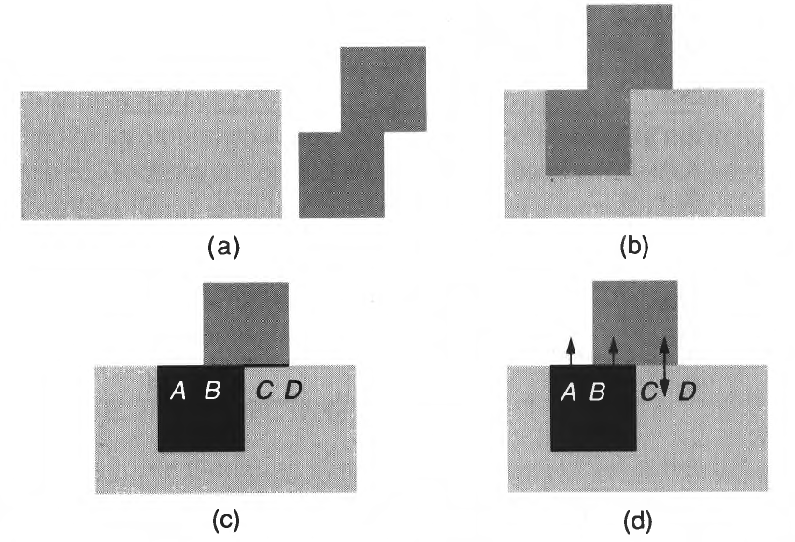
Definition
A regularized Boolean set operator in terms of the corresponding ordinary Boolean set operator is defined as
$$A op^{∗}B=closure(interior\left(A op B\right))$$

Slide 12
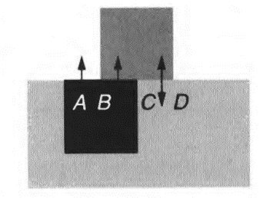
Boundary-Boundary Intersection
A subset of the boundary-boundary intersection is considered
How to choose the subset?
If the interiors of both objects lie on the same side of this piece of shared boundary.
Parts of one object’s boundary that intersect with the other object’s interior
Interiors of the objects lie on opposite sides of the shared boundary

Slide 13
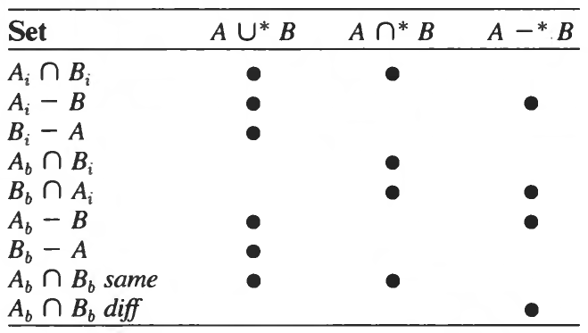
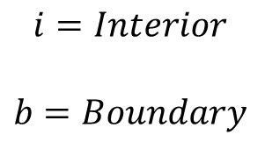
Results
$$i=Interior$$
$$b=Boundary$$

Slide 14
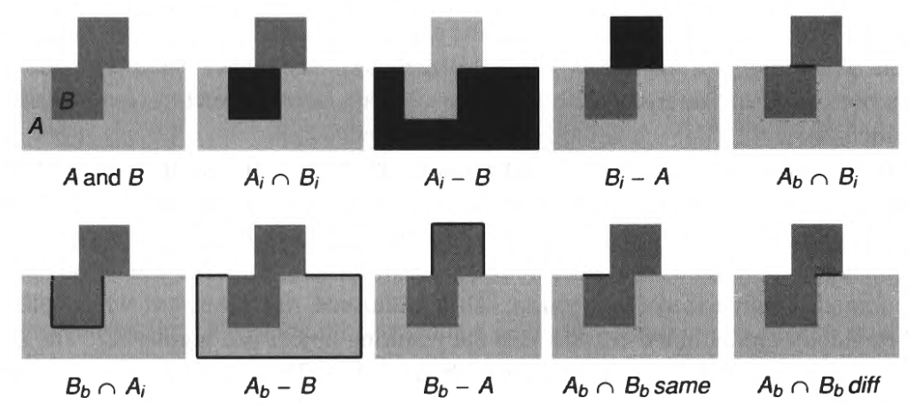
Example
What about the surface normal?

Slide 15
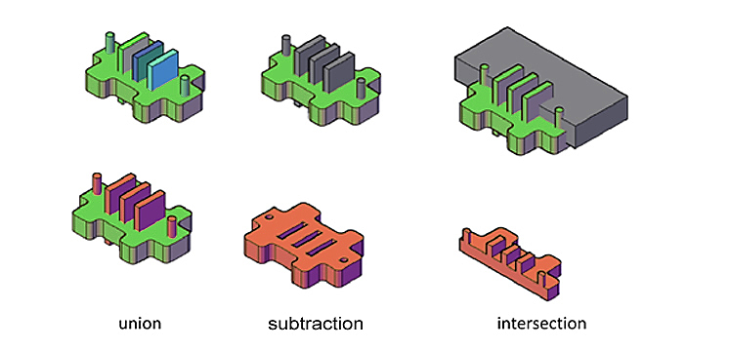
Examples

Slide 16
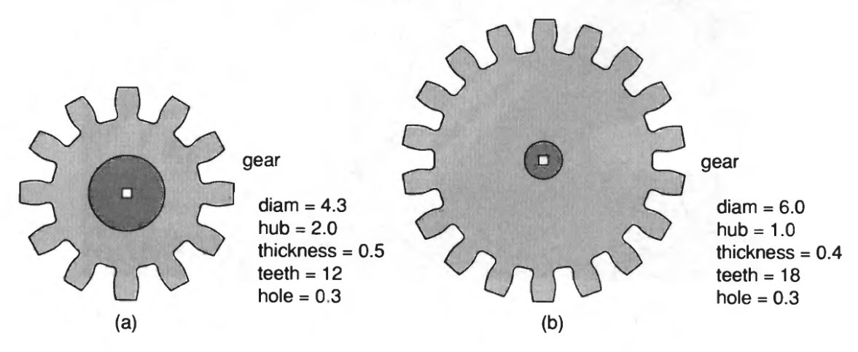
Primitive Instancing
The modeling system defines a set of primitive 3D solid shapes that are relevant to the application area.
The primitives has special properties

Slide 17
Sweep Representation
Sweeping an object along a trajectory through space defines a new object
The resultant object is called as a Sweep
Translational sweep
Tapered, Slanted
Rotational sweep
General sweep

Slide 18
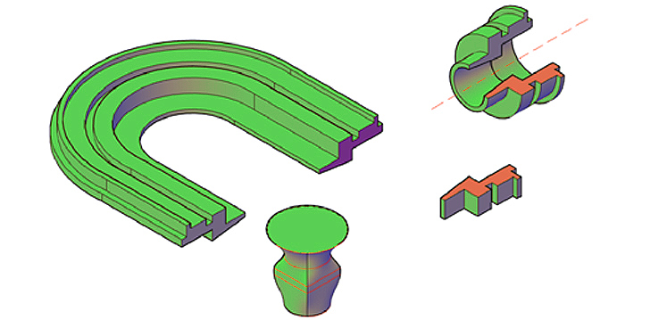
Examples

Slide 19
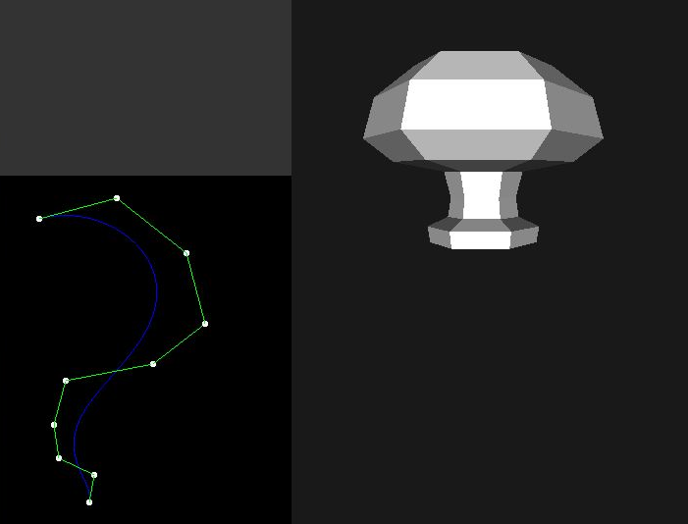
Examples

Slide 20
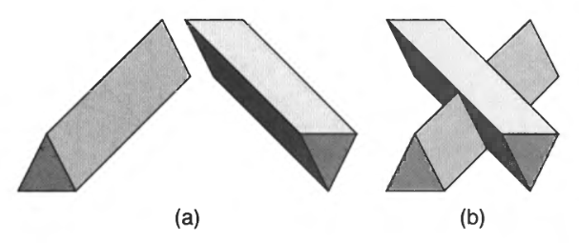
Regularization on Sweeps

Slide 21
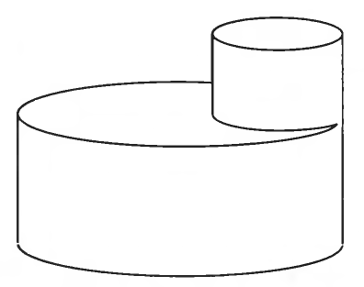
B-Reps
Describe an object in terms of its surface boundaries
Sometimes restricted to planar, polygonal boundaries
For curved surfaces it is difficult to determine the face

Slide 22
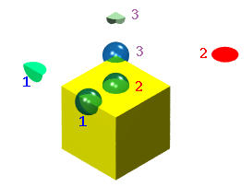
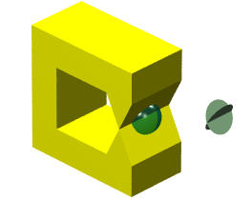
Manifolds
The surface of a solid must satisfy some conditions so that the resulting solid is well-behaved.
This is the so-called manifold condition.
Many b-rep systems support only solids whose boundaries are 2-manifolds.

Slide 23
Thank you
Next Lecture: Solid Modeling

