Slide 1

CS552: Computer Graphics
Lecture 28: Solid Modeling

Slide 2
Recap
Solid Modeling
Regularized Boolean set operations
Primitive Instancing
Sweep Representation
B-Reps

Slide 3
Objective
After completing this lecture, students will be able to
Explain different ways of representing solid objects
B-Reps
Mesh Bases approach
Spatial partitioning
Solve mathematical problems

Slide 4
Polyhedra and Euler's Formula
A solid that is bounded by a set of polygons
Whose edges are each a member of an even number of polygons (exactly two polygons in the case of 2-manifolds)
That satisfies some additional constraints.
Euler’s formula
Relationship between Vertices, Edges, and Faces
V – E + F = 2 (Faces without holes)
V, no. of vertices, E, no. of edges, F, no. of faces
V – E + F – H = 2(C – G)
H, no. of holes, G, no of holes passes through the object, C, no. of separate components

Slide 5
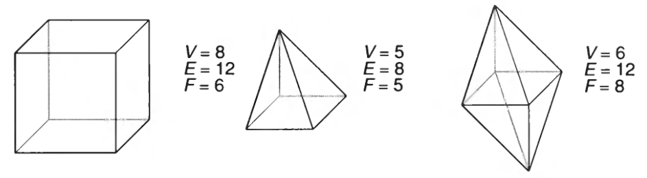
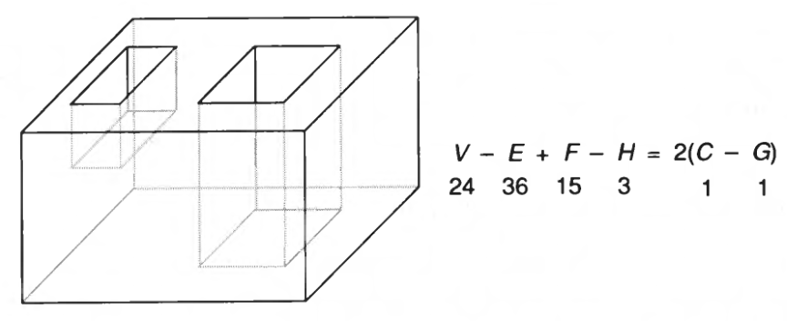
Example

Slide 6
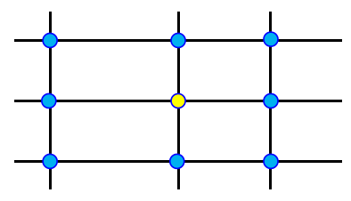
Mesh based representation
Data Structures for Meshes

Slide 7
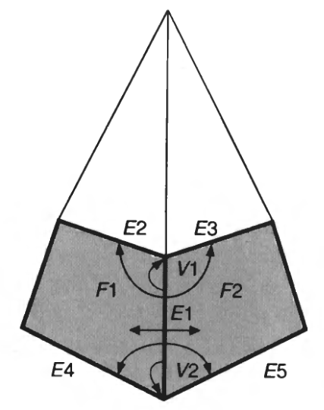
The Winged-Edge Representation
To answer many topological inquires very efficiently

Slide 8
Spatial-partitioning
A solid is decomposed into
A collection of adjoining,
Nonintersecting solids that are
More primitive than, not necessarily of the same type as, the original solid.
Primitives may vary in
Type, size, position, parameterization, and orientation
E.g. the different-shaped blocks in a child’s block set.

Slide 9
Cell Decomposition
In Cell Decomposition:
There is a set of primitive cells, parameterized
Curves can be
Differs from Instance Primitives, by admitting the composition of more complex objects from other already established
Gluing operation
It is a union of cells that do not intersect

Slide 10
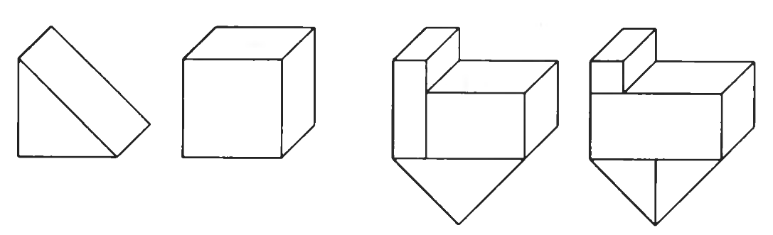
Example
An important representation for use in finite element analysis.

Slide 11
Enumeration of Space Occupation
It is a particular case of Cell Decomposition:
Solid formed by identical cells of equal size placed in a regular grid.
The cells are designated Voxels (Volume elements)
It controls only the presence or absence of each cell in the grid
The most common form is to cell cube
The object is encoded by a single list of occupied cells

Slide 12
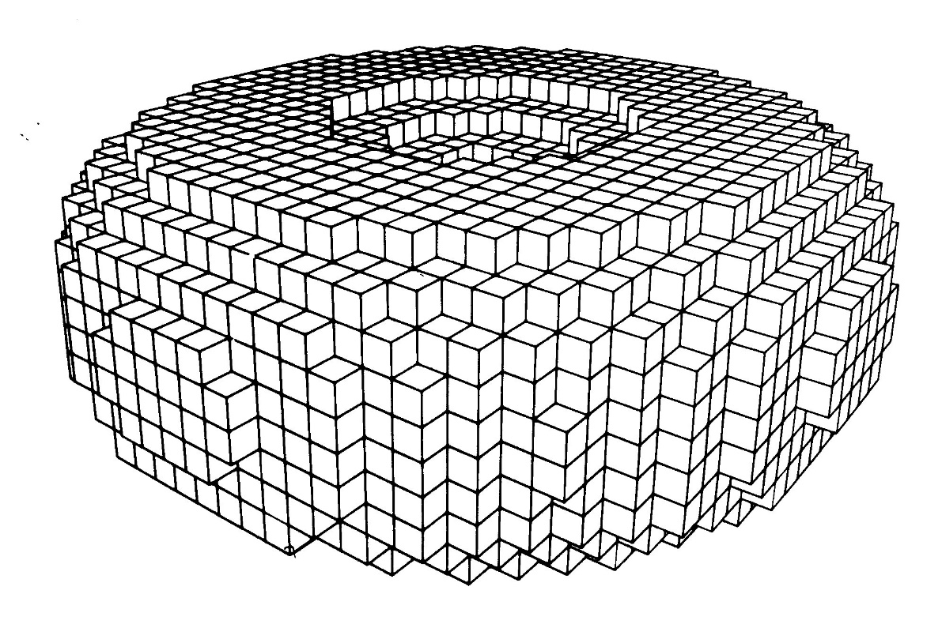
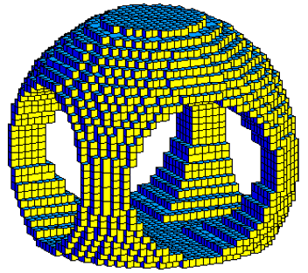
Example

Slide 13
Octree
The Octree is similar to quadtree
The octree is 3D and the division of space is in octants
Number of nodes of an octree
It is proportional to the object surface because of the necessity of the space division occurs only on the surface.
Play Animation

Slide 14
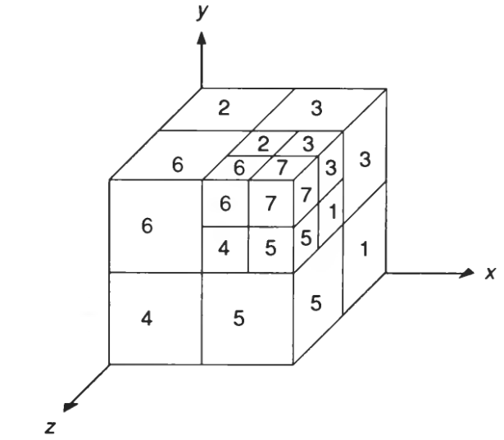
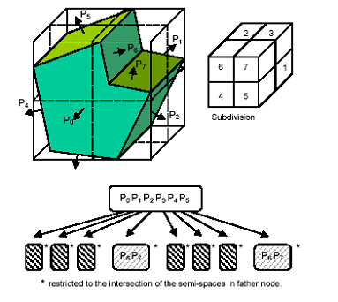
Example
Boolean set operations and transformations.
Neighborhood finding

Slide 15
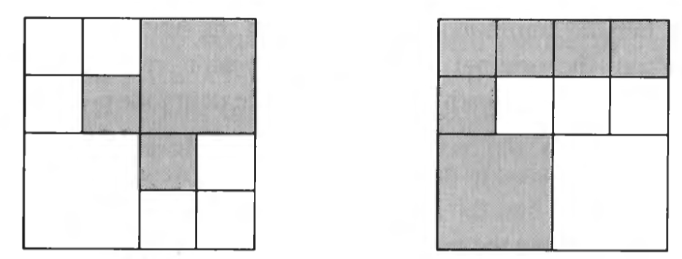
Boolean Set Operations

Slide 16
Binary Space Partitioning (BSP) Tree
A method for recursively subdividing a space into convex sets by hyperplanes
This subdivision gives rise to a representation of objects within the space by means of a tree data structure known as a BSP tree.
It is generally used for rendering double-sided polygons
All the polygons in a scene are rendered using this.

Slide 17
Steps
Choose a polygon P from the list.
Make a node N in the BSP tree, and add P to the list of polygons at that node.
For each other polygon in the list:
If that polygon is wholly in front of the plane containing P, move that polygon to the list of nodes in front of P.
If that polygon is wholly behind the plane containing P, move that polygon to the list of nodes behind P.
If that polygon is intersected by the plane containing P, split it into two polygons and move them to the respective lists of polygons behind and in front of P.
If that polygon lies in the plane containing P, add it to the list of polygons at node N.
Apply this algorithm to the list of polygons in front of P.
Apply this algorithm to the list of polygons behind P.

Slide 18
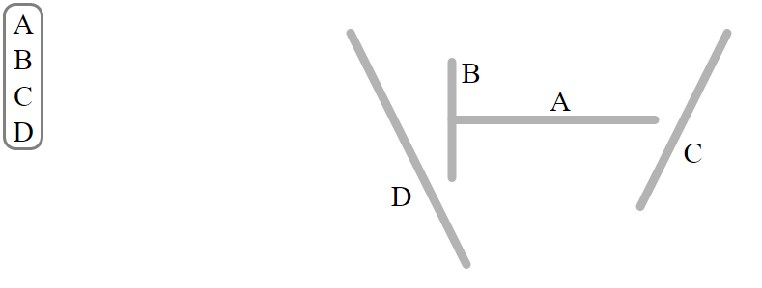
Example: BSP tree construction

Slide 19
Constructive Solid Geometry (CSG)
Primitive solids are combined by means of regularized boolean set operators.
Tree representation used to store steps of final object:
leaves = primitives or half-spaces,
nodes = operators

Slide 20
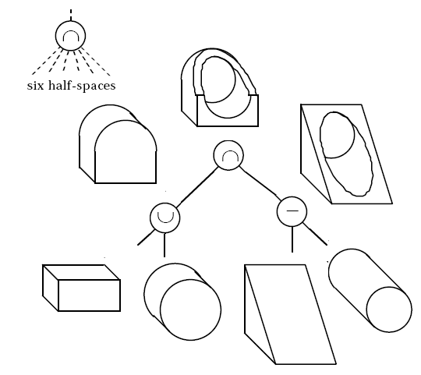
Example: CSG

Slide 21
Thank you
Next Lecture: Visible Surface Detection

