Slide 1

CS552: Computer Graphics
Lecture 2: Introduction to OpenGL

Slide 2
Objective
After this lecture students will be able to
Explain the importance of OpenGL
Install OpenGL in their system
Write program using OpenGL libraries

Slide 3
The BIG Picture
There really is no such thing as an
“OpenGL program”

Slide 4


The BIG picture
Application Program
Graphics Library (API)
Hardware
OpenGL
A low-level interface to the graphics hardware

Slide 5
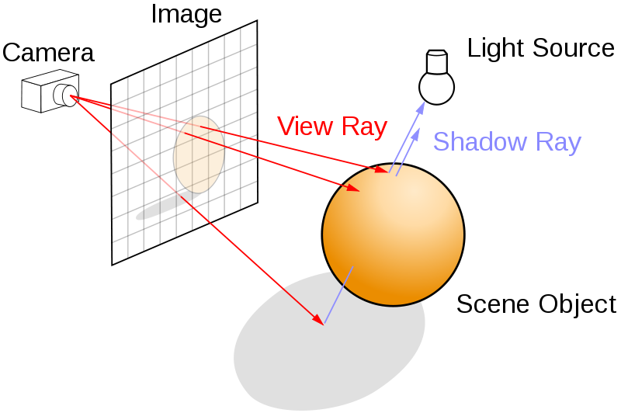
Illustration

Slide 6
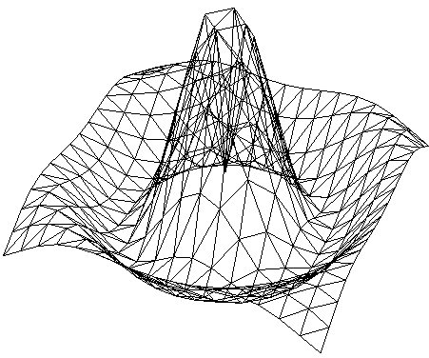
Graphics
lights (photons)
objects (triangles)
image (pixels)
viewer

Slide 7
Physical reality (sort of)
for (each photon)
for (each triangle)
for (each pixel)
draw;
lights (photons)
objects (triangles)
image (pixels)

Slide 8
Ray tracing
for (each pixel)
for (each triangle)
for (each light)
draw;
lights (photons)
objects (triangles)
image (pixels)

Slide 9
Physical reality (sort of)
for (each light)
for (each triangle)
for (each pixel)
draw;
lights
objects (triangles)
image (pixels)

Slide 10
Traditional graphics pipeline (OpenGL)
for (each triangle)
for (each light)
for (each pixel)
draw;
lights
objects (triangles)
image (pixels)

Slide 11
Modern graphics pipeline (OpenGL 2.1)
for (each triangle)
for (each pixel)
for (each light)
draw;
lights
objects (triangles)
image (pixels)

Slide 12
What is OpenGL?
OpenGL is a software interface to graphics hardware.
OpenGL is designed as a streamlined, hardware-independent interface to be implemented
Runs on many different hardware platforms.
With OpenGL, you must build your desired model from a small set of geometric primitives
Points, lines, and polygons.

Slide 13
What OpenGL doesn’t do?
The OpenGL API itself is not a programming language like C or C++.
No commands for performing windowing tasks or obtaining user input are included in OpenGL
Doesn't provide high-level commands for describing models of three-dimensional objects.

Slide 14
What is does do?
Construct shapes from geometric primitives, thereby creating mathematical descriptions of objects.
Arrange the objects in three-dimensional space and select the desired vantage point for viewing the composed scene.
Calculate the colors of all the objects
Convert the mathematical description of objects and their associated color information to pixels on the screen.

Slide 15
OpenGL Rendering Pipeline
Geometry Path
Vertex Data
Vertex Operation
Primitive Assembly
Display List
Texture Memory
Rasterization
Fragment Operation
Frame Buffer
Pixel Data
Pixel Transfer Operation
Image Path
Notes:
OpenGL Pipeline has a series of processing stages in order. Two graphical information, vertex-based data and pixel-based data, are processed through the pipeline, combined together then written into the frame buffer. Notice that OpenGL can send the processed data back to your application.
A framebuffer (frame buffer, or sometimes framestore) is a portion of RAM containing a bitmap that is driven to a video display from a memory buffer containing a complete frame of data.

Slide 16
OpenGL Rendering Pipeline
Geometry Path
It is a group of OpenGL commands that have been stored (compiled) for later execution.
Vertex Data
Vertex Operation
Primitive Assembly
Display List
Texture Memory
Rasterization
Fragment Operation
Frame Buffer
Pixel Data
Pixel Transfer Operation
Image Path
Notes:
OpenGL Pipeline has a series of processing stages in order. Two graphical information, vertex-based data and pixel-based data, are processed through the pipeline, combined together then written into the frame buffer. Notice that OpenGL can send the processed data back to your application.
A framebuffer (frame buffer, or sometimes framestore) is a portion of RAM containing a bitmap that is driven to a video display from a memory buffer containing a complete frame of data.

Slide 17
OpenGL Rendering Pipeline
Geometry Path
Each vertex and normal coordinates are transformed by GL_MODELVIEW matrix
Vertex Data
Vertex Operation
Primitive Assembly
Display List
Texture Memory
Rasterization
Fragment Operation
Frame Buffer
Pixel Data
Pixel Transfer Operation
Image Path
Notes:
OpenGL Pipeline has a series of processing stages in order. Two graphical information, vertex-based data and pixel-based data, are processed through the pipeline, combined together then written into the frame buffer. Notice that OpenGL can send the processed data back to your application.
A framebuffer (frame buffer, or sometimes framestore) is a portion of RAM containing a bitmap that is driven to a video display from a memory buffer containing a complete frame of data.

Slide 18
OpenGL Rendering Pipeline
Primitives are transformed eye coordinates to clip coordinates.
Viewport transform is applied in order to map 3D scene to window space coordinates.
Last thing to do in Primitive Assembly is culling test if culling is enabled.
Geometry Path
Vertex Data
Vertex Operation
Primitive Assembly
Display List
Texture Memory
Rasterization
Fragment Operation
Frame Buffer
Pixel Data
Pixel Transfer Operation
Image Path
Notes:
OpenGL Pipeline has a series of processing stages in order. Two graphical information, vertex-based data and pixel-based data, are processed through the pipeline, combined together then written into the frame buffer. Notice that OpenGL can send the processed data back to your application.
A framebuffer (frame buffer, or sometimes framestore) is a portion of RAM containing a bitmap that is driven to a video display from a memory buffer containing a complete frame of data.

Slide 19
OpenGL Rendering Pipeline
After reading the pixels, the data are performed scaling, bias, mapping and clamping.
The transferred data are either stored in texture memory or rasterized directly to fragments.
Geometry Path
Vertex Data
Vertex Operation
Primitive Assembly
Display List
Texture Memory
Rasterization
Fragment Operation
Frame Buffer
Pixel Data
Pixel Transfer Operation
Image Path
Notes:
OpenGL Pipeline has a series of processing stages in order. Two graphical information, vertex-based data and pixel-based data, are processed through the pipeline, combined together then written into the frame buffer. Notice that OpenGL can send the processed data back to your application.
A framebuffer (frame buffer, or sometimes framestore) is a portion of RAM containing a bitmap that is driven to a video display from a memory buffer containing a complete frame of data.

Slide 20
OpenGL Rendering Pipeline
Geometry Path
Texture images are loaded into texture memory to be applied onto geometric objects.
Vertex Data
Vertex Operation
Primitive Assembly
Display List
Texture Memory
Rasterization
Fragment Operation
Frame Buffer
Pixel Data
Pixel Transfer Operation
Image Path
Notes:
OpenGL Pipeline has a series of processing stages in order. Two graphical information, vertex-based data and pixel-based data, are processed through the pipeline, combined together then written into the frame buffer. Notice that OpenGL can send the processed data back to your application.
A framebuffer (frame buffer, or sometimes framestore) is a portion of RAM containing a bitmap that is driven to a video display from a memory buffer containing a complete frame of data.

Slide 21
OpenGL Rendering Pipeline
It is the conversion of both geometric and pixel data into fragment.
Fragments are a rectangular array containing color, depth, line width, point size and antialiasing calculations.
Geometry Path
Vertex Data
Vertex Operation
Primitive Assembly
Display List
Texture Memory
Rasterization
Fragment Operation
Frame Buffer
Pixel Data
Pixel Transfer Operation
Image Path
Notes:
OpenGL Pipeline has a series of processing stages in order. Two graphical information, vertex-based data and pixel-based data, are processed through the pipeline, combined together then written into the frame buffer. Notice that OpenGL can send the processed data back to your application.
A framebuffer (frame buffer, or sometimes framestore) is a portion of RAM containing a bitmap that is driven to a video display from a memory buffer containing a complete frame of data.

Slide 22
OpenGL Rendering Pipeline
Scissor Test ⇒ Alpha Test ⇒ Stencil Test ⇒ Depth Test.
Geometry Path
Vertex Operation
Primitive Assembly
Blending, dithering, logical operation and masking
Vertex Data
Display List
Texture Memory
Rasterization
Fragment Operation
Frame Buffer
Pixel Data
Pixel Transfer Operation
Image Path
Notes:
OpenGL Pipeline has a series of processing stages in order. Two graphical information, vertex-based data and pixel-based data, are processed through the pipeline, combined together then written into the frame buffer. Notice that OpenGL can send the processed data back to your application.
A framebuffer (frame buffer, or sometimes framestore) is a portion of RAM containing a bitmap that is driven to a video display from a memory buffer containing a complete frame of data.

Slide 23
The OpenGL State Machine
Collection of variables the state of the pipeline
A state machine is an abstract model of a collection of state variables

Slide 24
OpenGL Abstractions
OpenGL
Application Program
Graphics Library (API)
Hardware
GLU
Viewing –perspective/orthographic
Image scaling, polygon tessellation
Sphere, cylinders, quadratic surfaces
Primitives - points, line, polygons
Shading and Color
Translation, rotation, scaling
Viewing, Clipping, Texture
Hidden surface removal
GLUT
Windowing toolkit (key, mouse handler, window events)

Slide 25
Example
#include <whateverYouNeed.h>
main () {
InitializeAWindowPlease();
glClearColor(0.0, 0.0, 0.0);
glClear(GL_COLOR_BUFFER_BIT);
glColor3f(1.0, 1.0, 1.0);
glOrtho(0.0, 1.0, 0.0, 1.0, -1.0, 1.0);
glBegin(GL_POLYGON);
glVertex3f(0.25, 0.25, 0.0);
glVertex3f(0.75, 0.25, 0.0);
glVertex3f(0.75, 0.75, 0.0);
glVertex3f(0.25, 0.75, 0.0);
glEnd();
glFlush ();
UpdateTheWindowAndCheckForEvents);
}

Slide 26
Data Types
OpenGL Data Type | Internal Representation | Defined as C Type | C Literal Suffix
GLbyte | 8-bit integer | Signed char | b
GLshort | 16-bit integer | Short | s
GLint, GLsizei | 32-bit integer | Long | I
GLfloat, GLclampf | 32-bit floating point | Float | f
GLdouble, GLclampd | 64-bit floating point | Double | d
GLubyte, GLboolean | 8-bit unsigned integer | Unsigned char | ub
GLushort | 16-bit unsigned integer | Unsigned short | us
GLuint, GLenum, GLbitfield | 32-bit unsigned integer | Unsigned long | ui

Slide 27
Points, Lines, and Polygons
Homogeneous Co-ordinate system
four floating-point coordinates (x, y, z, w)
glVertex2i(Glint xi, Glint yi);
glVertex3f(Glfloat x, Glfloat y, Glfloat z);

Slide 28
Points, Lines, and Polygons
Lines:
glBegin(GL_LINES);
glVertex2f(x1, y1);
glVertex2f(x2, y2);
glEND();
Define a pair of points as:
glBegin(GL_POINTS);
glVertex2f(x1, y1);
glVertex2f(x2, y2);
glEND();

Slide 29
Transformations
Model View Matrix
Projection Matrix
Perspective Division
Viewport Transformation
[x y z w]
Eye
coordinates
Clip Coordinates
Normalized Device Coordinate
Window Coordinate

Slide 30
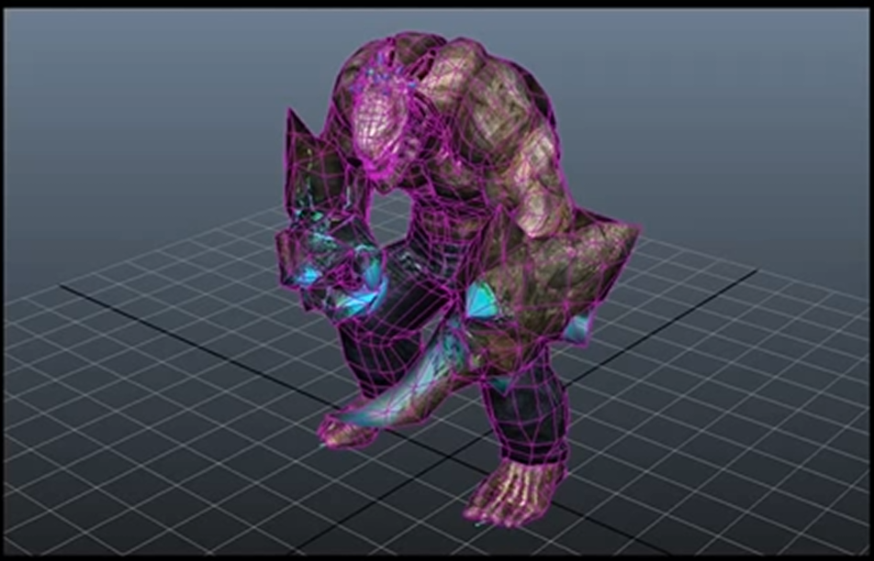
Transformations

Slide 31
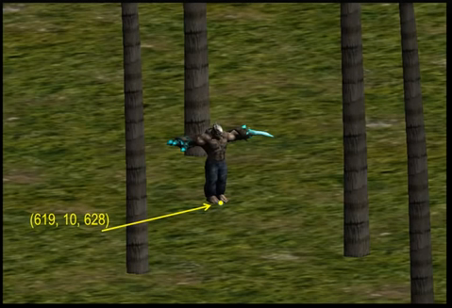
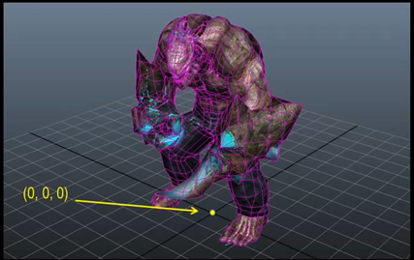
Transformations
Local Coordinate System
World Coordinate System

Slide 32
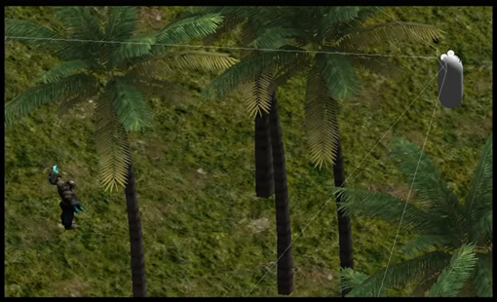
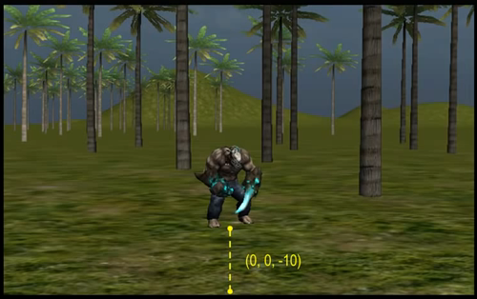
Camera Coordinate System

Slide 33
The Big Picture
Local Coordinate System
World Coordinate System
Model Matrix
Camera Coordinate System
View Matrix

Slide 34
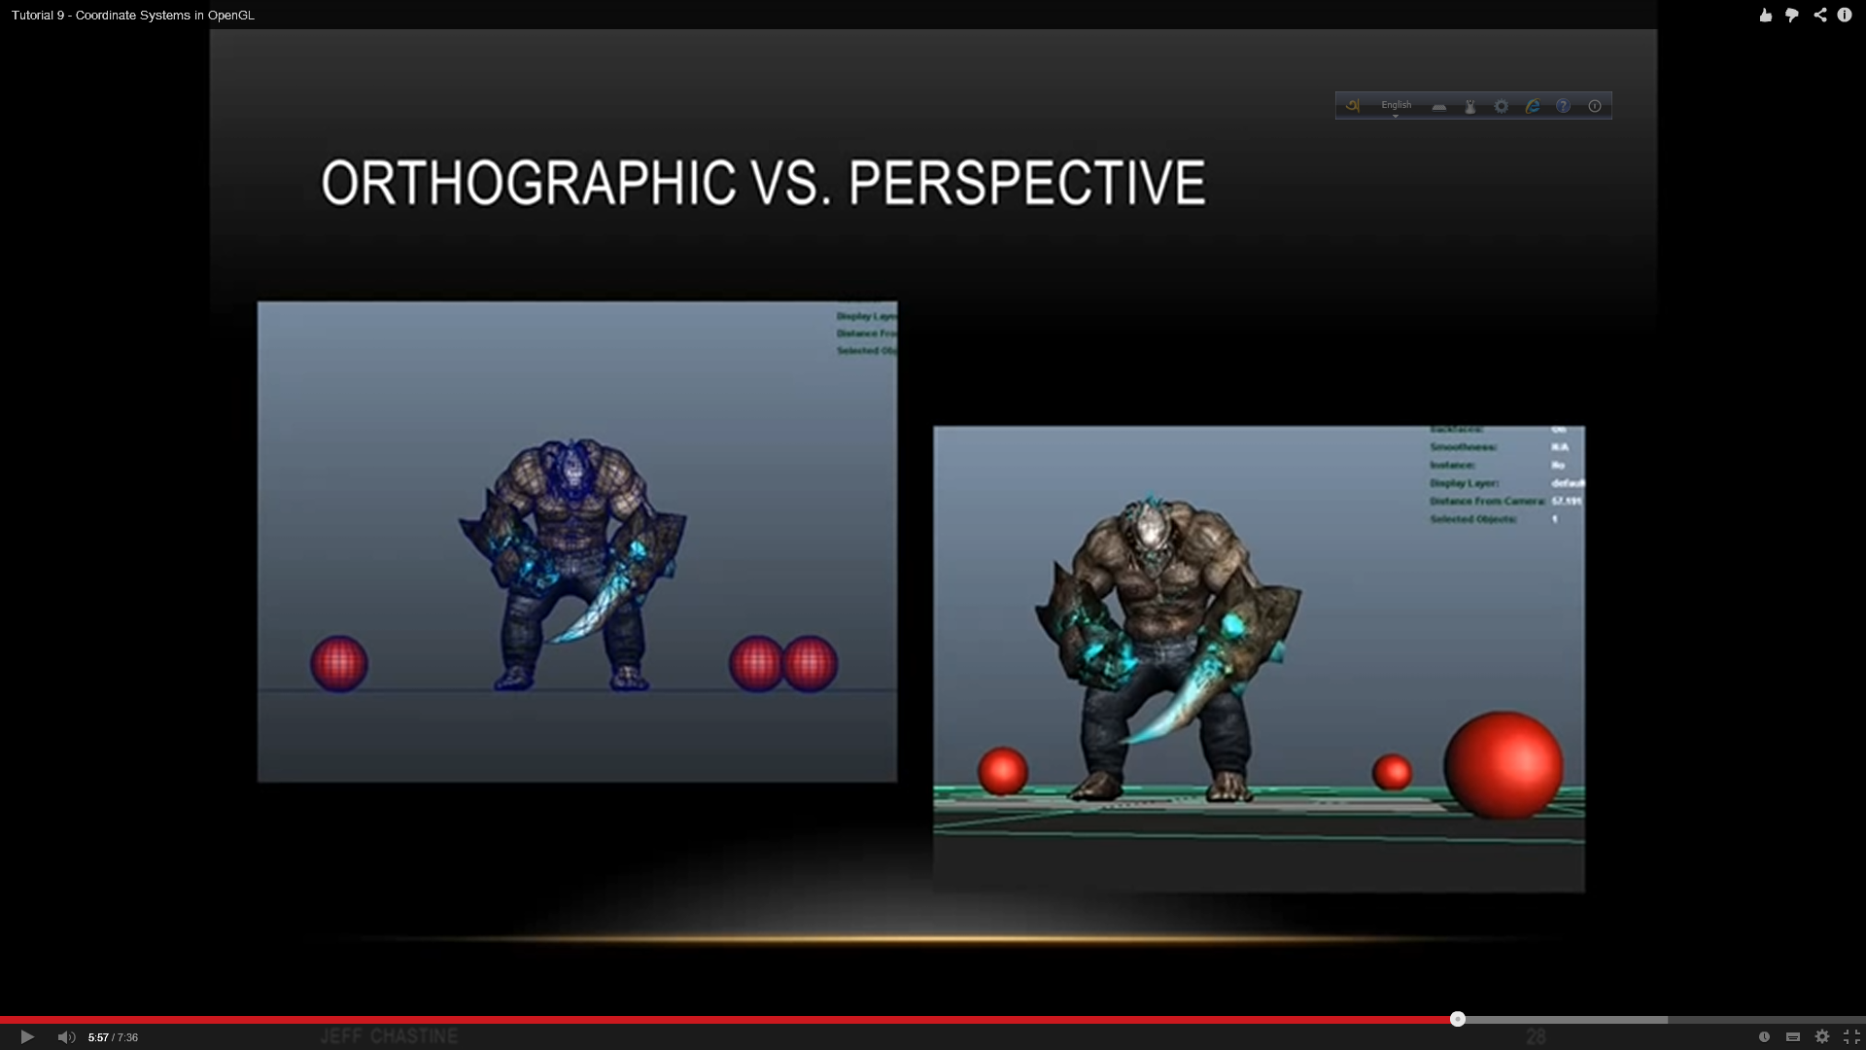
Projection
Orthographic
Perspective

Slide 35
OpenGL Example
…
glClear (GL_COLOR_BUFFER_BIT);
glColor3f (1.0, 1.0, 1.0);
glLoadIdentity ();/*clear the matrix*/
/* viewing transformation */
gluLookAt (0.0, 0.0, 5.0, 0.0, 0.0, 0.0, 0.0, 1.0, 0.0);
/* modeling transformation */
glScalef (1.0, 2.0, 1.0);
glutWireCube (1.0);
glFlush ();
…
Notes:
Recall that the viewing transformation is analogous to positioning and aiming a camera.

Slide 36
OpenGL Example
gluLookAt
(0.0, 0.0, 5.0, // Camera position
0.0, 0.0, 0.0, // Lens aim at
0.0, 1.0, 0.0);// Camera orientation
Notes:
Recall that the viewing transformation is analogous to positioning and aiming a camera.

Slide 37
OpenGL Example
…
glClear (GL_COLOR_BUFFER_BIT);
glColor3f (1.0, 1.0, 1.0);
glLoadIdentity ();/*clear the matrix*/
/* viewing transformation */
gluLookAt (0.0, 0.0, 5.0, 0.0, 0.0, 0.0, 0.0, 1.0, 0.0);
/* modeling transformation */
glScalef (1.0, 2.0, 1.0);
glutWireCube (1.0);
glFlush ();
…
Notes:
Recall that the viewing transformation is analogous to positioning and aiming a camera.

Slide 38
Modeling Transformations
void glTranslate{fd}(TYPEx, TYPE y, TYPEz);
void glRotate{fd}(TYPE angle, TYPE x, TYPE y, TYPE z);
glRotatef(45.0, 0.0, 0.0, 1.0)
void glScale{fd}(TYPEx, TYPE y, TYPEz);
glScalef(2.0, -0.5, 1.0).

Slide 39
Coloring
Widely used methods of describing a color is the RGB color model.
OpenGL usually a value between 0 and 1
We can mix these three colors together to give us a complete range of colors

Slide 40
Example
set_color(RED);
draw_item(A);
draw_item(B);
set_color(GREEN);
set_color(BLUE);
draw_item(C);

Slide 41
glColor3f
void display() {
glClear(GL_COLOR_BUFFER_BIT | GL_DEPTH_BUFFER_BIT);
glColor3f(0.5f, 0.0f, 1.0f);
glBegin(GL_QUADS);
glVertex2f(-0.75, 0.75);
glVertex2f(-0.75, -0.75);
glVertex2f(0.75, -0.75);
glVertex2f(0.75, 0.75);
glEnd();
glutSwapBuffers();
}

Slide 42
glColor3f (contd.)
void display() {
glClear(GL_COLOR_BUFFER_BIT | GL_DEPTH_BUFFER_BIT);
glBegin(GL_QUADS);
glColor3f(0.5f, 0.0f, 1.0f);
glVertex2f(-0.75, 0.75);
glColor3f(1.0f, 0.0f, 0.0f); glVertex2f(-0.75, -0.75);
glColor3f(0.0f, 1.0f, 0.0f); glVertex2f(0.75, -0.75);
glColor3f(1.0f, 1.0f, 0.0f); glVertex2f(0.75, 0.75);
glEnd();
glutSwapBuffers();
}

Slide 43
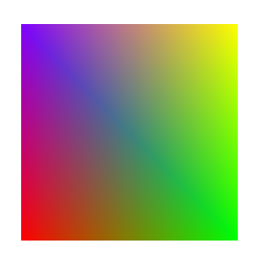
Output

Slide 44
Keyboard & Mouse handling
Write your function to handle key-press event
void keyPressed
(unsigned char key, int x, int y) {}
In main invoke your function using GLUT
glutKeyboardFunc(keyPressed);
// If they ‘a’ key was pressed
If (key == ‘a’) {
// Perform action associated with the ‘a’ key
}

Slide 45
Ubuntu
Following packages are required
freeglut3-dev
mesa-common-dev
Command
sudo apt-get install freeglut3 freeglut3-dev mesa-common-dev

Slide 46
Windows
Following files are required for development
opengl32.lib
glu32.lib
gl.h
glu.h
For GLUT (Downloadable)
glut32.dll
glut32.lib
glut.h

Slide 47
Windows
Runtime libraries:
C:\Windows\System32\{opengl,glu}32.dll
On 64-bit Windows:
C:\Windows\SysWOW64\{opengl,glu}32.dll
Header files:
C:\Program Files\Microsoft SDKs\Windows\v7.1A\Include\gl\{GL,GLU}.h
Linker library:
C:\Program Files\Microsoft SDKs\Windows\v7.1A\Lib\OpenGL32.Lib

Slide 48
Windows
Runtime library:
C:\Program Files\Microsoft Visual Studio *\VC\bin\glut32.dll
Header file:
C:\Program Files\Microsoft Visual Studio *\VC\include\GL\glut.h
Linker library:
C:\Program Files\Microsoft Visual Studio *\VC\lib\glut32.lib

Slide 49
Windows (in VC not there)
Runtime library:
C:\Windows\system\glut32.dll
Header file:
C:\Program Files\Microsoft SDKs\Windows\v7.0A\Include\GL\glut.h
Linker library:
C:\Program Files\Microsoft SDKs\Windows\v7.0A\Lib\glut32.lib

Slide 50
Linux
You will have to use the -lglut linker option with gcc/g++ to compile a program with glut library.
For example,
Name of the program to be compiled
cube.c
Command
gcc -o cube cube.c -lglut -lGLU

Slide 51
Example
Compiler
Source File
gcc -o cube cube.c -lglut -lGLU
Output option
OpenGL Option

Slide 52
Windows
Start Visual C++ and create a new empty project of type Win32 Console Application
Add a GLUT program to the project
Go to Projects→ Settings→ C++ tab select Category - Preprocessor.
In the additional include directory box give the path where GL/glut.h is present.
Go to Projects→ Settings→ Link tab, select Category - Input.
In additional library path give the location of glut32.lib

Slide 53
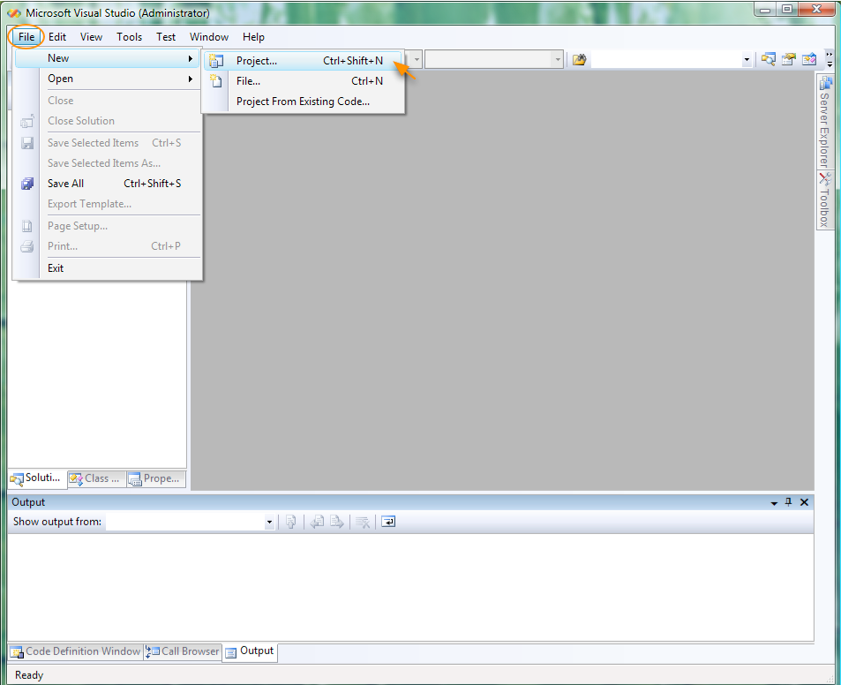

Slide 54
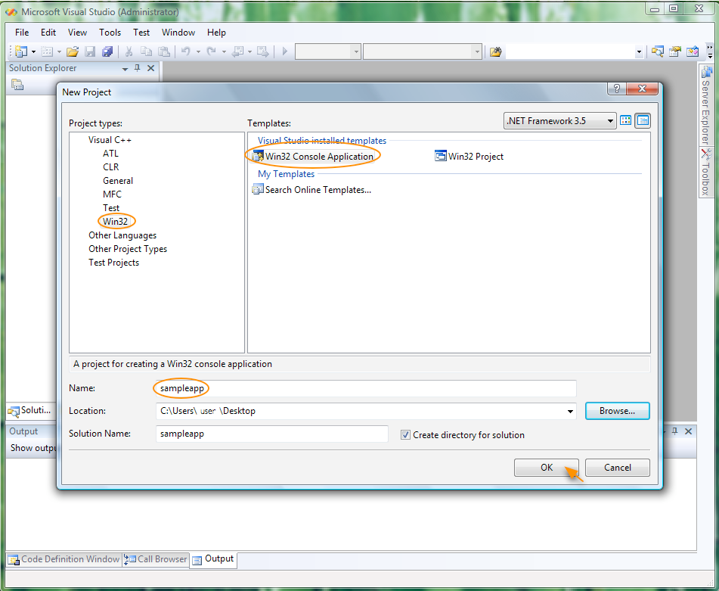

Slide 55
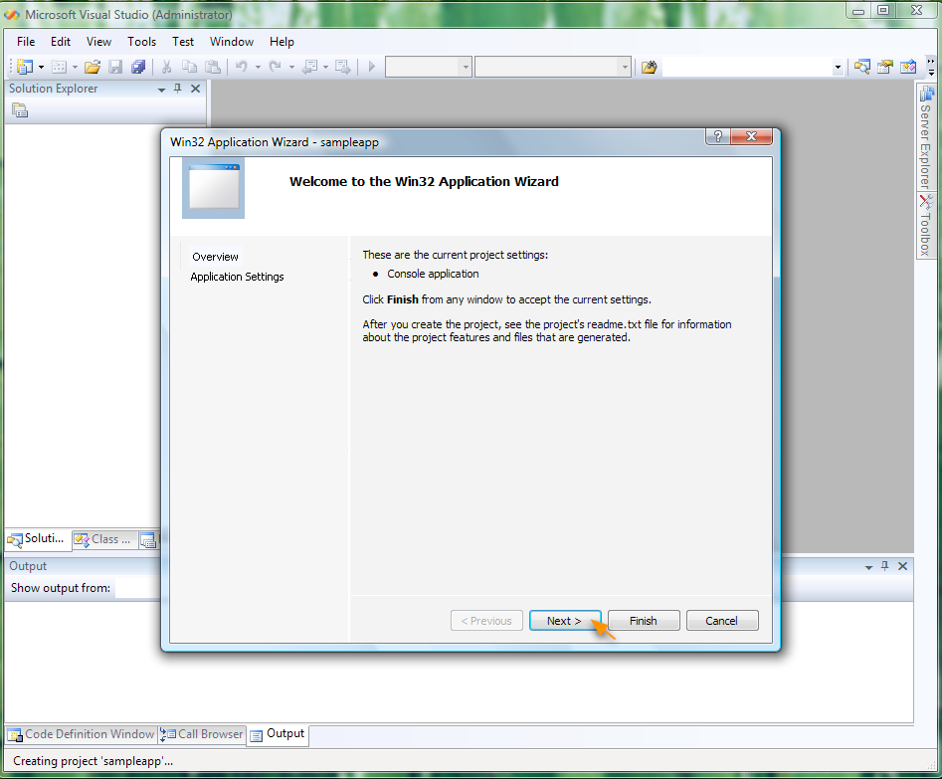

Slide 56
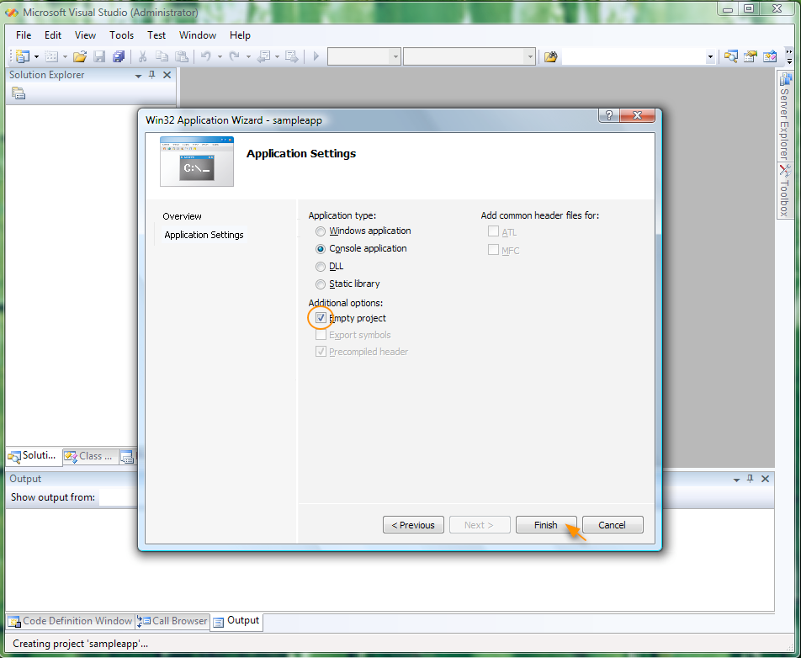

Slide 57
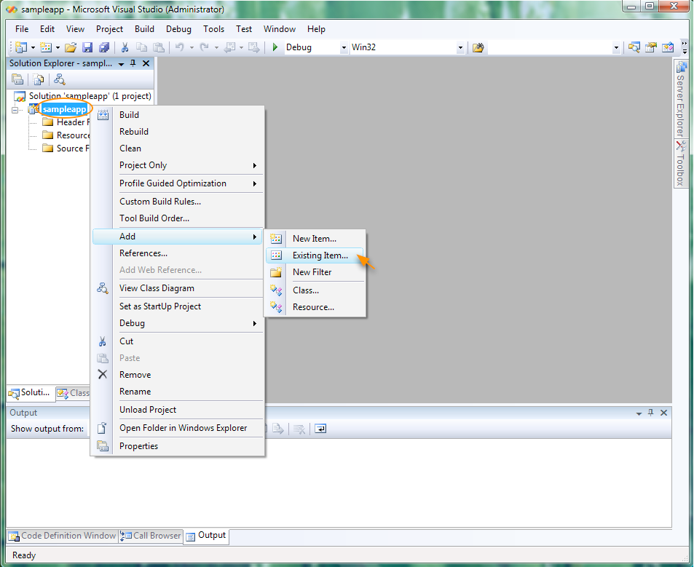

Slide 58
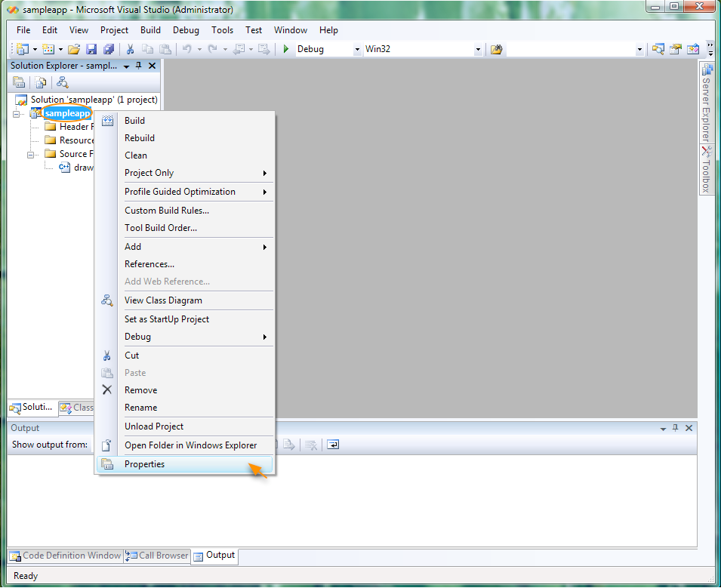

Slide 59
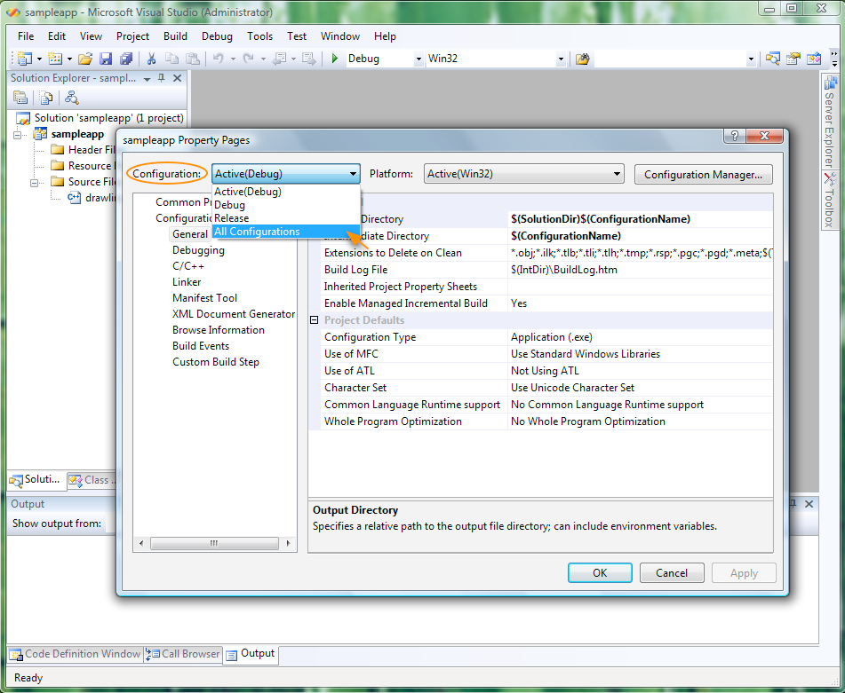

Slide 60
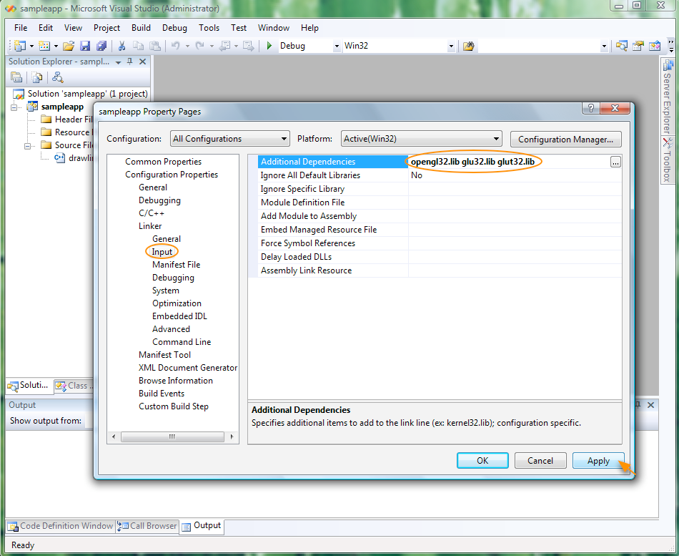

Slide 61
Thank you
Next Lecture: Introduction to 2D Graphics

