Slide 1

CS552: Computer Graphics
Lecture 30: Visible Surface Detection

Slide 2
Recap
Solid Modeling
Represent the solid object in a 3D space
B-Reps
Subdividing algorithms

Slide 3
Objective
After completing this lecture, students will be able to
Explain the importance of VSDs
Solve the problem of backface culling

Slide 4
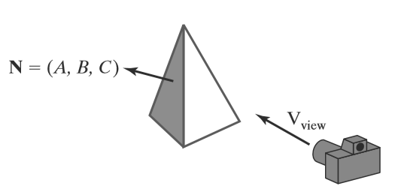
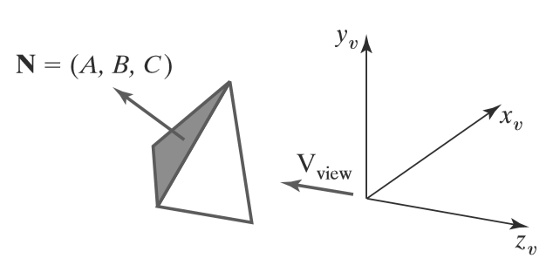
Visible Surface Detection
A surface normal vector N and the viewing-direction vector V_{view}.
A polygon surface with plane parameter
C< 0 in a right-handed viewing coordinate system is identiﬁed as a back face when the viewing direction is along the negative

Slide 5
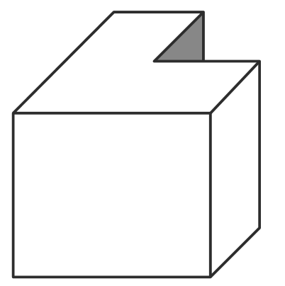
Limitation of Back-face Culling
Concave polyhedron with one face partially hidden by other faces of the object.

Slide 6
Depth-Buffer Method
Image-space approach for detecting visible surfaces
Compares surface depth values throughout a scene for each pixel position on the projection plane
Each surface of a scene is processed separately\
The algorithm is usually applied to scenes containing only polygon surfaces
Also frequently alluded to as the z-buffer method

Slide 7
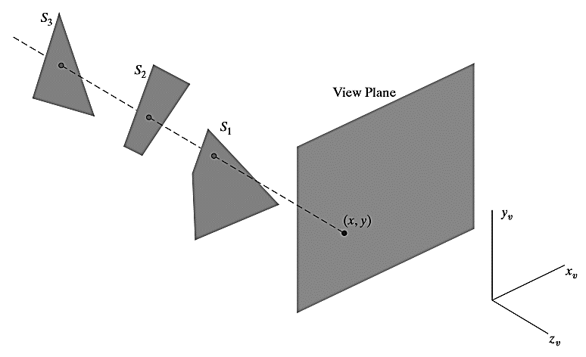
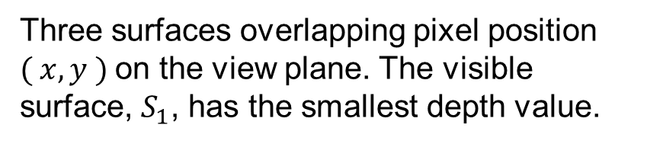
Illustration
Three surfaces overlapping pixel position
$( x,y )$on the view plane. The visible surface, $S_{1}$, has the smallest depth value.

Slide 8
Depth-Buffer Algorithm
Initialize the depth buffer and frame buffer so that for all buffer positions (x, y),
depthBuff (x, y) = 1.0, frameBuff (x, y) = backgndColor
Process each polygon in a scene, one at a time, as follows:
For each projected (x, y) pixel position of a polygon, calculate the depth z (if not already known).
If z < depthBuff (x, y), compute the surface color at that position and set
depthBuff (x, y) = z, frameBuff (x, y) = surfColor (x, y)
After all surfaces have been processed, the depth buffer contains depth values for the visible surfaces and the frame buffer contains the corresponding color values for those surfaces

Slide 9
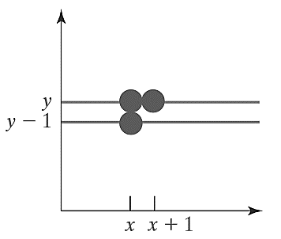


Calculation
Given the depth values for the vertex positions of any polygon in a scene
At surface position (x, y), the depth is calculated from the plane equation as:
$$z=\frac{−Ax−By−D}{C}$$
The depth z’ of the next position (x+1, y) along the scan line is obtained
$$z=\frac{−A(x+1)−By−D}{C}$$

Slide 10
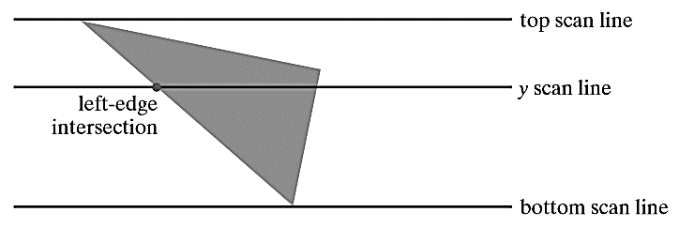
Illustration
y-1 scan line

Slide 11
A-Buffer Method
An extension of the depth-buffer ideas
An antialiasing, area-averaging, visibility-detection method
REYES (“Renders Everything You Ever Saw”)
The buffer region - accumulation buffer
Stores a variety of surface data, in addition to depth values

Slide 12
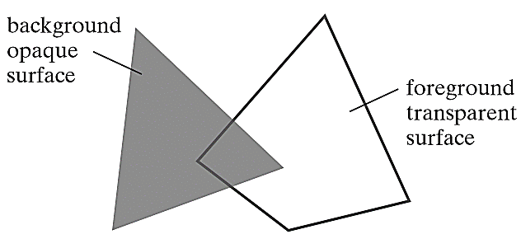
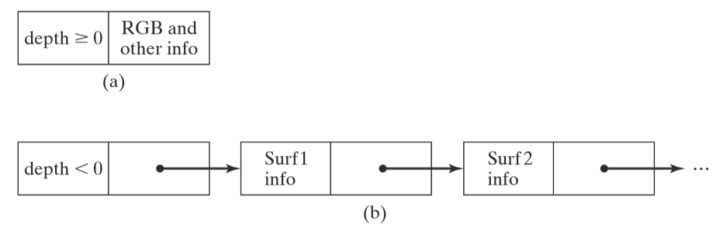
Advantage of A-Buffer
Each position in the A-buffer has two ﬁelds
Depth ﬁeld: A real-number value (+ve, -ve, 0).
Surface data ﬁeld: Surface data or a pointer.

Slide 13
A buffer: Surface Information
RGB intensity components
Opacity parameter (percent of transparency)
Depth
Percent of area coverage
Surface identiﬁer
Other surface-rendering parameters

Slide 14
Scan-Line Method
Image-space method for identifying visible surface
Compares depth values along the various scan lines for a scene
Different tables used for VSD
Edge table
Surface-facet table
Active list table
Flag for each surface

Slide 15
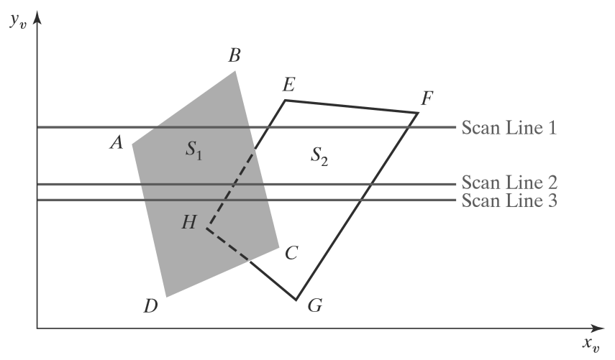
Illustration

Slide 16
Depth-Sorting Method
Uses both image-space and object-space operations
Surfaces are sorted in order of decreasing depth
Surfaces are scan converted in order, starting with the surface of greatest depth.
Sorting operations are carried out in both image and object space
The scan conversion of the polygon surfaces is performed in image space.
Painter’s algorithm

Slide 17
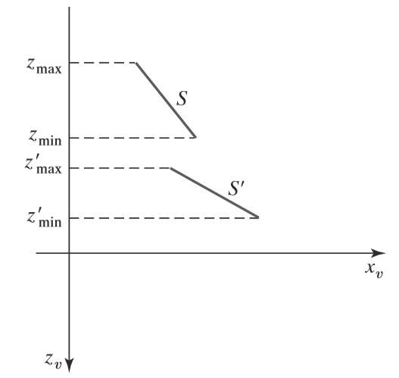
Illustration
No depth overlap

Slide 18
Depth test
The bounding rectangles (coordinate extents) in the xy directions for the two surfaces do not overlap.
Surface S is completely behind the overlapping surface relative to the viewing position.
The overlapping surface is completely in front of S relative to the viewing position.
The boundary-edge projections of the two surfaces onto the view plane do not overlap.

Slide 19
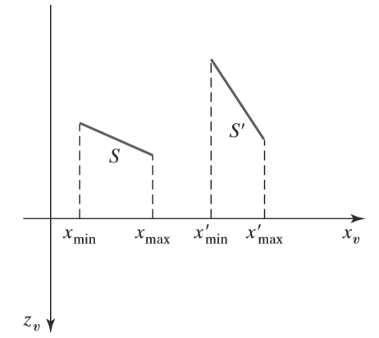
Test 1
Two surfaces with depth overlap but no overlap in the x direction.

Slide 20
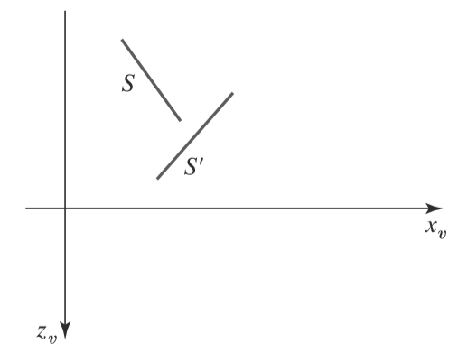
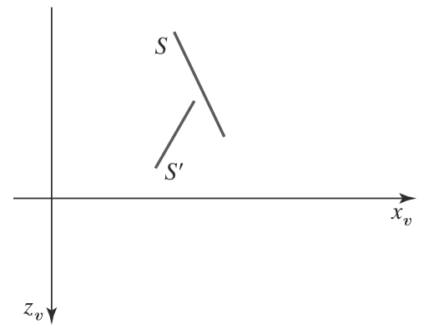
Test 2 and 3
Surface S is completely behind the overlapping surface S’
Overlapping surface S’ is completely in front of surface S , but
S is not completely behind S’

Slide 21
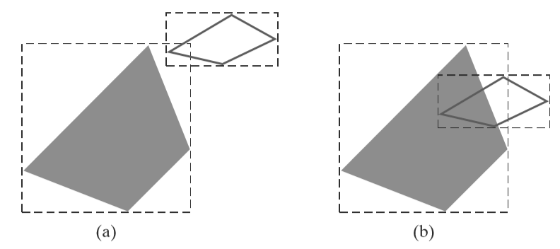
Test 4
Two polygon surfaces with overlapping bounding rectangles in the xy plane.

Slide 22
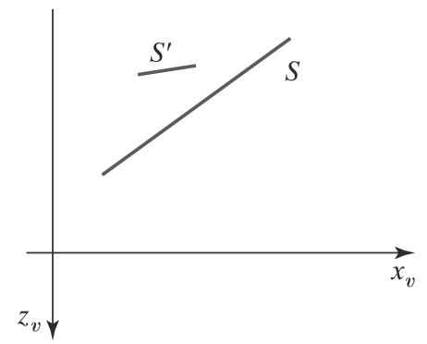
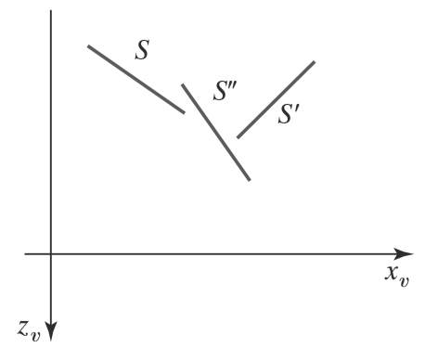
Use of Sorted List
Three surfaces that have been entered into the sorted surface list in the order S, S’, S’’ should be reordered as S’,S’’, S.
Surface S extends to a greater depth, but it obscures surface S’

Slide 23
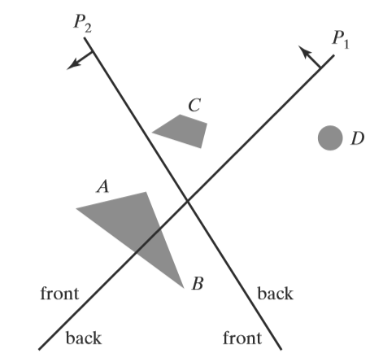
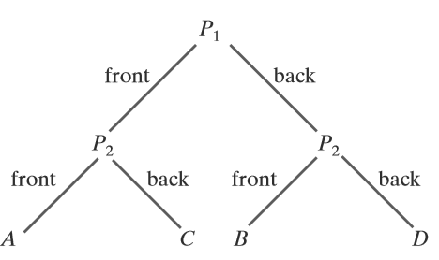
BSP-Tree Method
BSP tree representation

Slide 24
Thank you
Next Lecture: Visible Surface Detection

