Slide 1

CS552: Computer Graphics
Lecture 31: Visible Surface Detection

Slide 2
Recap
Solid Modeling
Represent the solid object in a 3D space
B-Reps
Subdividing algorithms

Slide 3
Objective
After completing this lecture, students will be able to
Explain the importance of VSDs
Solve the problem of backface culling

Slide 4
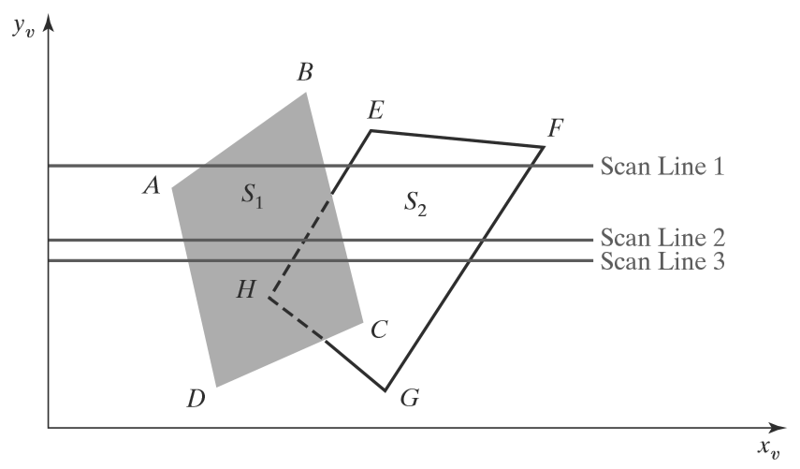
Illustration

Slide 5
Multiple non-intersecting polygon
J
B
I
E
D
C
A
F
G
H

Slide 6
Special cases of polygon intersection

Slide 7
Depth-Sorting Method
Uses both image-space and object-space operations
Surfaces are sorted in order of decreasing depth
Surfaces are scan converted in order, starting with the surface of greatest depth.
Sorting operations are carried out in both image and object space
The scan conversion of the polygon surfaces is performed in image space.
Painter’s algorithm

Slide 8
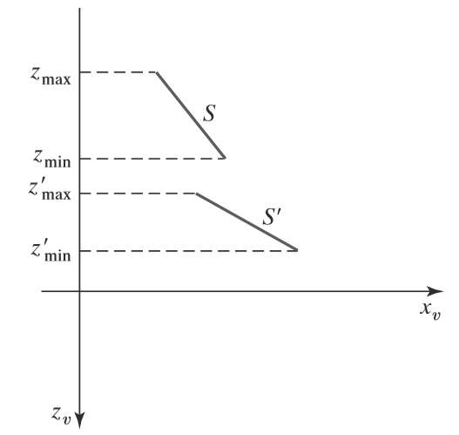
Illustration
No depth overlap

Slide 9
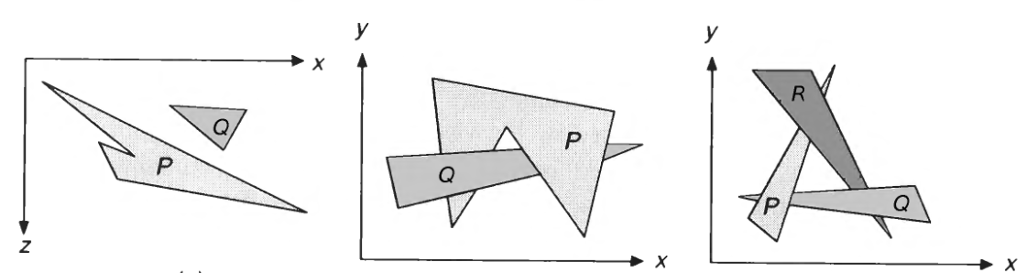
Ambiguity
Depth Test
1. Do the polygons’ x extents not overlap?
2. Do the polygons’ y extents not overlap?
3. Is P entirely on the opposite side of Q’s plane from the viewpoint?
4. Is Q entirely on the same side of P’s plane as the viewpoint?
5. Do the projections of the polygons onto the (x,y) plane not overlap?

Slide 10
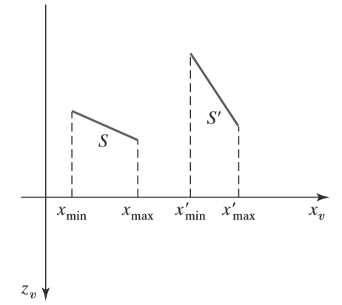
Test 1
Two surfaces with depth overlap but no overlap in the x direction.

Slide 11
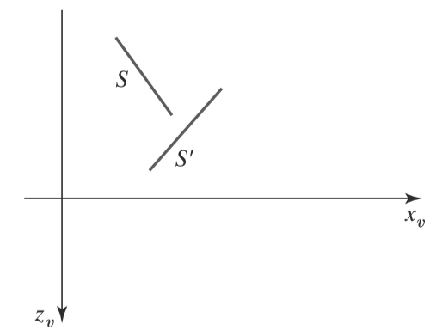
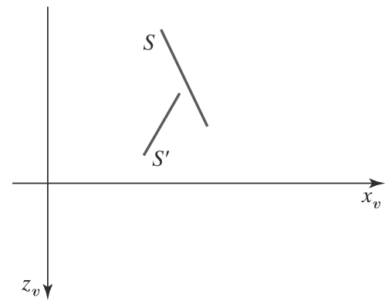
Test 2 and 3
Surface S is completely behind the overlapping surface S’
Overlapping surface S’ is completely in front of surface S , but
S is not completely behind S’

Slide 12
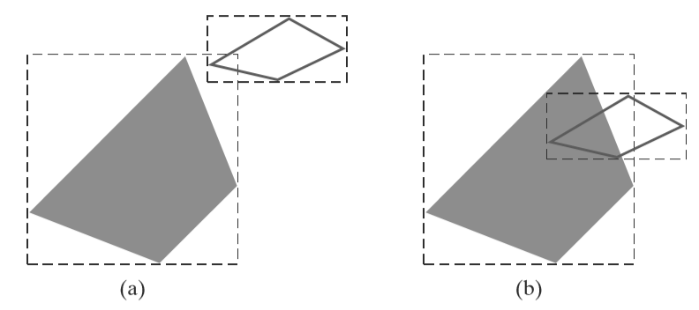
Test 4
Two polygon surfaces with overlapping bounding rectangles in the xy plane.

Slide 13
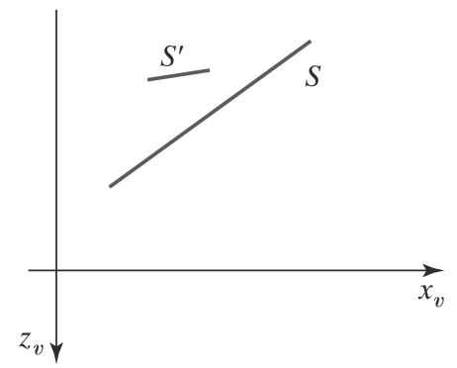
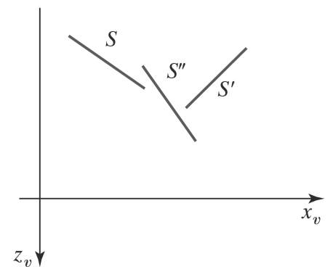
Use of Sorted List
Three surfaces that have been entered into the sorted surface list in the order S, S’, S’’ should be reordered as S’,S’’, S.
Surface S extends to a greater depth, but it obscures surface S’

Slide 14
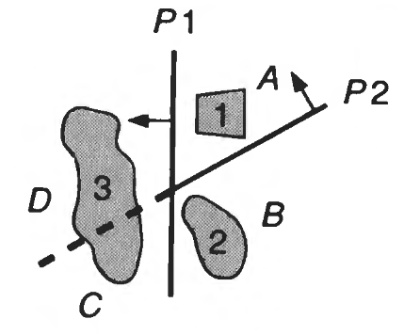
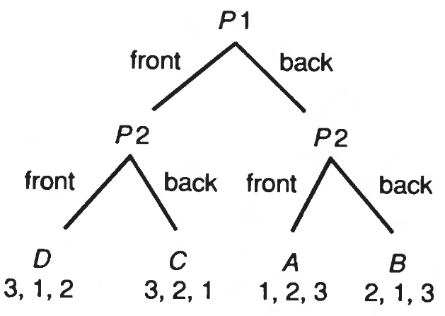
BSP Tree Method
Extremely efficient method
Calculates the visibility relationships among a static group of 3D polygons
The viewpoint can be arbitrary
Environments can be viewed as being composed of clusters

Slide 15
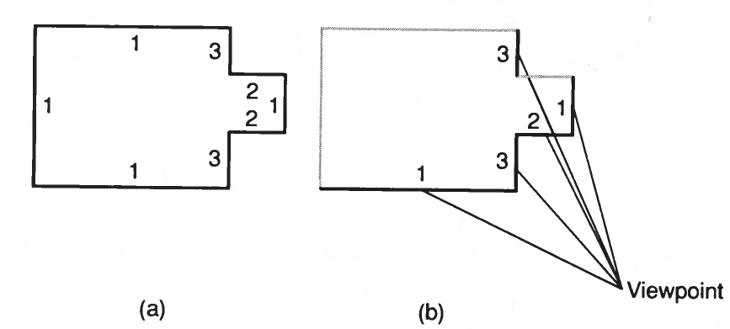
Face Priority

Slide 16
BSP Tree
The BSP tree’s root is a polygon selected from those to be displayed
The root polygon is used to partition the environment into two half-spaces.
Front-face and Back Face
Recursively partition the space till a single polygon is remaining

Slide 17
Pseudocode
BSP_ tree *BSP_makeTree (polygon *polyList)
{
polygon roof,
polygon *backList, *frontList;
polygon p, backPart, frontPart;
if {polyList == NULL)
return NULL;
else {
root = BSP.selectAndRemovePoly (&polyList);
backList = NULL;
frontList = NULL;
for (each remaining polygon p in polyList) {
if (polygon p in front of root)
BSP.addToList (p, &frontList);
else if (polygon p in back of root)
BSP.addToList (p, &backList);
else { /* Polygon p must be split. */
BSP.splitPoly (p, root, &frontPart, &backPart);
BSP.addToList {frontPart, &frontList);
BSP.addToList (backPart, &backList);
}
}
return BSP.combineTree (BSP.makeTree (frontList),
root,
BSP. makeTree (backList));
}
}

Slide 18
Illustration
5
2
3
4
1

Slide 19
Thank you
Next Lecture: Visible Surface Detection

