Slide 1

CS552: Computer Graphics
Lecture 32: Visible Surface Detection

Slide 2
Recap
Solid Modeling
Represent the solid object in a 3D space
B-Reps
Subdividing algorithms

Slide 3
Objective
After completing this lecture, students will be able to
Explain the importance of VSDs
Solve the problem of backface culling

Slide 4
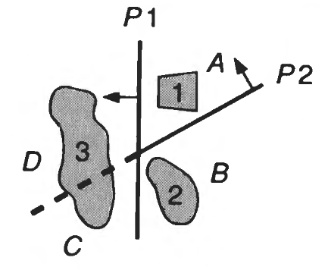
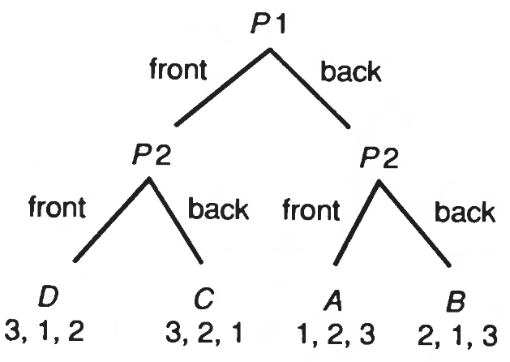
BSP Tree Method
Extremely efficient method
Calculates the visibility relationships among a static group of 3D polygons
The viewpoint can be arbitrary
Environments can be viewed as being composed of clusters

Slide 5
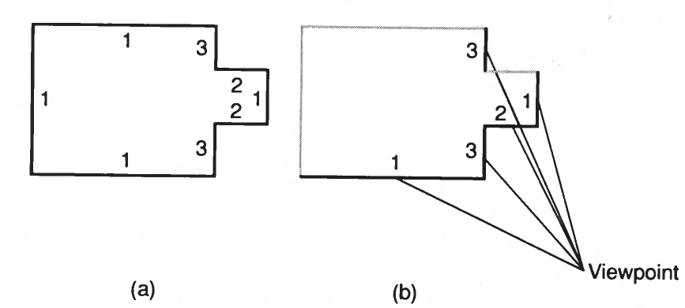
Face Priority

Slide 6
BSP Tree
The BSP tree’s root is a polygon selected from those to be displayed
The root polygon is used to partition the environment into two half-spaces.
Front-face and Back Face
Recursively partition the space till a single polygon is remaining

Slide 7
Pseudocode
BSP_ tree *BSP_makeTree (polygon *polyList)
{
polygon roof,
polygon *backList, *frontList;
polygon p, backPart, frontPart;
if {polyList == NULL)
return NULL;
else {
root = BSP.selectAndRemovePoly (&polyList);
backList = NULL;
frontList = NULL;
for (each remaining polygon p in polyList) {
if (polygon p in front of root)
BSP.addToList (p, &frontList);
else if (polygon p in back of root)
BSP.addToList (p, &backList);
else { /* Polygon p must be split. */
BSP.splitPoly (p, root, &frontPart, &backPart);
BSP.addToList {frontPart, &frontList);
BSP.addToList (backPart, &backList);
}
}
return BSP.combineTree (BSP.makeTree (frontList),
root,
BSP. makeTree (backList));
}
}

Slide 8
Illustration
5
2
3
4
1

Slide 9
Illustration
5
2
3
4
1

Slide 10
Illustration
4
5
2
2
5
3
3
1
6
4
1

Slide 11
Area-subdivision
Follow the divide-and-conquer strategy
Spatial partitioning in the projection plane.
An area of the projected image is examined.
This approach exploits area coherence,

Slide 12
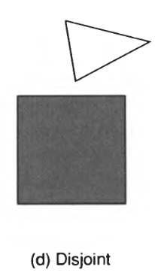
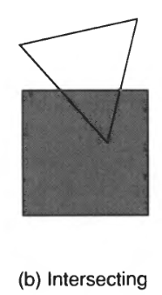
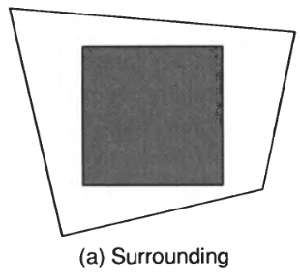
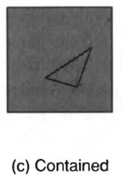
Warnock's Algorithm
Subdivides each area into four equal squares.
The projection of each polygon has one of four relationships to the area of interest

Slide 13
Steps
All the polygons are disjoint from the area.
The background color can be displayed in the area.
There is only one intersecting or only one contained polygon.
The area is first filled with the background color, and
then the part of the polygon contained in the area is scan-converted.
There is a single surrounding polygon, but no intersecting or contained polygons.
The area is filled with the color of the surrounding
More than one polygon is intersecting, contained in, or surrounding the area, but one is a surrounding polygon that is in front of all the other polygons.

Slide 14
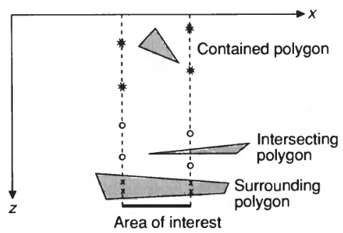
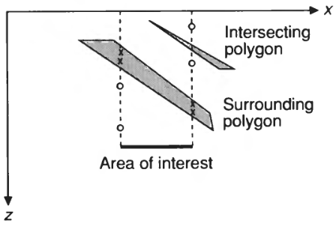
Illustration

Slide 15
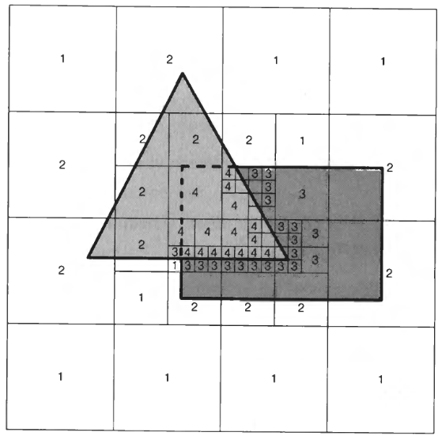
Example

Slide 16
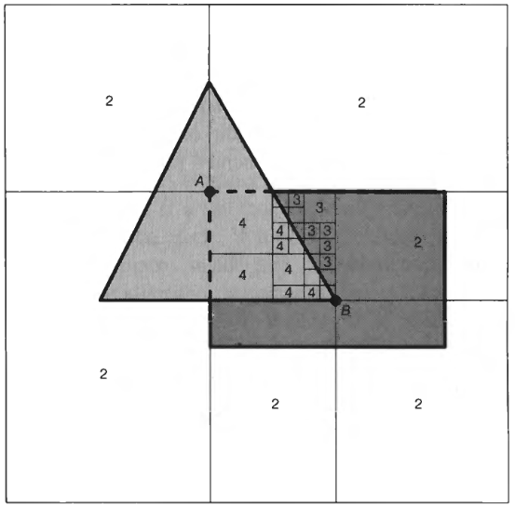
Example

Slide 17
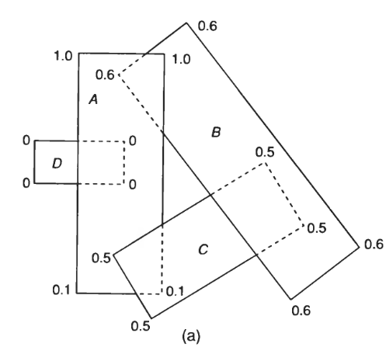
The Weiler- Atherton Algorithm

Slide 18
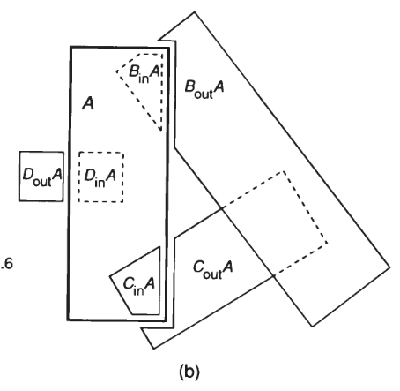
The Weiler- Atherton Algorithm

Slide 19
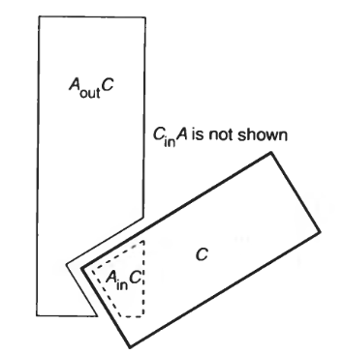
The Weiler- Atherton Algorithm

Slide 20
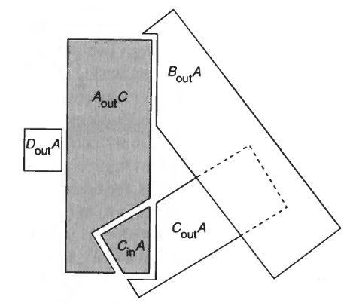
The Weiler- Atherton Algorithm

Slide 21
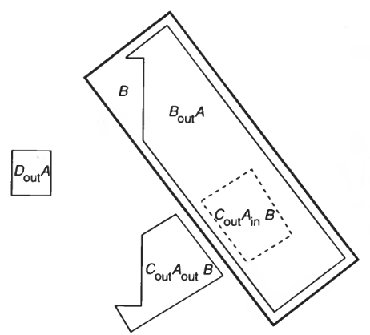
The Weiler- Atherton Algorithm

Slide 22
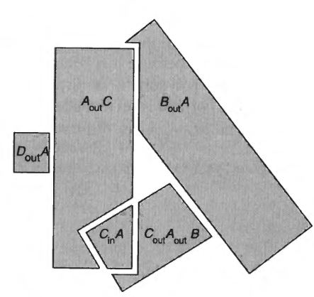
The Weiler- Atherton Algorithm

Slide 23
Thank you
Next Lecture: Illumination and Shading

