Slide 1

CS552: Computer Graphics
Lecture 33: Illumination and Shading

Slide 2
Recap
Solid Modeling
Represent the solid object in a 3D space
B-Reps
Subdividing algorithms

Slide 3
Objective
After completing this lecture, students will be able to
Explain the importance of VSDs
Solve the problem of backface culling

Slide 4
Surface Rendering Method
Realistic displays of a scene are obtained by
Generating perspective projections of objects and
Applying natural lighting effects to the visible surfaces
An illumination model is used to calculate the color of an illuminated position on the surface of an object.
A surface-rendering method uses the color calculations from an illumination model to determine the pixel colors for all projected positions in a scene.

Slide 5
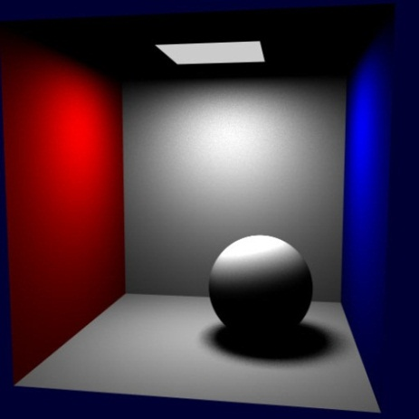
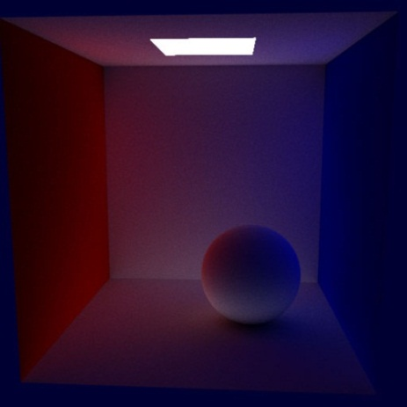
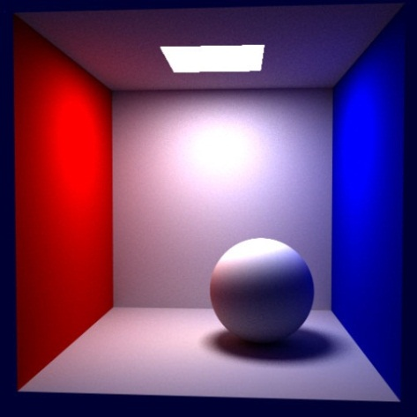
Global Illumination
+
=
Direct illumination
Indirect illumination
Total illumination

Slide 6
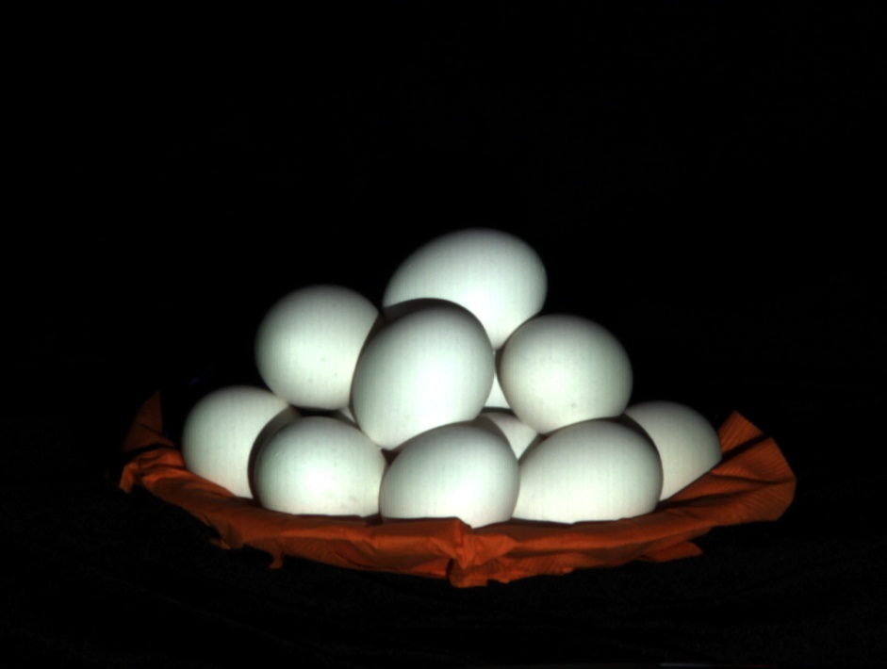
Diffuse Inter-reflection
Total illumination (normal image)

Slide 7
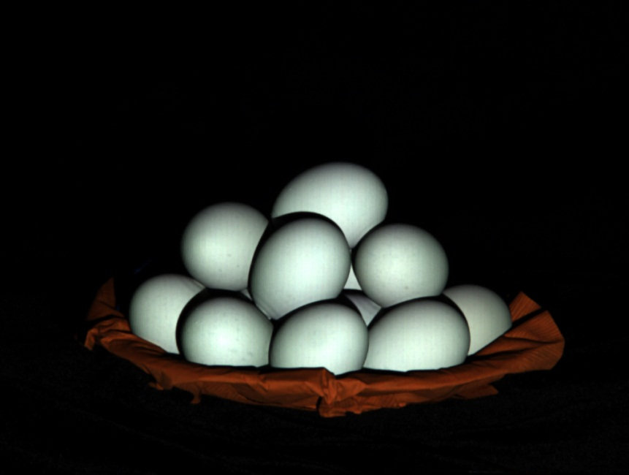
Diffuse Inter-reflection
Direct illumination

Slide 8
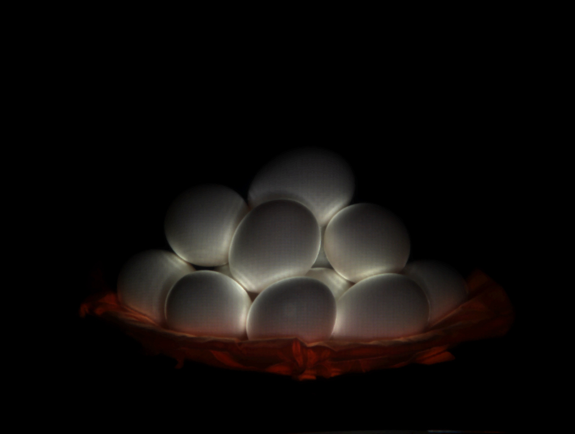
Diffuse Interreflection
Indirect illumination (diffuse interreflection)

Slide 9
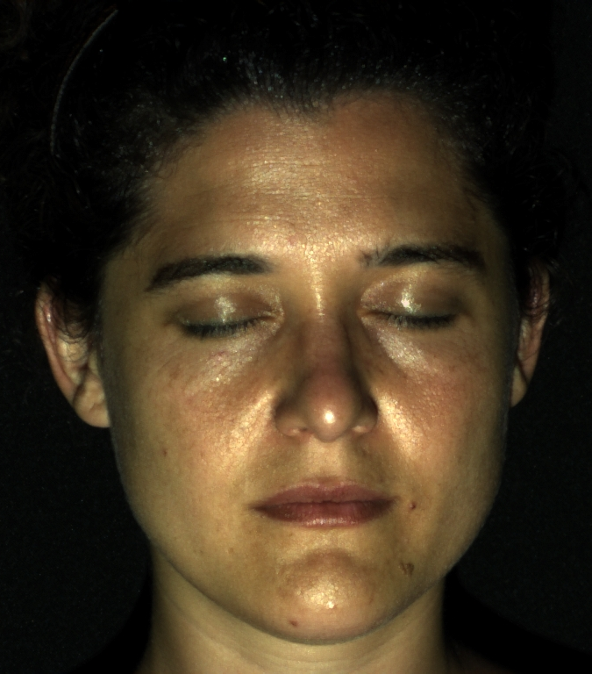
Human face
Total illumination (normal image)

Slide 10
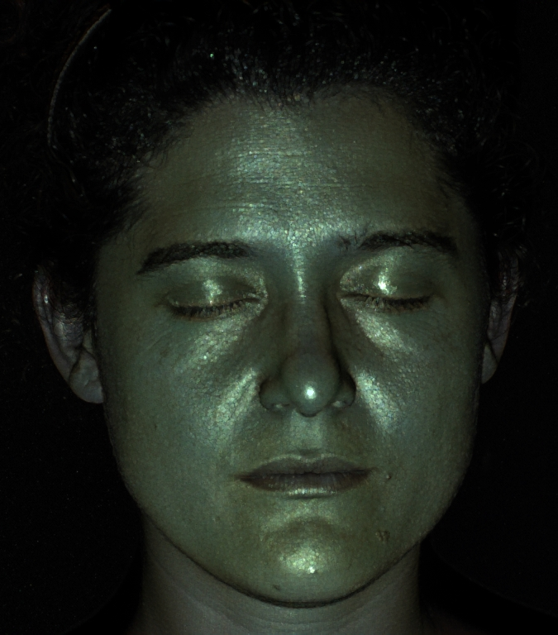
Human face
Direct illumination

Slide 11
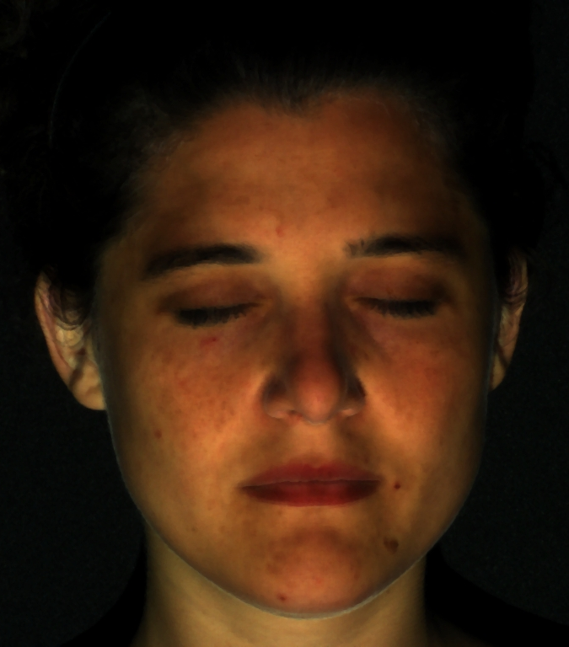
Human face
Indirect illumination

Slide 12
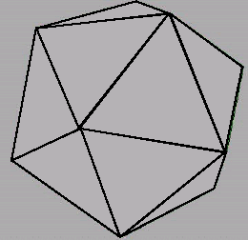

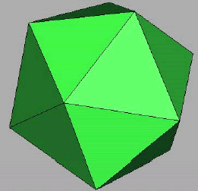
Illumination
How do We Compute Radiance for a Sample Ray?
Must derive computer models for ...
Emission at light sources
Scattering at surfaces
Reception at the camera
Wireframe
Without
Illumination
Direct
Illumination

Slide 13
Overview
Direct Illumination
Emission at light sources
Scattering at surfaces
Global Illumination
Shadows
Refractions
Inter-object reflections
Direct Illumination

Slide 14
Overview
Direct Illumination
Emission at light sources
Scattering at surfaces
Global Illumination
Shadows
Refractions
Inter-object reflections
Direct Illumination

Slide 15
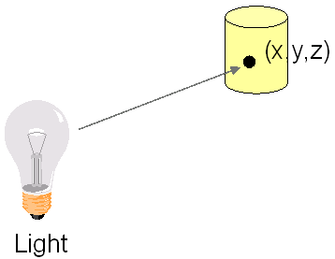
Modeling Light Source
I_{L}(x,y,z,θ,φ,λ)
Describes the intensity of energy,
Leaving a light source
Arriving at location(x,y,z)
From direction (θ,φ)
With wavelength λ

Slide 16
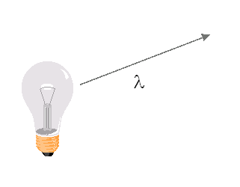
Empirical Model
Ideally Measure Irradiant Energy for “All” Situations
Too much storage
Difficult in practice

Slide 17


Light Source Model
Simple Mathematical Models:
Point light
Directional light
Spot light

Slide 18
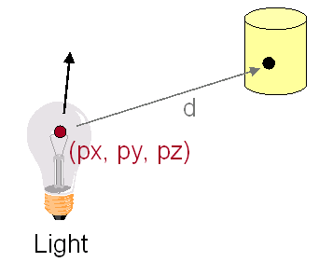
Point Light Source
Models Omni-Directional Point Source (E.g., Bulb)
Intensity (I₀)
Position (px, py, pz)
Factors (k_{c}, k_{l}, k_{q}) for attenuation with distance (d)

Slide 19
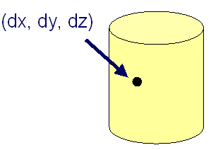
Directional Light Source
Models Point Light Source at Infinity (E.g., Sun)
Intensity (I₀)
Direction (dx,dy,dz)
No attenuation
with distance

Slide 20
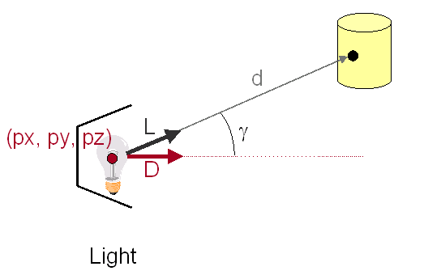
Spot Light Source
Models Point Light Source with Direction
Intensity (I₀),
Position (px, py, pz)
Direction (dx, dy, dz)
Attenuation

Slide 21
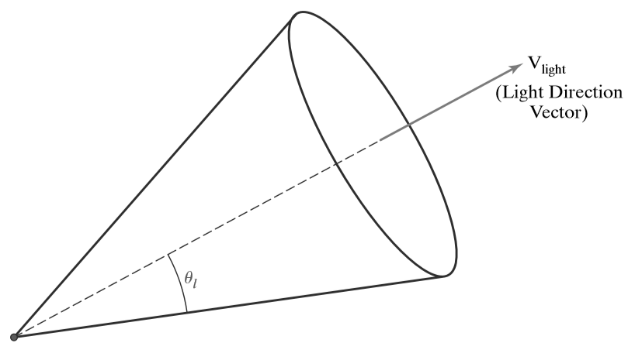
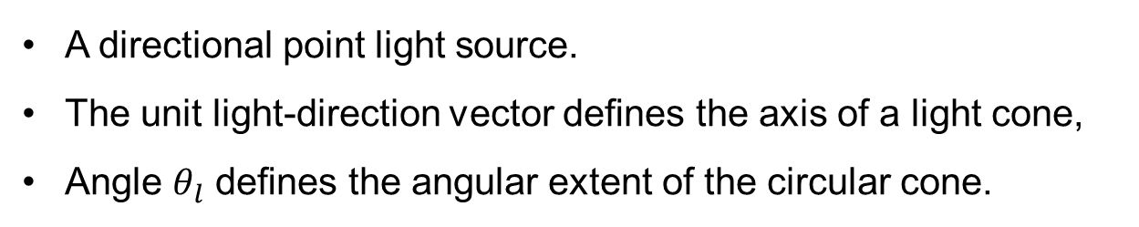
Directional Light Sources
A directional point light source.
The unit light-direction vector deﬁnes the axis of a light cone,
Angle $θ_{l}$ deﬁnes the angular extent of the circular cone.

Slide 22

Angular Intensity Attenuation
Attenuate the light intensity
Angularly about the source
Radially out from the point-source position.

Slide 23
Overview
Direct Illumination
Emission at light sources
Scattering at surfaces
Global Illumination
Shadows
Refractions
Inter-object reflections
Direct Illumination

Slide 24
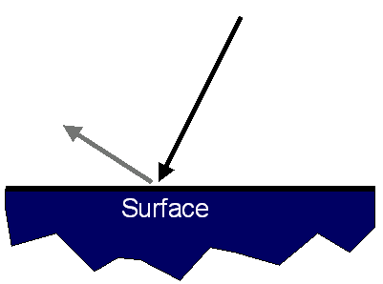
Modeling Surface Reflection
R_{s}(θ,φ,γ,ψ,λ)
Describes the amount of incident energy
Arriving from direction (θ,φ)
Leaving in direction (γ,ψ)
With wavelength λ

Slide 25
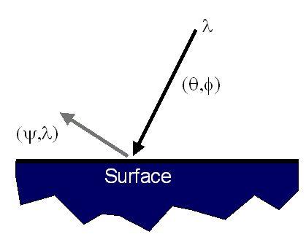
Empirical Model
Ideally Measure Radiant Energy for “All” Combinations of Incident Angles
Too much storage
Difficult in practice

Slide 26
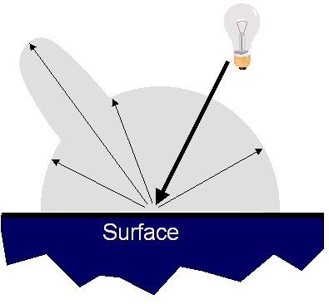
Reflectance Model
Simple Analytic Model:
Diffuse reflection +
Specular reflection +
Emission +
“Ambient”
Based on model
proposed by Phong

Slide 27
Reflectance Model
Simple Analytic Model:
Diffuse reflection +
Specular reflection +
Emission +
“Ambient”
Based on model
proposed by Phong

Slide 28
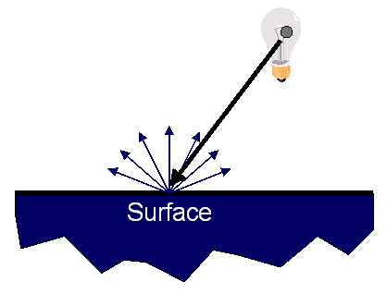
Diffuse Reflection
Assume Surface Reflects Equally in All Directions
Examples: chalk, clay

Slide 29
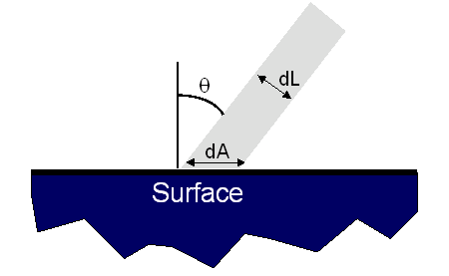
Diffuse Reflection
How Much Light is Reflected?
Depends on angle of incident light
dL = dA cos Θ

Slide 30
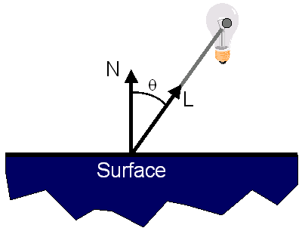
Diffuse Reflection
Lambertian Model
Cosine law (dot product)

Slide 31
Reflectance Model
Simple Analytic Model:
Diffuse reflection +
Specular reflection +
Emission +
“Ambient”
Based on model
proposed by Phong

Slide 32
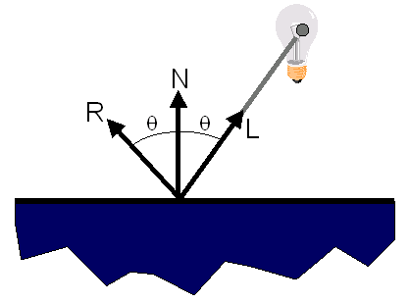
Specular Reflection
Reflection is Strongest Near Mirror Angle
Examples: mirrors, metals

Slide 33
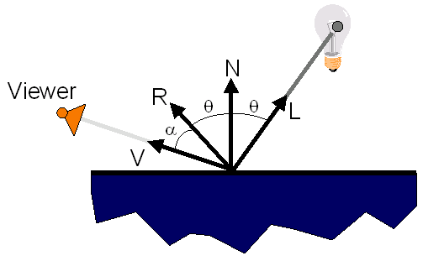
Specular Reflection
How Much Light is Seen?
Depends on angle of incident light and angle to viewer

Slide 34
Specular Reflection
Phong Model
{cos(α)}^{n}

Slide 35
Reflectance Model
Simple Analytic Model:
Diffuse reflection +
Specular reflection +
Emission +
“Ambient”
Based on model
proposed by Phong

Slide 36
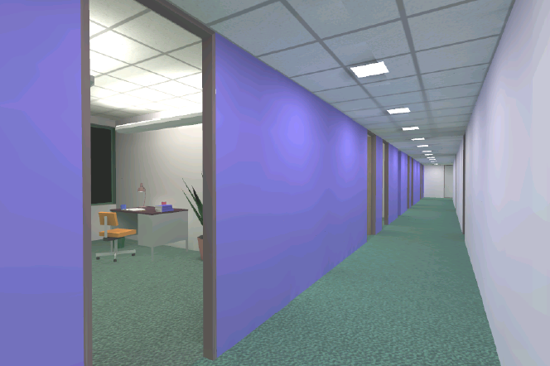
Emission
Represents Light Emitting Directly From Polygon
Emission ≠ 0

Slide 37
Reflectance Model
Simple Analytic Model:
Diffuse reflection +
Specular reflection +
Emission +
“Ambient”
Based on model
proposed by Phong

Slide 38
Ambient Term
Represents Reflection of All Indirect Illumination

Slide 39
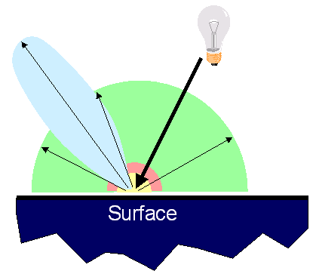
Reflectance Model
Simple Analytic Model:
Diffuse reflection +
Specular reflection +
Emission +
“Ambient”

Slide 40
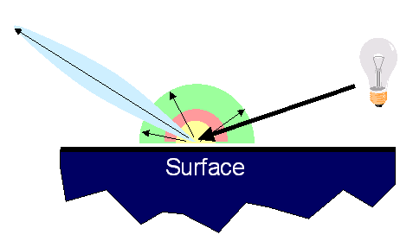
Reflectance Model
Simple Analytic Model:
Diffuse reflection +
Specular reflection +
Emission +
“Ambient”

Slide 41
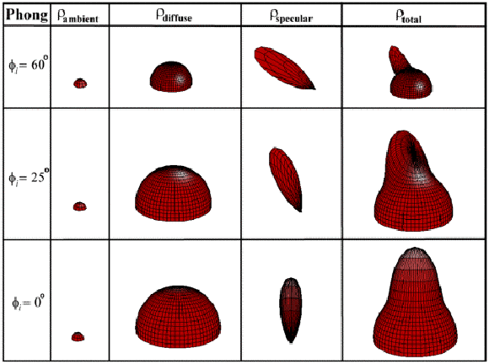
Reflectance Model
Sum Diffuse, Specular, Emission, and Ambient

Slide 42
Surface Illumination Calculation
Single Light Source:

Slide 43
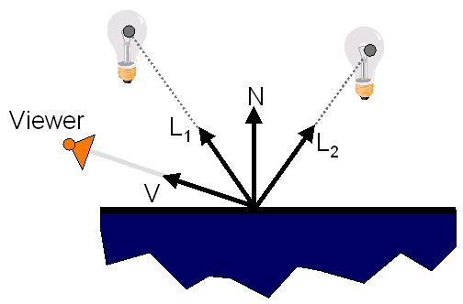
Surface Illumination Calculation
Multiple Light Sources:

Slide 44
Overview
Direct Illumination
Emission at light sources
Scattering at surfaces
Global Illumination
Shadows
Refractions
Inter-object reflections
Global Illumination

Slide 45

Global Illumination

Slide 46
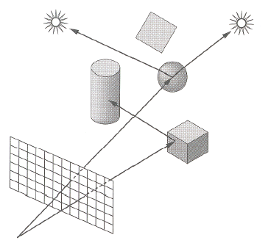
Shadows
Shadow Terms Tell Which Light Sources are Blocked
Cast ray towards each light source L_{i}
S_{i} = 0 if ray is blocked, S_{i} = 1 otherwise
Shadow
Term

Slide 47
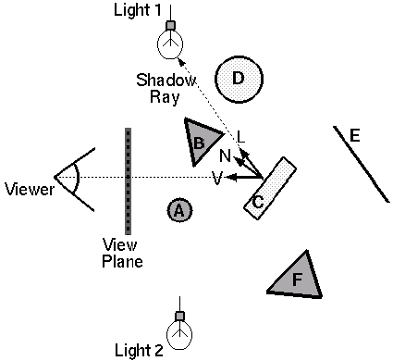
Ray Casting
Trace Primary Rays from Camera
Direct illumination from unblocked lights only

Slide 48
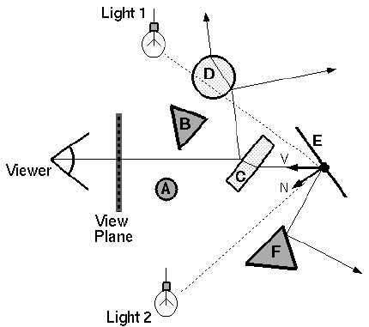
Recursive Ray Tracing
Also Trace Secondary Rays from Hit Surfaces
Global illumination from mirror reflection and transparency

Slide 49
Mirror Reflection
Trace Secondary Ray in Direction of Mirror Reflection
Evaluate radiance along secondary ray and include it into illumination model
Radiance
for mirror
reflection ray

Slide 50
Transparency
Trace Secondary Ray in Direction of Refraction
Evaluate radiance along secondary ray and include it into illumination model
Radiance for
refraction ray

Slide 51
Transparency
Transparency coefficient is fraction transmitted
K_{T} = 1 if object is translucent, K_{T} = 0 if object is opaque
0 < K_{T} < 1 if object is semi-translucent
Transparency
Coefficient

Slide 52
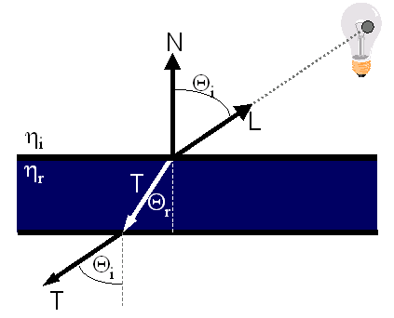
Refractive Transparency
For Thin Surfaces, Can Ignore Change in Direction
Assume light travels straight through surface

Slide 53
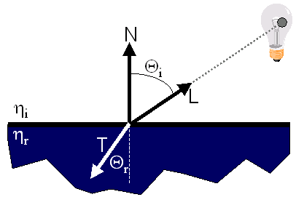
Refractive Transparency
For Solid Objects, Apply Snell’s Law:
η_{r} sin Θ_{r} = η_{i} sin Θ_{i}

Slide 54
Summary
Direct Illumination
Ray casting
Usually use simple analytic approximations for light source emission and surface reflectance
Global illumination
Recursive ray tracing
Incorporate shadows, mirror reflections,
and pure refractions

Slide 55
Illumination Terminology
Radiant power [flux] (Φ)
Rate at which light energy is transmitted (in Watts).
Radiant Intensity (I)
Power radiated onto a unit solid angle in direction( in Watt/sr)
e.g.: energy distribution of a light source (inverse square law)
Radiance (L)
Radiant intensity per unit projected surface area( in Watts/m²sr)
e.g.: light carried by a single ray (no inverse square law)
Irradianc (E)
Incident flux density on a locally planar area (in Watts/m² )
Radiosity (B)
Exitant flux density from a locally planar area ( in Watts/m² )

Slide 56
Thank you
Next Lecture: Rendering

