Slide 1

CS552: Computer Graphics
Lecture 34: Rendering

Slide 2
Recap
Illumination Model
Light Source
Point source
Directional
Spot Light
Surface
Diffuse
Specular
Emission
Ambient

Slide 3
Objective
After completing this lecture, students will be able to
Explain reflectance model
Describe various illumination models

Slide 4
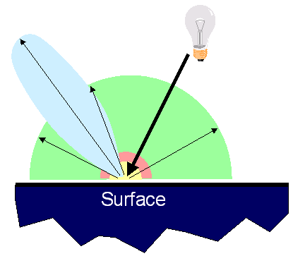
Reflectance Model
Simple Analytic Model:
Diffuse reflection +
Specular reflection +
Emission +
“Ambient”

Slide 5
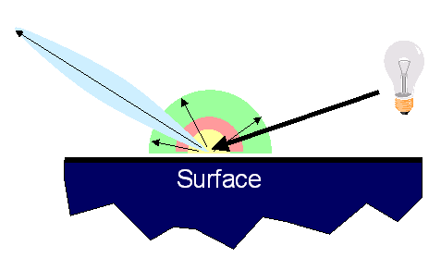
Reflectance Model
Simple Analytic Model:
Diffuse reflection +
Specular reflection +
Emission +
“Ambient”

Slide 6
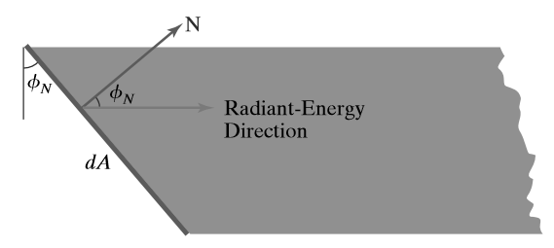

Diffuse Reflection
Lambert’s cosine law
The intensity of light is the same over all viewing directions

Slide 7

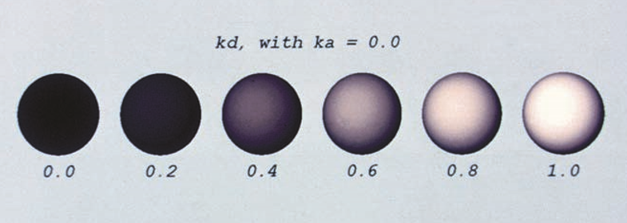
Effect of diffuse reflection coefficient

Slide 8
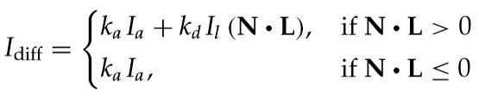
Combining Ambient and Diffuse Reflection
Combine the ambient and point-source intensity calculations to obtain an expression for the total diffuse reﬂection at a surface position
Ambient-reﬂection coefﬁcient

Slide 9
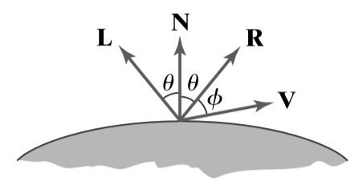

Specular Reflection
Phong model: sets the intensity of specular reﬂection proportional to $Cos^{n_{s}}φ$
Specular-reﬂection exponent = $ns$

Slide 10
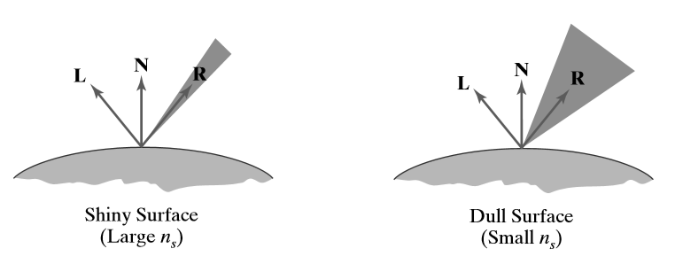

Choice of $ns$

Slide 11
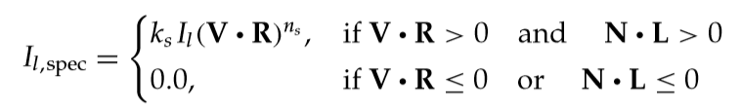
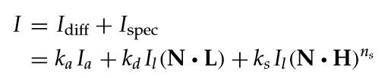
Specular Reflection Equation
Combined Diffuse and Specular Reﬂections

Slide 12
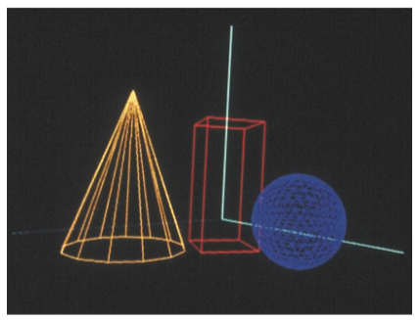
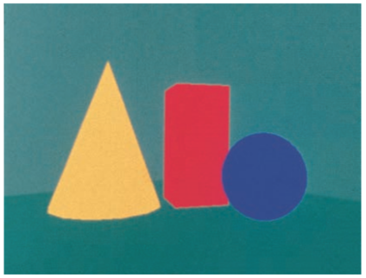
Illustration

Slide 13
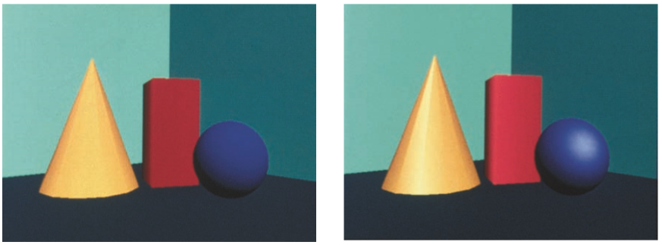
Illustration

Slide 14
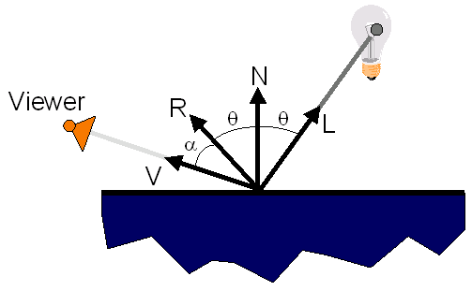
Surface Illumination Calculation
Single Light Source:

Slide 15
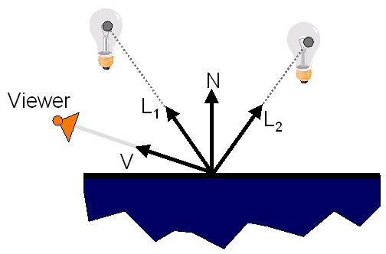
Surface Illumination Calculation
Multiple Light Sources:

Slide 16

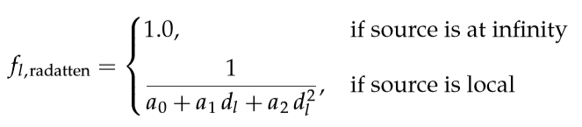
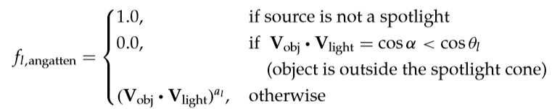
Illumination Model with Intensity Attenuation and Spotlights
General, monochromatic illumination model for surface reﬂections

Slide 17
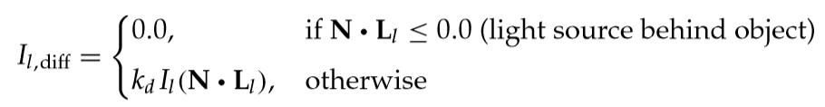
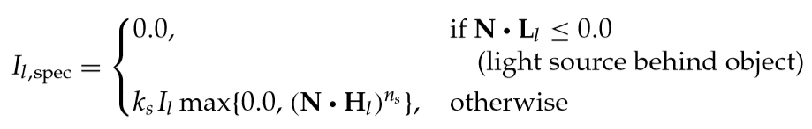
Illumination Model with Intensity Attenuation and Spotlights
General, monochromatic illumination model for surface reﬂections

Slide 18




RGB Color Considerations
Each intensity speciﬁcation in the illumination model is a three-element vector
Similarly, the reﬂection coefﬁcients
Each component of the surface color is then calculated with a separate expression.

Slide 19
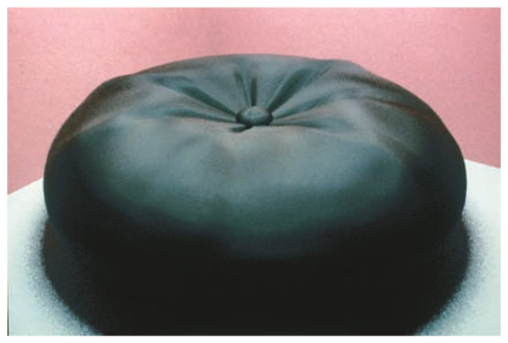
Illustration
Color reﬂections from matte surfaces.

Slide 20
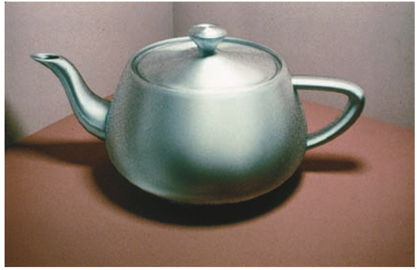
Illustration
Color reﬂections from metal surfaces.

Slide 21
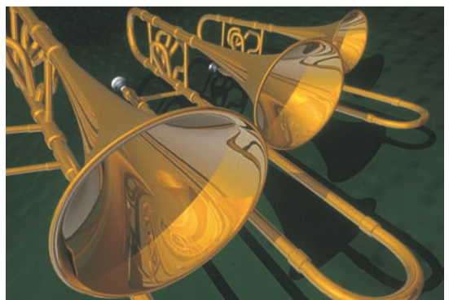
Illustration
Color reﬂections from metal surfaces.

Slide 22


Setting surface color
To specify the components of diffuse and specular color vectors for each surface
Retaining the reﬂectivity coefﬁcients as single-valued constants
Blue component of the diffuse reflection
Reflectivity coefficient as vector
Reflectivity coefficient as single-valued constant

Slide 23
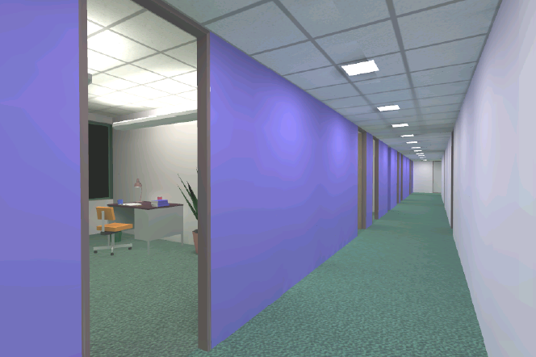
Overview
Direct Illumination
Emission at light sources
Scattering at surfaces
Global Illumination
Shadows
Refractions
Inter-object reflections
Global Illumination

Slide 24

Global Illumination

Slide 25
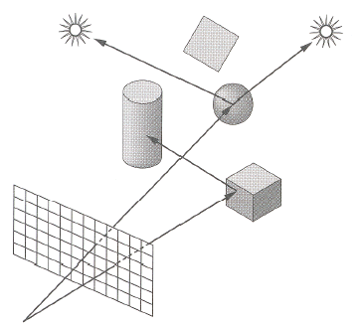
Shadows
Shadow Terms Tell Which Light Sources are Blocked
Cast ray towards each light source L_{i}
S_{i} = 0 if ray is blocked, S_{i} = 1 otherwise
Shadow
Term

Slide 26
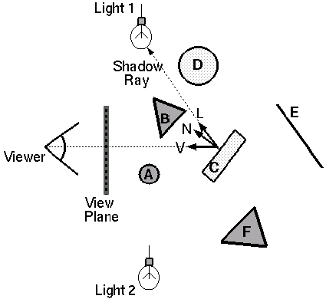
Ray Casting
Trace Primary Rays from Camera
Direct illumination from unblocked lights only

Slide 27
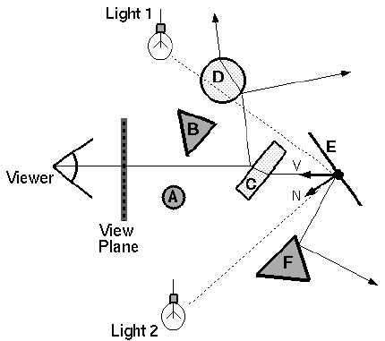
Recursive Ray Tracing
Also Trace Secondary Rays from Hit Surfaces
Global illumination from mirror reflection and transparency

Slide 28
Mirror Reflection
Trace Secondary Ray in Direction of Mirror Reflection
Evaluate radiance along secondary ray and include it into illumination model
Radiance
for mirror
reflection ray

Slide 29
Transparency
Trace Secondary Ray in Direction of Refraction
Evaluate radiance along secondary ray and include it into illumination model
Radiance for
refraction ray

Slide 30
Transparency
Transparency coefficient is fraction transmitted
K_{T} = 1 if object is translucent, K_{T} = 0 if object is opaque
0 < K_{T} < 1 if object is semi-translucent
Transparency
Coefficient

Slide 31
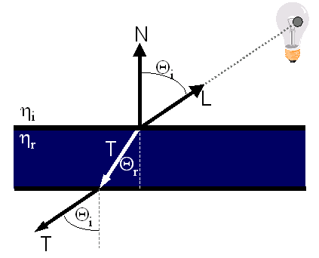
Refractive Transparency
For Thin Surfaces, Can Ignore Change in Direction
Assume light travels straight through surface

Slide 32
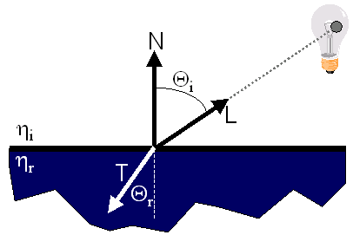
Refractive Transparency
For Solid Objects, Apply Snell’s Law:
η_{r} sin Θ_{r} = η_{i} sin Θ_{i}

Slide 33
Summary
Direct Illumination
Ray casting
Usually use simple analytic approximations for light source emission and surface reflectance
Global illumination
Recursive ray tracing
Incorporate shadows, mirror reflections,
and pure refractions

Slide 34
Illumination Terminology
Radiant power [flux] (Φ)
Rate at which light energy is transmitted (in Watts).
Radiant Intensity (I)
Power radiated onto a unit solid angle in direction( in Watt/sr)
e.g.: energy distribution of a light source (inverse square law)
Radiance (L)
Radiant intensity per unit projected surface area( in Watts/m²sr)
e.g.: light carried by a single ray (no inverse square law)
Irradianc (E)
Incident flux density on a locally planar area (in Watts/m² )
Radiosity (B)
Exitant flux density from a locally planar area ( in Watts/m² )

Slide 35
Thank you
Next Lecture: Rendering

