Slide 1

CS552: Computer Graphics
Lecture 35: Rendering

Slide 2
Recap
Illumination Model
Light Source and surface
Effect of multiple light source
Colored lights and surface
Effect of atmosphere
Refraction

Slide 3
Objective
After completing this lecture, students will be able to
Apply different shading method for rendering

Slide 4

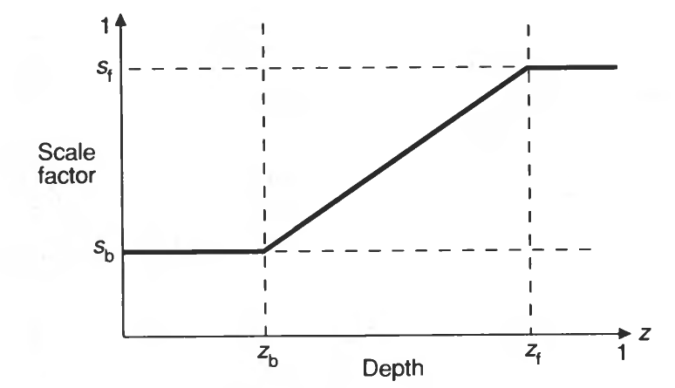

Atmospheric Attenuation
Previously computed color
Depth-cue color
Scale factor
Depth cueing

Slide 5
Shading Models for Polygon
We can shade any surface by
Calculating the surface normal at each visible point
Applying the desired illumination model at that point.
This approach is computationally expensive
There are efficient techniques to achieve the desired effect

Slide 6
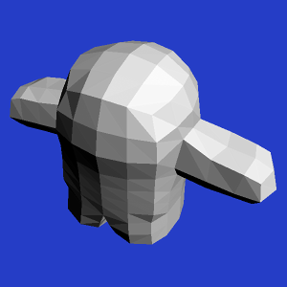
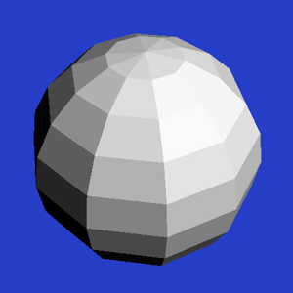
Constant Shading

Slide 7
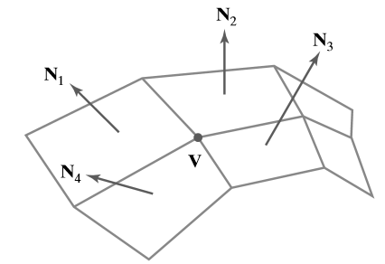
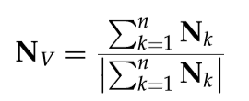
Gouraud Surface Rendering
Also referred to as intensity-interpolation surface rendering

Slide 8
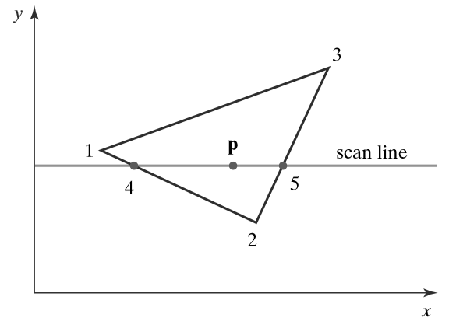


Illumination interpolation

Slide 9
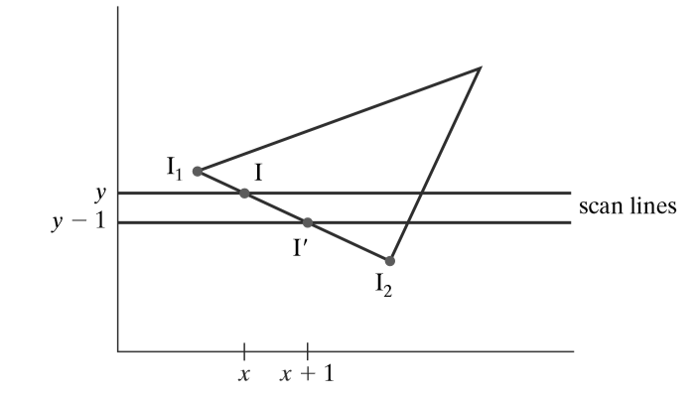
Incremental approach

Slide 10
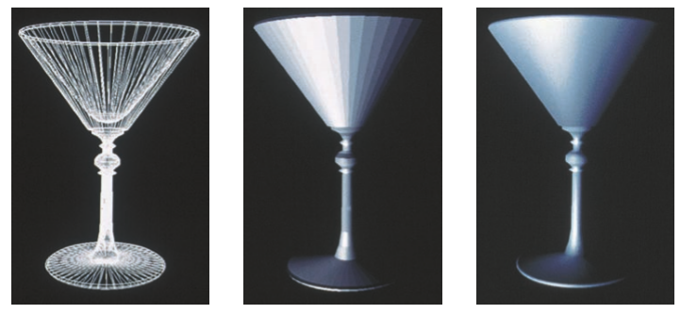
Illustration

Slide 11
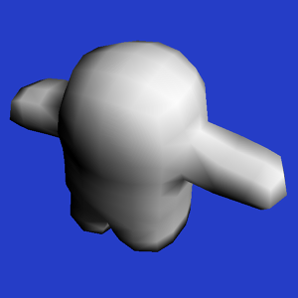
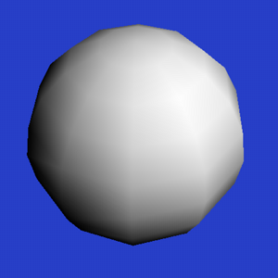
Illustration

Slide 12
Phong Surface Rendering
A more accurate interpolation method for rendering a polygon mesh
Normal-vector interpolation rendering
Interpolates normal vectors instead of intensity values

Slide 13
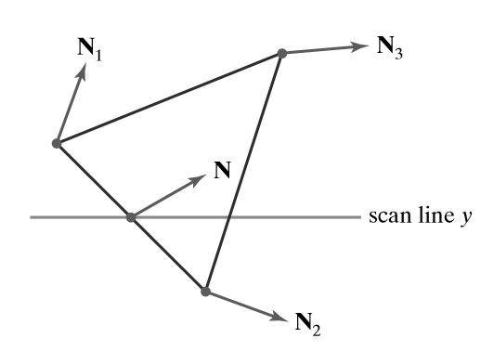
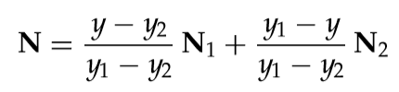
Illustration

Slide 14
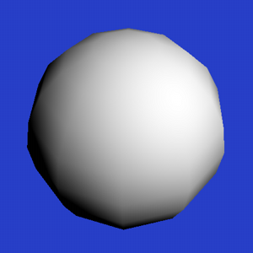

Illustrations

Slide 15
Thank you
Next Lecture: Rendering

