Slide 1

CS552: Computer Graphics
Lecture 36: Ray Tracing

Slide 2
Recap
Visibility detection
Illumination Model

Slide 3
Objective
After completing this lecture, students will be able to
Apply ray tracing method for photorealistic rendering

Slide 4

© Gilles Tran

Slide 5
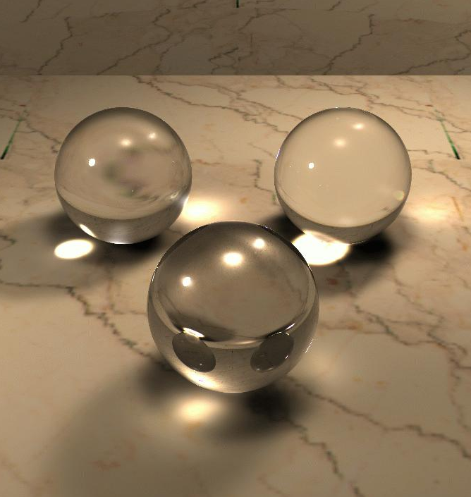
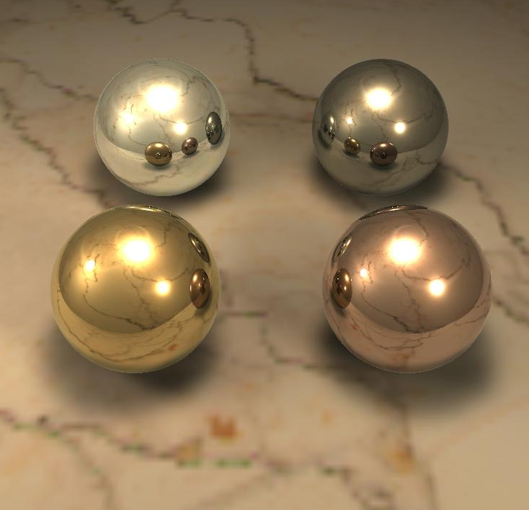
The Phong Illumination algorithm cannot generate images like these

Slide 6
Rendering Issues
What object (part) to be visible?
Visibility
Clipping
Occlusion
Illumination
Reflection
Refraction
Transparency
Shadow

Slide 7
Idea
A
Light_transport_from B to A:
Emmitance of B
Visibility of B from A
Distance to B from A
Also:
Reflectance of B
Light_transport_from C_{i} to B
Emmitance of C
Visibility of C from B
Distance to C from B
B
C₂
C₁
C₃
D₁

Slide 8
Assumptions
I on both sides of the equation suggests an infinitely recursive path of light transfer.
We need to make some simplifying assumptions in order to solve this equation
Local Illumination algorithms assume light only “bounces” once travelling from light source to a point in the scene and then to the eye
Global Illumination algorithms account for light transport between several points on the scene before reaching the eye (several bounces)
Thus can account for refraction, shadows, reflections etc.
Less realistic, usually used in real-time rendering
More expensive, usually used in off-line rendering

Slide 9
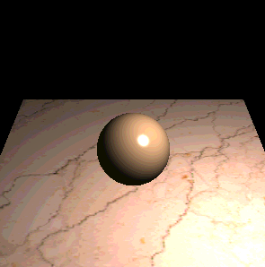
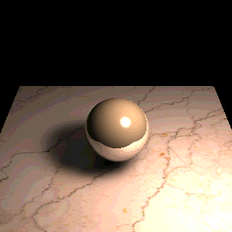
Local vs. Global Illumination
Local
Global
Illumination depends on local object &
light sources only
Illumination at a point can depend
on any other point in the scene

Slide 10
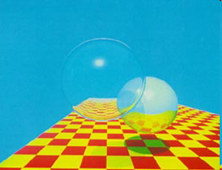
Ray Tracing
A photo-realistic rendering algorithm
Current ray tracing methods are attributed to Turner Whitted (Bell Labs. 1980) ⇒ Whitted Illumination Model
First implementation of ray tracing in computer graphics = Appel (IBM 1968)
Recursive Raytracing, 1979
Recorded in “An Improved Illumination Model for Shaded Display” (Bell Labs, 1980).

Slide 11
Ray Tracing from Eye
Tracing from light source
Traditional ray-tracing
Starting at the light position traces many rays that never reach the eye. Thus the traditional ray-tracing method is to start at the eye and trace rays back-wards to the source.
Notes:
We are only interested in light rays that reach the viewplane from the light source
If we begin at the light source only a small proportion of the rays we trace will reach the viewer
More efficient to start at viewer and trace in reverse – traditional ray tracing
Some implementations start at the light source and trace the actually light path – backwards raytracing

Slide 12
Ray Casting
Virtual Viewpoint
Virtual Screen
Objects
Ray misses all objects: Pixel colored black
Ray intersects object: shade using color, lights, materials
Multiple intersections: Use closest one (as does OpenGL)

Slide 13
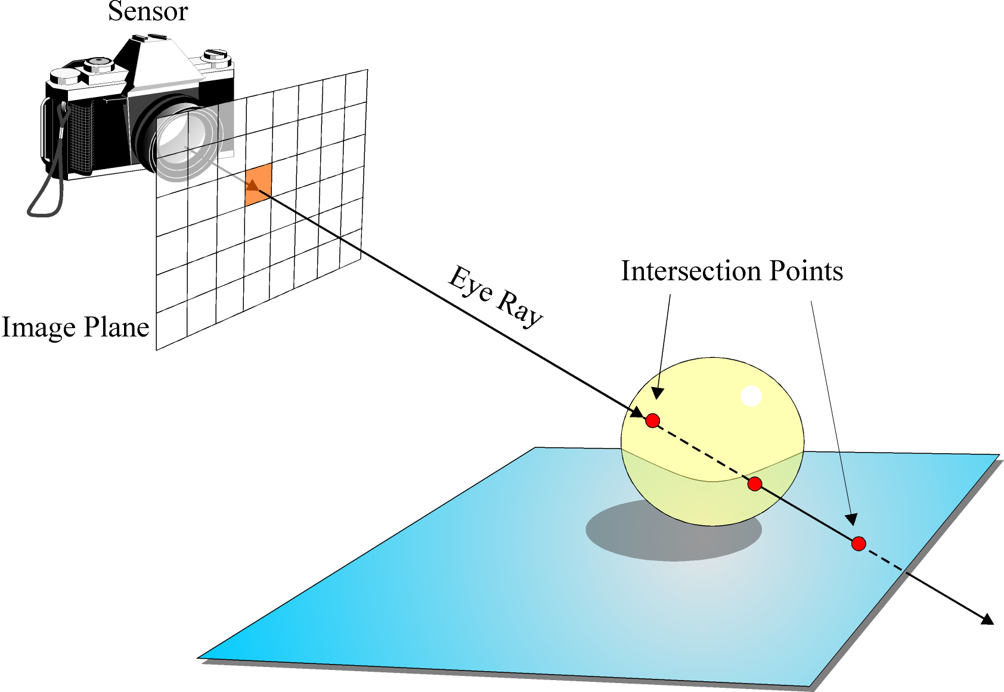
Eye Ray and Object Intersection
Cast a ray from camera position through each pixel into the scene.
Calculate where this intersects with objects in the scene. Get the first intersection.

Slide 14


Computing Intersections
Determining the intersection of a ray with an object.
Sphere
$$(x_{1},y_{1},z_{1})$$
$$(x_{0},y_{0},z_{0})$$

Slide 15
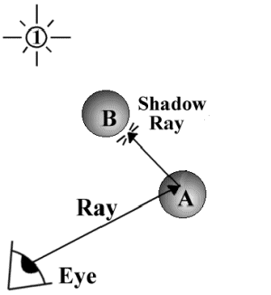
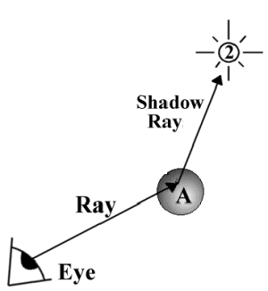
Diffuse Term
Extend a “Shadow Feeler” (or light ray) and see if it is occluded by an object in the scene
If so the object is in shadow from this light source
Otherwise solve the phong model to calculate the contribution of this point to the colour of the pixel.
If object is diffuse stop here.

Slide 16
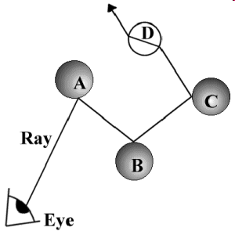
Reflection
If object is specular THEN create a ray in the direction of perfect specular reflection.
For this new ray, we will again check whether…
it intersects an object,
if so is this object in shadow
what is the contribution of this object to the colour of the pixel?
Each ray contributes to the colour of the pixel it originated from

Slide 17
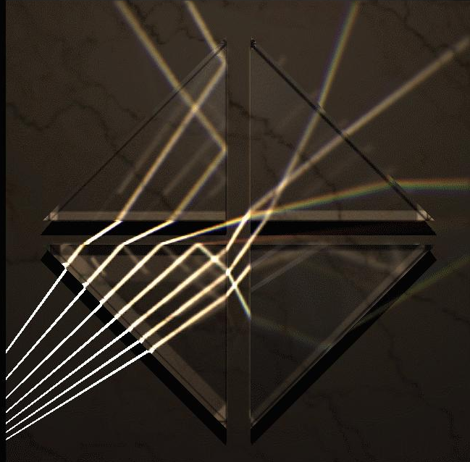
Refraction
Similarly if the object is transmissive (not-opaque) then generate a transmitted (or refracted) ray and repeat…

Slide 18
The Angle of Refraction
When light passes from a material of one optical density to another it changes direction.
The amount by which the direction changes is determined by the optical densities of the two media.
Optical density (and thus the amount of bending is related to a value we call the refractive index of the material.
Air
Air
Air
Water
Glass
Diamond

Slide 19
Index of Refraction (ior)
Material
Index of Refraction
Vacuum
1.0000
<--lowest optical density
Air
1.0003
Ice
1.31
Water
1.333
Ethyl Alcohol
1.36
Plexiglas
1.51
Crown Glass
1.52
Light Flint Glass
1.58
Dense Flint Glass
1.66
Zircon
1.923
Diamond
2.417
Rutile
2.907
Gallium phosphide
3.50
<--highest optical density
You can try these refracted index values in POVRay.

Slide 20
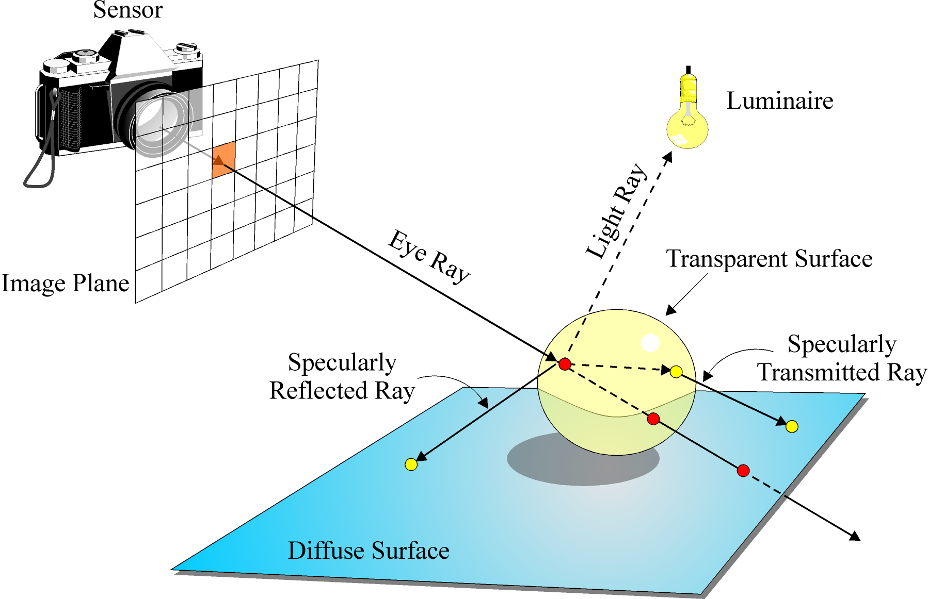
Ray Tracing Summary

Slide 21
Thank you
Next Lecture: Ray Tracing

