Slide 1

CS552: Computer Graphics
Lecture 3: Introduction to 2D Graphics

Slide 2
Recap
What is OpenGL
How to install and configure OpenGL in Windows and Linux
OpenGL rendering pipeline

Slide 3
Objective
After this lecture students will be able to
Explain different graphics platform
Differentiate between different coordinate systems
Use different coordinate system in OpenGL
Solve numerical problems on basic 2D transformation

Slide 4
Why Learn 2D first?
A good stepping stone towards 3D – many issues much easier to understand in 2D
No need to simulate lights, cameras, the physics of light interacting with objects, etc.
Introduction to modeling vs. rendering and other notions
2D is still really important and the most common use of computer graphics
In UI/UX, documents, browsers

Slide 5
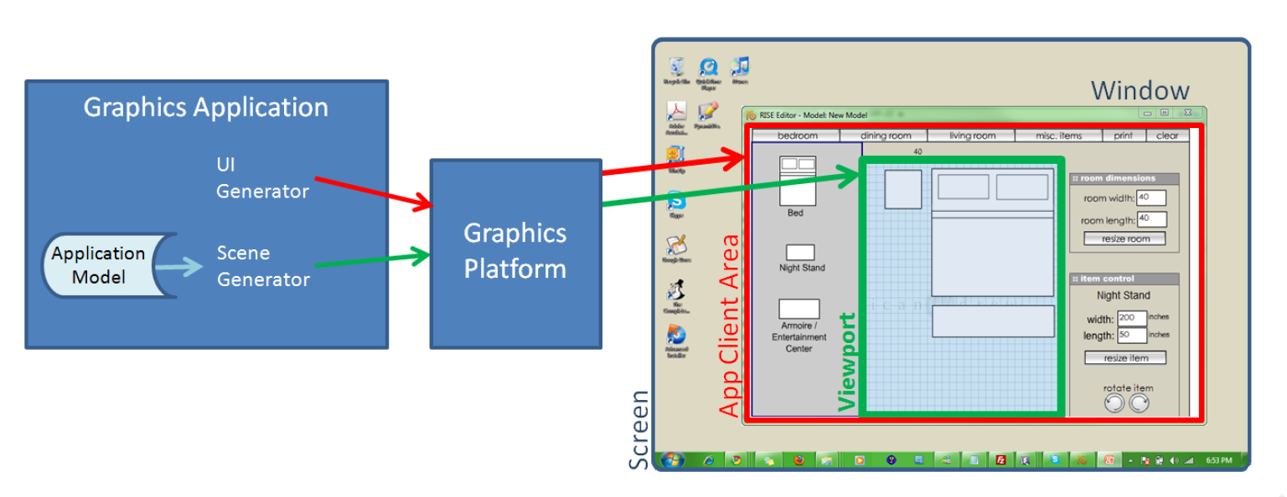
Graphics Platforms (1/4)
Applications that only write pixels are rare
Application Model (AM) is the data being represented by a rendered image
manipulated by user interaction with the application
typically a hierarchical model, with components built from lower-level components
Graphics Platform is intermediary between application and platform
Rendering and interaction handling

Slide 6
Graphics Platforms (2/4)
Graphics Platform runs in conjunction with window manager
Determines what section of the screen is allocated to the application
Handles “chrome” (title bar, resize handles);
client area is controlled by application

Slide 7
Graphics Platforms (3/4)
Typically, AM uses client area for:
user interface to collect input to the AM
display some representation of AM in the viewport
This is usually called the scene, in the context of both 2D and 3D applications
Scene is rendered by the scene generator, which is typically separate from the UI generator, which renders rest of UI

Slide 8
Graphics Platforms (4/4)
Early raster graphics packages/libraries/platforms
RamTek library 1981, Apple QuickDraw 1984
Microsoft's Graphics Display Interface (GDI 1990, now GDI+), Java.awt.Graphics2D
Earliest packages usually had these characteristics:
geometric primitives/shapes, appearance attributes specified in attribute bundles (a.k.a. ”graphical contexts”/”brushes”)
Integer coordinates map directly to screen pixels on output device
immediate mode (no record kept of display commands)
no built-in functions for applying transforms to primitives
no built-in support for component hierarchy (no composite shapes)
Early packages were little more than assembly languages

Slide 9
Problems with Early Graphics Platforms (1/3)
Geometric Scalability
Integer coordinates mapped to display pixels affects apparent size of image:
Large on low-res display & small on high-res display
Application needs flexible internal coordinate representation
floating point is essential
float to fixed conversion required;
actually a general mapping

Slide 10
Problems with Early Graphics Platforms (2/3)
Display updates
Application must keep list of all primitives and their attributes
Transitory “feedback animations,” only a display change
Consider an interior-design layout application
when user picks up an object and drags to new location (drag?)
interim movements do not relate to data changes (what?)
application model only updated when user drops object (how?)
in immediate mode, application must re-specify entire scene each time cursor moves
Alternatively, use a retained mode platform
Called a display model to distinguish it from application model from which it is derived

Slide 11
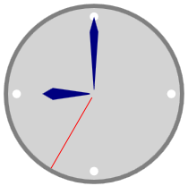
Problems with Early Graphics Platforms (3/3)
Interaction
Consider a simple clock example:
User clicks minute hand, location must be mapped to relevant application object; called pick correlation
Developer responsible for pick correlation (usually some kind of "point-in-bounding box rectangle" test based on pick coordinates)
find top-most object at clicked location
may need to find entire composite object hierarchy from lowest-level primitive to highest level composite
e.g., triangle -> hand -> clock
Solution: retained mode can do pick correlation, as it has a representation of scene

Slide 12
Modern Graphics Platforms (1/2)
Device-independent floating point coordinate system
Packages convert “application-space" to "device-space" coordinates
Specification of hierarchy
Support building scenes as hierarchy of objects,
Using transforms (scale, rotate, translate) to place children into parents' coordinate systems
support manipulating composites as coherent objects
Smart Objects (Widgets, etc.)
graphic objects have innate behaviors and interaction responses
e.g., button that automatically highlights itself when cursor is over it

Slide 13
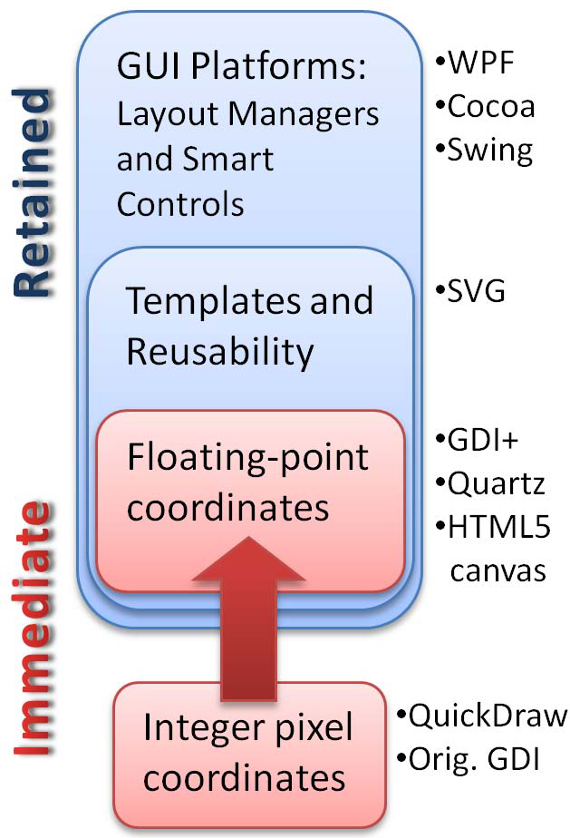
Modern Graphics Platforms (2/2)

Slide 14
Immediate Mode Vs Retained Mode
Immediate Mode (OpenGL, MSFT’s DirectX)
Application model:
stores geometric information
non-geometric information in Application Database
Platform keeps no record of primitives that compose scene

Slide 15
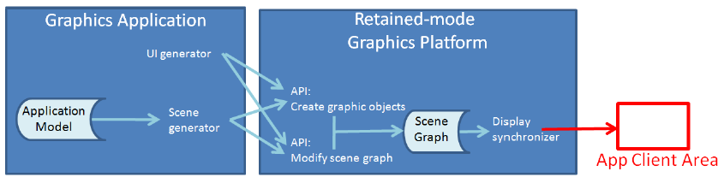
Immediate Mode Vs Retained Mode
Retained Mode (WPF, SVG, most game engines)
Application model (AM) in app and Display model in platform
Display model contains information that defines geometry to be viewed
Display model is a geometric subset of AM (scene graph)
Simple drawing application doesn’t need AM (e.g., clock example)
No right answer on which to use – context-dependent tradeoffs

Slide 16
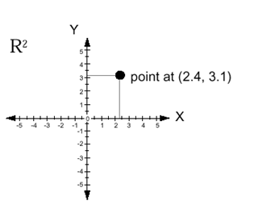
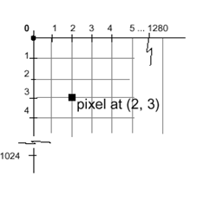
Coordinate Systems (1/3)
Cartesian coordinates in math, engineering
typically modeled as floating point
typically X increasing right, Y increasing up
Display (physical) coordinates
integer only
typically X increasing right, Y increasing down
1 unit = 1 pixel
But we want to be insulated from physical display (pixel) coordinates
OpenGL is the intermediary

Slide 17
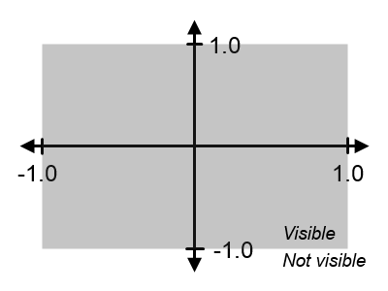
Coordinate Systems (2/3)
OpenGL Coordinates (which it maps to the window)
Choose a convention
For us: X increases right, Y increases up
Units are based on the size of the window or screen
Visible area stretches to fill window
Units are percentage of window size, don’t correspond to physical units or pixels
Define coordinate system using the projection matrix. Supply it to shader as a uniform variable (the term projection matrix will become clear)
Note: 3d glm functions still work in the special case of 2D – just use our defaults
glm::mat4 projectionMat; // Our projection matrix is a 4x4 matrix projectionMat = glm::ortho(-1, // X coordinate of left edge 1, // X coordinate of right edge -1, // Y coordinate of bottom edge 1, // Y coordinate of top edge 1, // Z coordinate of the “near” plane -1); // Z coordinate of the “far” plane

Slide 18
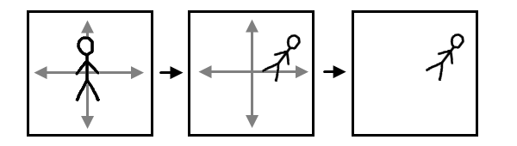
Coordinate Systems (3/3)
Two choices on how to think
Draw everything in OpenGL coordinate system
Choose your own abstract coordinate system natural for your app
Then specify all app’s primitives to OpenGL using your coordinates.
Must also specify a transformation to map the application coordinates to OpenGL coordinates
“Transformation” usually mean a composition of scale, rotate and translate transforms
Application
Coordinates
Display
OGL Coordinates

Slide 19
Winding Order (1/2)
Order is important
Vertices must be specified in counter-clockwise order relative to the viewer.
Otherwise nothing shows up!
Winding order determines the direction of the normal vector used in the “lighting calculation”;
If the normal is pointing the wrong way, we won’t see anything
Counter-clockwise winding consistent with the “right-hand rule”

Slide 20
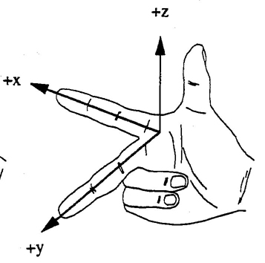
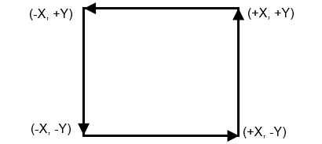
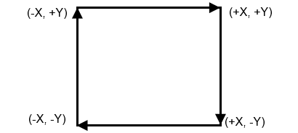
Winding Order (2/2)
GLfloat vertexData[] = {
-.7, -.7,
.7, -.7,
.7, .7,
-.7, .7, };
N
✓
GLfloat vertexData[] = {
-.7, -.7,
-.7, .7,
.7, .7,
.7, -.7, };
N
X

Slide 21
Matrix Math
Is there a difference between possible representations?
⎡
⎤
⎡
⎤
⎡
+
⎤
a
b
e
ae
bf
⎢
⎥
•
⎢
⎥
=
⎢
⎥
c
d
f
ce
+
⎣
⎦
⎣
⎦
⎣
df
⎦
⎡
⎤
[
]
a
b
[
]
e
f
•
=
ae
+
+
⎢
⎥
cf
be
df
c
d
⎣
⎦
⎡
⎤
[
]
a
c
[
]
e
f
•
=
ae
+
bf
ce
+
⎢
⎥
df
b
d
⎣
⎦

Slide 22
Matrix Math
We’ll use the column-vector representation for a point.
Which implies that we use pre-multiplication of the transformation
It appears before the point to be transformed in the equation.
What if we needed to switch to the other convention?

Slide 23
Translation
A translation moves all points in an object along the same straight-line path to new positions.
The path is represented by a vector, called the translation or shift vector.
We can write the components:
p'_{x} = p_{x} + t_{x}
p'_{y} = p_{y} + t_{y}
or in matrix form:
P' = P + T
?
t_{y}
=4
x’
y’
x
y
t_{x}
t_{y}
(2, 2)
t_{x}
= 6
= +

Slide 24
Rotation
A rotation repositions all points in an object along a circular path in the plane centered at the pivot point.
First, we’ll assume the pivot is at the origin.
P’
θ
P

Slide 25
Rotation
Review Trigonometry
=> cos φ = x/r , sin φ= y/r
x = r. cos φ, y = r.sin φ
P’(x’, y’)
θ
r
=> cos (φ+ θ) = x’/r
x’ = r. cos (φ+ θ)
x’ = r.cosφcosθ -r.sinφsinθ
x’ = x.cos θ – y.sin θ
=>sin (φ+ θ) = y’/r
y’ = r. sin (φ+ θ)
y’ = r.cosφsinθ + r.sinφcosθ
y’ = x.sin θ + y.cos θ
y’
P(x,y)
θ
r
y
φ
x’
x
Identity of Trigonometry

Slide 26
Rotation
P’(x’, y’)
We can write the components:
p'_{x} = p_{x} cos θ – p_{y} sin θ
p'_{y} = p_{x} sin θ + p_{y} cos θ
or in matrix form:
P' = R • P
θ can be clockwise (-ve) or counterclockwise (+ve).
Rotation matrix
θ
r
y’
P(x,y)
θ
r
y
φ
x’
x

Slide 27
Rotation
Example
Find the transformed point, P’, caused by rotating P= (5, 1) about the origin through an angle of 90°.

Slide 28
Scaling
It changes the size of an object
Involves two scale factors, S_{x} and S_{y} for the x- and y- coordinates respectively.
Scales are about the origin.
We can write the components:
p'_{x} = s_{x} • p_{x}
p'_{y} = s_{y} • p_{y}
or in matrix form:
P' = S • P
Scale matrix as:
P’
P

Slide 29
Scaling
If the scale factors are in between 0 and 1
the points will be moved closer to the origin
the object will be smaller.
Example :
P(2, 5), Sx = 0.5, Sy = 0.5
Find P’ ?
P(2, 5)
P’

Slide 30
Scaling
P’’
Example :
P(2, 5), Sx = 0.5, Sy = 0.5
Find P’ ?
P(2, 5)
If the scale factors are larger than 1
the points will be moved away from the origin
the object will be larger.
P’
Example :
P(2, 5), Sx = 2, Sy = 2
Find P’’ ?

Slide 31
Scaling
If the scale factors are the same,
S_{x} = S_{y}
uniform scaling
Only change in size (as previous example)
P’
If S_{x} ≠ S_{y}
differential scaling.
Change in size and shape
Example : square → rectangle
P(1, 3), S_{x} = 2, S_{y} = 5 , P’ ?
P(1, 2)
What does scaling by a negative value do?

Slide 32
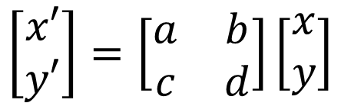
Reflection
Either x or y axis is treated as mirror
Distance of the reflection and the actual object from the mirror is same
P’ = M_{x}(P)
P’’ (-x,y)
P (x,y)
$$\left[\begin{matrix}x′ \\ y′\end{matrix}\right]=\left[\begin{matrix}a & b \\ c & d\end{matrix}\right]\left[\begin{matrix}x \\ y\end{matrix}\right]$$
P’’’ (-x,-y)
P’ (x,-y)

Slide 33

Inverse Geometric Transform
Each geometric transform has an inverse
e.g.
Translation: $T_{v}^{−1}=T_{−v}$
Rotation: $R_{θ}^{−1}=R_{−θ}$
Scaling: $S_{s_{x}s_{y}}^{−1}=S_{\frac{1}{s_{x}},\frac{1}{s_{y}}}$
Mirror reflection: $M_{x}^{−1}=M_{x}, M_{y}^{−1}=M_{y}$

Slide 34
Combining transformations
We have a general transformation of a point:
P' = M • P + A
When we scale or rotate, we set M, and A is the additive identity.
When we translate, we set A, and M is the multiplicative identity.
To combine multiple transformations, we must explicitly compute each transformed point.
Is it possible to use the same matrix operation all the time?
How to combine multiplication and addition into a single operation?

Slide 35
Homogeneous coordinates
Uniform representation of translation, rotation, scaling
Uniform representation of points and vectors
Compact representation of sequence of transformations

Slide 36
Thank you
Next Lecture: 2D Transformations

