Slide 1

CS552: Computer Graphics
Lecture 4: 2D Graphics

Slide 2
Recap
2D Graphics
Coordinate systems
2D Transformations
Translation
Scaling
Rotation
Combining Transformations

Slide 3
Objective
After completing this lecture students will be able to
Perform composite transformations in 2D
Solve mathematical problems on generalized 2D transform
Transform object coordinate to Cartesian coordinate
Write program in OpenGL to perform 2D transform

Slide 4
Combining transformations
We have a general transformation of a point:
P' = M • P + A
When we scale or rotate, we set M, and A is the additive identity.
When we translate, we set A, and M is the multiplicative identity.
To combine multiple transformations, we must explicitly compute each transformed point.
Is it possible to use the same matrix operation all the time?
How to combine multiplication and addition into a single operation?

Slide 5
Homogeneous coordinates
Uniform representation of translation, rotation, scaling
Uniform representation of points and vectors
Compact representation of sequence of transformations

Slide 6
Homogeneous coordinate
Add extra coordinate:
P = (p_{x} , p_{y} , p_{h}) or
x = (x, y, h)
Cartesian coordinates: divide by h
x = (x/h, y/h)
Points: h = 1 (for the time being…),
vectors: h = 0
y
y
w
x
➔
x

Slide 7
Homogeneous coordinate
We can always map back to the original 2D point by dividing by the last coordinate
(15, 6, 3) ---→ (5, 2).
(60, 40, 10) -→ ?.
Why do we use 1 for the last coordinate?
The fact that all the points along each line can be mapped back to the same point in 2D gives this coordinate system its name – homogeneous coordinates.

Slide 8
Matrix Representation
Point in column-vector:
A point now has three coordinates.
So the matrix is needs to be 3x3.
Translation
x
y
1

Slide 9
Matrix Representation
Rotation
Scaling

Slide 10
Composite Transformation
We can represent any sequence of transformations as a single matrix.
No special cases when transforming a point – matrix • vector.
Composite transformations – matrix • matrix.
Composite transformations:
Rotate about an arbitrary point – translate, rotate, translate
Scale about an arbitrary point – translate, scale, translate
Change coordinate systems – translate, rotate, scale
Does the order of operations matter?

Slide 11
Composition Properties
Is matrix multiplication associative?
(A.B).C = A.(B.C)
?
⎛
⎡
⎤
⎡
⎞
⎡
+
+
⎤
⎡
⎤
a
b
e
f
⎤
⎡
⎤
i
j
ae
bg
af
bh
i
j
⎜
⎢
⎥
•
⎢
⎟
•
=
•
⎜
⎥
⎢
⎥
⎢
⎥
⎢
⎥
c
d
g
h
⎟
k
l
ce
+
dg
cf
+
dh
k
l
⎝
⎣
⎦
⎣
⎦
⎣
⎦
⎣
⎦
⎣
⎦
⎠
⎡
+
+
+
+
+
+
⎤
aei
bgi
afk
bhk
aej
bgj
afl
bhl
=
⎢
⎥
⎣
cei
+
dgi
+
cfk
+
dhk
cej
+
dgj
+
cfl
+
dhl
⎦
⎡
⎤
⎛
⎡
⎤
⎡
⎞
+
+
a
b
e
f
i
j
⎤
⎡
⎤
⎡
⎤
a
b
ei
fk
ej
fl
⎢
⎥
•
⎜
⎢
⎥
•
⎢
⎟
=
•
⎜
⎥
⎢
⎥
⎢
⎥
c
d
g
h
k
l
⎟
c
d
gi
+
hk
gj
+
hl
⎣
⎦
⎝
⎣
⎦
⎣
⎦
⎣
⎦
⎣
⎦
⎠
⎡
+
+
+
+
+
+
⎤
aei
afk
bgi
bhk
aej
afl
bgj
bhl
=
⎢
⎥
cei
+
cfk
+
dgi
+
dhk
cej
+
cfl
+
dgj
+
dhl
⎣
⎦

Slide 12
Composition Properties
Is matrix multiplication commutative?
A . B = B . A
?

Slide 13
Order of operations
So, it does matter. Let’s look at an example:
Translate
Rotate
Rotate
Translate

Slide 14
Composite Transformation Matrix
Arrange the transformation matrices in order from right to left.
General Pivot- Point Rotation
Operation :-
Translate (pivot point is moved to origin)
Rotate about origin
Translate (pivot point is returned to original position)
T(pivot) • R(θ) • T(–pivot)
1 0 t_{x}
0 1 t_{y}
0 0 1
cosθ -sinθ 0
sinθ cosθ 0
0 0 1
1 0 -t_{x}
0 1 -t_{y}
0 0 1
.
.
1 0 t_{x}
0 1 t_{y}
0 0 1
cosθ -sinθ -t_{x} cosθ+ t_{y} sinθ
sinθ cosθ -t_{x} sinθ - t_{y} cosθ
0 0 1
.
cosθ -sinθ -t_{x} cosθ+ t_{y} sinθ + t_{x}
sinθ cosθ -t_{x} sinθ - t_{y} cosθ + t_{y}
0 0 1

Slide 15
Composite Transformation Matrix
General Fixed-Point Scaling
Operation :-
Translate (fixed point is moved to origin)
Scale with respect to origin
Translate (fixed point is returned to original position)
T(fixed) • S(scale) • T(–fixed)
Find the matrix that represents scaling of an object with respect to any fixed point?
Given P(6, 8) , Sx = 2, Sy = 3 and fixed point (2, 2). Use that matrix to find P’?

Slide 16
Composite Transformation Matrix
General Scaling Direction
Operation :-
1. Rotate (scaling direction align with the coordinate axes)
2. Scale with respect to origin
3. Rotate (scaling direction is returned to original position)
R(–θ) • S(scale) • R(θ)
Find the composite transformation matrix
(Homework)

Slide 17
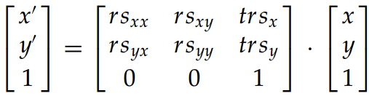

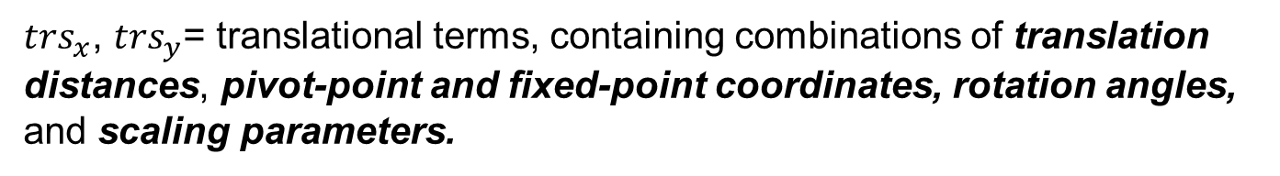
Computational efficiency
A two-dimensional transformation can be represented as:
$rs_{jk}$= Multiplicative rotation-scaling term
$trs_{x}$, $trs_{y}$= translational terms, containing combinations of translation distances, pivot-point and fixed-point coordinates, rotation angles, and scaling parameters.

Slide 18
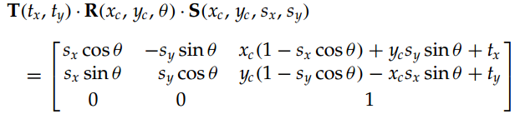


Computational efficiency
Example:
In practice:
E.g. Rotation
$$x^{′}=xcosθ−ySinθ$$
$$y^{′}=xSinθ+yCosθ$$
Can we approximate??

Slide 19
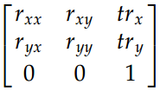
2D- Rigid body transformation
If the transformation involves only rotation and translation, i.e.
Orthonormal matrix
Angles and distances between coordinate positions are unchanged
The two vector sets $(r_{xx},r_{xy})$, and $\left(r_{yx},r_{yy}\right):$orthonormal vector set
How to use this property?

Slide 20
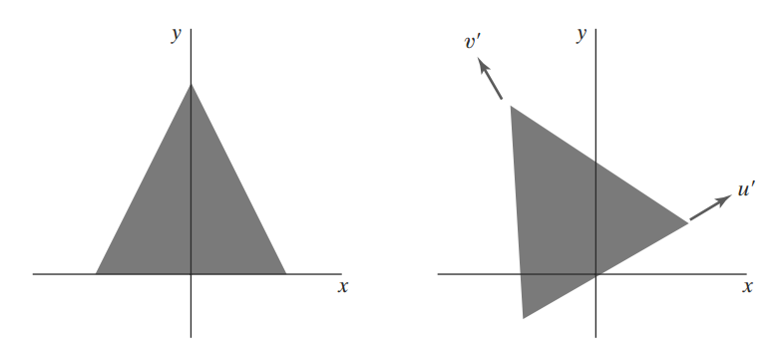
Constructing 2D Rotation Matrices
Constructing the matrix when we know the final orientation of an object
Rather than the amount of angular rotation necessary to put the object into that position

Slide 21
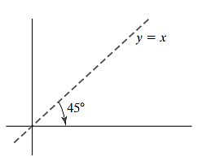
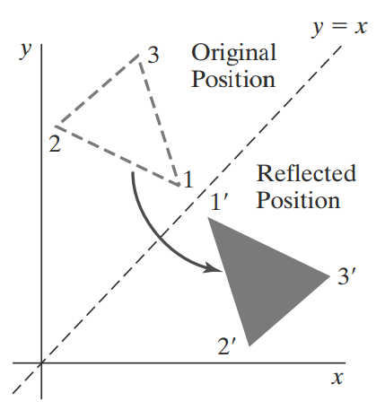
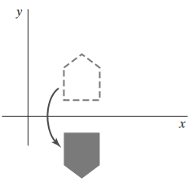
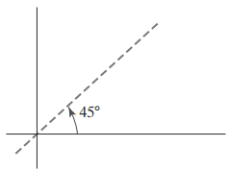
Reflection about a line

Slide 22

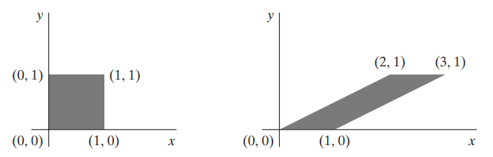
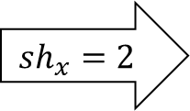
Shear
A transformation that distorts the shape of an object
An x-direction shear relative to the x axis
$$sh_{x}=2$$

Slide 23
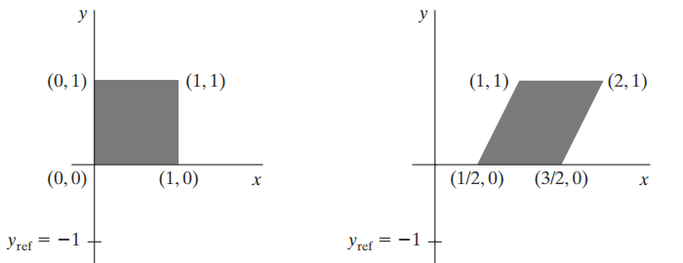

Shear w.r.to a reference
x-direction shears relative to other reference lines
Composite matrix:

Slide 24
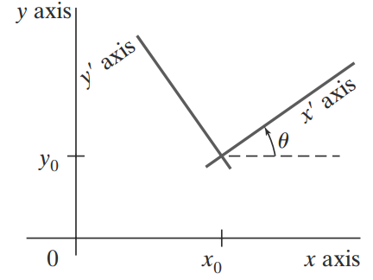
2D Coordinate Transformation
Converting from one 2D Cartesian frame to the other

Slide 25
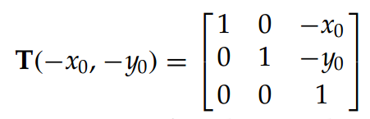
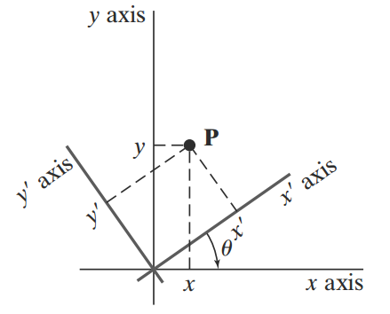
2D Coordinate Transformation (1)

Slide 26
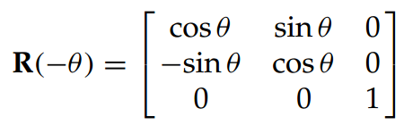
2D Coordinate Transformation (2)

Slide 27
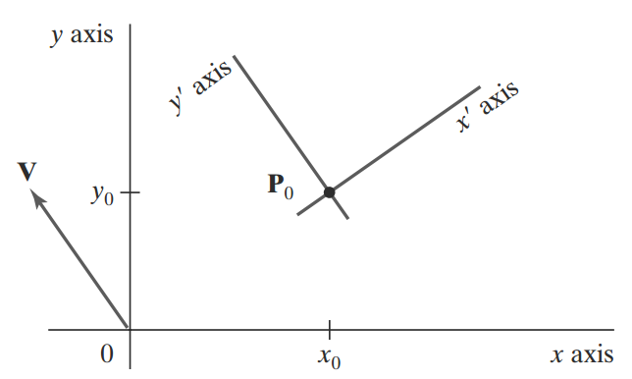
2D Coordinate Transformation: Alternative
Is the idea of unit vector going to help?

Slide 28
How to do it in OpenGL? Translate
class wcPt2D { // A point class
public: GLfloat x, y;
};
void translatePolygon
(wcPt2D * verts, GLint nVerts, GLfloat tx, GLfloat ty)
{
GLint k;
for (k = 0; k < nVerts; k++) {
verts [k].x = verts [k].x + tx;
verts [k].y = verts [k].y + ty;
}
glBegin (GL_POLYGON);
for (k = 0; k < nVerts; k++)
glVertex2f (verts [k].x, verts [k].y);
glEnd ( );
}

Slide 29
How to do it in OpenGL? Rotate
void rotatePolygon (wcPt2D * verts, GLint nVerts, wcPt2D pivPt, GLdouble theta)
{
wcPt2D * vertsRot;
GLint k;
for (k = 0; k < nVerts; k++) {
vertsRot [k].x = pivPt.x + (verts [k].x - pivPt.x) * cos (theta) - (verts [k].y - pivPt.y) * sin (theta);
vertsRot [k].y = pivPt.y + (verts [k].x - pivPt.x) * sin (theta) + (verts [k].y - pivPt.y) * cos (theta);
}
glBegin {GL_POLYGON};
for (k = 0; k < nVerts; k++)
glVertex2f (vertsRot [k].x, vertsRot [k].y);
glEnd ( );
}

Slide 30
Scaling using OpenGL
void scalePolygon (wcPt2D * verts, GLint nVerts,
wcPt2D fixedPt, GLfloat sx, GLfloat sy)
{
wcPt2D vertsNew;
GLint k;
for (k = 0; k < nVerts; k++) {
vertsNew [k].x = verts [k].x * sx + fixedPt.x * (1 - sx);
vertsNew [k].y = verts [k].y * sy + fixedPt.y * (1 - sy);
}
glBegin {GL_POLYGON};
for (k = 0; k < nVerts; k++)
glVertex2f (vertsNew [k].x, vertsNew [k].y);
glEnd ( );
}

Slide 31
OpenGL 2D transformations 1
Internally:
Coordinates are four-element row vectors
Transformations are 4×4 matrices
2D trafo’s: Ignore z-coordinates, set z = 0.

Slide 32
OpenGL 2D transformations 2
OpenGL maintains two matrices:
GL_PROJECTION
GL_MODELVIEW
Transformations are applied to the current matrix, to be selected with:
glMatrixMode(GL_PROJECTION) or
glMatrixMode(GL_MODELVIEW)

Slide 33
OpenGL 2D transformations 3
Initializing the matrix to I:
glLoadIdentity();
Replace the matrix with M:
GLfloat M[16]; fill(M);
glLoadMatrix*(M);
Matrices are specified in column-major order:
Multiply current matrix with M:
glMultMatrix*(M);

Slide 34
OpenGL 2D transformations 4
Basic transformation functions: generate matrix and post-multiply this with current matrix.
Translate over [tx, ty, tz]:
glTranslate*(tx, ty, tz);
Rotate over theta degrees (!) around axis [vx, vy, vz]:
glRotate*(theta, vx, vy, vz);
Scale axes with factors sx, sy, sz:
glScale*(sx, sy, sz);

Slide 35
OpenGL 2D Transformations 5
OpenGL maintains stacks of transformation matrices.
Two operations:
glPushMatrix():
Make copy of current matrix and put that on top of the stack;
glPopMatrix():
Remove top element of the stack.
Handy for dealing with hierarchical models
Handy for “undoing” transformations

Slide 36
OpenGL 2D Transformations 6
Standard:
glRotate(10, 1, 2, 0);
glScale(2, 1, 0.5);
glTranslate(1, 2, 3);
glutWireCube(1);
glTranslate(−1, −2, −3);
glScale(0.5, 1, 2);
glRotate(−10, 1, 2, 0);
Using the stack:
glPushMatrix();
glRotate(10, 1, 2, 0);
glScale(2, 1, 0.5);
glTranslate(1, 2, 3);
glutWireCube(1);
glPopMatrix();
Shorter, more robust
Undo transformation

Slide 37
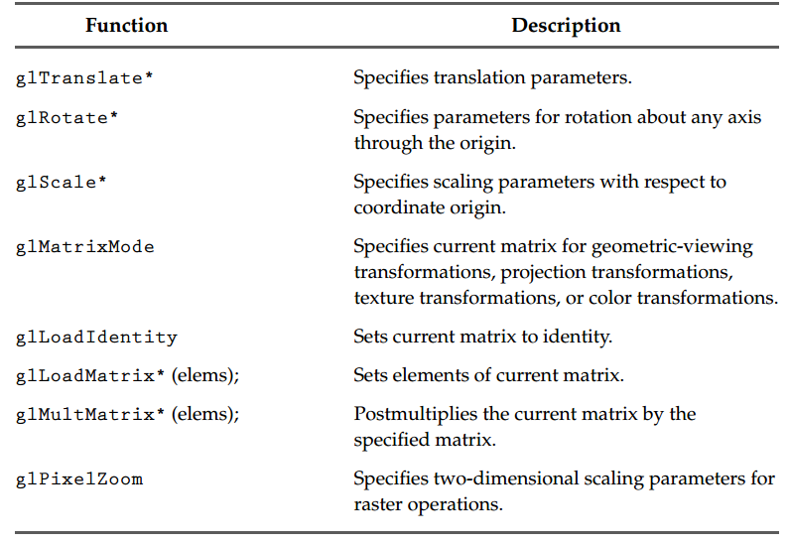
Summary of important functions

Slide 38
Thank you
Next Lecture: Introduction to 3D Graphics

