Slide 1

CS552: Computer Graphics
Lecture 5: Introduction to 3D

Slide 2
Recap
2D Transformation
Generalized Transformation
Composite Transformation
OpenGL routines for 2D transformation

Slide 3
Objective
After completing this lecture the students will be able to
Perform basic transformations like translate, scale, rotate in 3D
Calculate the result of generalized rotation in 3D
Solve mathematical problems on basic 3D transformations

Slide 4
Introduction
Transformations in 3-space are in many ways analogous to those in 2-space
Special care to be taken due to the introduction of the 3rd axis
Translation, scaling → obvious
Rotation → not so obvious

Slide 5
3D Translation
Remembering 2D transformations → 3x3 matrices,
T=(t_{x}, t_{y}, t_{z})

Slide 6
3D Scale
S=(s_{x}, s_{y}, s_{z})

Slide 7
3D Rotations
What does a rotation in 3D mean?
Q: How do we specify a rotation?
R=(r_{x}, r_{y}, r_{z}, θ)
A: We give a vector to rotate about, and a theta that describes how much we rotate.
θ
Q: Since 2D is sort of like a special case of 3D, what is the vector we’ve been rotating about in 2D?

Slide 8
Rotations about the Z axis
What do you think the rotation matrix is for rotations about the z axis?
R=(0,0,1,θ)
θ

Slide 9
Rotations about the X axis
Let’s look at the other axis rotations
R=(1,0,0,θ)
θ

Slide 10
Rotations about the Y axis
R=(0,1,0,θ)
θ

Slide 11
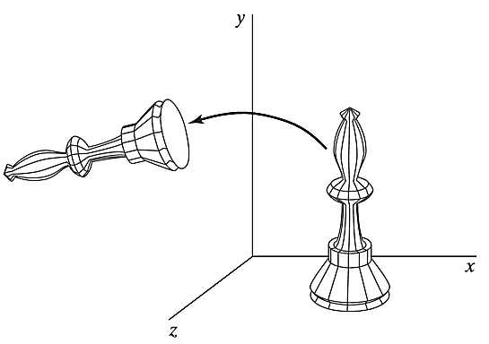
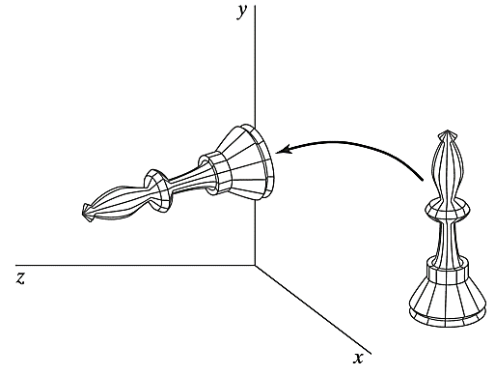
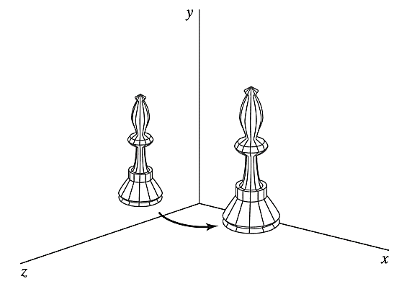
Example
Rotation of an object about the z axis.
Rotation of an object about the x axis.
Rotation of an object about the y axis.

Slide 12
General Three-Dimensional Rotations
A rotation matrix for any axis that does not coincide with a coordinate axis
Case A: An object is to be rotated about an axis that is parallel to one of the coordinate axes
Case B: An object is to be rotated about an axis that is not parallel to one of the coordinate axes

Slide 13
Case A: Steps of operation
Translate the object so that the rotation axis coincides with the parallel coordinate axis.
Perform the speciﬁed rotation about that axis.
Translate the object so that the rotation axis is moved back to its original position

Slide 14
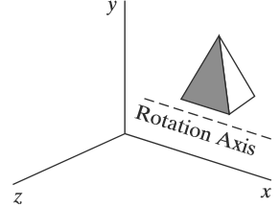
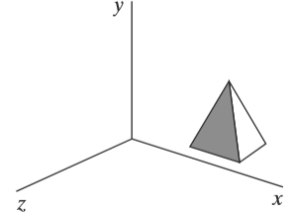
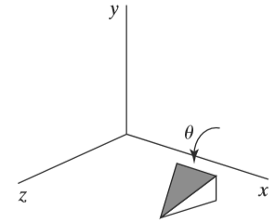
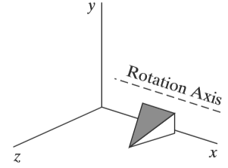

Case A: Illustration
Original Position of Object
Translate Rotation Axis onto x Axis
Translate Rotation Axis to original position
Rotate Object Through Angle$θ$

Slide 15


Case A: Formulation
A coordinate position P is transformed as
The composite rotation matrix for the transformation is

Slide 16
Case B: Steps of operation
Translate the object so that the rotation axis passes through the coordinate origin.
Rotate the object so that the axis of rotation coincides with one of the coordinate axes.
Perform the speciﬁed rotation about the selected coordinate axis.
Apply inverse rotations to bring the rotation axis back to its original orientation.
Apply the inverse translation to bring the rotation axis back to its original spatial position.

Slide 17
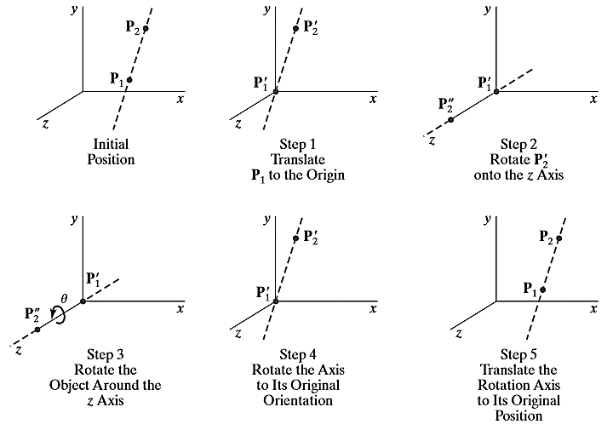
Case B: Illustration

Slide 18
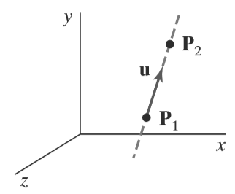
Case B: Formulation
A rotation axis can be deﬁned with
two coordinate positions,
with one coordinate point and direction angles between the rotation axis and two of the coordinate axes

Slide 19



Case B: Formulation
The components of the rotation-axis vector are then computed as
The unit rotation-axis vector u is
The components $a, b,$and $c$ are the direction cosines for the rotation axis

Slide 20
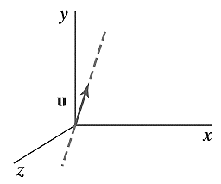
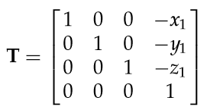
Case B: Formulation
We should move the point P1/P2 to the origin ?
Ans: P1
We formulate the transformations that will put the rotation axis onto the z axis.

Slide 21
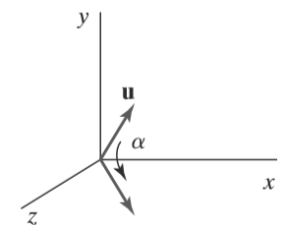
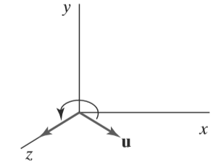
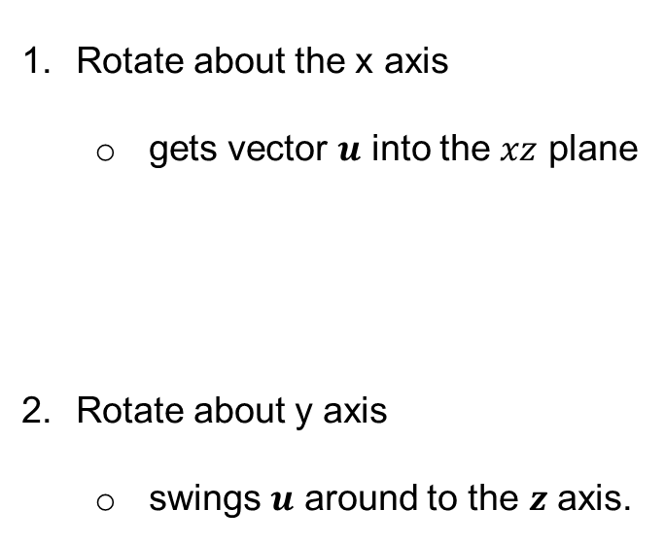
Case B: Formulation
We formulate the transformations that will put the rotation axis onto the z axis.
Rotate about the x axis
gets vector $u$ into the $xz$ plane
Rotate about y axis
swings $u$ around to the $z$ axis.

Slide 22
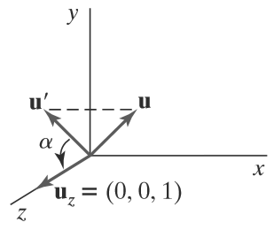
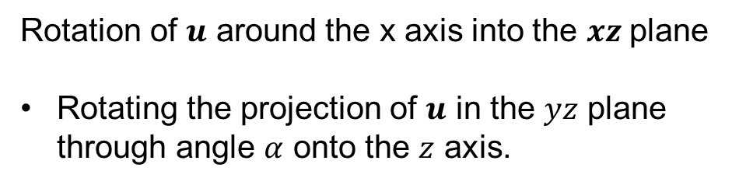
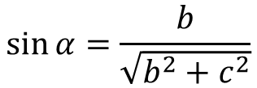
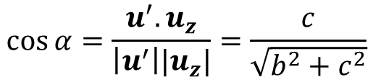


Case B: Formulation
Rotation of $u$ around the x axis into the $xz$plane
Rotating the projection of $u$ in the $yz$ plane through angle $α$ onto the $z$ axis.
$$u^{′}=(0,b,c)$$
$$u_{z}=(0,0,1)$$
$$\cos{α=\frac{u^{′}.u_{z}}{\left|u^{′}\right||u_{z}|}=\frac{c}{\sqrt{b^{2}+c^{2}}}}$$
$$\sin{α=\frac{b}{\sqrt{b^{2}+c^{2}}}}$$

Slide 23
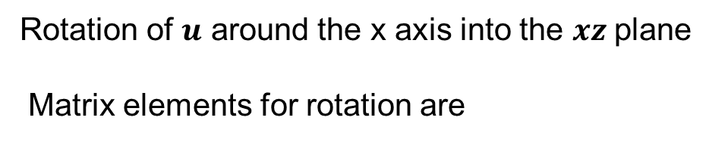

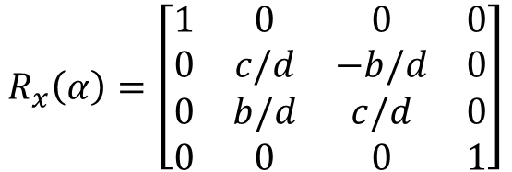
Case B: Formulation
Rotation of $u$ around the x axis into the $xz$plane
Matrix elements for rotation are
$$R_{x}\left(α\right)=\left[\begin{matrix}1 & 0 & 0 & 0 \\ 0 & c/d & −b/d & 0 \\ 0 & b/d & c/d & 0 \\ 0 & 0 & 0 & 1\end{matrix}\right]$$
$$d=\sqrt{b^{2}+c^{2}}$$

Slide 24
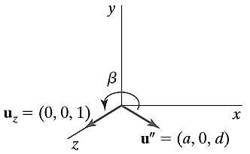


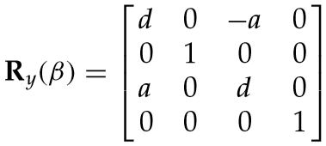
Case B: Formulation
To determine the matrix that will swing the unit vector in the xz plane counter-clockwise around the y axis onto the positive z axis.
The transformation matrix for rotation

Slide 25
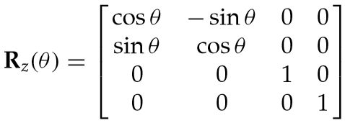
Case B: Formulation
We have aligned the rotation axis with the positive $z$axis
Composition of seven individual transformations:

Slide 26
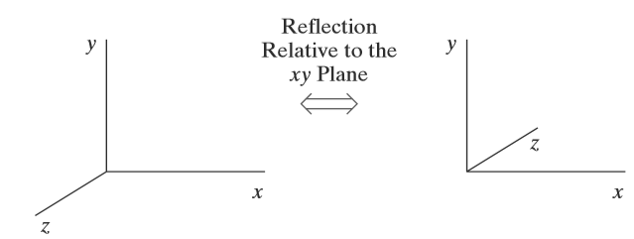
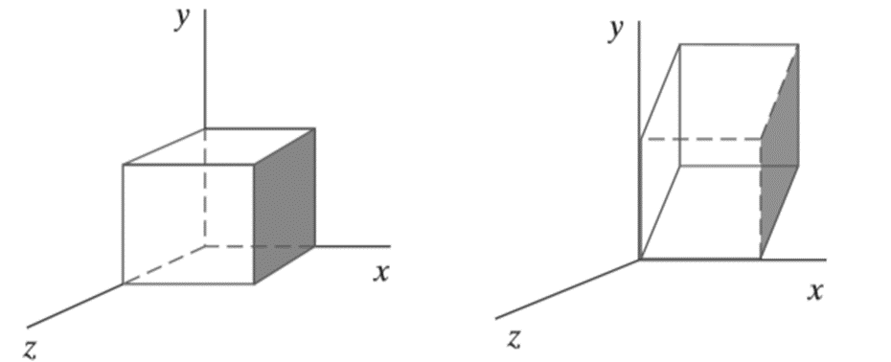
Other 3D Transformations
Reflection
Shear

Slide 27
Thank you
Next Lecture: 3D Projection

