Slide 1

CS552: Computer Graphics
Lecture 6: Viewing in 2D

Slide 2
Recap
3D World
3D Transformation
Scaling, Translation is simple extension of 2D
Rotation
About Cartesian axis
Arbitrary axis
Coordinate transformation

Slide 3
Objective
After completing this lecture the students will be able to
Define different space
Describe 2D Viewing pipeline
Transform World coordinate to view coordinate
Write program in OpenGL for 2D viewing

Slide 4
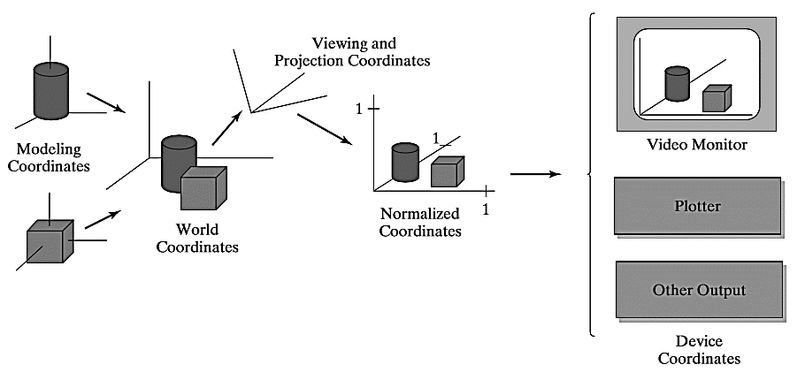
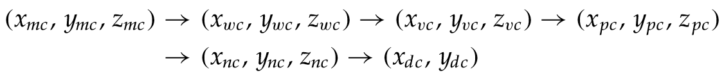
Coordinate representation

Slide 5
2D Viewing pipeline 1
World:
Screen:
Clipping window
Viewport
yw_{max}
yv_{max}
yw_{min}
yv_{min}
xw_{min}
xw_{max}
xv_{min}
xv_{max}
Clipping window:
What do we want to see?
Viewport:
Where do we want to see it?

Slide 6
2D Viewing pipeline 2
World:
Screen:
Clipping window
Viewport
yw_{max}
yv_{max}
yw_{min}
yv_{min}
xw_{min}
xw_{max}
xv_{min}
xv_{max}
Clipping window:
Panning…

Slide 7
2D Viewing pipeline 2
World:
Screen:
Clipping window
Viewport
yw_{max}
yv_{max}
yw_{min}
yv_{min}
xw_{min}
xw_{max}
xv_{min}
xv_{max}
Clipping window:
Panning…

Slide 8
2D Viewing pipeline 3
World:
Screen:
Viewport
yw_{max}
yv_{max}
yw_{min}
yv_{min}
xw_{min}
xw_{max}
xv_{min}
xv_{max}
Clipping window:
Zooming…

Slide 9
2D Viewing pipeline 3
World:
Screen:
yw_{max}
Viewport
yv_{max}
yv_{min}
yw_{min}
xw_{min}
xw_{max}
xv_{min}
xv_{max}
Clipping window:
Zooming…

Slide 10
2D Viewing pipeline 4
MC: Modeling Coordinates
WC: World Coordinates
VC: Viewing Coordinates
NC: Normalized Coordinates
DC: Device Coordinates
Apply model transformations
Determine visible parts
To standard coordinates
Clip and determine pixels

Slide 11
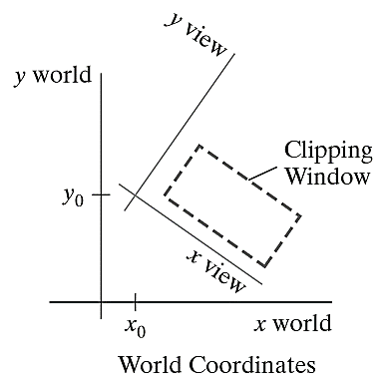
Viewing coordinate clipping window
Setup a viewing-coordinate system within the world-coordinate frame
Origin for a two-dimensional viewing-co-ordinate frame
V: the two-dimensional view up vector.

Slide 12
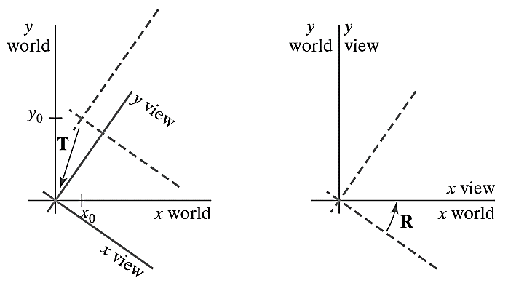
Viewing coordinate clipping window

Slide 13
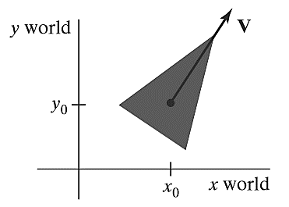
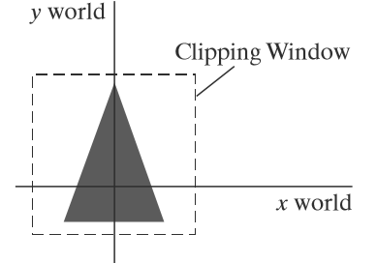
World coordinate clipping window
Define an orientation vector and choose a reference point

Slide 14
Normalization and Viewport Transformations
In some packages the normalization and window-to-view port transformations are combined into one operation
The view-port coordinates are often given in the range from 0 to 1
After clipping, the unit square containing the viewport is mapped to the output display device
Viewport boundaries are speciﬁed in screen coordinates relative to the display window position.

Slide 15
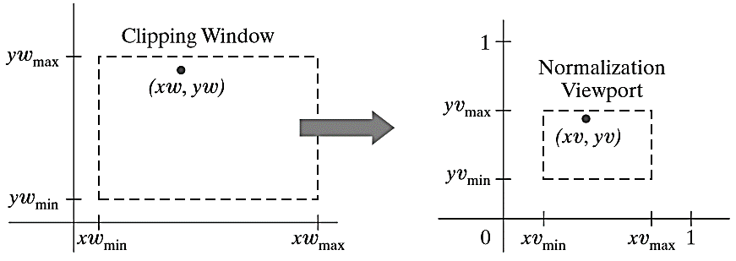
Clipping Window into a Normalized Viewport
Consider a view port deﬁned with normalized co-ordinate values
Object descriptions are transferred to this normalized space
By a transformation that maintains the same relative placement of a point (relative to the clipping window)

Slide 16
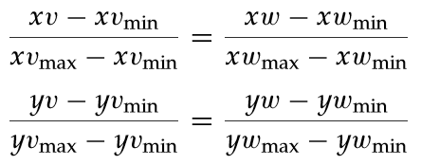
Window to view port transformation

Slide 17
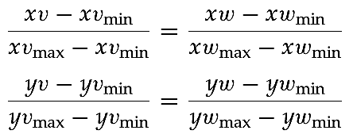
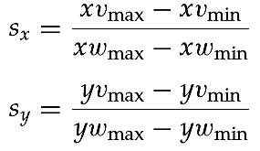

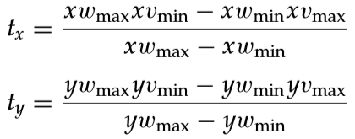
Window to view port transformation
Solving these expressions for the viewport position
Scaling factor
Translating factor

Slide 18
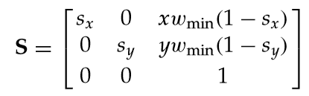
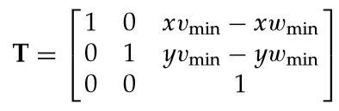

Alternate approach
Scale the clipping window to the size of the view port using a ﬁxed-point position of ($xw_{min}, yw_{min}$)
Translate ($xw_{min}, yw_{min}$) to ($xv_{min}, yv_{min}$)

Slide 19
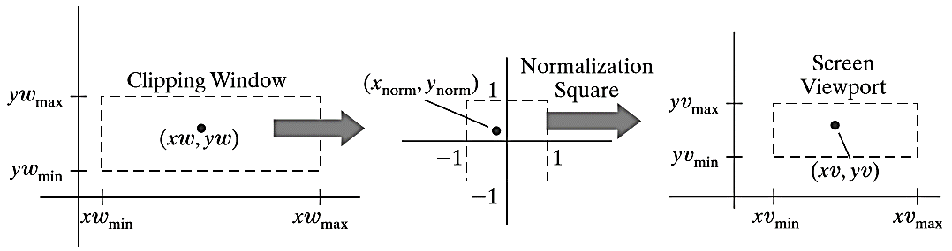
Clipping Window into a Normalized Square
Another approach to two-dimensional viewing is
Transform the clipping window into a normalized square
Clip in normalized coordinates
Transfer the scene description to a viewport speciﬁed in screen coordinates

Slide 20
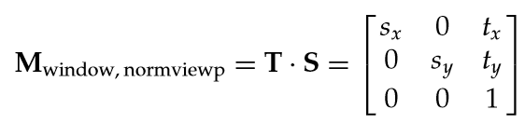
Clipping Window into a Normalized Square
= +1
= -1
Scaling factor
= +1
= -1
Translating factor

Slide 21
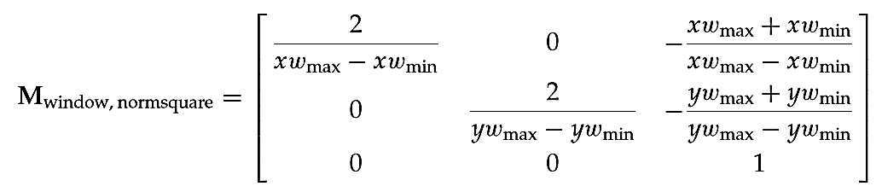
Clipping Window into a Normalized Square
Window to normalized square
Normalized square to viewport ??

Slide 22
Clipping Window into a Normalized Square
Scaling factor
= +1
= -1
= -1
= +1
Translating factor

Slide 23
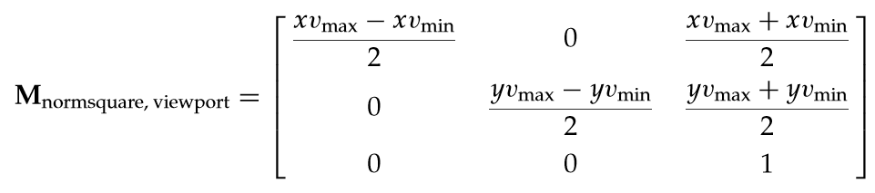
Clipping Window into a Normalized Square
Window to normalized square
Normalized square to viewport

Slide 24
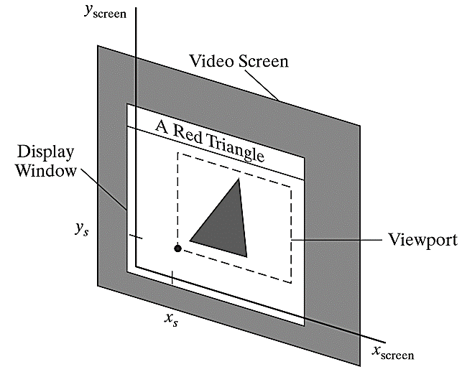
Viewport to display
Last step: position the viewport area in the display window
Convention: lower-left corner of the viewport is placed at a coordinate position speciﬁed relative to the lower-left corner of the display window

Slide 25
How to do it in OpenGL?
OpenGL library has no functions speciﬁcally for 2D viewing
The 3D routines can be adapted to a 2D

Slide 26

OpenGL Projection Mode
First select the projection mode
To deﬁne a two-dimensional clipping window
View port parameters are specified as

Slide 27
An Example
#include <GL/glut.h>
class wcPt2D {
public: GLfloat x, y;
};
void init (void) {
/* Set color of display window to white. */
glClearColor (1.0, 1.0, 1.0, 0.0);
/* Set parameters for world-coordinate clipping window. */ glMatrixMode (GL_PROJECTION); gluOrtho2D (-100.0, 100.0, - 100.0, 100.0);
/**
Set mode for constructing geometric transformation matrix.
*/
glMatrixMode (GL_MODELVIEW);
}

Slide 28
An Example
void triangle (wcPt2D *verts) {
GLint k;
glBegin (GL_TRIANGLES);
for (k = 0; k < 3; k++)
glVertex2f (verts [k].x, verts [k].y);
glEnd ( );
}

Slide 29
An Example
void displayFcn (void) {
/* Define initial position for triangle. */
wcPt2D verts [3] = { {-50.0, -25.0}, {50.0, -25.0}, {0.0, 50.0} };
glClear (GL_COLOR_BUFFER_BIT); // Clear display window.
glColor3f (0.0, 0.0, 1.0); // Set fill color to blue. glViewport (0, 0, 300, 300); // Set left viewport.
triangle (verts); // Display triangle.
/* Rotate triangle and display in right half of display window. */
glColor3f (1.0, 0.0, 0.0); // Set fill color to red.
glViewport (300, 0, 300, 300); // Set right viewport.
glRotatef (90.0, 0.0, 0.0, 1.0); // Rotate about z axis.
triangle (verts); // Display red rotated triangle.
glFlush ( );
}

Slide 30
An Example
void main (int argc, char ** argv) {
glutInit (&argc, argv);
glutInitDisplayMode (GLUT_SINGLE | GLUT_RGB); glutInitWindowPosition (50, 50);
glutInitWindowSize (600, 300);
glutCreateWindow ("Split-Screen Example");
init ( );
glutDisplayFunc (displayFcn);
glutMainLoop ( );
}

Slide 31
Thank you
Next Lecture: 2D Clipping

