Slide 1

CS552: Computer Graphics
Lecture 7: 2D Clipping Algorithm

Slide 2
Recap
2D Viewing pipeline
Model → World → View → Device
Model to view transformation
Viewing → Clipping
2D viewing in OpenGL

Slide 3
Objective
After completing this lecture the students will be able to
Explain and solve numerical problems of 2D Clipping of
Point
Line
Polygon

Slide 4
Clipping
We’ve been assuming that all primitives (lines, triangles, polygons) lie entirely within the viewport
In general, this assumption will not hold

Slide 5
Clipping
Analytically calculating the portions of primitives within the viewport

Slide 6
Why Clip?
Bad idea to rasterize outside of framebuffer bounds
Also, don’t waste time scan converting pixels outside window

Slide 7
Clipping
The naïve approach to clipping lines:
for each line segment
for each edge of viewport
find intersection points
pick “nearest” point
if anything is left, draw it
What do we mean by “nearest”?
How can we optimize this?

Slide 8
Trivial Accepts
Big optimization: trivial accept/rejects
How can we quickly determine whether a line segment is entirely inside the viewport?
A: test both endpoints.
x_{min}
x_{max}
y_{max}
y_{min}

Slide 9
Trivial Rejects
How can we know a line is outside viewport?
A: if both endpoints on wrong side of same edge, can trivially reject line
x_{min}
x_{max}
y_{max}
y_{min}

Slide 10
Cohen-Sutherland Line Clipping
Divide view plane into regions defined by viewport edges
Assign each region a 4-bit outcode:
x_{min}
x_{max}
1001
1000
1010
y_{max}
0001
0000
0010
y_{min}
0101
0100
0110

Slide 11
Cohen-Sutherland Line Clipping
To what do we assign outcodes?
How do we set the bits in the outcode?
How do you suppose we use them?
x_{min}
x_{max}
1001
1000
1010
y_{max}
0001
0000
0010
y_{min}
0101
0100
0110

Slide 12
Cohen-Sutherland Line Clipping
Set bits with simple tests
x > x_{max} y < y_{min} etc.
Assign an outcode to each vertex of line
If both outcodes = 0, trivial accept
bitwise AND vertex outcodes together
If result ≠ 0, trivial reject
As those lines lie on one side of the boundary lines
1001
1000
1010
y_{max}
0001
0000
0010
y_{min}
0101
0100
0110

Slide 13
Cohen-Sutherland Line Clipping
If line cannot be trivially accepted or rejected, subdivide so that one or both segments can be discarded
Pick an edge that the line crosses (how?)
Intersect line with edge (how?)
Discard portion on wrong side of edge and assign outcode to new vertex
Apply trivial accept/reject tests; repeat if necessary

Slide 14
Cohen-Sutherland Line Clipping
Outcode tests and line-edge intersects are quite fast (how fast?)
But some lines require multiple iterations:
Clip top
Clip left
Clip bottom
Clip right
Fundamentally more efficient algorithms:
Cyrus-Beck uses parametric lines
Liang-Barsky optimizes this for upright volumes

Slide 15
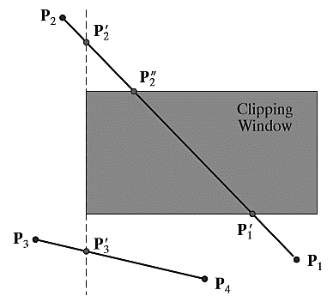
Example
1001
0101
0100
0100

Slide 16
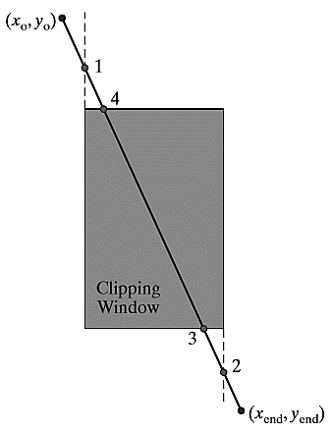

More Example
Use the slope intercept form of the line equation
y coordinate of the intersection point with a vertical clipping border line
$$x=xw_{min} or xw_{max}$$

Slide 17


More Example
Use the slope intercept form of the line equation
x coordinate of the intersection point with a horizontal clipping border line
$$y=yw_{min} or yw_{max}$$

Slide 18
Clipping Polygons
We know how to clip a single line segment
How about a polygon in 2D?
How about in 3D?
Clipping polygons is more complex than clipping the individual lines
Input: polygon
Output: polygon, or nothing
When can we trivially accept/reject a polygon as opposed to the line segments that make up the polygon?

Slide 19
Convex polygon clipping window
B
B
A
A
Convex
Non-Convex

Slide 20
Why Is Clipping Hard?
What happens to a triangle during clipping?
Possible outcomes:
Triangle→triangle
Triangle→quad
Triangle→5-gon
How many sides can a clipped triangle have?

Slide 21
Why Is Clipping Hard?
A really tough case:

Slide 22
Why Is Clipping Hard?
A really tough case:
concave polygon→multiple polygons

Slide 23
Sutherland-Hodgman Clipping
Basic idea:
Consider each edge of the viewport individually
Clip the polygon against the edge equation
After doing all planes, the polygon is fully clipped

Slide 24
Sutherland-Hodgman Clipping
Basic idea:
Consider each edge of the viewport individually
Clip the polygon against the edge equation
After doing all planes, the polygon is fully clipped

Slide 25
Sutherland-Hodgman Clipping
Basic idea:
Consider each edge of the viewport individually
Clip the polygon against the edge equation
After doing all planes, the polygon is fully clipped

Slide 26
Sutherland-Hodgman Clipping
Basic idea:
Consider each edge of the viewport individually
Clip the polygon against the edge equation
After doing all planes, the polygon is fully clipped

Slide 27
Sutherland-Hodgman Clipping
Basic idea:
Consider each edge of the viewport individually
Clip the polygon against the edge equation
After doing all planes, the polygon is fully clipped

Slide 28
Sutherland-Hodgman Clipping
Basic idea:
Consider each edge of the viewport individually
Clip the polygon against the edge equation
After doing all planes, the polygon is fully clipped

Slide 29
Sutherland-Hodgman Clipping
Basic idea:
Consider each edge of the viewport individually
Clip the polygon against the edge equation
After doing all planes, the polygon is fully clipped

Slide 30
Sutherland-Hodgman Clipping
Basic idea:
Consider each edge of the viewport individually
Clip the polygon against the edge equation
After doing all planes, the polygon is fully clipped

Slide 31
Sutherland-Hodgman Clipping
Basic idea:
Consider each edge of the viewport individually
Clip the polygon against the edge equation
After doing all planes, the polygon is fully clipped

Slide 32
Sutherland-Hodgman Clipping
Basic idea:
Consider each edge of the viewport individually
Clip the polygon against the edge equation
After doing all planes, the polygon is fully clipped
Will this work for non-rectangular clip regions?
What would 3-D clipping involve?

Slide 33
Sutherland-Hodgman Clipping
Input/output for algorithm:
Input: list of polygon vertices in order
Output: list of clipped polygon vertices consisting of old vertices (maybe) and new vertices (maybe)
Note: this is exactly what we expect from the clipping operation against each edge
This algorithm generalizes to 3-D

Slide 34
Sutherland-Hodgman Clipping
We need to be able to create clipped polygons from the original polygons
Sutherland-Hodgman basic routine:
Go around polygon one vertex at a time
Current vertex has position p
Previous vertex had position s, and it has been added to the output if appropriate

Slide 35
Sutherland-Hodgman Clipping
Edge from s to p takes one of four cases:
(Purple line can be a line or a plane)
inside
outside
inside
outside
inside
outside
inside
outside
p
s
p
s
p
s
p
s
p output
i output
no output
i output p output

Slide 36
Sutherland-Hodgman Clipping
Four cases:
s inside plane and p inside plane
Add p to output
Note: s has already been added
s inside plane and p outside plane
Find intersection point i
Add i to output
s outside plane and p outside plane
Add nothing
s outside plane and p inside plane
Find intersection point i
Add i to output, followed by p

Slide 37
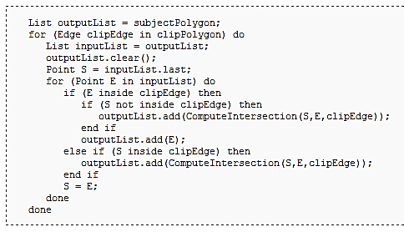
Pseudo-Code

Slide 38
Thank you
Next Lecture: 2D Clipping

