Slide 1

CS552: Computer Graphics
Lecture 8: 2D Clipping

Slide 2
Recap
2D Clipping
Point and Line Clipping
Cohen-Sutherland Line Clipping Algorithm
Polygon clipping
Sutherland-Hodgeman Polygon Clipping

Slide 3
Objective
After completing this lecture the students will be able to
Explain the issues with Sutherland-Hodgeman
Explain generalized polygon clipping technique
Solve numerical problems

Slide 4
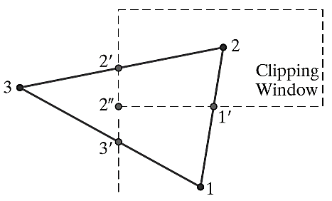
Example: Sutherland-Hodgeman

Slide 5
Problems with Sutherland-Hodgman
What if you clip these?

Slide 6
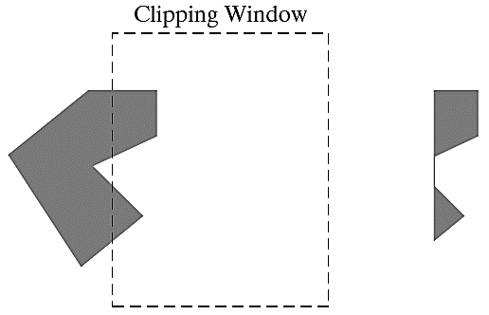
Problems with Sutherland-Hodgman

Slide 7
Weiler-Atherton Algorithm
When we have non-convex polygons then the algorithm above might produce polygons with coincident edges
This is sometimes OK for rendering but is not for other applications (e.g. shadows)
The Weiler-Atherton algorithm produces separate polygons for each visible fragment

Slide 8
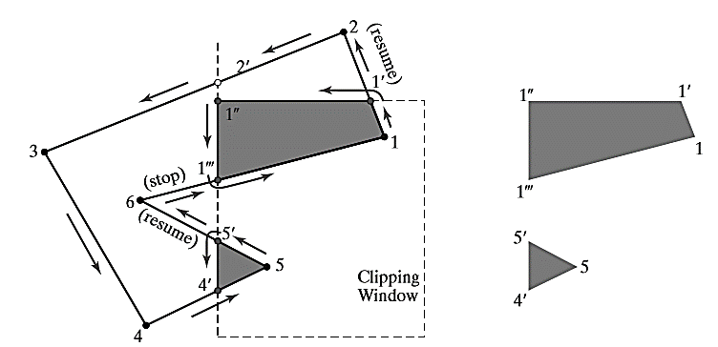
Example

Slide 9
3D Viewing

Slide 10
Objective
After completing this section the students will be able to
Classify different projection techniques
Explain 3D Viewing pipeline
Transform 3D coordinate systems

Slide 11
Introduction
Each object in the scene is typically deﬁned with a set of surfaces
They form a closed boundary around the object interior
We may also need to specify information about the interior structure of an object
Ultimately project a speciﬁed view of the objects onto the surface of a display device
Additional routines are there to visualize a 3D scene

Slide 12
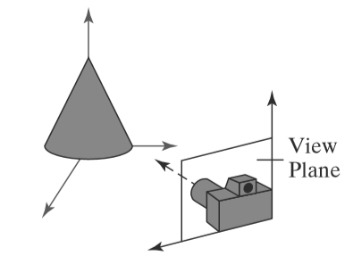
Viewing a 3D Scene

Slide 13
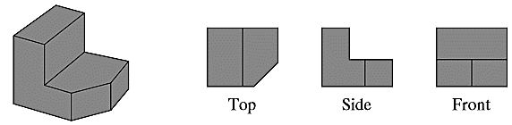
Projection
We can choose different methods for projecting a scene onto the view plane.
Parallel Projection
Project points on the object surface along parallel lines
Used in engineering and architectural drawing store present an object
A set of views that show accurate dimensions of the object

Slide 14
Projection
Perspective projection
Project points to the view plane along converging paths
Objects farther from the viewing position : appear small
Objects of same size nearer to the viewing position: appear large
More realistic scene

Slide 15
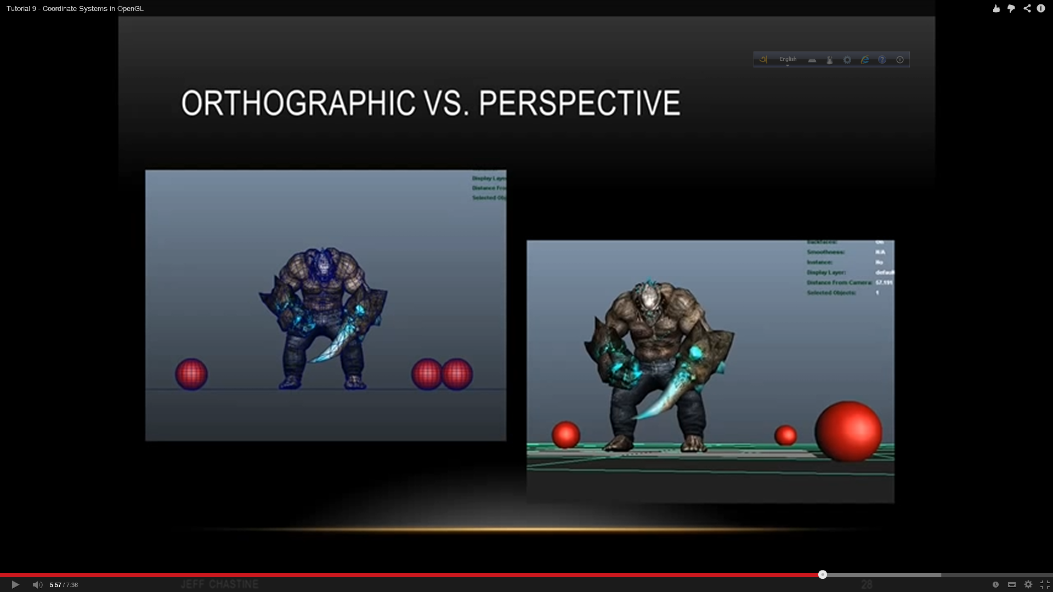
Projection
Orthographic
Perspective

Slide 16
Types of Projection
Projection
Perspective
Parallel
One point
Two point
Three point
Orthographic
Oblique
Multiview
Axonometric
Isometric
Dimetric
Trimetric
General
Cavalier
Cabinet

Slide 17
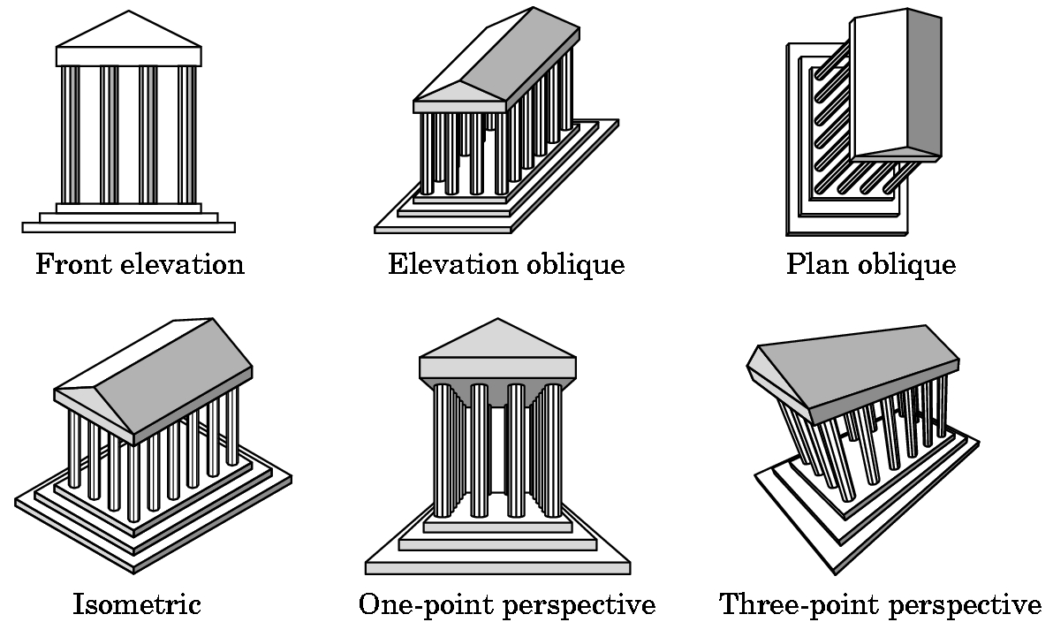
Classical Viewings
Hand drawings : Determined by a specific relationship between the object and the viewer.

Slide 18
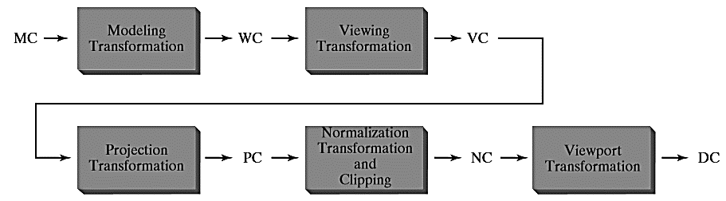
3D Viewing Pipeline

Slide 19
Viewing Coordinates
Generating a view of an object in 3D is similar to photographing the object.
Whatever appears in the viewfinder is projected onto the flat film surface.
Depending on the position, orientation and aperture size of the camera corresponding views of the scene is obtained.

Slide 20
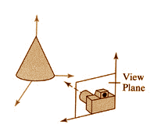
Specifying The View Coordinates
For a particular view of a scene
First we establish viewing-coordinate system.
A view-plane (or projection plane) is set up perpendicular to the viewing z-axis.
World coordinates are transformed to viewing coordinates
Then viewing coordinates are projected onto the view plane.
x_{v}
y_{v}
y_{w}
z_{v}
P₀=(x₀ , y₀ , z₀)
x_{w}
z_{w}

Slide 21
Specifying The View Coordinates
To establish the viewing reference frame,
We first pick a world coordinate position : view reference point.
This point is the origin of the viewing coordinate system.
E.g. consider a point on an object
This point as the position where we aim a camera to take a picture of the object.

Slide 22
Specifying The View Coordinates
Select the positive direction for the viewing z-axis, and the orientation of the view plane, by specifying the view-plane normal vector, N.
Choose a world coordinate position P and this point establishes the direction for N.
OpenGL establishes the direction for N using the point P as a look at point relative to the viewing coordinate origin.
y_{v}
x_{v}
x_{v}
y_{w}
z_{v}
N
P₀
P
x_{w}
z_{w}

Slide 23
Specifying The View Coordinates
Finally, choose the up direction for the view by specifying view-up vector V.
This vector is used to establish the positive direction for the yv axis.
The vector V is perpendicular to N.
Using N and V, we can compute a third vector U, perpendicular to both N and V, to define the direction for the xv axis.
y_{v}
x_{v}
V
y_{w}
z_{v}
N
P₀
P
x_{w}
z_{w}

Slide 24
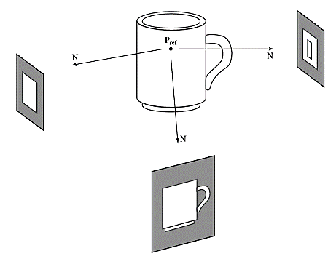
Specifying The View Coordinates
To obtain a series of views of a scene ,
Keep the the view reference point fixed
Change the direcion of N.
This generate views as we move around the viewing coordinate origin.

Slide 25
Transformation From World To Viewing Coordinates
It is equivalent to transformation that superimpoes the viewing reference frame onto the world frame using the translation and rotation.
y_{v}
y_{w}
x_{v}
z_{v}
x_{w}
z_{w}

Slide 26
Transformation From World To Viewing Coordinates
First, we translate the view reference point to the origin of the world coordinate system
y_{v}
y_{w}
x_{v}
z_{v}
x_{w}
z_{w}

Slide 27
Transformation From World To Viewing Coordinates
Second, apply rotations to align the xv, yv and zv axes with the world xw, yw and zw axes, respectively.
y_{w}
y_{v}
y_{v}
x_{v}
z_{v}
x_{v}
x_{w}
z_{v}
z_{w}

Slide 28
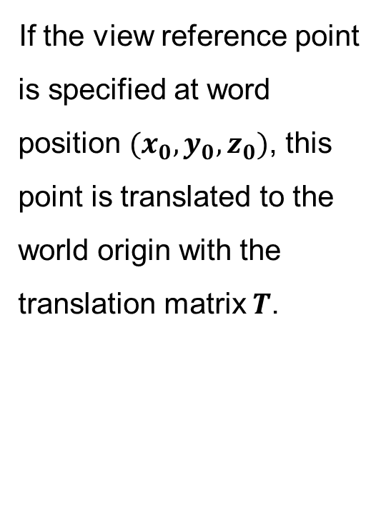
Transformation From World To Viewing Coordinates
If the view reference point is specified at word position $(x_{0}, y_{0}, z_{0})$, this point is translated to the world origin with the translation matrix $T$.

Slide 29
Transformation From World To Viewing Coordinates
The rotation sequence requires 3 coordinate-axis transformation depending on the direction of N.
First we rotate around xw-axis to bring zv into the xw -zw plane.

Slide 30
Transformation From World To Viewing Coordinates
Then, we rotate around the world yw axis to align the zw and zv axes.

Slide 31
Transformation From World To Viewing Coordinates
The final rotation is about the world zw axis to align the yw and yv axes.

Slide 32
Transformation From World To Viewing Coordinates
The complete transformation from world to viewing coordinate transformation matrix is obtaine as the matrix product
What if the rotation angles are not given ?

Slide 33
Transformation From World To Viewing Coordinates: An Example For 2d System
y
₂
P=(5,5)
y′
x′
0 2 4 6
₂
Θ=30⁰
P₀=(4,3)
0 2 4 6
x

Slide 34
Transformation From World To Viewing Coordinates: An Example For 2d System
Translation:
y
0 2 4 6
₂
P
x′
y′
₂
Θ=30⁰
₂ ₄ ₆
P₀
x

Slide 35
Transformation From World To Viewing Coordinates: An Example For 2d System
Rotation
y
0 2 4 6
y′
P
x′
₂ ₄ ₆
P₀
x

Slide 36
Transformation From World To Viewing Coordinates: An Example For 2d System
New coordinates

Slide 37
Transformation From World To Viewing Coordinates: An Example For 2d System
Alternative Method
y
0 1 2 3
₁
P
x′
y′
₁
n
v
Θ=30⁰
x
P₀
1 2 3

Slide 38
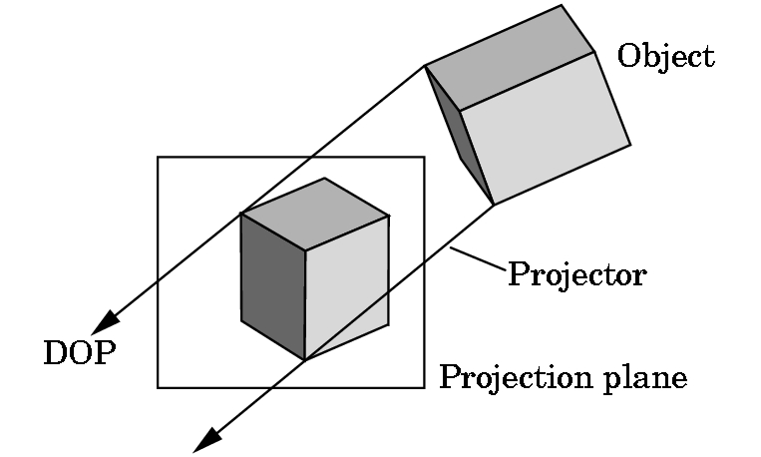
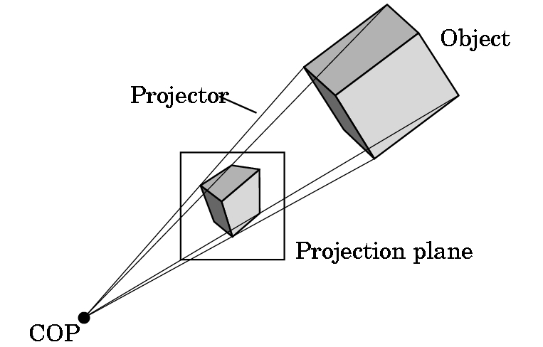
Projections
Once WC description of the objects in a scene are converted to VC we can project the 3D objects onto 2D view-plane.
Two types of projections:
Parallel Projection
Perspective Projection

Slide 39
Parallel Projections
Coordinate Positions are transformed to the view plane along parallel lines.
View
Plane
P₂
P′₂
P₁
P′₁

Slide 40
Parallel Projections
Orthographic parallel projection
The projection is perpendicular to the view plane.
Oblique parallel projecion
The parallel projection is not perpendicular to the view plane.

Slide 41
Thank you
Next Lecture: Projection Geometry

