Slide 1

CS552: Computer Graphics
Lecture 9: Perspective Projection

Slide 2
Recap
Different projection techniques
3D Viewing pipeline
Transform 3D coordinate systems

Slide 3
Outline
After completing this lecture the students will be able to
Explain perspective projection
Derive mathematical expressions for perspective projection

Slide 4
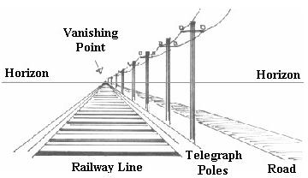
Perspective Projection
Distance from COP to the projection plane is finite
The projectors are not parallel
We specify a center of projection (COP)
Also known as perspective reference point (PRP)
Perspective foreshortening (illusion)
Vanishing point

Slide 5
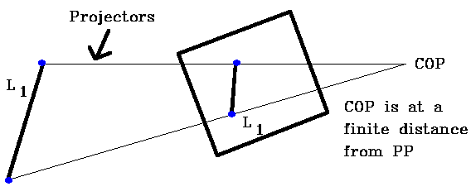
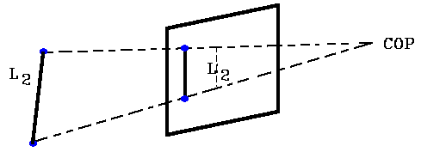
Perspective Foreshortening
The Perspective viewing projection has a Center of Projection ("eye")
At a finite distance from the projection plane (PP).

Slide 6
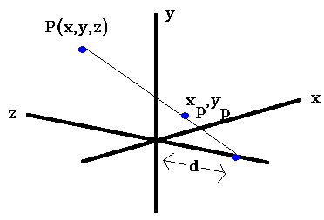
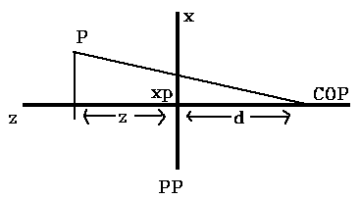
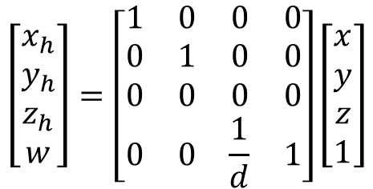

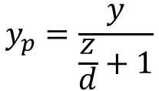
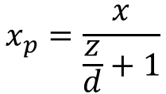
Computing the perspective projection
$$x_{p}=\frac{x}{\frac{z}{d}+1}$$
$$y_{p}=\frac{y}{\frac{z}{d}+1}$$
Look at above diagram from y axis
$$z_{p}=0$$
In homogeneous representation
$$\left[\begin{matrix}x_{h} \\ y_{h} \\ z_{h} \\ w\end{matrix}\right]=\left[\begin{matrix}1 & 0 & 0 & 0 \\ 0 & 1 & 0 & 0 \\ 0 & 0 & 0 & 0 \\ 0 & 0 & \frac{1}{d} & 1\end{matrix}\right]\left[\begin{matrix}x \\ y \\ z \\ 1\end{matrix}\right]$$

Slide 7
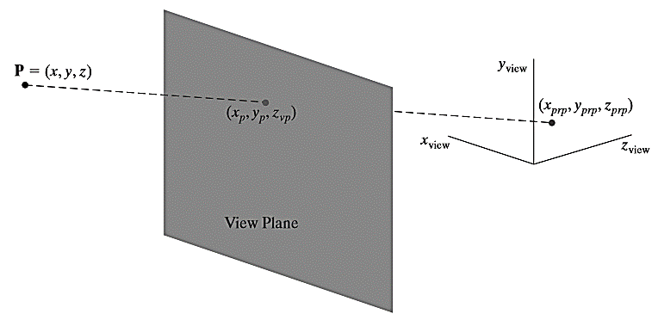

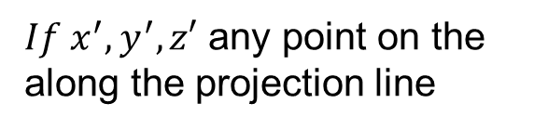
Generalized PRP
Spatial position
PRP
Point of Intersection
Equation of the line in parametric form
$If x^{′},y^{′},z′$ any point on the along the projection line

Slide 8


Generalized PRP
Spatial position
PRP
Point of Intersection
$$z^{′}=z_{vp}$$
$$u=\frac{z_{vp}−z}{z_{prp}−z}$$

Slide 9
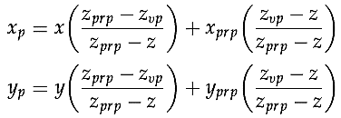
Generalized PRP
Spatial position
PRP
Point of Intersection
$$z^{′}=z_{vp}$$
$$u=\frac{z_{vp}−z}{z_{prp}−z}$$

Slide 10



Special Cases
Case 1: Projection reference point along $z_{view}$ axis
$$x_{prp}=y_{prp}=0$$

Slide 11


Special Cases
Case 2: Projection reference point is ﬁxed at the coordinate origin
$$x_{prp}=y_{prp}=z_{prp}=0$$

Slide 12
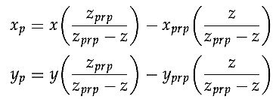


Special Cases
Case 3: If the view plane is the $uv$ plan
$$z_{vp}=0$$

Slide 13


Special Cases
Case 4: Case 2 + Case 4
$${x_{prp}=y_{prp}=z}_{vp}=0$$

Slide 14
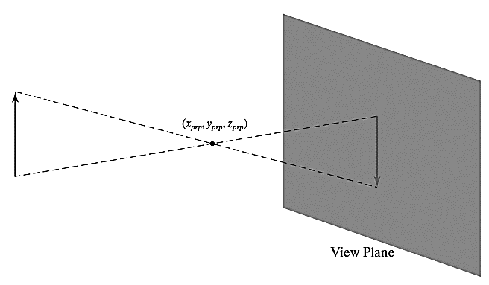
Positioning the PRP and VP
The view plane could be placed anywhere except at the projection point

Slide 15
Vanishing Point
A scene is projected onto a view plane using a perspective mapping
Lines parallel to the view plane remains parallel
Parallel lines in the scene that are not parallel to the view plane are projected into converging lines
There point of convergence is called the vanishing point

Slide 16
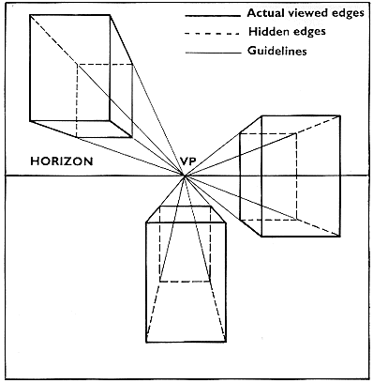
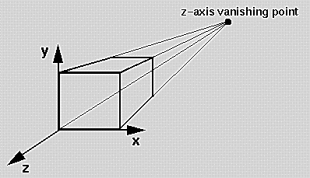
Z-axis vanishing point

Slide 17
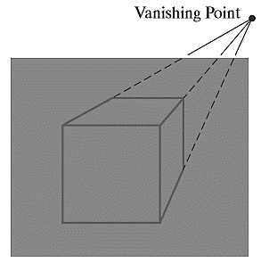
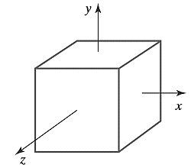
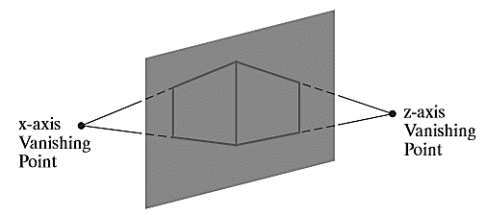
Illustrations
one-point, two-point, three-point projections
Number of principal vanishing points = Number of principal axes that intersect the view plane.

Slide 18
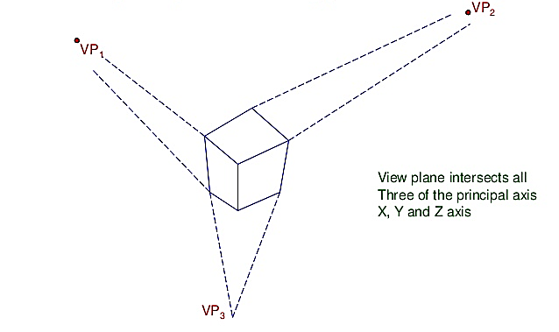
Three point perspective projection
View plane intersects all three of the principal axis X, Y, Z axis

Slide 19
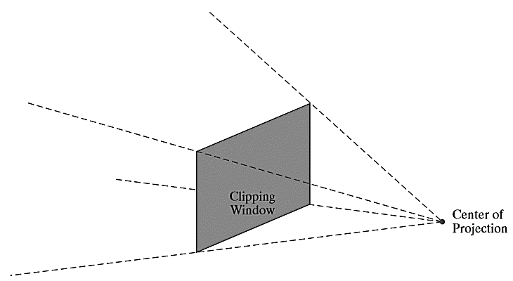
Perspective-Projection View Volume
Specifying the position of a rectangular clipping window on the view plane
Forms a view volume that is an inﬁnite rectangular pyramid with its apex at the center of projection

Slide 20
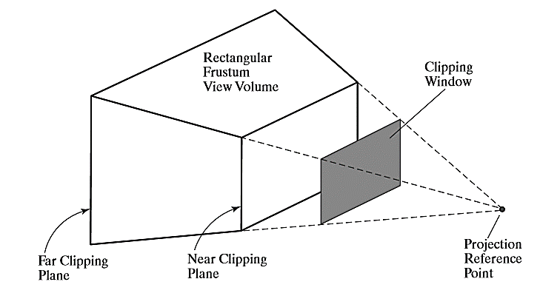
Frustum

Slide 21
Thank you
Next Lecture: Projection Geometry

