Slide 1

CS212: Object Oriented Analysis and Design
GRASP Design Principles

Slide 2
Recap of Lecture 7
Arrays
Pointers
Pointer to members
Dynamic Memory allocation

Slide 3
Outline of lecture 8
Modularity and Typing
GRASP Principle
Polymorphism
Name mangling
Overloading

Slide 4
Automated Gardner
On a hydroponics farm, plants are grown in a nutrient solution, without sand, gravel, or other soils. Maintaining the proper greenhouse environment is a delicate job and depends on the kind of plant being grown and its age. One must control diverse factors such as temperature, humidity, light, pH, and nutrient concentrations. On a large farm, it is not unusual to have an automated system that constantly monitors and adjusts these elements. Simply stated, the purpose of an automated gardener is to efficiently carry out, with minimal human intervention, growing plans for the healthy production of multiple crops.

Slide 5
Automated Gardner
On a hydroponics farm, plants are grown in a nutrient solution, without sand, gravel, or other soils. Maintaining the proper greenhouse environment is a delicate job and depends on the kind of plant being grown and its age. One must control diverse factors such as temperature, humidity, light, pH, and nutrient concentrations. On a large farm, it is not unusual to have an automated system that constantly monitors and adjusts these elements. Simply stated, the purpose of an automated gardener is to efficiently carry out, with minimal human intervention, growing plans for the healthy production of multiple crops.

Slide 6
Automated Gardner
On a hydroponics farm, plants are grown in a nutrient solution, without sand, gravel, or other soils. Maintaining the proper greenhouse environment is a delicate job and depends on the kind of plant being grown and its age. One must control diverse factors such as temperature, humidity, light, pH, and nutrient concentrations. On a large farm, it is not unusual to have an automated system that constantly monitors and adjusts these elements. Simply stated, the purpose of an automated gardener is to efficiently carry out, with minimal human intervention, growing plans for the healthy production of multiple crops.

Slide 7
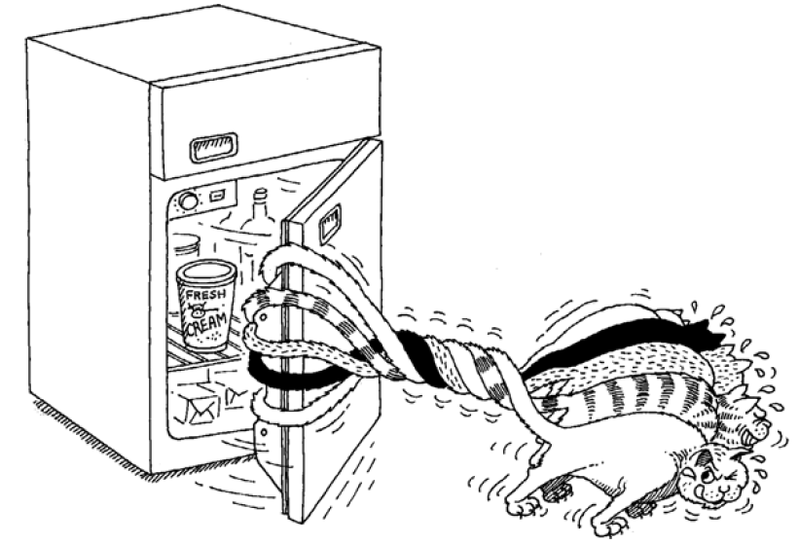
Objects collaborate with other objects to achieve a task
How objects cooperate with one another define the boundaries of each abstraction and thus the responsibilities and protocol of each object.

Slide 8
Meaning of Modularity
The act of partitioning a program into individual components can reduce its complexity to some degree
It creates a number of well-defined, documented boundaries within the program.
Classes and objects form the logical structure of a system
Abstractions are kept in modules to produce the system’s physical architecture.

Slide 9
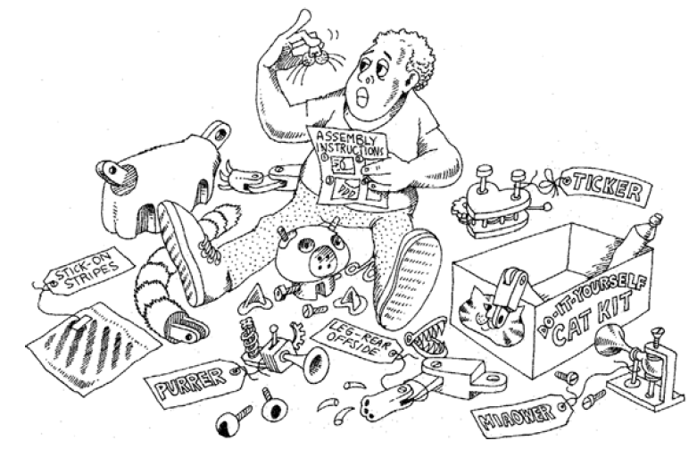
Deciding on the right set of modules for a given problem is almost as hard a problem as deciding on the right set of abstractions.
Modularity is the property of a system that has been decomposed into a set of cohesive and loosely coupled modules

Slide 10
Object design
After identifying the requirements and creating a domain model, then
Add methods to the software classes,
Define the messaging between the objects to fulfil the requirements
But how?
What method belongs where?
How should the objects interact?
This is a critical, important, and non-trivial task

Slide 11
GRASP Patterns/Principles
The GRASP patterns are a learning aid
Help one understand essential object design
Apply design reasoning in a methodical, rational, explainable way.
This approach to understanding and using design principles is based on patterns of assigning responsibilities.
Not been invented to create new ways of working, but to better existing one

Slide 12
GRASP
Name chosen to suggest the importance of grasping fundamental principles to successfully design object-oriented software
Acronym: General Responsibility Assignment Software Patterns
Describe fundamental principles of object design and responsibility
General principles, may be overruled by others

Slide 13
Nine GRASP Principles
Creator
Information Expert
Low Coupling
Controller
High Cohesion
Polymorphism
Indirection
Pure Fabrication
Protected Variations
Creation of objects
Where to delegate responsibilities
Model-view-controller pattern
A non-user interface object
Change in one class having lower impact on others
Variation of behaviors based on type
Focused, manageable and understandable
Artificial class, Open-close principle
Avoid impact of variations of some element on others

Slide 14
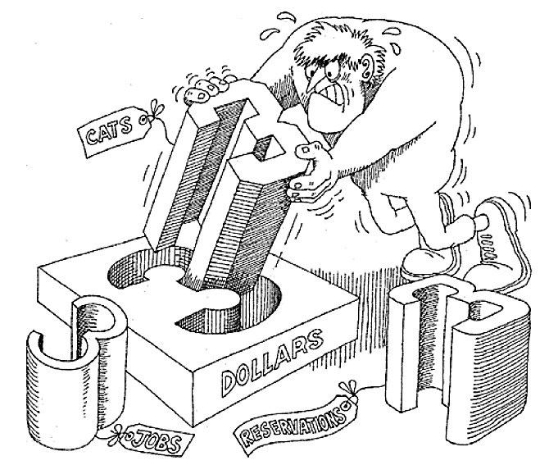
The Meaning of Typing
Precise characterization of structural or behavioural properties
Express abstractions using the underlying programming language.
Strongly, or weakly typed: consistency
Static and dynamic typing: timing

Slide 15
Polymorphism
Polymorphism in C++
Compile Time
Runtime
Function overloading
Operator overloading
Virtual Function
Refers to ‘one name having many forms’
‘Different behaviour of an instance depending upon the situation’.
An ‘overloaded function’ refers to a function having (one name and) more than one distinct meanings.
Not only does it provide support for compile-time polymorphism, it also adds flexibility and convenience.

Slide 16
Thank you
Next Lecture: Function Overloading - II

