Slide 1

CS654: Digital Image Analysis
Lecture 11: Image Transforms

Slide 2
Recap of Lecture 10
B-Spline curve
Constant, Linear, Quadratic, Cubic interpolation
Nearest neighbour, Bi-Linear, Bi-Cubic interpolation

Slide 3
Outline of Lecture 11
Image transforms
Unitary matrices
1-D and 2-D unitary transforms

Slide 4
Introduction
Input Image
Forward transform
Output Image
N
N
Reverse transform
N
N
Applications
Filtering – removing higher or lower frequency component
Data Compression – storage space and transmission bandwidth
Feature extraction

Slide 5
Example
Magnitude of the Fourier Transform
Input Image
Mask to eliminate energy bursts
Output Image

Slide 6
General Approach

Slide 7
Definition
It refers to a class of unitary matrices used for representing images
Similarly to 1-D basis functions, an image can be represented with the help of basis images
The basis images can be generated using unitary matrices
An image transform provides a set of basis vector the vector space

Slide 8
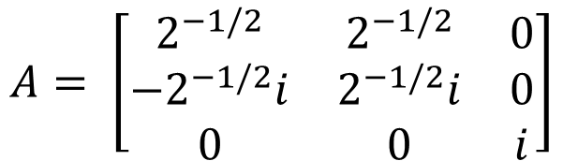

Unitary Matrix
A complex square matrix $A$ is unitary if its conjugate transpose is its inverse, i.e.
$$A^{−1}=A^{∗T}$$
Example:
$$A= \left[\begin{matrix}2^{−1/2} & 2^{−1/2} & 0 \\ −2^{−1/2}i & 2^{−1/2}i & 0 \\ 0 & 0 & i\end{matrix}\right]$$
As transformations they preserve length, and preserve the angle between vectors.

Slide 9




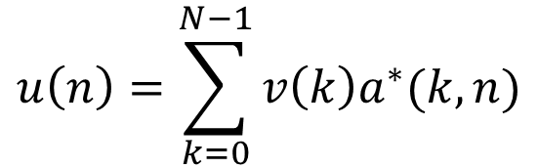


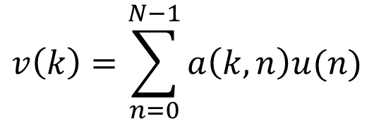

1-D Representation
For an one dimensional sequence
A unitary transformation is written as:
$$\{u\left(n\right),0≤n≤N−1\}$$
$$v\left(k\right)=\sum_{n=0}^{N−1}{a\left(k,n\right)u(n)}$$
$$\vec{v}=A \vec{u}$$
Or,
$$\{0≤k≤N−1\}$$
Series representation
$$u\left(n\right)=\sum_{k=0}^{N−1}{v\left(k\right)a^{∗}(k,n)}$$
$$\vec{u}=A^{∗T} \vec{v}$$
Or,
$$\{0≤n≤N−1\}$$
Series representation
Basis vector of A
Columns of $A^{∗T}$
$$a_{k}^{∗}={\left\{a^{∗}\left(k,n\right),0≤n≤N−1\right\}}^{T}$$

Slide 10
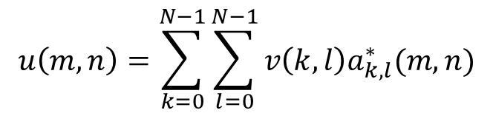



2-D Orthogonal Unitary Transforms
Let $u\left(m,n\right)$ is an $N×N$ image, then
$$v\left(k,l\right)=\sum_{m=0}^{N−1}{\sum_{n=0}^{N−1}{u\left(m,n\right)a_{k,l}(m,n)}}$$
where $0≤k,l≤N−1$
$\left\{a_{k,l}\left(m,n\right)\right\},$ is called the Image Transform
Complete, orthonormal, discrete basis functions
Inverse transform
$$u\left(m,n\right)=\sum_{k=0}^{N−1}{\sum_{l=0}^{N−1}{v\left(k,l\right)a_{k,l}^{∗}(m,n)}}$$
where $0≤m,n≤N−1$

Slide 11

Properties of Basis functions
Orthonormality
$$\sum_{m=0}^{N−1}{\sum_{n=0}^{N−1}{a_{k,l}\left(m,n\right)}}a_{k^{′},l^{′}}^{∗}\left(m,n\right)=δ(k−k^{′},l−l^{′})$$
Completeness
$$\sum_{k=0}^{N−1}{\sum_{l=0}^{N−1}{a_{k,l}\left(m,n\right)}}a_{k,l}^{∗}\left(m′,n′\right)=δ(m−m^{′},n−n′)$$

Slide 12
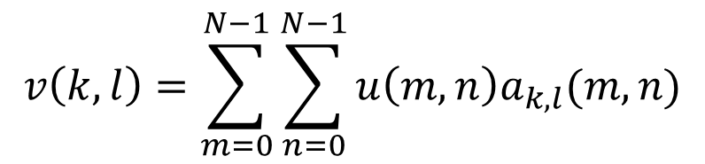
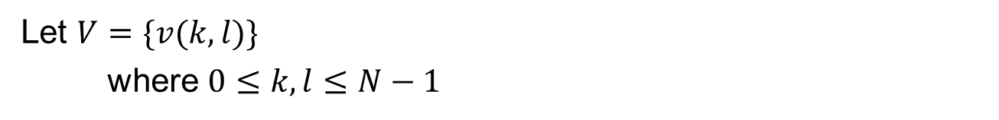
Transformed Image
$$v\left(k,l\right)=\sum_{m=0}^{N−1}{\sum_{n=0}^{N−1}{u\left(m,n\right)a_{k,l}(m,n)}}$$
Let $V=\{v(k,l)\}$
where $0≤k,l≤N−1$
The set V denotes the transformed image

Slide 13

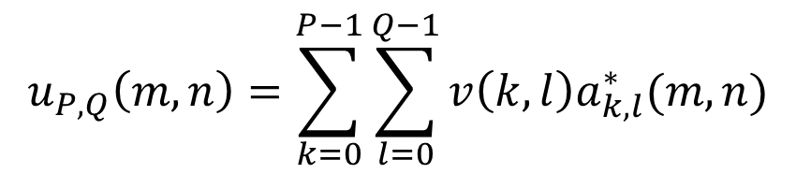
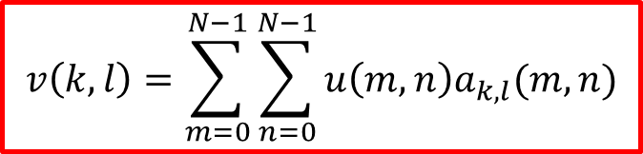
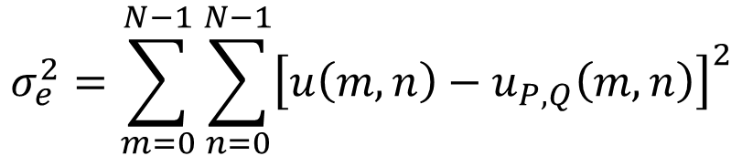
Truncated series summation
$$u_{P,Q}\left(m,n\right)=\sum_{k=0}^{P−1}{\sum_{l=0}^{Q−1}{v\left(k,l\right)a_{k,l}^{∗}(m,n)}}$$
$$P≤N,Q≤N$$
Sum of squared Error
$$σ_{e}^{2}=\sum_{m=0}^{N−1}{\sum_{n=0}^{N−1}{{\left[{u\left(m,n\right)−u}_{P,Q}\left(m,n\right)\right]}^{2}}}$$
$$v\left(k,l\right)=\sum_{m=0}^{N−1}{\sum_{n=0}^{N−1}{u\left(m,n\right)a_{k,l}(m,n)}}$$
Error will be minimum if

Slide 14
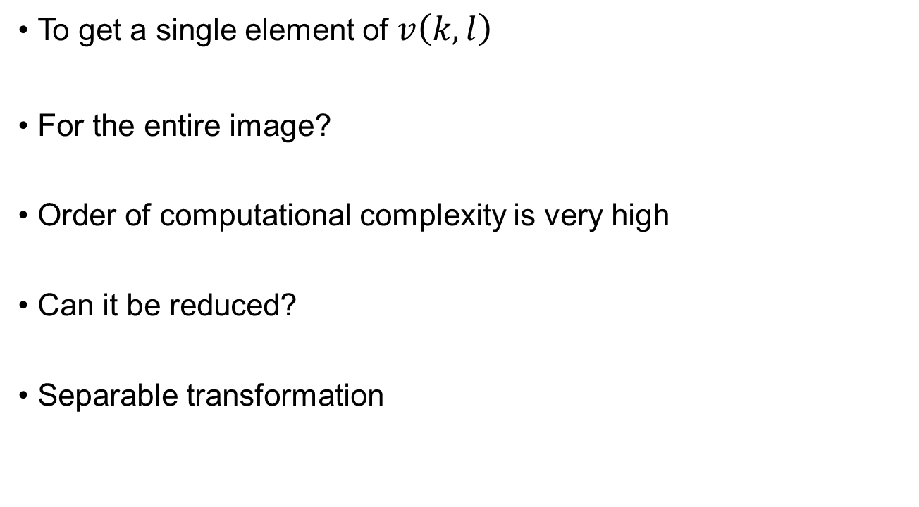
Computational complexity
To get a single element of $v\left(k,l\right)$
For the entire image?
Order of computational complexity is very high
Can it be reduced?
Separable transformation

Slide 15
Thank you
Next Lecture: Image transformations-II

