Slide 1

CS654: Digital Image Analysis
Lecture 12: Separable Transforms

Slide 2
Recap of Lecture 11
Image Transforms
Source and target domain
Unitary transform, 1-D
Unitary transform, 2-D
High computational complexity

Slide 3
Outline of Lecture 12
Unitary transforms
Separable functions
Properties of unitary transforms

Slide 4
Image transforms
Operation to change the default representation space of a digital image (source domain → target domain)
All the information present in the image is preserved in the transformed domain, but represented differently;
The transform is reversible
Source domain = spatial domain and target domain= frequency domain

Slide 5

Unitary transform
1-D input sequence
If $v=$ Transformed sequence

Slide 6
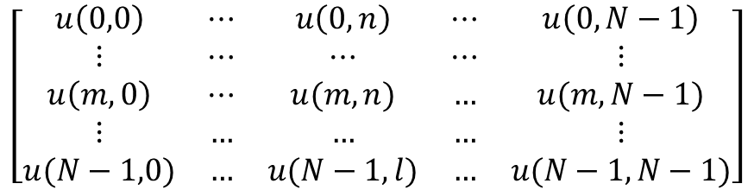
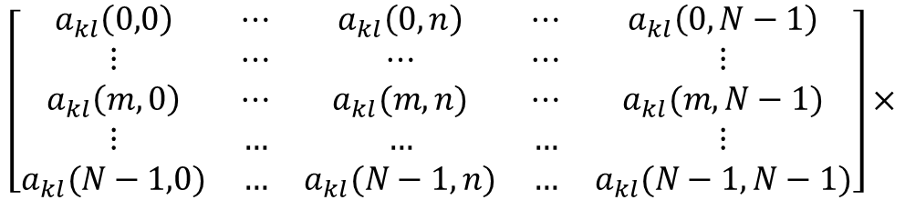
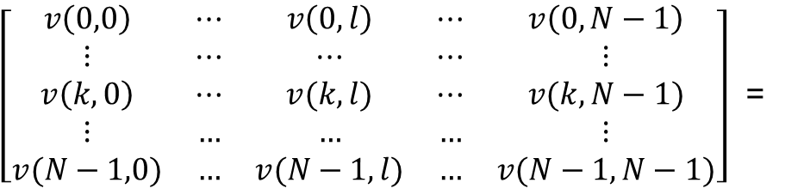
2-D sequence
High computational complexity
O(N⁴)
$\left[\begin{matrix}v\left(0,0\right) & ⋯ & v\left(0,l\right) & ⋯ & v\left(0,N−1\right) \\ ⋮ & ⋯ & ⋯ & ⋯ & ⋮ \\ v\left(k,0\right) & ⋯ & v(k,l) & ⋯ & v(k,N−1) \\ ⋮ & … & … & … & ⋮ \\ v(N−1,0) & … & v(N−1,l) & … & v(N−1,N−1)\end{matrix}\right]$ =
$$\left[\begin{matrix}a_{kl}\left(0,0\right) & ⋯ & a_{kl}\left(0,n\right) & ⋯ & a_{kl}\left(0,N−1\right) \\ ⋮ & ⋯ & ⋯ & ⋯ & ⋮ \\ a_{kl}\left(m,0\right) & ⋯ & a_{kl}(m,n) & ⋯ & a_{kl}(m,N−1) \\ ⋮ & … & … & … & ⋮ \\ a_{kl}(N−1,0) & … & a_{kl}(N−1,n) & … & a_{kl}(N−1,N−1)\end{matrix}\right]×$$
$$\left[\begin{matrix}u\left(0,0\right) & ⋯ & u\left(0,n\right) & ⋯ & u\left(0,N−1\right) \\ ⋮ & ⋯ & ⋯ & ⋯ & ⋮ \\ u\left(m,0\right) & ⋯ & u(m,n) & … & u(m,N−1) \\ ⋮ & … & … & … & ⋮ \\ u(N−1,0) & … & u(N−1,l) & … & u(N−1,N−1)\end{matrix}\right]$$

Slide 7




Separable Transformations
We like to design a transformation such that
$$a_{k,l}\left(m,n\right)=a_{k}\left(m\right)b_{l}\left(n\right)=a\left(k,m\right)b(l,n)$$
$${\{a}_{k}\left(m\right),k=0,…, N−1\}$$
1-D complete orthonormal basis vectors
$${\{b}_{l}\left(n\right),l=0,…, N−1\}$$
Let there be two sets
$$A=\{a(k,m)\}$$
$$B=\{b(l,n)\}$$

Slide 8



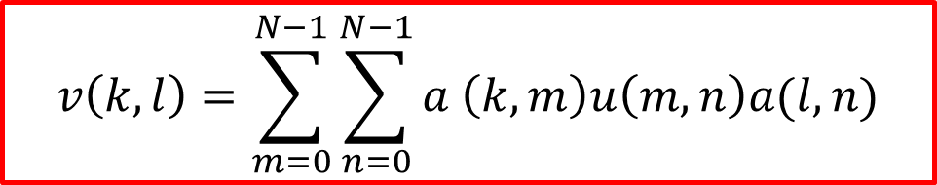
Separable Transformations
$$AA^{∗T}=A^{∗T}A=I$$
$$BB^{∗T}=B^{∗T}B=I$$
Assumption: the separable matrices be same, then
$$v\left(k,l\right)=\sum_{m=0}^{N−1}{\sum_{n=0}^{N−1}{a \left(k,m\right)u\left(m,n\right)a(l,n)}}$$
What would be v in matrix notation?
$$V=AUA^{T}$$

Slide 9
Reverse transformations
For non-square matrices

Slide 10
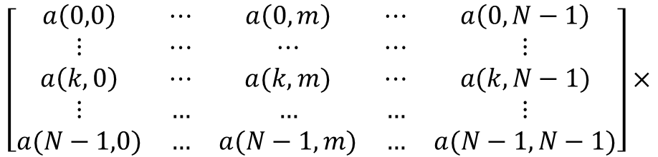
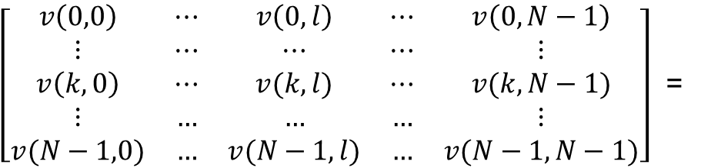
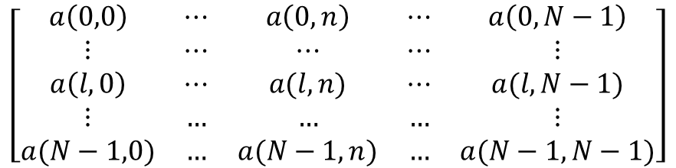
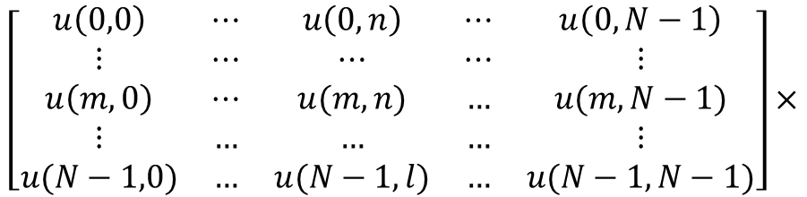
$\left[\begin{matrix}v\left(0,0\right) & ⋯ & v\left(0,l\right) & ⋯ & v\left(0,N−1\right) \\ ⋮ & ⋯ & ⋯ & ⋯ & ⋮ \\ v\left(k,0\right) & ⋯ & v(k,l) & ⋯ & v(k,N−1) \\ ⋮ & … & … & … & ⋮ \\ v(N−1,0) & … & v(N−1,l) & … & v(N−1,N−1)\end{matrix}\right]$ =
$$\left[\begin{matrix}a\left(0,0\right) & ⋯ & a\left(0,m\right) & ⋯ & a\left(0,N−1\right) \\ ⋮ & ⋯ & ⋯ & ⋯ & ⋮ \\ a\left(k,0\right) & ⋯ & a(k,m) & ⋯ & a(k,N−1) \\ ⋮ & … & … & … & ⋮ \\ a(N−1,0) & … & a(N−1,m) & … & a(N−1,N−1)\end{matrix}\right]×$$
Computational complexity
O(N³)
$$\left[\begin{matrix}u\left(0,0\right) & ⋯ & u\left(0,n\right) & ⋯ & u\left(0,N−1\right) \\ ⋮ & ⋯ & ⋯ & ⋯ & ⋮ \\ u\left(m,0\right) & ⋯ & u(m,n) & … & u(m,N−1) \\ ⋮ & … & … & … & ⋮ \\ u(N−1,0) & … & u(N−1,l) & … & u(N−1,N−1)\end{matrix}\right]×$$
$$\left[\begin{matrix}a\left(0,0\right) & ⋯ & a\left(0,n\right) & ⋯ & a\left(0,N−1\right) \\ ⋮ & ⋯ & ⋯ & ⋯ & ⋮ \\ a\left(l,0\right) & ⋯ & a(l,n) & ⋯ & a(l,N−1) \\ ⋮ & … & … & … & ⋮ \\ a(N−1,0) & … & a(N−1,n) & … & a(N−1,N−1)\end{matrix}\right]$$

Slide 11
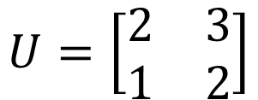
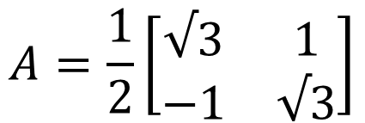
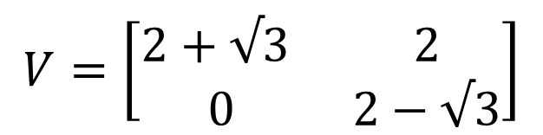
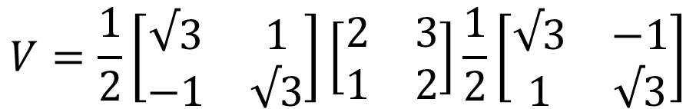

Example
$$A=\frac{1}{2}\left[\begin{matrix}√3 & 1 \\ −1 & √3\end{matrix}\right]$$
$$U=\left[\begin{matrix}2 & 3 \\ 1 & 2\end{matrix}\right]$$
$$V=AUA^{T}$$
$$V=\frac{1}{2}\left[\begin{matrix}√3 & 1 \\ −1 & √3\end{matrix}\right]\left[\begin{matrix}2 & 3 \\ 1 & 2\end{matrix}\right]\frac{1}{2}\left[\begin{matrix}√3 & −1 \\ 1 & √3\end{matrix}\right]$$
$$V=\left[\begin{matrix}2+√3 & 2 \\ 0 & 2−√3\end{matrix}\right]$$

Slide 12
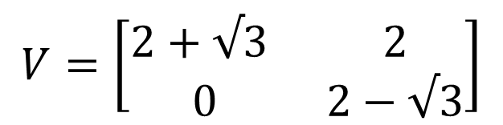
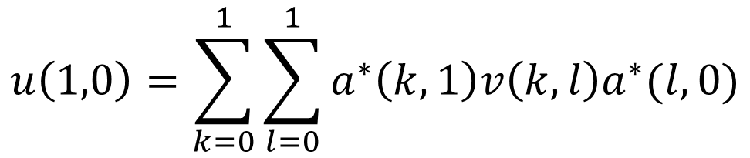
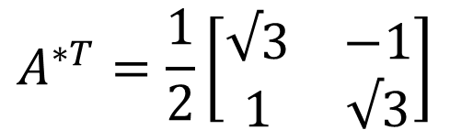
Inverse transforms
$$V=\left[\begin{matrix}2+√3 & 2 \\ 0 & 2−√3\end{matrix}\right]$$
$$A^{∗T}=\frac{1}{2}\left[\begin{matrix}√3 & −1 \\ 1 & √3\end{matrix}\right]$$
$$u\left(1,0\right)=\sum_{k=0}^{1}{\sum_{l=0}^{1}{a^{∗}\left(k,1\right)v\left(k,l\right)a^{∗}(l,0)}}$$

Slide 13

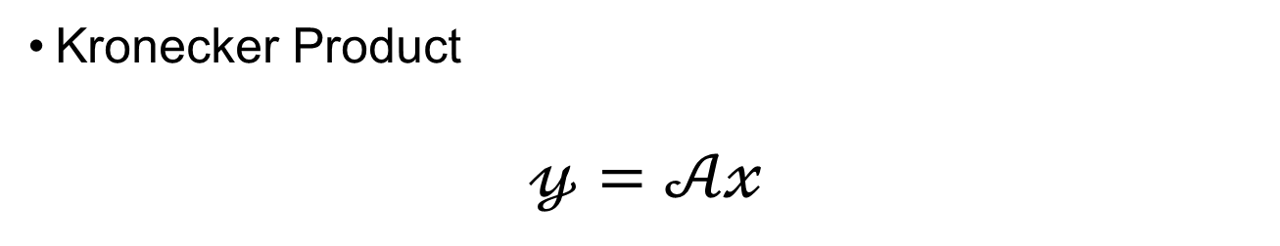
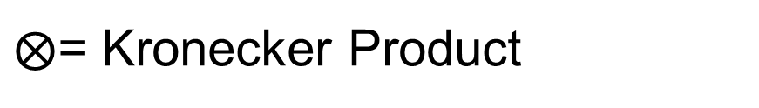
Kronecker Products
Kronecker Product
$$𝓎=𝒜𝓍$$
Arbitrary 1-D transformation
This will be separable if
$$𝒜=A_{1}⨂A_{2}$$
$⨂$= Kronecker Product
It is a generalization of the outer product

Slide 14

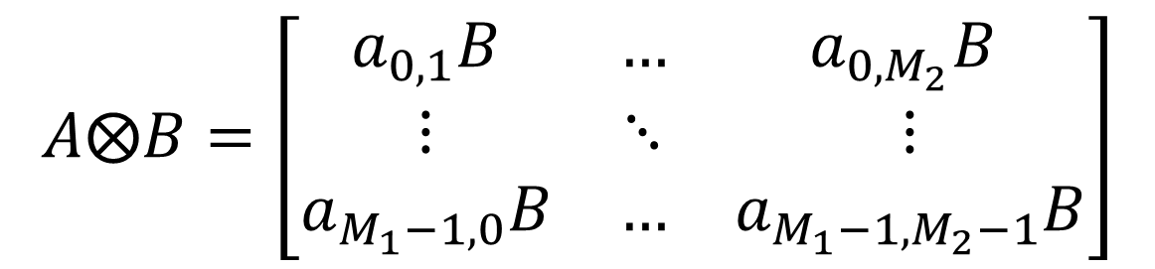
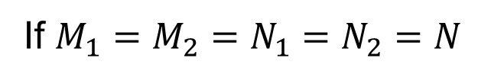
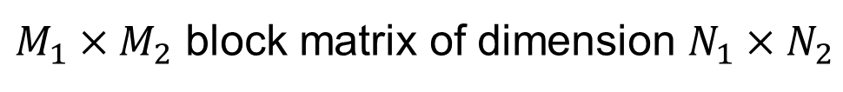
Kronecker Products
If $A$ and $B$ are $M_{1}×M_{2}$ and $N_{1}×N_{2}$ matrices then Kronecker product of $A$ and $B$ is defined as
$$A⨂B=\left[\begin{matrix}a_{0,1}B & … & a_{0,M_{2}}B \\ ⋮ & ⋱ & ⋮ \\ a_{M_{1}−1,0}B & … & a_{M_{1}−1,M_{2}−1}B\end{matrix}\right]$$
$M_{1}×M_{2}$ block matrix of dimension $N_{1}×N_{2}$
If $M_{1}=M_{2}=N_{1}=N_{2}=N$
Computational complexity??
Fast image transforms

Slide 15

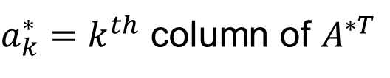
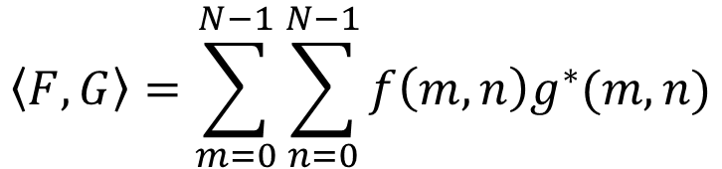
Basis Images
$a_{k}^{∗}=k^{th}$ column of $A^{∗T}$
Outer product
$A_{k,l}^{∗}=a_{k}^{∗}⨂a_{l}^{∗T}$
Inner product
$$\left\langle F,G\right\rangle =\sum_{m=0}^{N−1}{\sum_{n=0}^{N−1}{f\left(m,n\right)g^{∗}(m,n)}}$$

Slide 16
Basis Images
=
=
+
+
+
+
+
+
+
+
+
+
+
+
+
…
+
Keeping only 50% of coefficients

Slide 17
Thank you
Next Lecture: Discrete Fourier Transform

