Slide 1

CS654: Digital Image Analysis
Lecture 13: Discrete Fourier Transformation

Slide 2
Recap of Lecture 12
Unitary transform
Separable transform
Kronecker Product
Improvement of computational complexity

Slide 3
Outline of lecture 13
Discrete Fourier transformation
1D and 2D
Separable DFT
Fast Fourier Transform

Slide 4

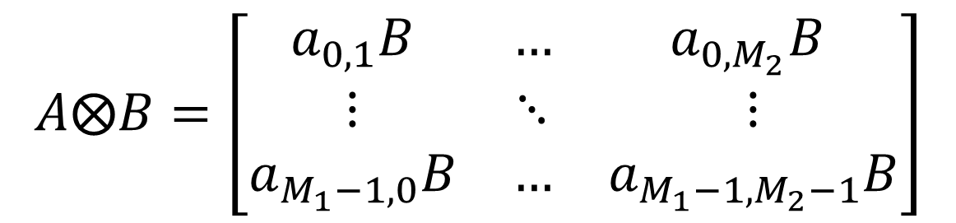
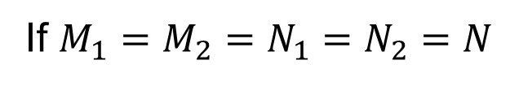
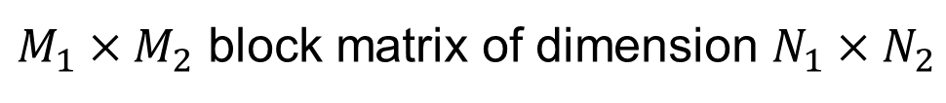
Kronecker Products
If $A$ and $B$ are $M_{1}×M_{2}$ and $N_{1}×N_{2}$ matrices then Kronecker product of $A$ and $B$ is defined as
$$A⨂B=\left[\begin{matrix}a_{0,1}B & … & a_{0,M_{2}}B \\ ⋮ & ⋱ & ⋮ \\ a_{M_{1}−1,0}B & … & a_{M_{1}−1,M_{2}−1}B\end{matrix}\right]$$
$M_{1}×M_{2}$ block matrix of dimension $N_{1}×N_{2}$
If $M_{1}=M_{2}=N_{1}=N_{2}=N$
Computational complexity??
Fast image transforms

Slide 5
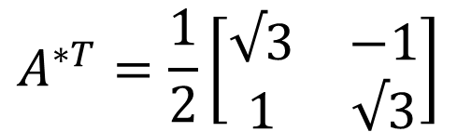
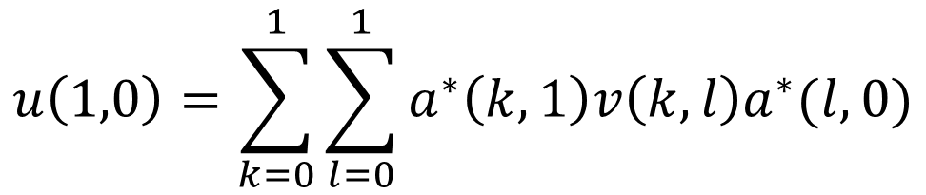
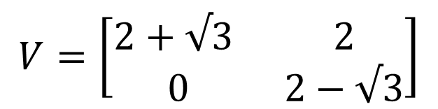



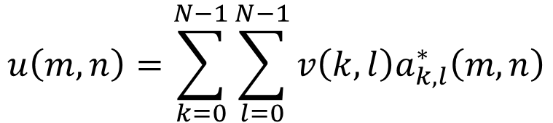

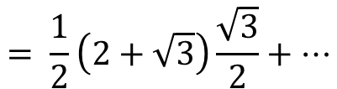

Validation using Basis images
$$u\left(1,0\right)=$$
$$a^{∗}\left(0,1\right)v\left(0,0\right)a^{∗}\left(0,0\right)+$$
$$a^{∗}\left(0,1\right)v\left(0,1\right)a^{∗}\left(1,0\right)+$$
$$a^{∗}\left(1,1\right)v\left(1,0\right)a^{∗}\left(0,0\right)+$$
$$a^{∗}\left(1,1\right)v\left(1,1\right)a^{∗}\left(1,0\right)$$
$$= \frac{1}{2}\left(2+\sqrt{3}\right)\frac{\sqrt{3}}{2}+…$$
$$u\left(m,n\right)=\sum_{k=0}^{N−1}{\sum_{l=0}^{N−1}{v\left(k,l\right)a_{k,l}^{∗}\left(m,n\right)}}$$
Verification using:

Slide 6
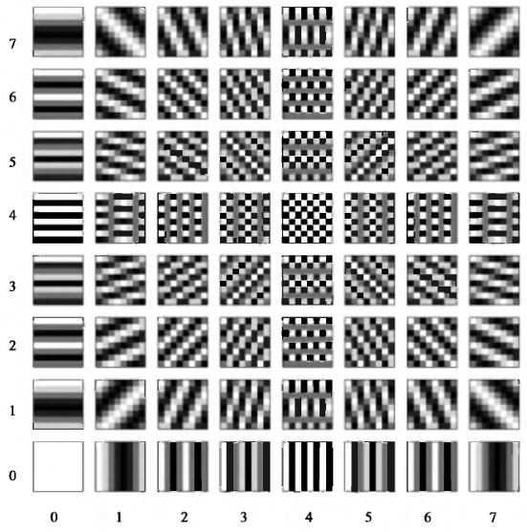
Basis images
Real part of the Fourier transform basis images.

Slide 7

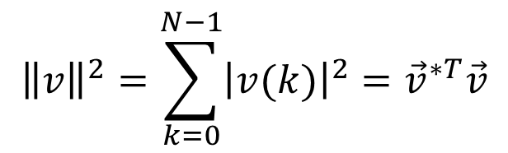
Properties of Unitary transform
Energy Conservation
Energy compaction
Decorrelation
$$v=Au$$
Energy of an 1D signal should be preserved, ${\left\|v\right\|}^{2}={\left\|u\right\|}^{2}$
$${\left\|v\right\|}^{2}=\sum_{k=0}^{N−1}{{\left|v(k)\right|}^{2}={\vec{v}}^{∗T}\vec{v}}$$

Slide 8
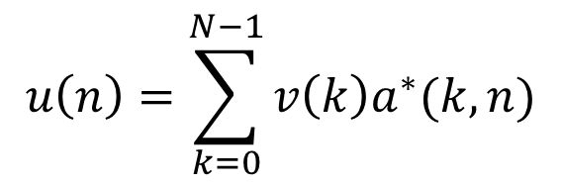



Introduction
1-D Unitary transform
$$v\left(k\right)=\sum_{n=0}^{N−1}{u\left(n\right)a(k,n)}$$
$$0≤k≤N−1$$
Transformation matrix to be chosen appropriately
Forward transformation
$$u\left(n\right)=\sum_{k=0}^{N−1}{v\left(k\right)a^{∗}(k,n)}$$
$$0≤n≤N−1$$
Reverse transformation

Slide 9
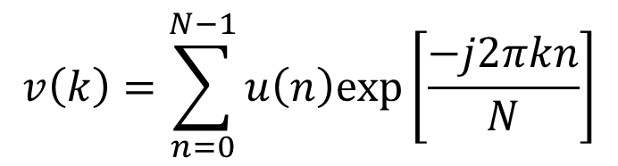
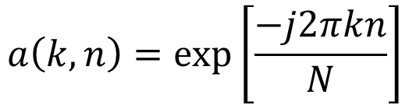
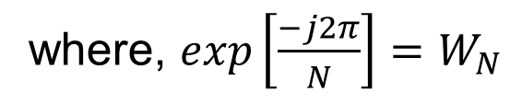
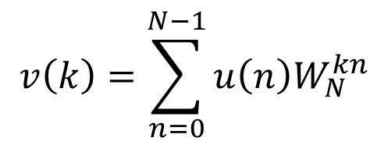
Discrete Fourier Transformation (DFT)
Let the transformation matrix be defined as
$$a\left(k,n\right)=exp⁡\left[\frac{−j2πkn}{N}\right]$$
$$v\left(k\right)=\sum_{n=0}^{N−1}{u\left(n\right)exp⁡\left[\frac{−j2πkn}{N}\right]}$$
For ease of notation
$$v\left(k\right)=\sum_{n=0}^{N−1}{u\left(n\right)W_{N}^{kn}}$$
where, $exp\left[\frac{−j2π}{N}\right]=W_{N}$

Slide 10
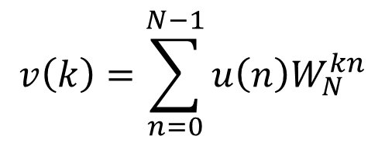
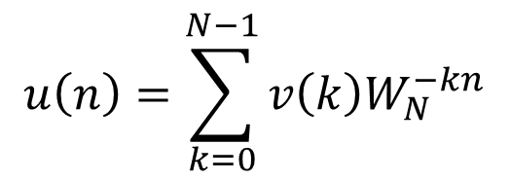
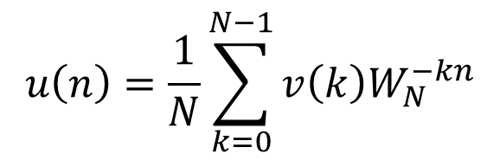
Inverse DFT
Then the inverse DFT will be defined as:
$$u\left(n\right)=\sum_{k=0}^{N−1}{v\left(k\right)W_{N}^{−kn}}$$
Is the transformation unitary?
$$v\left(k\right)=\sum_{n=0}^{N−1}{u\left(n\right)W_{N}^{kn}}$$
$$u\left(n\right)=\frac{1}{N}\sum_{k=0}^{N−1}{v\left(k\right)W_{N}^{−kn}}$$

Slide 11
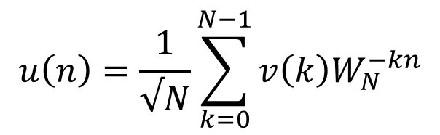
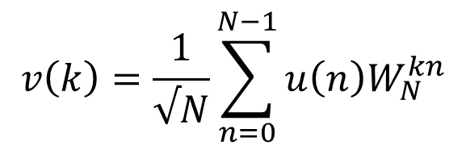
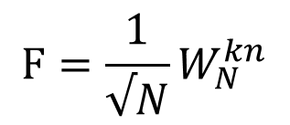

Unitary DFT
Unitary forward and reverse DFT equations are defined as
$$v\left(k\right)=\frac{1}{√N}\sum_{n=0}^{N−1}{u\left(n\right)W_{N}^{kn}}$$
$$u\left(n\right)=\frac{1}{√N}\sum_{k=0}^{N−1}{v\left(k\right)W_{N}^{−kn}}$$
Using matrix notation
$$F=\frac{1}{√N}W_{N}^{kn}$$
$$\vec{v}=F\vec{u}$$
where,

Slide 12
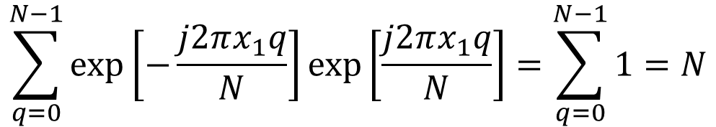
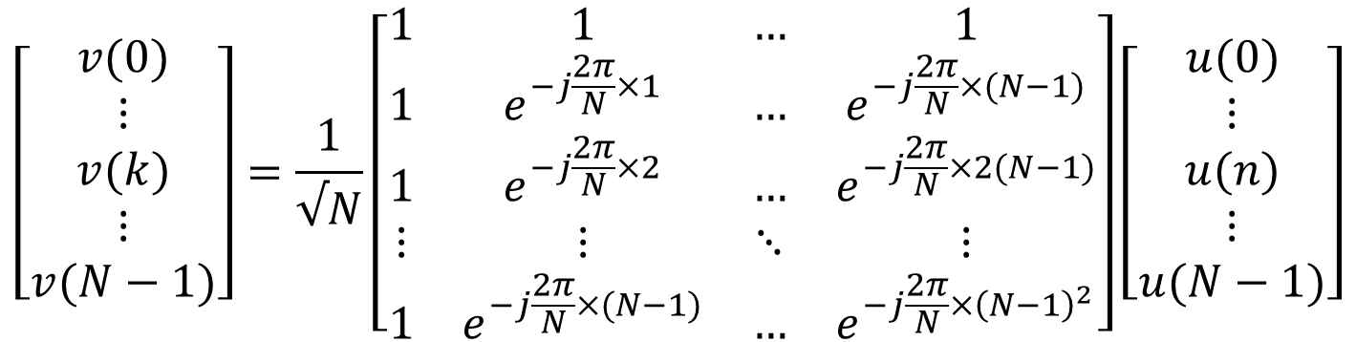
Is matrix used for DFT Unitary?
$$\left[\begin{matrix}v(0) \\ ⋮ \\ v(k) \\ ⋮ \\ v(N−1)\end{matrix}\right]=\frac{1}{√N}\left[\begin{matrix}1 & 1 & … & 1 \\ 1 & e^{−j\frac{2π}{N}×1} & … & e^{−j\frac{2π}{N}×(N−1)} \\ 1 & e^{−j\frac{2π}{N}×2} & … & e^{−j\frac{2π}{N}×2(N−1)} \\ ⋮ & ⋮ & ⋱ & ⋮ \\ 1 & e^{−j\frac{2π}{N}×(N−1)} & … & e^{−j\frac{2π}{N}×{\left(N−1\right)}^{2}}\end{matrix}\right]\left[\begin{matrix}u(0) \\ ⋮ \\ u(n) \\ ⋮ \\ u(N−1)\end{matrix}\right]$$
Magnitude of each row is equal to 1
$$\sum_{q=0}^{N−1}{\exp\left[−\frac{j2πx_{1}q}{N}\right]\exp\left[\frac{j2πx_{1}q}{N}\right]=\sum_{q=0}^{N−1}{1=N}}$$
Rows are orthogonal to each other

Slide 13
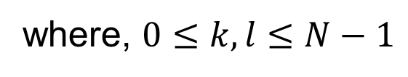
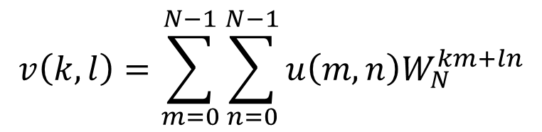
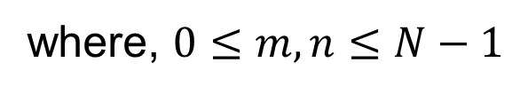
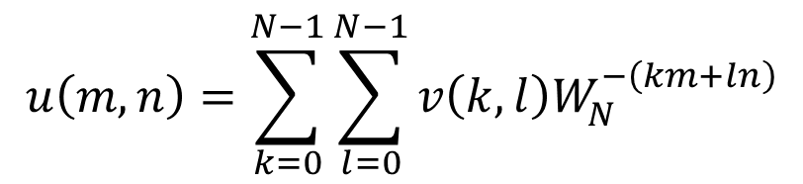
2-D DFT
Forward transformation
$$v\left(k,l\right)=\sum_{m=0}^{N−1}{\sum_{n=0}^{N−1}{u\left(m,n\right)W_{N}^{km+ln}}}$$
where, $0≤k,l≤N−1$
Reverse transformation
$$u\left(m,n\right)=\sum_{k=0}^{N−1}{\sum_{l=0}^{N−1}{v\left(k,l\right)W_{N}^{−\left(km+ln\right)}}}$$
where, $0≤m,n≤N−1$

Slide 14
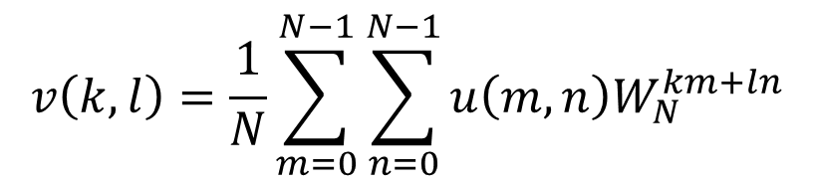
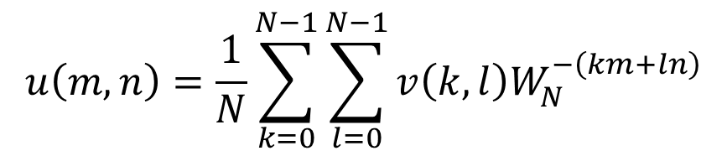
Unitary 2-D DFT
Forward transformation
$$v\left(k,l\right)=\frac{1}{N}\sum_{m=0}^{N−1}{\sum_{n=0}^{N−1}{u\left(m,n\right)W_{N}^{km+ln}}}$$
where, $0≤k,l≤N−1$
Reverse transformation
$$u\left(m,n\right)=\frac{1}{N}\sum_{k=0}^{N−1}{\sum_{l=0}^{N−1}{v\left(k,l\right)W_{N}^{−\left(km+ln\right)}}}$$
where, $0≤m,n≤N−1$

Slide 15
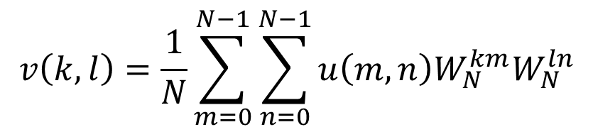
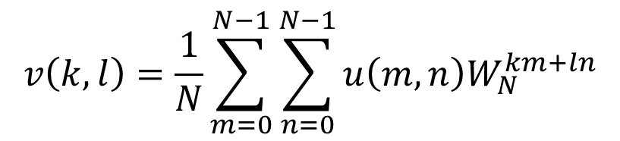
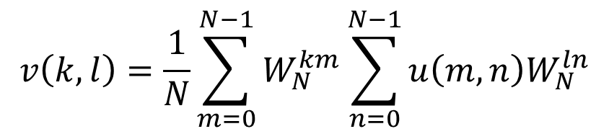
Separable 2-D DFT
$$v\left(k,l\right)=\frac{1}{N}\sum_{m=0}^{N−1}{\sum_{n=0}^{N−1}{u\left(m,n\right)W_{N}^{km+ln}}}$$
$$v\left(k,l\right)=\frac{1}{N}\sum_{m=0}^{N−1}{\sum_{n=0}^{N−1}{u\left(m,n\right)W_{N}^{km}W_{N}^{ln}}}$$
$$v\left(k,l\right)=\frac{1}{N}\sum_{m=0}^{N−1}{W_{N}^{km}\sum_{n=0}^{N−1}{u\left(m,n\right)W_{N}^{ln}}}$$

Slide 16
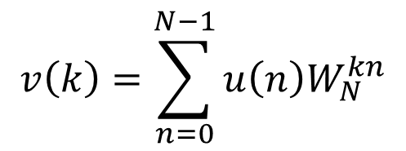
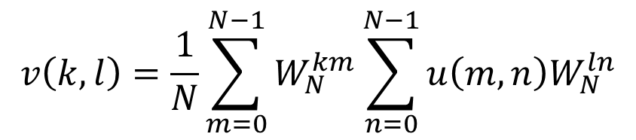
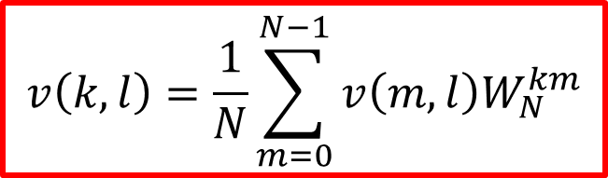
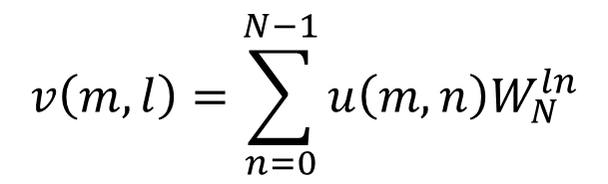
Significance of Separability
$$v\left(k,l\right)=\frac{1}{N}\sum_{m=0}^{N−1}{W_{N}^{km}\sum_{n=0}^{N−1}{u\left(m,n\right)W_{N}^{ln}}}$$
$$v\left(k\right)=\sum_{n=0}^{N−1}{u\left(n\right)W_{N}^{kn}}$$
1-D case:
Using the 1D analogy
$$v\left(m,l\right)=\sum_{n=0}^{N−1}{u\left(m,n\right)W_{N}^{ln}}$$
$$v\left(k,l\right)=\frac{1}{N}\sum_{m=0}^{N−1}{v\left(m,l\right)W_{N}^{km}}$$

Slide 17
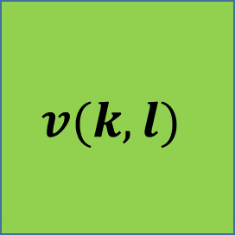




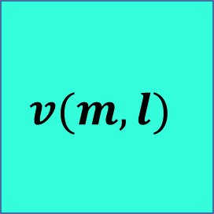



Visualization of separability
(0,0)
(0,0)
$$n$$
Transform over column for each row
$$v(m,l)$$
$$l$$
$$u(m,n)$$
$$m$$
Input image
$$m$$
(0,0)
Transform over rows for each columns
$$v(k,l)$$
$$l$$
$$k$$
DFT image

Slide 18

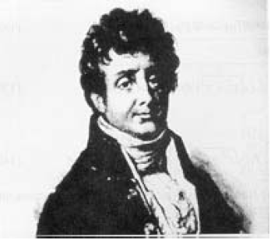
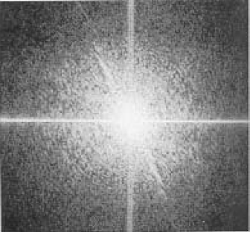

Magnitude and Phase of DFT
Matrix of Complex values: $a+jb$
Magnitude:
Phase:
Input image
Magnitude
Phase angle

Slide 19
Illustration of reconstruction
Input Image 1 (Woman)
Phase angle of Input (IPA1)
Reconstructed only using IPA1
Reconstructed only using the magnitude

Slide 20
Thank you
Next Lecture: Properties of DFT

