Slide 1

CS654: Digital Image Analysis
Lecture 14: Properties of DFT

Slide 2
Recap of Lecture 13
Introduction to DFT
1D and 2D DFT - Unitary
Separability of DFT
Computational complexity
Improvement in computational complexity

Slide 3
Outline of Lecture 14
Properties of DFT
Translation
Periodicity
Conjugate symmetry
Distributivity
Scaling
Average value
Convolution

Slide 4
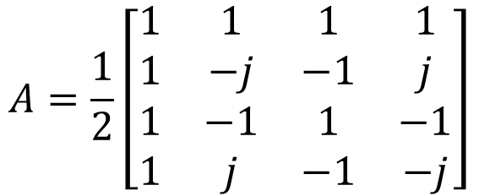

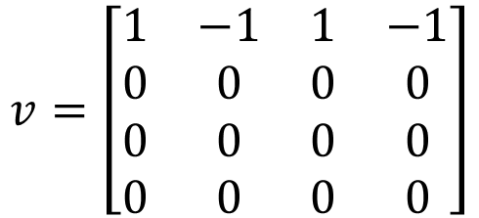
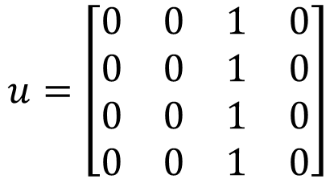
Numerical example
A $4×4$ DFT transformation matrix can be written as
$$A=\frac{1}{2}\left[\begin{matrix}1 & 1 & 1 & 1 \\ 1 & −j & −1 & j \\ 1 & −1 & 1 & −1 \\ 1 & j & −1 & −j\end{matrix}\right]$$
$$u=\left[\begin{matrix}0 & 0 & 1 & 0 \\ 0 & 0 & 1 & 0 \\ 0 & 0 & 1 & 0 \\ 0 & 0 & 1 & 0\end{matrix}\right]$$
$$V=AUA$$
$$v=\left[\begin{matrix}1 & −1 & 1 & −1 \\ 0 & 0 & 0 & 0 \\ 0 & 0 & 0 & 0 \\ 0 & 0 & 0 & 0\end{matrix}\right]$$

Slide 5
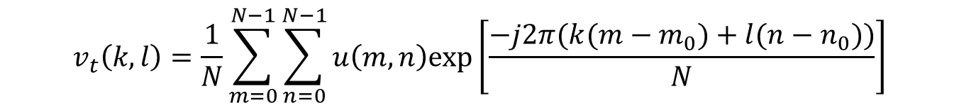

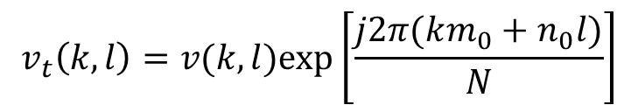
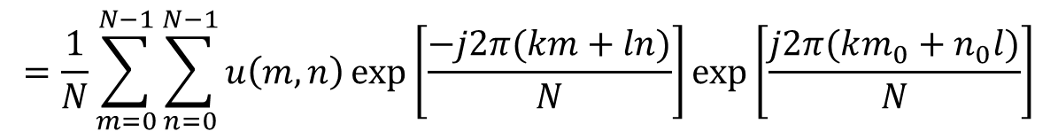
Translation property of DFT
Let, the input image $u\left(m,n\right)$ is translated to a location $u(m−m_{0},n−n_{0})$
$$v\left(k,l\right)=\frac{1}{N}\sum_{m=0}^{N−1}{\sum_{n=0}^{N−1}{u\left(m,n\right)exp⁡\left[\frac{−j2π(km+nl)}{N}\right]}}$$
$$v_{t}\left(k,l\right)=\frac{1}{N}\sum_{m=0}^{N−1}{\sum_{n=0}^{N−1}{u\left(m,n\right)exp⁡\left[\frac{−j2π(k(m−m_{0})+l(n−n_{0}))}{N}\right]}}$$
$$=\frac{1}{N}\sum_{m=0}^{N−1}{\sum_{n=0}^{N−1}{u\left(m,n\right)}}exp⁡\left[\frac{−j2π(km+ln)}{N}\right]exp⁡\left[\frac{j2π(km_{0}+n_{0}l)}{N}\right]$$
$$v_{t}\left(k,l\right)=v(k,l)exp⁡\left[\frac{j2π(km_{0}+n_{0}l)}{N}\right]$$

Slide 6
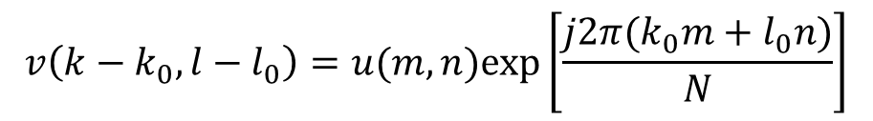
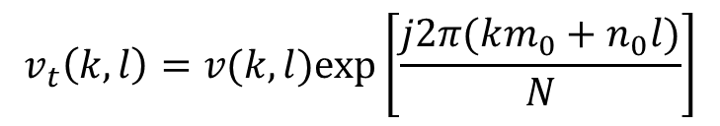
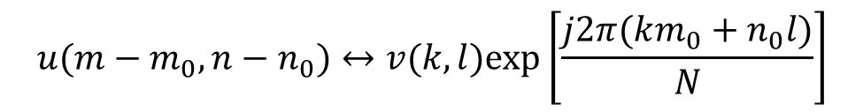
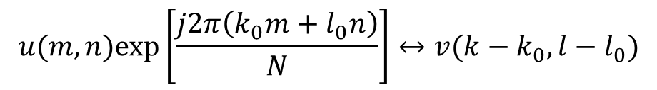
Translation property
$$v_{t}\left(k,l\right)=v(k,l)exp⁡\left[\frac{j2π(km_{0}+n_{0}l)}{N}\right]$$
DFT of translated image
$$v\left(k−k_{0},l−l_{0}\right)=u(m,n)exp⁡\left[\frac{j2π(k_{0}m+l_{0}n)}{N}\right]$$
Inverse DFT
$$u(m,n)exp⁡\left[\frac{j2π\left(k_{0}m+l_{0}n\right)}{N}\right]↔v(k−k_{0},l−l_{0})$$
$$u(m−m_{0},n−n_{0})↔v(k,l)exp⁡\left[\frac{j2π(km_{0}+n_{0}l)}{N}\right]$$

Slide 7
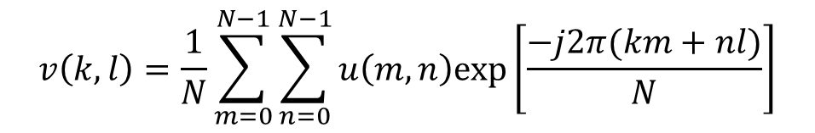

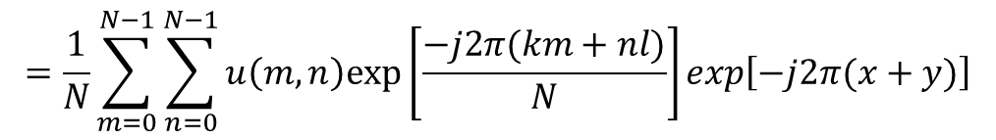
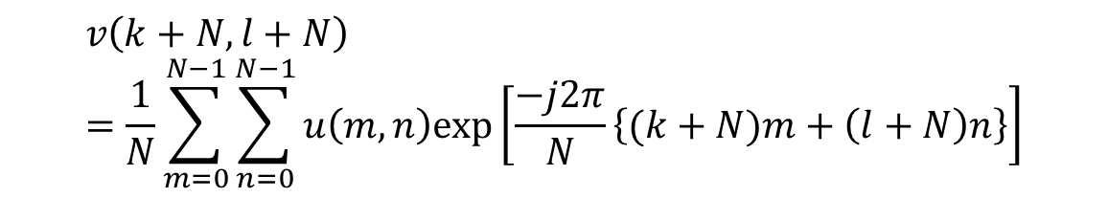
Periodicity
$$v\left(k,l\right)=v\left(m+N,n\right)=v\left(m,n+N\right)=v(m+n,n+N)$$
$$∀k,l$$
$$v\left(k,l\right)=\frac{1}{N}\sum_{m=0}^{N−1}{\sum_{n=0}^{N−1}{u\left(m,n\right)exp⁡\left[\frac{−j2π(km+nl)}{N}\right]}}$$
$$v\left(k+N,l+N\right)=\frac{1}{N}\sum_{m=0}^{N−1}{\sum_{n=0}^{N−1}{u\left(m,n\right)exp⁡\left[\frac{−j2π}{N}\left\{(k+N)m+\left(l+N\right)n\right\}\right]}}$$
$$=\frac{1}{N}\sum_{m=0}^{N−1}{\sum_{n=0}^{N−1}{u\left(m,n\right)exp⁡\left[\frac{−j2π(km+nl)}{N}\right]exp\left[−j2π(x+y)\right]}}$$

Slide 8

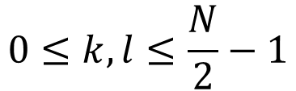

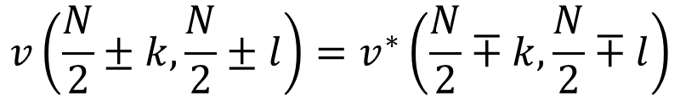



Conjugate symmetry
When $u(m,n)$ is real
$$v\left(\frac{N}{2}±k,\frac{N}{2}±l\right)=v^{∗}\left(\frac{N}{2}∓k,\frac{N}{2}∓l\right)$$
$$0≤k,l≤\frac{N}{2}−1$$
$$\left(\frac{N}{2},\frac{N}{2}\right)$$
$$k=0$$
$$\frac{N}{2}$$
$$N$$
1-D Example
2-D Example

Slide 9
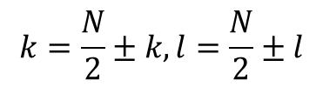
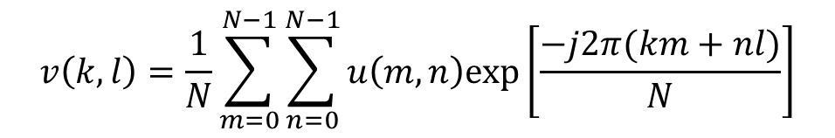
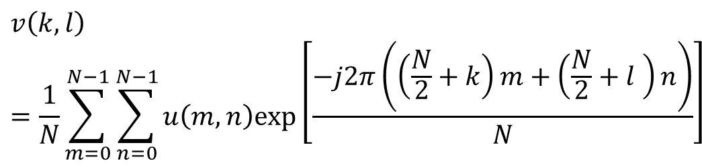
Conjugate symmetry
$$v\left(k,l\right)=\frac{1}{N}\sum_{m=0}^{N−1}{\sum_{n=0}^{N−1}{u\left(m,n\right)exp⁡\left[\frac{−j2π(km+nl)}{N}\right]}}$$
$$k=\frac{N}{2}±k,l=\frac{N}{2}±l$$
$$v\left(k,l\right)=\frac{1}{N}\sum_{m=0}^{N−1}{\sum_{n=0}^{N−1}{u\left(m,n\right)exp⁡\left[\frac{−j2π\left(\left(\frac{N}{2}+k\right)m+\left(\frac{N}{2}+l \right)n\right)}{N}\right]}}$$

Slide 10
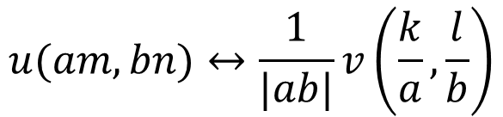

Distributivity
DFT of sum of two signals is equal to the sum of their individual summations
$$DFT\left\{u_{1}\left(m,n\right)+u_{2}(m,n)\right\}=DFT\left\{u_{1}(m,n)\right\}+DFT\left\{u_{2}(m,n)\right\}$$
Scaling
$$u(am,bn)↔\frac{1}{|ab|}v\left(\frac{k}{a},\frac{l}{b}\right)$$
$a,b$ are scaling parameters

Slide 11
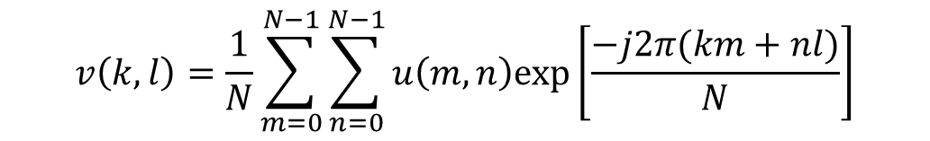
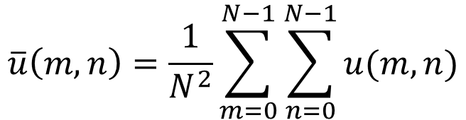
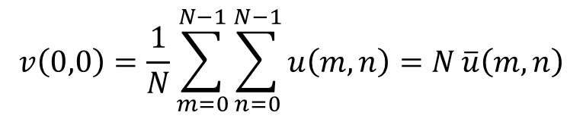

Average value
$$\overline{u}\left(m,n\right)=\frac{1}{N^{2}}\sum_{m=0}^{N−1}{\sum_{n=0}^{N−1}{u(m,n)}}$$
Average value of image
$$v\left(k,l\right)=\frac{1}{N}\sum_{m=0}^{N−1}{\sum_{n=0}^{N−1}{u\left(m,n\right)exp⁡\left[\frac{−j2π(km+nl)}{N}\right]}}$$
For $k=0,l=0$
$$v\left(0,0\right)=\frac{1}{N}\sum_{m=0}^{N−1}{\sum_{n=0}^{N−1}{u\left(m,n\right)=N}}\overline{u}\left(m,n\right)$$
DC Component of an image

Slide 12






Rotation
Polar coordinate in source domain
$$m=rcosθ$$
$$n=rsinθ$$
Instead of working in the Cartesian coordinate, we are working in the polar coordinate
Polar coordinate in target domain
$$k=ωcosφ$$
$$n=ωsinφ$$
If we have
$$u\left(r,θ\right)↔v(ω,φ)$$
Then,
$$u\left(r,θ+θ_{0}\right)↔v(ω,φ+θ_{0})$$

Slide 13

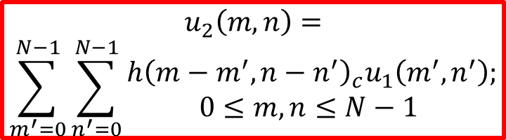











Convolution
Let there be two images of different size
$$n$$
$$u_{2}\left(m,n\right)=$$
$$\sum_{m^{′}=0}^{N−1}{\sum_{n^{′}=0}^{N−1}{\begin{aligned}h{\left(m−m^{′},n−n^{′}\right)}_{c}u_{1}\left(m^{′},n^{′}\right); \\ 0≤m,n≤N−1 \end{aligned}}}$$
$$(N−1)$$
$$\left(h,m\right)=0$$
$$u_{1}(m,n)$$
$$(M−1)$$
$$≠0$$
$$h(m,n)$$
$$h{\left(m,n\right)}_{c}=h(m mod N,n mod N)$$
$$(0,0)$$
$$(M−1)$$
$$(N−1)$$
$$m$$

Slide 14





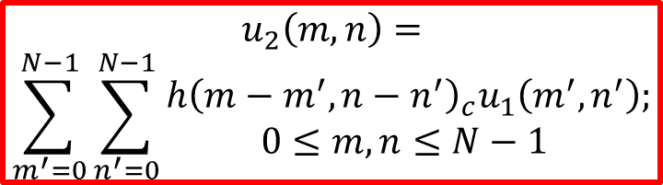










Circular Symmetry
$$n$$
$$(N−1)$$
$$\left(h,m\right)=0$$
$$u_{1}(m,n)$$
$$(M−1)$$
$$≠0$$
$$h(m,n)$$
$$h{\left(m−m^{′},n−n^{′}\right)}_{c}$$
$$(0,0)$$
$$(M−1)$$
$$(N−1)$$
$$m$$
$$u_{2}\left(m,n\right)=$$
$$\sum_{m^{′}=0}^{N−1}{\sum_{n^{′}=0}^{N−1}{\begin{aligned}h{\left(m−m^{′},n−n^{′}\right)}_{c}u_{1}\left(m^{′},n^{′}\right); \\ 0≤m,n≤N−1 \end{aligned}}}$$
$$u_{1}(m′,n′)$$
$$n′$$
Computational complexity??
$$m′$$

Slide 15
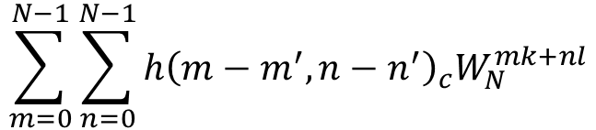
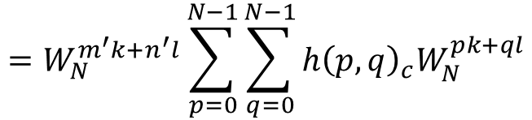

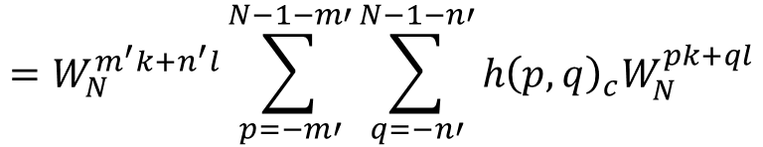

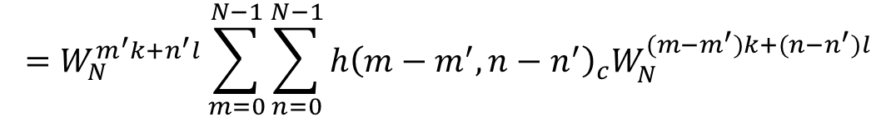
2D DFT for h in frequency domain
$$DFT\left\{h{\left(m−m^{′},n−n^{′}\right)}_{c}\right\}=$$
$$\sum_{m=0}^{N−1}{\sum_{n=0}^{N−1}{h{\left(m−m^{′},n−n^{′}\right)}_{c}W_{N}^{mk+nl}}}$$
$$=W_{N}^{m^{′}k+n^{′}l}\sum_{m=0}^{N−1}{\sum_{n=0}^{N−1}{h{\left(m−m^{′},n−n^{′}\right)}_{c}W_{N}^{(m−m^{′})k+(n−n^{′})l}}}$$
Let, $p=m−m′$ and $q=n−n′$
$$=W_{N}^{m^{′}k+n^{′}l}\sum_{p=−m′}^{N−1−m′}{\sum_{q=−n′}^{N−1−n′}{h{\left(p,q\right)}_{c}W_{N}^{pk+ql}}}$$
$$=W_{N}^{m^{′}k+n^{′}l}\sum_{p=0}^{N−1}{\sum_{q=0}^{N−1}{h{\left(p,q\right)}_{c}W_{N}^{pk+ql}}}$$

Slide 16
DFT of Convolution Function
$$DFT{\left\{u_{2}\left(m,n\right)\right\}}_{N}=DFT{\left\{h\left(m,n\right)\right\}}_{N}DFT\{u_{1}(m,n)\}$$
DFT of a two dimensional circular convolution of two arrays is the product of their DFTs

Slide 17
Thank you
Next Lecture: Hadamard Transform

