Slide 1

CS654: Digital Image Analysis
Lecture 15: Image Transforms with Real Basis Functions

Slide 2
Recap of Lecture 14
Discrete Fourier Transform
Orthogonal sinusoidal waveform
Computational complexity is high
Involves complex multiplication

Slide 3
Outline of Lecture 15
Basis function with real (Integer) values
Hadamard Transform
Haar Transform
KL Transform

Slide 4
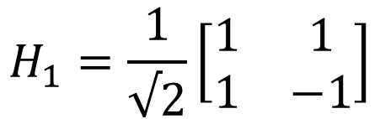


Hadamard Transform
Real, orthogonal, symmetric
Elements of the basis vectors are $±1$
Hadamard transformation matrix${(H}_{n})$
$$H_{1}=\frac{1}{√2}\left[\begin{matrix}1 & 1 \\ 1 & −1\end{matrix}\right]$$
Core matrix
$$N=2^{n},n=1, 2,3,…$$

Slide 5



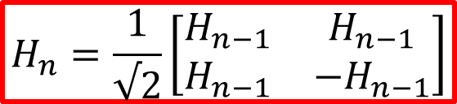

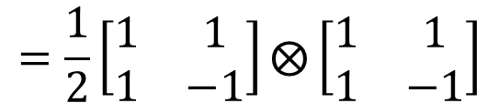
Generation of transformation matrix
Using Kronecker product recursion
$$H_{n}=H_{n−1}⨂H_{1}$$
Example
$$H_{2}=H_{1}⨂H_{1}$$
$$=\frac{1}{2}\left[\begin{matrix}1 & 1 \\ 1 & −1\end{matrix}\right]⨂\left[\begin{matrix}1 & 1 \\ 1 & −1\end{matrix}\right]$$
$$H_{n}=\frac{1}{√2}\left[\begin{matrix}H_{n−1} & H_{n−1} \\ H_{n−1} & −H_{n−1}\end{matrix}\right]$$
$$=\frac{1}{2}\left[\begin{matrix}\left[\begin{matrix}1 & 1 \\ 1 & −1\end{matrix}\right] & \left[\begin{matrix}1 & 1 \\ 1 & −1\end{matrix}\right] \\ \left[\begin{matrix}1 & 1 \\ 1 & −1\end{matrix}\right] & −\left[\begin{matrix}1 & 1 \\ 1 & −1\end{matrix}\right]\end{matrix}\right]$$
$$n=\log_{2}{N}$$

Slide 6





Unitary Hadamard Transform
General unitary transformation equation
Using Hadamard transform
Forward transformation
$$v=Au$$
Inverse transformation
$$u=A^{∗T}v$$
Forward transformation
$$v=Hu$$
Inverse transformation
$$u=H^{∗T}v=Hv$$
Dimension of $H,u,v$ ?
What happens in case of images?

Slide 7
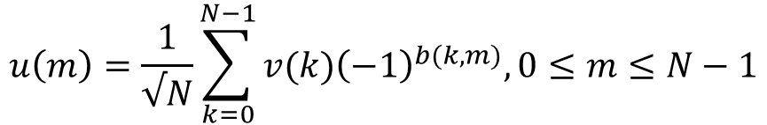
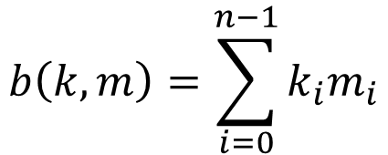
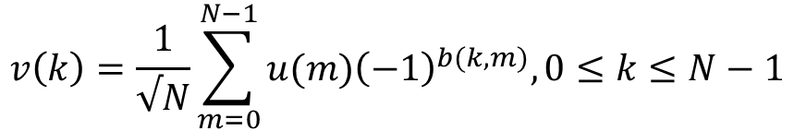
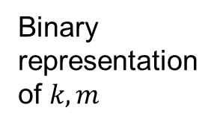
Summation expression
$$v\left(k\right)=\frac{1}{√N}\sum_{m=0}^{N−1}{{u(m)\left(−1\right)}^{b(k,m)},0≤k≤N−1}$$
Forward transformation
$$u\left(m\right)=\frac{1}{√N}\sum_{k=0}^{N−1}{{v(k)\left(−1\right)}^{b(k,m)},0≤m≤N−1}$$
Inverse transformation
Binary representation of $k,m$
$$k=k_{0}2^{0}+k_{1}2^{1}+…+k_{n−1}2^{n−1}$$
LSB, MSB ?
$$m=m_{0}2^{0}+m_{1}2^{1}+…+m_{n−1}2^{n−1}$$
$$b\left(k,m\right)=\sum_{i=0}^{n−1}{k_{i}m_{i}}$$

Slide 8
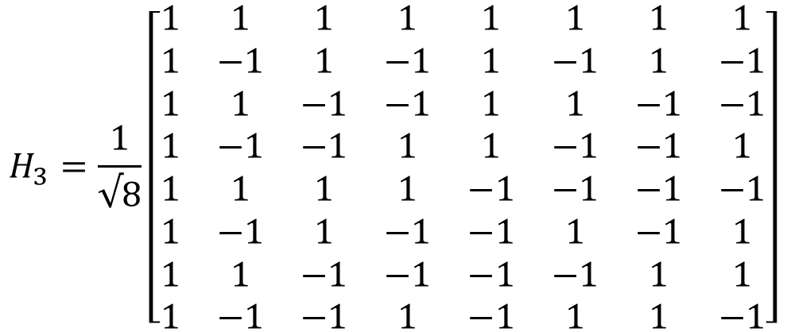
Properties of Hadamard Transformation
Sequency
$$H_{3}=\frac{1}{√8}\left[\begin{matrix}1 & 1 & 1 & 1 & 1 & 1 & 1 & 1 \\ 1 & −1 & 1 & −1 & 1 & −1 & 1 & −1 \\ 1 & 1 & −1 & −1 & 1 & 1 & −1 & −1 \\ 1 & −1 & −1 & 1 & 1 & −1 & −1 & 1 \\ 1 & 1 & 1 & 1 & −1 & −1 & −1 & −1 \\ 1 & −1 & 1 & −1 & −1 & 1 & −1 & 1 \\ 1 & 1 & −1 & −1 & −1 & −1 & 1 & 1 \\ 1 & −1 & −1 & 1 & −1 & 1 & 1 & −1\end{matrix}\right]$$
0
7
3
4
1
6
2
5

Slide 9
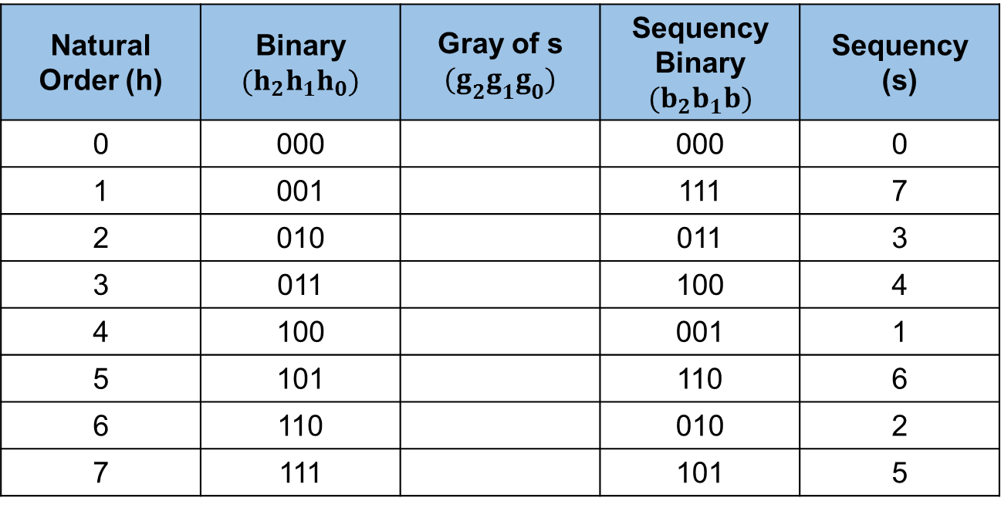
Natural Ordering vs. Sequency Ordering
Natural Order (h) | Binary $(h_{2}h_{1}h_{0})$ | Gray of s $(g_{2}g_{1}g_{0})$ | Sequency Binary $(b_{2}b_{1}b)$ | Sequency (s)
0 | 000 |  | 000 | 0
1 | 001 |  | 111 | 7
2 | 010 |  | 011 | 3
3 | 011 |  | 100 | 4
4 | 100 |  | 001 | 1
5 | 101 |  | 110 | 6
6 | 110 |  | 010 | 2
7 | 111 |  | 101 | 5
000
100
010
110
001
101
011
111
Natural order of the Hadamard transform coefficients = bit reversed gray code representation of its sequency

Slide 10

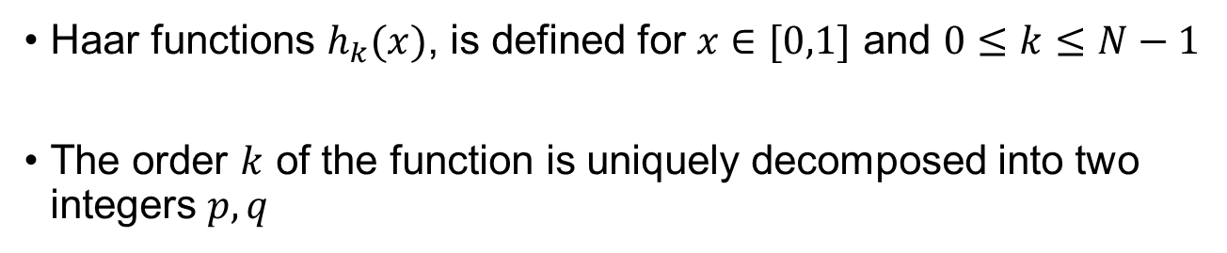



Haar Transform
Haar functions $h_{k}(x)$, is defined for $x∈[0,1]$ and $0≤k≤N−1$
The order $k$ of the function is uniquely decomposed into two integers $p,q$
$$k=2^{p}+q−1$$
Where, $0≤p≤n−1$
$q=0, 1$ for $p=0$
$1≤q≤2^{p};$ for $p≠0$

Slide 11
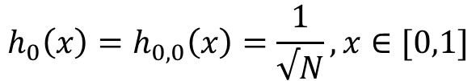
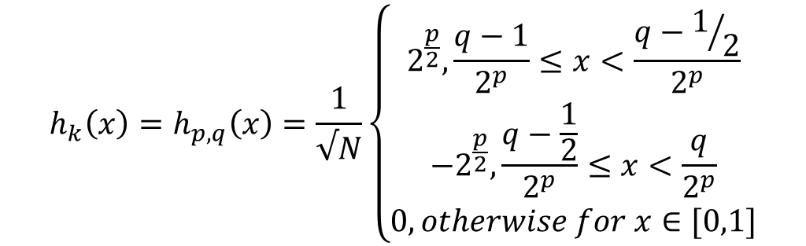
Haar Function
Representing $k$ by $(p,q)$, the Haar functions are defined as:
$$h_{0}\left(x\right)=h_{0,0}\left(x\right)=\frac{1}{√N}, x∈[0,1]$$
$$h_{k}\left(x\right)=h_{p,q}\left(x\right)=\frac{1}{√N}\left\{\begin{aligned}2^{\frac{p}{2}}, \frac{q−1}{2^{p}}≤x<\frac{q−1/2}{2^{p}} \\ −2^{\frac{p}{2}}, \frac{q−\frac{1}{2}}{2^{p}}≤x<\frac{q}{2^{p}} \\ 0, otherwise for x∈[0,1]\end{aligned}\right.$$
$x$ takes discrete values at $\frac{m}{N},m=0,1,…,N−1$

Slide 12





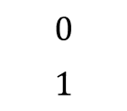



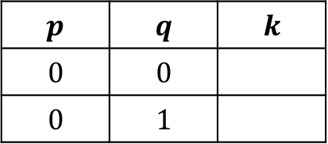
Haar Basis Function Computation
Determine the order of N
Example: Haar basis for $N=2$
Determine $n=\log_{2}{N}$
$$n=\log_{2}{2}=1$$
$$p=0; q=0 or 1$$
Determine $p,q$
$$p$$ | $$q$$ | $$k$$
$$0$$ | $$0$$
$$0$$ | $$1$$
Determine $k=2^{p}+q−1$
$$0$$
$$1$$
Determine the sequence $(x)$
$$x=\frac{0}{2},\frac{1}{2}$$
Calculate the Haar function

Slide 13
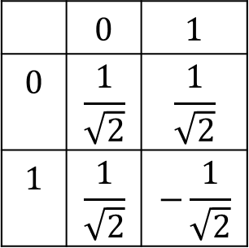

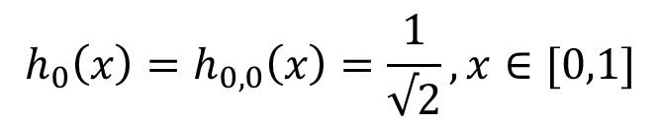
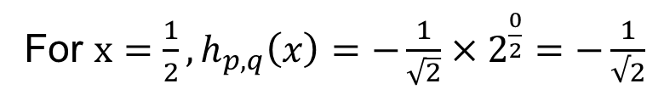


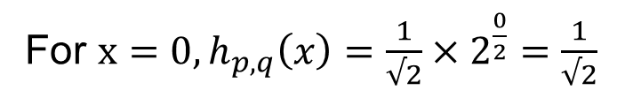



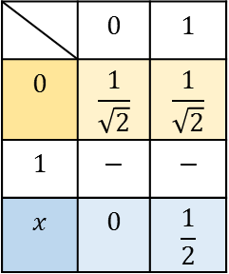


Haar Basis Function Computation
$$n$$
$$n$$
 | $$0$$ | $$1$$
$$0$$ | $$\frac{1}{\sqrt{2}}$$ | $$\frac{1}{\sqrt{2}}$$
$$1$$ | $$−$$ | $$−$$
$$x$$ | $$0$$ | $$\frac{1}{2}$$
Case 1: $k=0$
$$k$$
$$h_{0}\left(x\right)=h_{0,0}\left(x\right)=\frac{1}{√2}, x∈[0,1]$$
$$k$$
Case 2: $k=1,p=0,q=1$
$$n$$
 | $$0$$ | $$1$$
$$0$$ | $$\frac{1}{\sqrt{2}}$$ | $$\frac{1}{\sqrt{2}}$$
$$1$$ | $$\frac{1}{\sqrt{2}}$$ | $$−\frac{1}{\sqrt{2}}$$
For $x=0, h_{p,q}\left(x\right)=\frac{1}{√2}×2^{\frac{0}{2}}=\frac{1}{√2}$
For $x=\frac{1}{2}, h_{p,q}\left(x\right)=−\frac{1}{\sqrt{2}}×2^{\frac{0}{2}}=−\frac{1}{√2}$
$$k$$

Slide 14

Haar basis for N=2

Slide 15
KL Transform
Exploits the statistical properties of an image
Basis functions are orthogonal Eigen vectors of the covariance matrix
Optimally de-correlates the input data
Energy compaction
Input dependent, and high computational complexity

Slide 16








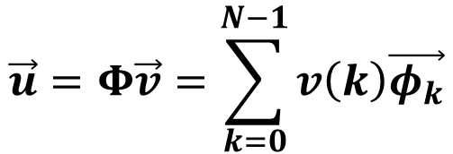


Eigen analysis
Let, $\vec{u}$ be a $N×1$ vector of random variables
Auto-correlation matrix $R=$
$$E[\vec{u}{\vec{u}}^{∗T}]$$
$λ_{k}$: Eigen values of $R$
$$Rφ_{k}=λ_{k}φ_{k}$$
$$0≤k≤N−1$$
$φ_{k}$: Eigen vectors of $R$
KL Transform of $\vec{u}$ is defined as:
$$\vec{v}=Φ^{∗T}\vec{u}$$
$$\vec{u}=Φ\vec{v}=\sum_{k=0}^{N−1}{v\left(k\right)\vec{φ_{k}}}$$
Inverse Transform is defined as:
$$Φ^{∗T}RΦ=Λ=Diag\{λ_{k}\}$$

Slide 17
Thank you
Next Lecture: Convolution and Correlation

