Slide 1

CS654: Digital Image Analysis
Lecture 16: Convolution and Correlation

Slide 2
Recap of Lecture 15
Image Transforms
Hadamard Transform
Haar Transform
KL Transform (1-D)

Slide 3
Outline of Lecture 16
Mask processing
Correlation
Convolution

Slide 4
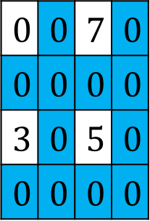
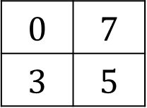
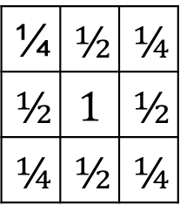
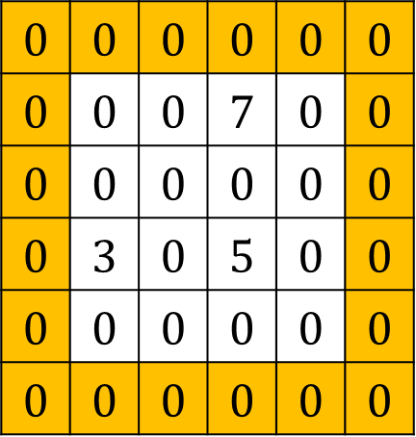
Interpolation using mask
$$0$$ | $$0$$ | $$0$$ | $$0$$ | $$0$$ | $$0$$
$$0$$ | $$0$$ | $$0$$ | $$7$$ | $$0$$ | $$0$$
$$0$$ | $$0$$ | $$0$$ | $$0$$ | $$0$$ | $$0$$
$$0$$ | $$3$$ | $$0$$ | $$5$$ | $$0$$ | $$0$$
$$0$$ | $$0$$ | $$0$$ | $$0$$ | $$0$$ | $$0$$
$$0$$ | $$0$$ | $$0$$ | $$0$$ | $$0$$ | $$0$$
$$0$$ | $$0$$ | $$7$$ | $$0$$
$$0$$ | $$0$$ | $$0$$ | $$0$$
$$3$$ | $$0$$ | $$5$$ | $$0$$
$$0$$ | $$0$$ | $$0$$ | $$0$$
$$0$$ | $$7$$
$$3$$ | $$5$$
Input image
Scaled image
Zero padded image
¼ | $$½$$ | $$¼$$
$$½$$ | $$1$$ | $$½$$
$$¼$$ | $$½$$ | $$¼$$
Interpolation mask

Slide 5
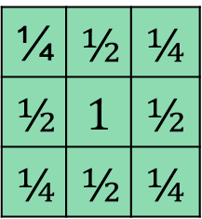
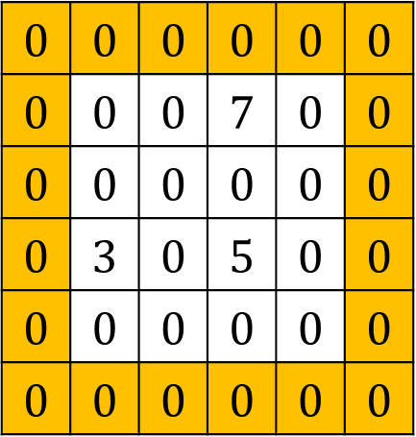
Mask processing
$$0$$ | $$0$$ | $$0$$ | $$0$$ | $$0$$ | $$0$$
$$0$$ | $$0$$ | $$0$$ | $$7$$ | $$0$$ | $$0$$
$$0$$ | $$0$$ | $$0$$ | $$0$$ | $$0$$ | $$0$$
$$0$$ | $$3$$ | $$0$$ | $$5$$ | $$0$$ | $$0$$
$$0$$ | $$0$$ | $$0$$ | $$0$$ | $$0$$ | $$0$$
$$0$$ | $$0$$ | $$0$$ | $$0$$ | $$0$$ | $$0$$
0
3.5
7
3.5
1.5
3.75
6
3
3
4
5
2.5
1.5
2
2.5
1.25
¼ | $$½$$ | $$¼$$
$$½$$ | $$1$$ | $$½$$
$$¼$$ | $$½$$ | $$¼$$

Slide 6
Introduction
Basic operations to extract information from images
The simplest as well as most effective operations
Can be analysed and understood very well
Easy to implement and can be computed very efficiently

Slide 7





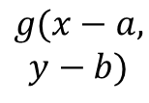

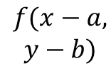


Key Features
Two key features: shift-invariant, and linear.
Linear, Shift-Invariant System (LSI)
Linear system
Shift Invariant System
$$f_{1}$$
$$g_{1}$$
$$f(x,y)$$
$$g(x,y)$$
$$f_{2}$$
$$g_{2}$$
$$f(x−a,$$
$$y−b)$$
$$g(x−a,$$
$$y−b)$$
$${αf}_{1}+βf_{2}$$
$${αg}_{1}+βg_{2}$$
Real systems cannot be strictly linear
Only holds for limited displacements

Slide 8
Advantage of understanding LSI systems
Understanding the properties of image-forming systems
System shortcomings can often be discussed
Transform the ideal image into the one actually observed
Linear: replace every pixel with a linear combination of its neighbours
Shift-invariance: same operation at every point in the image.
Linear-spatial filtering

Slide 9


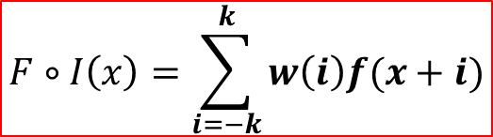

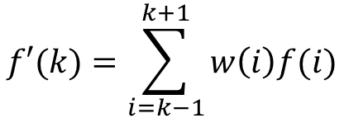

Correlation
The relationship of pixels with respect to its neighborhood
0 | 1 | 2 | 3 | 4 | 5 | 6 | 7 | 8 | 9
5 | 4 | 2 | 3 | 7 | 4 | 6 | 5 | 3 | 6
$$w(−1)$$ | $$w(0)$$ | $$w(1)$$
$$f\left(4\right)=\frac{f\left(3\right)+f\left(4\right)+f(5)}{3}$$
$$f\left(4\right)=\frac{f\left(3\right)}{3}+\frac{f\left(4\right)}{3}+\frac{f\left(5\right)}{3}$$
$$=\frac{1}{3}f(3)+\frac{1}{3}f(4)+\frac{1}{3}f(5)$$
$$f′(k)=w(k−1)f(k−1)+w(k)f(k)+w(k+1)f(k+1)$$
$$f′(k)=\sum_{i=k−1}^{k+1}{w\left(i\right)f(i)}$$
$$F∘I\left(x\right)=\sum_{i=−k}^{k}{w\left(i\right)f(x+i)}$$

Slide 10
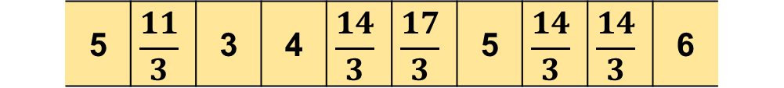

Taking care of the boundaries
 | 0 | 1 | 2 | 3 | 4 | 5 | 6 | 7 | 8 | 9
 | 5 | $$\frac{11}{3}$$ | 3 | 4 | $$\frac{14}{3}$$ | $$\frac{17}{3}$$ | 5 | $$\frac{14}{3}$$ | $$\frac{14}{3}$$ | 6
 | 5 | 4 | 2 | 3 | 7 | 4 | 6 | 5 | 3 | 6
$$\frac{1}{3}$$ | $$\frac{1}{3}$$ | $$\frac{1}{3}$$
 | 0 | 1 | 2 | 3 | 4 | 5 | 6 | 7 | 8 | 9
Case 1:
0 | 5 | 4 | 2 | 3 | 7 | 4 | 6 | 5 | 3 | 6 | 0
Zero-padding
Case 2:
5 | 5 | 4 | 2 | 3 | 7 | 4 | 6 | 5 | 3 | 6 | 5
Replication
Case 3:
6 | 5 | 4 | 2 | 3 | 7 | 4 | 6 | 5 | 3 | 6 | 5
Circular

Slide 11
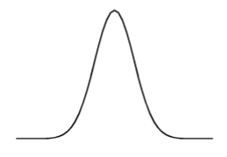
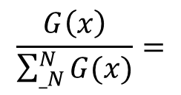

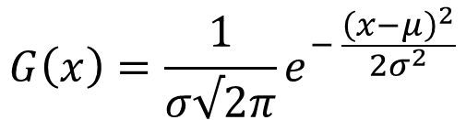
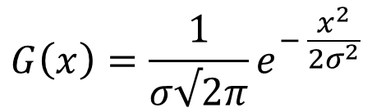


Constructing a filter
Consider the 1-D Gaussian function
$$G\left(x\right)=\frac{1}{σ√2π}e^{− \frac{{\left(x−μ\right)}^{2}}{2σ^{2}}}$$
$$μ$$
$$G\left(x\right)=\frac{1}{σ√2π}e^{− \frac{x^{2}}{2σ^{2}}}$$
$$σ$$
 |  | 0 | 1 | 2
$$σ=1,G(x)$$
0.053 | 0.242 | 0.399 | 0.242 | 0.053
$$\frac{G\left(x\right)}{\sum_{_N}^{N}{G(x)}}=$$
0.053 | 0.244 | 0.403 | 0.244 | 0.053

Slide 12
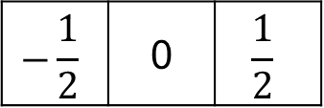





Derivative
Rate of $y$, with respect to $x$, i.e. $\frac{Δy}{Δx}$
$$−\frac{1}{2}$$ | 0 | $$\frac{1}{2}$$
1 | 4 | 9 | 16 | 25 | 36 | 49 | 64 | 81
$$f\left(x\right)=x^{2}⇒f^{′}\left(x\right)=2x$$
1 | 4 | 6 | 8 | 10 | 12 | 14 | 16 | 18
$$f′(k)=w(k−1)f(k−1)+w(k)f(k)+w(k+1)f(k+1)$$
$$−\frac{1}{2}$$
$$0$$
$$\frac{1}{2}$$

Slide 13
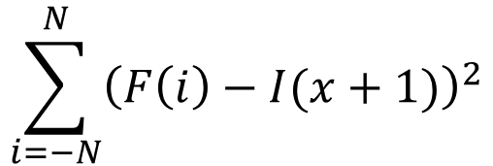
Matching with correlation
Locations in an image that are similar to a template
How to measure the similarity
Sum of the square of the differences
$$\sum_{i=−N}^{N}{{\left(F\left(i\right)−I(x+1)\right)}^{2}}$$
As the correlation between the filter and the image increases, the Euclidean distance between them decreases

Slide 14
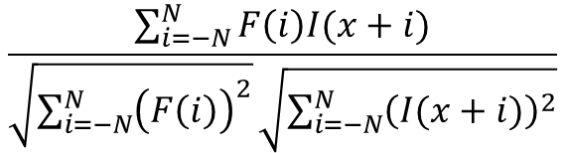
Example
$$\frac{\sum_{i=−N}^{N}{F\left(i\right)I(x+i)}}{\sqrt{\sum_{i=−N}^{N}{{\left(F\left(i\right)\right)}^{2}}}\sqrt{\sum_{i=−N}^{N}{{\left(I(x+i)\right)}^{2}}}}$$
Normalized correlation=
3 | 7 | 5
Template
3 | 2 | 4 | 1 | 3 | 8 | 4 | 0 | 3 | 8 | 0 | 7 | 7 | 7 | 1 | 2
Image
3 | 7 | 5
40 | 43 | 39 | 34 | 64 | 85 | 52 | 27 | 61 | 65 | 59 | 84 | 105 | 75 | 38 | 27
Correlation
25 | 26 | 26 | 41 | 29 | 2 | 59 | 54 | 34 | 26 | 78 | 13 | 20 | 32 | 61 | 38
Sum of squared difference
.94 | .88 | .94 | .73 | .81 | .99 | .64 | .59 | .78 | .84 | .61 | .93 | .95 | .83 | .57 | .99
Normalized correlation

Slide 15
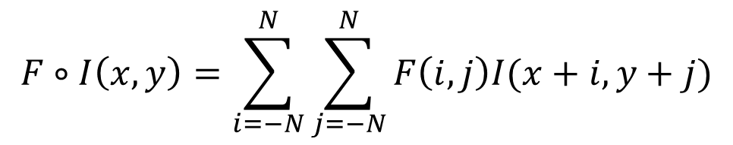
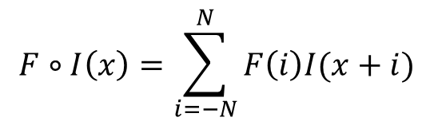
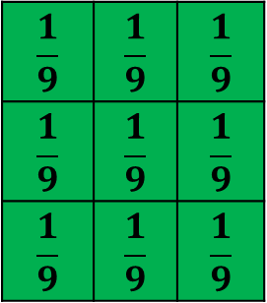
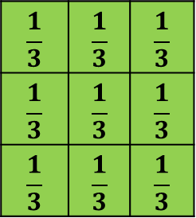

Correlation in 2D
$$F∘I\left(x\right)=\sum_{i=−N}^{N}{F\left(i\right)I(x+i)}$$
$$F∘I\left(x,y\right)=\sum_{i=−N}^{N}{\sum_{j=−N}^{N}{F\left(i,j\right)I(x+i,y+j)}}$$
$$\frac{1}{9}$$ | $$\frac{1}{9}$$ | $$\frac{1}{9}$$
$$\frac{1}{9}$$ | $$\frac{1}{9}$$ | $$\frac{1}{9}$$
$$\frac{1}{9}$$ | $$\frac{1}{9}$$ | $$\frac{1}{9}$$
$$\frac{1}{3}$$ | $$\frac{1}{3}$$ | $$\frac{1}{3}$$
$$\frac{1}{3}$$ | $$\frac{1}{3}$$ | $$\frac{1}{3}$$
$$\frac{1}{3}$$ | $$\frac{1}{3}$$ | $$\frac{1}{3}$$
$$\frac{1}{3}$$ | $$\frac{1}{3}$$ | $$\frac{1}{3}$$

Slide 16
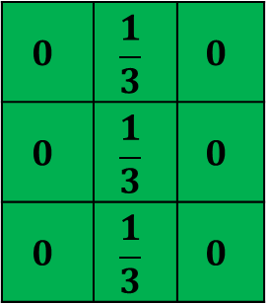
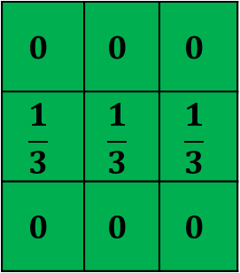

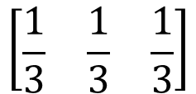
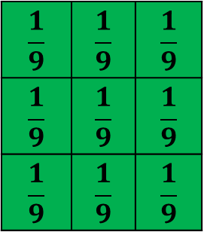
Seperability
8 | 3 | 4 | 5
7 | 6 | 4 | 5
4 | 5 | 7 | 8
6 | 5 | 5 | 6
$$0$$ | $$0$$ | $$0$$
$$\frac{1}{3}$$ | $$\frac{1}{3}$$ | $$\frac{1}{3}$$
$$0$$ | $$0$$ | $$0$$
$$0$$ | $$\frac{1}{3}$$ | $$0$$
$$0$$ | $$\frac{1}{3}$$ | $$0$$
$$0$$ | $$\frac{1}{3}$$ | $$0$$
$$\frac{1}{9}$$ | $$\frac{1}{9}$$ | $$\frac{1}{9}$$
$$\frac{1}{9}$$ | $$\frac{1}{9}$$ | $$\frac{1}{9}$$
$$\frac{1}{9}$$ | $$\frac{1}{9}$$ | $$\frac{1}{9}$$
 | 5.33
Input image
Mask
Averaged image
$$\left[\begin{matrix}\frac{1}{3} \\ \frac{1}{3} \\ \frac{1}{3}\end{matrix}\right]$$
8 | 3 | 4
7 | 6 | 4
4 | 5 | 7
$$\left[\begin{matrix}\frac{1}{3} & \frac{1}{3} & \frac{1}{3}\end{matrix}\right]$$
Reduced computational complexity?

Slide 17

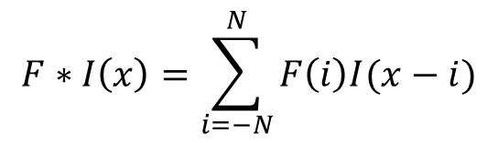
Convolution
Similar to correlation
Flip over the filter before correlating
$$F∗I\left(x\right)=\sum_{i=−N}^{N}{F\left(i\right)I(x−i)}$$
2D convolution we flip the filter both horizontally and vertically
$$F∗I\left(x,y\right)=\sum_{i=−N}^{N}{\sum_{j=−N}^{N}{\begin{aligned}F\left(i,j\right)I(x−i,y−j)\end{aligned}}}$$
In case of symmetric filters?

Slide 18

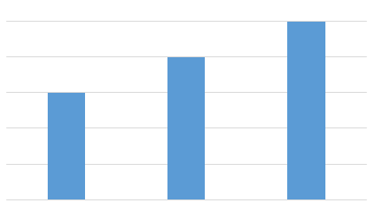


Example: 1D
$$f\left(x\right)=\left\{3,4,5\right\}$$
$$g\left(x\right)=\{2,1\}$$
Dimension of the resultant signal = (No. of columns in f + No. of columns in g) - 1

Slide 19


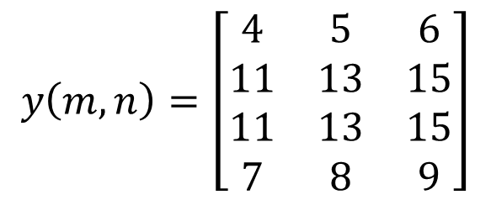
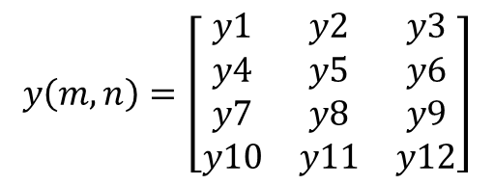
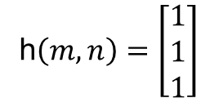
Example: 2D
Dimension of the resultant signal = (No. of rows in f + No. of rows in g) - 1
X
(No. of columns in f + No. of columns in g) - 1
$$x\left(m,n\right)=\left[\begin{matrix}4 & 5 & 6 \\ 7 & 8 & 9\end{matrix}\right]$$
h$\left(m,n\right)=\left[\begin{matrix}1 \\ 1 \\ 1\end{matrix}\right]$
4 | 5 | 6
7 | 8 | 9
$$y\left(m,n\right)=\left[\begin{matrix}y1 & y2 & y3 \\ y4 & y5 & y6 \\ y7 & y8 & y9 \\ y10 & y11 & y12\end{matrix}\right]$$
$$y\left(m,n\right)=\left[\begin{matrix}4 & 5 & 6 \\ 11 & 13 & 15 \\ 11 & 13 & 15 \\ 7 & 8 & 9\end{matrix}\right]$$

Slide 20
Thank you
Next lecture: Image Enhancement

