Slide 1

CS654: Digital Image Analysis
Lecture 18: Image Enhancement in Spatial Domain (Histogram)

Slide 2
Recap of Lecture 17
Image enhancement
Dynamic range
Point processing
Contrast stretching
Intensity level slicing

Slide 3
Outline of Lecture 18
Image histogram
Histogram stretching
Histogram equalization
Histogram specification

Slide 4
Histogram
It is a graphical representation of the distribution of numerical data.
It is an estimate of the probability distribution of a continuous variable
Divide the entire range of values into a series of intervals
Count how many values fall into each interval.
The bins (intervals) must be adjacent, non-overlapping and are usually equal size

Slide 5
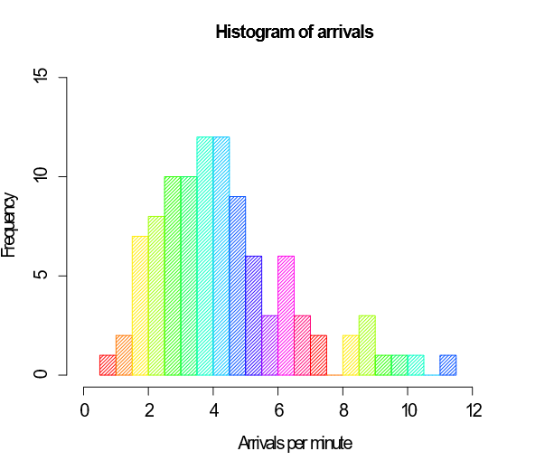
Example

Slide 6
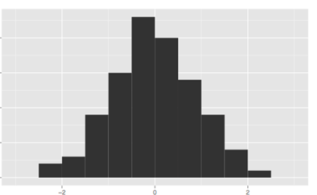
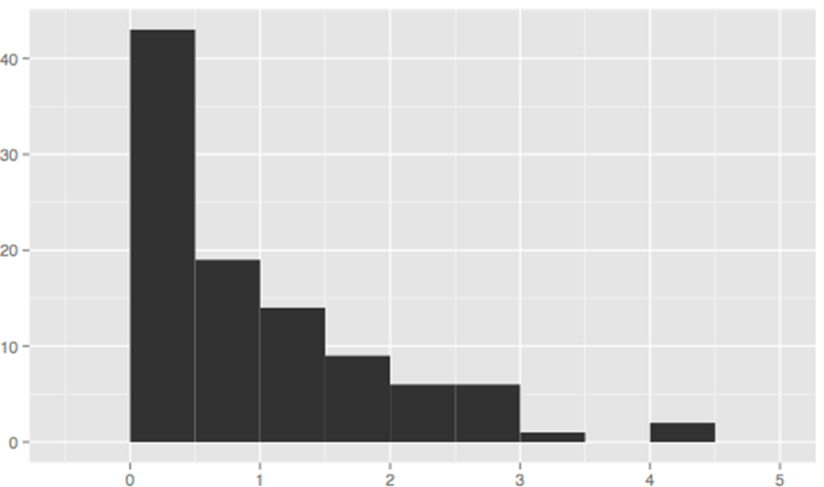
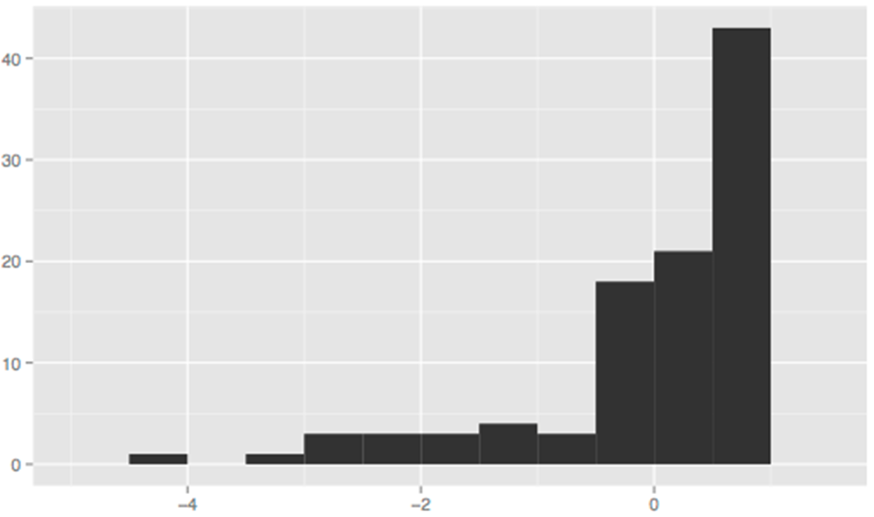
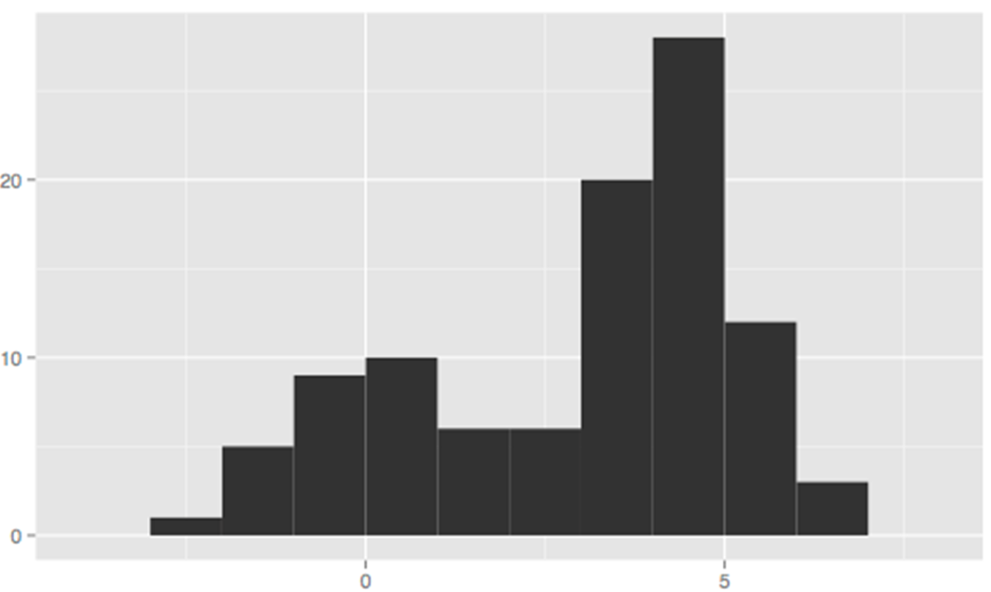
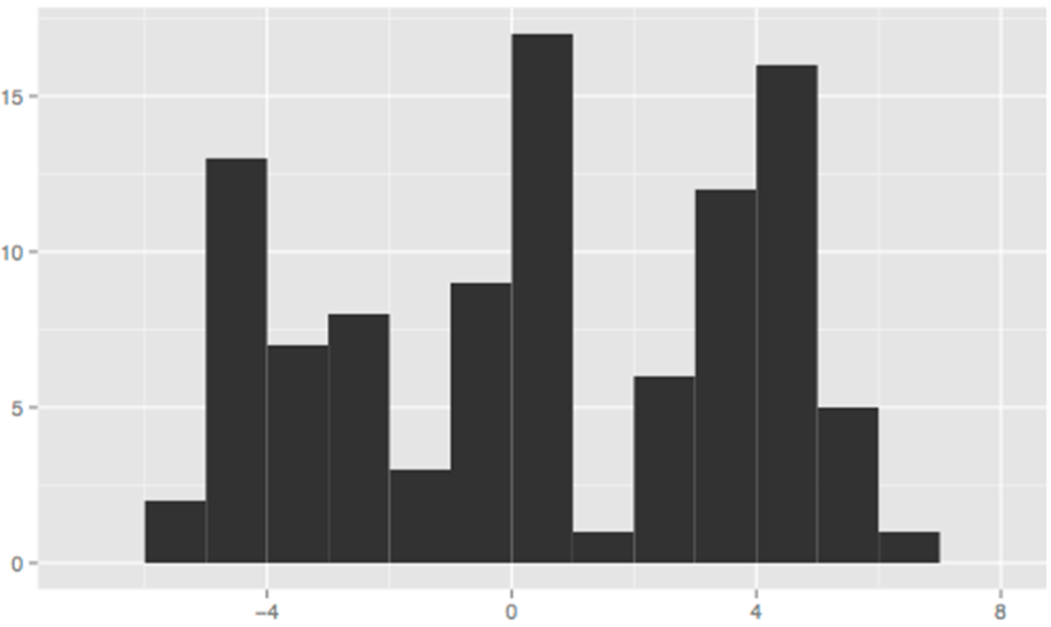
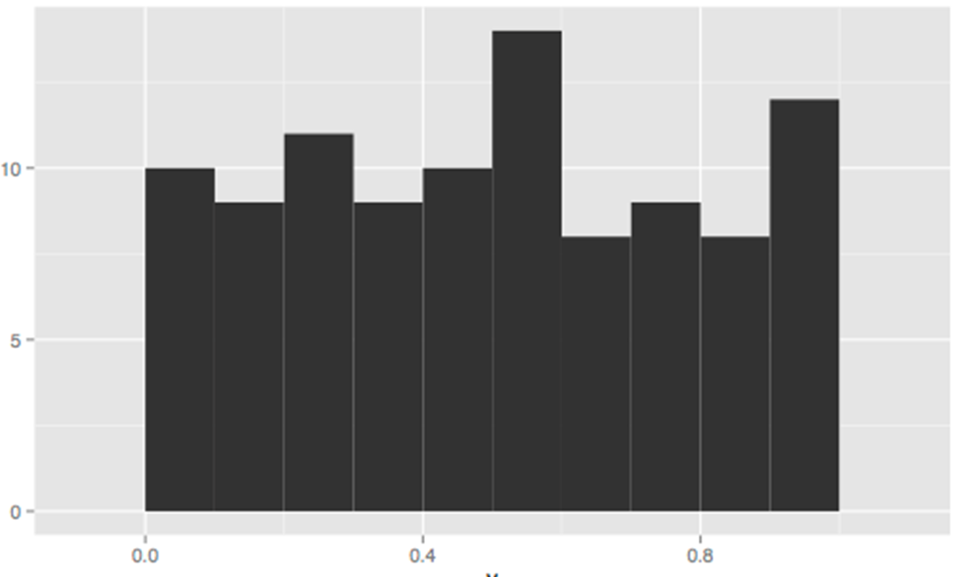
Shape of histogram
Symmetric, unimodal
Skewed, right
Skewed, left
Bimodal
Multimodal
Symmetric

Slide 7
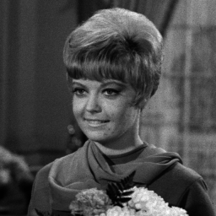
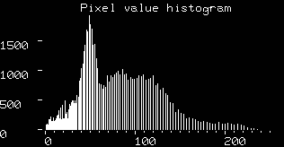
Intensity Histogram
Histogram of the pixel intensity values.
Number of pixels in an image at each different intensity value found in that image
Demonstration

Slide 8
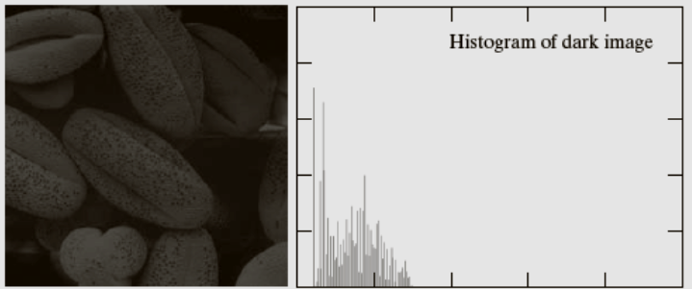
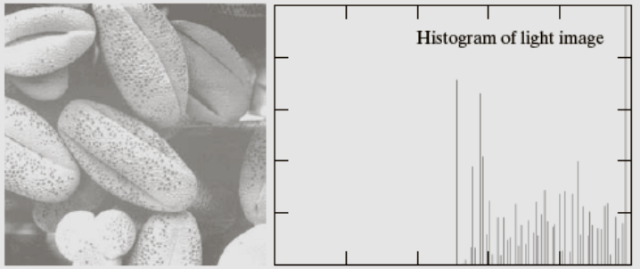
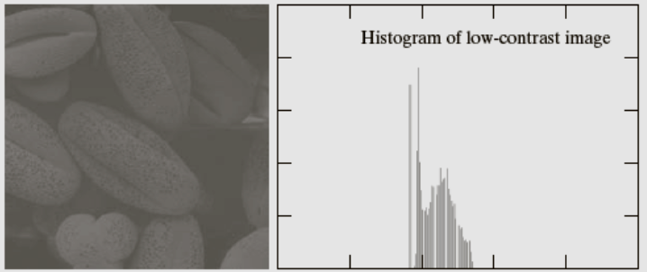
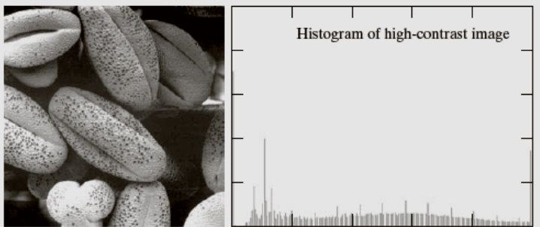
Basic types of images
Images: Gonzalez & Woods, 3rd edition
Dark
Light
Low-contrast
High-contrast

Slide 9
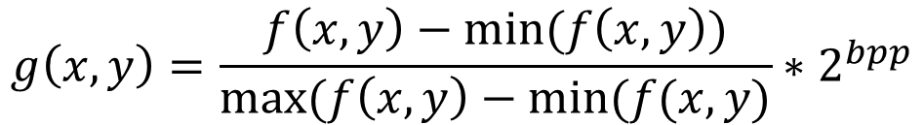
Histogram stretching
Contrast is the difference between maximum and minimum pixel intensity.
Histogram stretching increases contrast
Failing of histogram stretching
Histogram equalization
$$g\left(x,y\right)=\frac{f\left(x,y\right)−min⁡(f\left(x,y\right))}{max⁡(f\left(x,y\right)−min⁡(f(x,y)}∗2^{bpp}$$
Demonstration

Slide 10
PMF and CDF
PMF: Probability of each number in the data set
The count or frequency of each element.
Monotonically increasing function
CDF: cumulative sum of all the values that are calculated by PMF

Slide 11
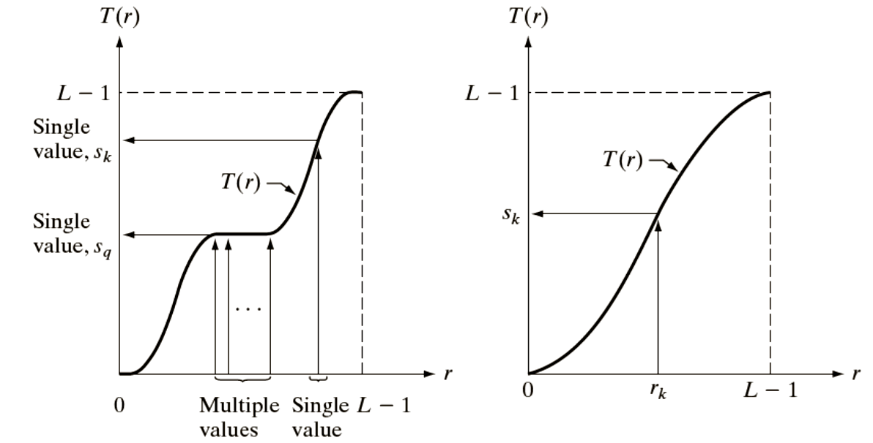
Mapping functions
Images: Gonzalez & Woods, 3rd edition
Monotonically increasing
Strictly Monotonically increasing

Slide 12
Histogram Equalization
Histogram equalization is used to enhance contrast.
Not necessary that contrast will always be increase
Some cases were histogram equalization can be worse

Slide 13
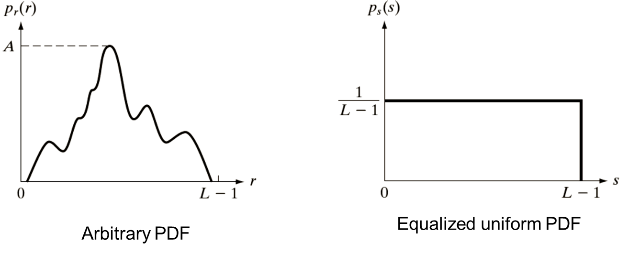
Uniform PDF generation
Images: Gonzalez & Woods, 3rd edition

Slide 14

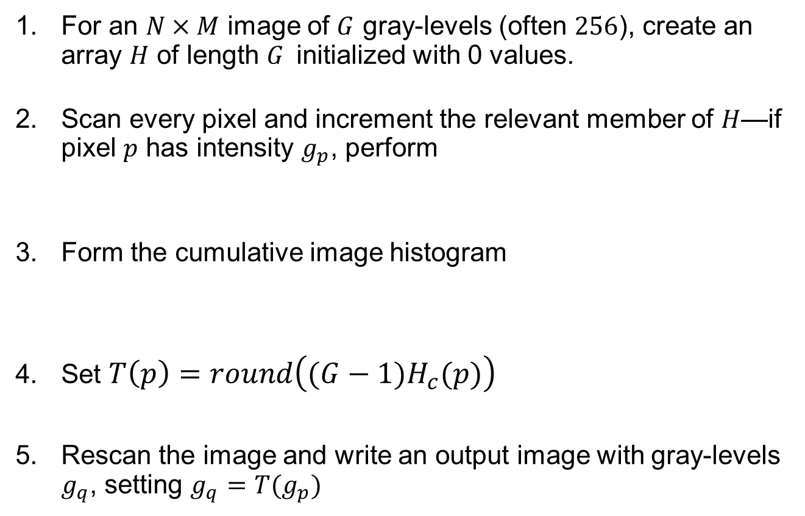

Algorithm
For an $N×M$ image of $G$ gray-levels (often $256$), create an array $H$ of length $G$initialized with 0 values.
Scan every pixel and increment the relevant member of $H$—if pixel $p$ has intensity $g_{p}$, perform
Form the cumulative image histogram
Set $T\left(p\right)=round\left({(G−1)H}_{c}(p)\right)$
Rescan the image and write an output image with gray-levels $g_{q}$, setting $g_{q}=T(g_{p})$
$$H\left(g_{p}\right)=H\left(g_{p}\right)+1$$
$$H_{c}\left(0\right)=H\left(0\right)$$
$$H_{c}\left(p\right)=H\left(p−1\right)+H\left(p\right);1≤p≤G−1$$

Slide 15
Histogram Equalization Process
Calculate the PMF of the given image
Calculation of CDF
Multiply the CDF value with (Grey levels (minus) 1)
Map the new grey level values into number of pixels

Slide 16
Example
4 | 4 | 4 | 4 | 4
3 | 4 | 5 | 4 | 3
3 | 5 | 5 | 5 | 3
3 | 4 | 5 | 4 | 3
4 | 4 | 4 | 4 | 4
I | F(I) | PMF | CDF | CDF * (L-1) | ~L | Mapping
0
1
2
3
4
5
6
7
0
0
0
6
14
5
0
0
0
0
0
0.24
0.56
0.2
0
0
0
0
0
0.24
0.80
1
1
1
0
0
0
1.68
5.6
7
7
7
0
0
0
1
5
7
7
7
0
6
0
0
0
14
0
5
Input image
5 | 5 | 5 | 5 | 5
1 | 5 | 7 | 5 | 1
1 | 7 | 7 | 7 | 1
1 | 5 | 5 | 5 | 1
5 | 5 | 5 | 5 | 5
Equalized image

Slide 17
Example: Alternate method
4 | 4 | 4 | 4 | 4
3 | 4 | 5 | 4 | 3
3 | 5 | 5 | 5 | 3
3 | 4 | 5 | 4 | 3
4 | 4 | 4 | 4 | 4
I | F(I) | CDF | F(Id) | CDF (Id) | ~L | Mapping
0
1
2
3
4
5
6
7
0
0
0
6
14
5
0
0
0
0
0
6
20
25
25
25
3
3
3
3
4
3
3
3
3
6
9
12
16
19
22
25
0
0
0
1
5
7
7
7
0
6
0
0
0
14
0
5
Input image
5 | 5 | 5 | 5 | 5
1 | 5 | 7 | 5 | 1
1 | 7 | 7 | 7 | 1
1 | 5 | 5 | 5 | 1
5 | 5 | 5 | 5 | 5
Equalized image

Slide 18
Histogram Specification/ Matching
Histogram equalization produces (in theory) image with uniform distribution of pixel intensities
To enhance image based on a specified histogram: Histogram Specification
Histogram matching: transform a given image into a similar image that has a pre-defined histogram
A desired histogram can be speciﬁed according to various needs
Allows interactive image enhancement

Slide 19

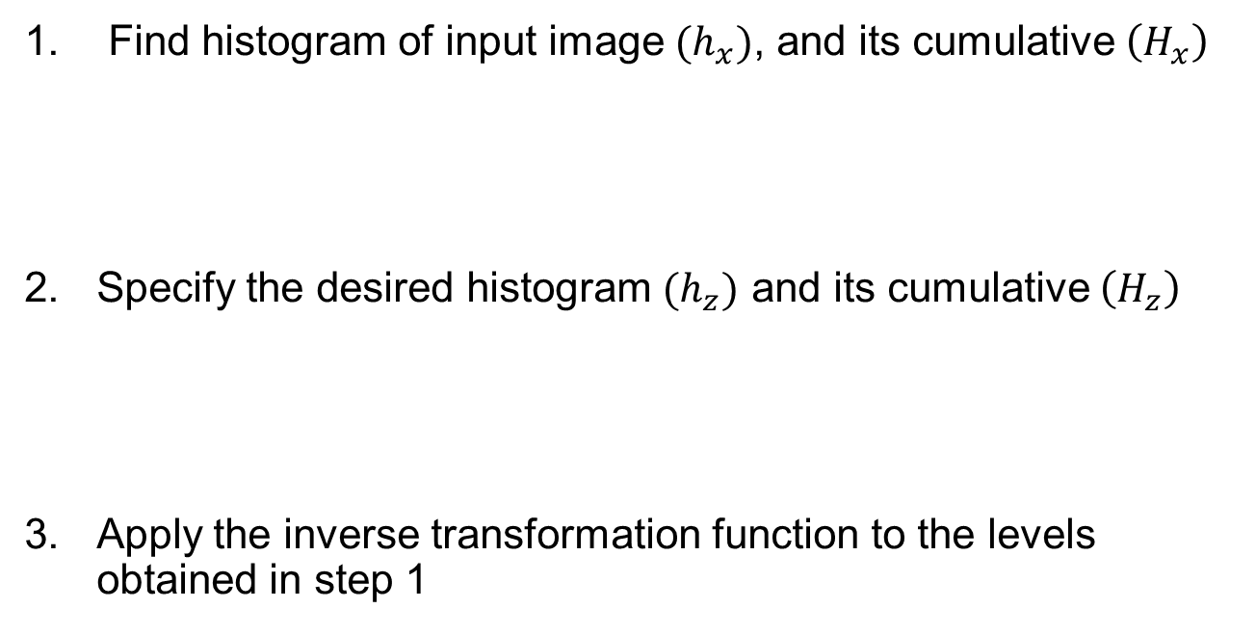


Steps of Histogram Specification
Find histogram of input image $(h_{x})$, and its cumulative $\left(H_{x}\right)$
Specify the desired histogram $(h_{z})$ and its cumulative $\left(H_{z}\right)$
Apply the inverse transformation function to the levels obtained in step 1
$$H_{x}\left(j\right)=\sum_{i=0}^{j}{h_{x}(i)}$$
$$H_{z}\left(j\right)=\sum_{i=0}^{j}{h_{z}(i)}$$
$$\left|H_{x}\left(i\right)−H_{z}\left(j\right)\right|=\min_{k}\left|H_{x}\left(i\right)−H_{z}\left(k\right)\right|$$

Slide 20
Example

Slide 21
Example
Gray-level | Input Image |  | Mapping | Specified Image
 | PDF | CDF |  | PDF | CDF
0 | 0.19 |  |  | 0.0
1 | 0.25 |  |  | 0.0
2 | 0.21 |  |  | 0.0
3 | 0.16 |  |  | 0.15
4 | 0.08 |  |  | 0.20
5 | 0.06 |  |  | 0.30
6 | 0.03 |  |  | 0.20
7 | 0.02 |  |  | 0.15
0.19
0.44
0.65
0.81
0.89
0.95
0.98
1.0
3
4
5
6
6
7
7
7
0.0
0.0
0.0
0.15
0.35
0.65
0.85
1.0
3
6

Slide 22
Example: Final result

Slide 23


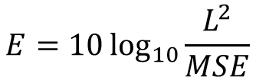
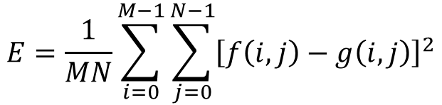
Image quality metrics
Let $f(x,y)$ be the original image and $g(x,y)$ is the processed image
Mean Square Error (MSE)
Peak Signal to Noise Ratio (PSNR)
$$E=[f\left(x,y\right)−g\left(x,y\right)]$$
$$E=\frac{1}{MN}\sum_{i=0}^{M−1}{\sum_{j=0}^{N−1}{{\left[f\left(i,j\right)−g\left(i,j\right)\right]}^{2}}}$$
$$E=10\log_{10}{\frac{L^{2}}{MSE}}$$

Slide 24
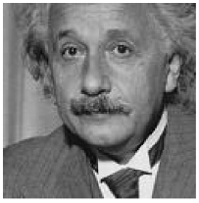
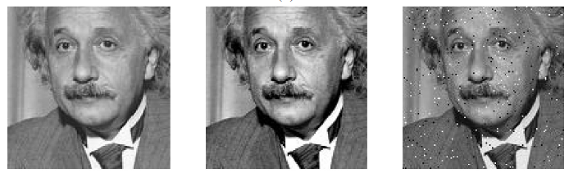
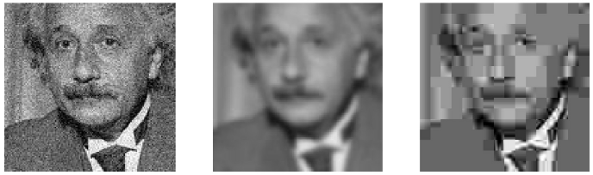
Issues
MSE=309
MSE=306
MSE=313
MSE=309
MSE=308
MSE=309

Slide 25
Thank you
Next lecture: Image Enhancement: Spatial Filters

