Slide 1

CS654: Digital Image Analysis
Lecture 19: Spatial Operations

Slide 2
Recap of Lecture 18
Histogram
Stretching
Equalizing
Matching/ Specification
Image quality measure

Slide 3
Outline of Lecture 19
Spatial Filters
Averaging
Median Filter

Slide 4
Common Enhancement techniques
Image enhancement
Point processing
Spatial operation
Transform operation
Pseudocoloring
Contrast stretching
Noise clipping
Window slicing
Histogram modeling
Noise smoothing
Median filtering
Unsharp masking
Filtering
Linear filter
Root filter
Homomorphic filter

Slide 5
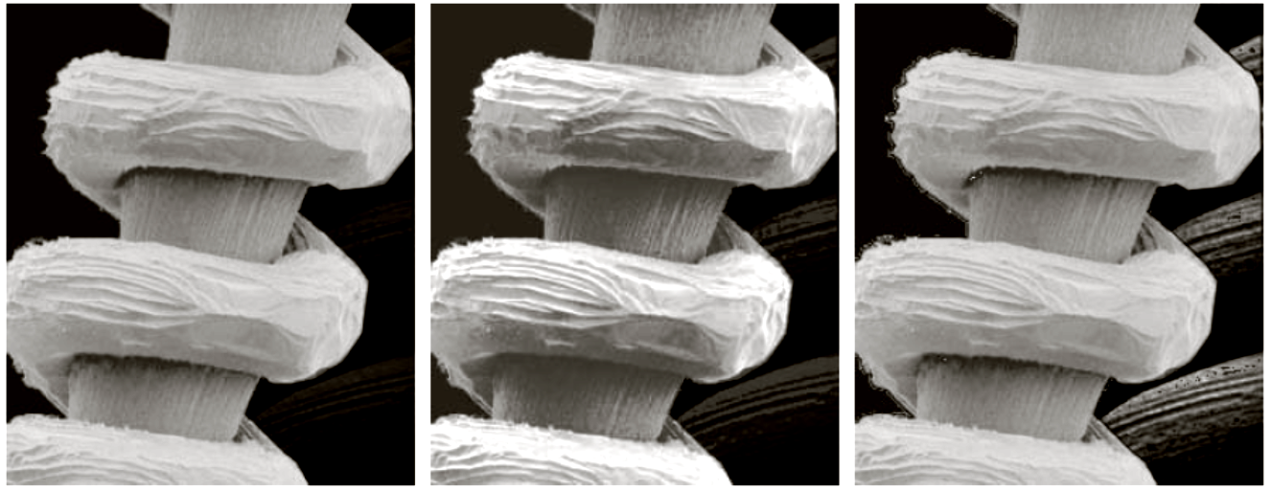
Local histogram processing
Input image
Global histogram
Local histogram

Slide 6
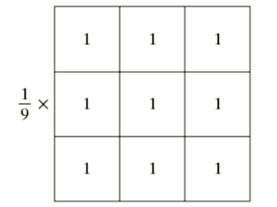
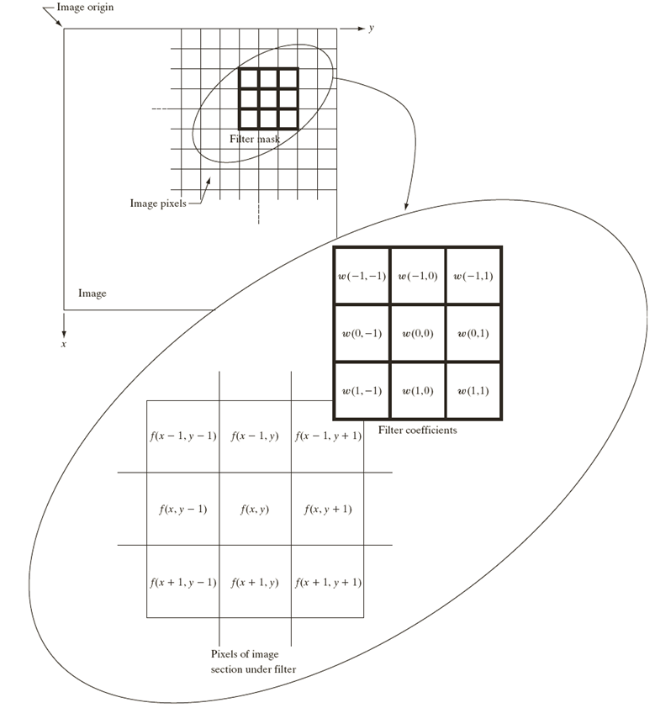
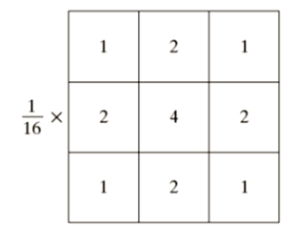
Neighborhood operations
Averaging Filter
Weighted Averaging Filter

Slide 7
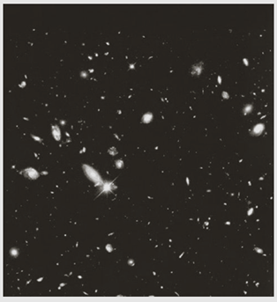
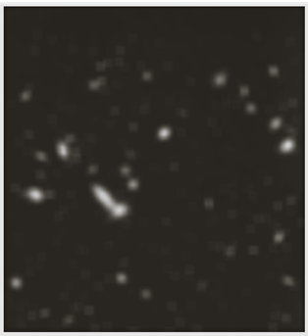

Examples of averaging
3
5
9
Input image
Filtered image
15
35
Thresholded image

Slide 8
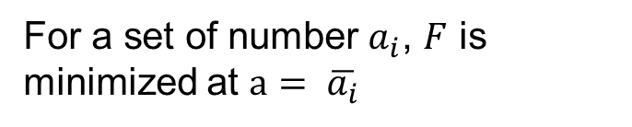
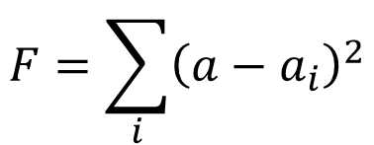
Local Averaging/ Mean Filter
1 | 2 | 3
$$F={\left(a−1\right)}^{2}+{\left(a−2\right)}^{2}+{\left(a−3\right)}^{2}$$
For what value of $a$, the value of the function $F$ is minimum?
$$F=\sum_{i}{{\left(a−a_{i}\right)}^{2}}$$
For a set of number $a_{i}$, $F$ is minimized at $a= \overline{a_{i}}$
We choose a value at the center pixel, such that the square error is minimized
In case of images??

Slide 9
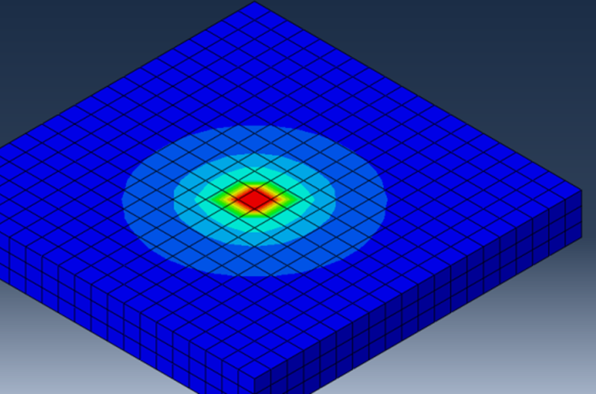

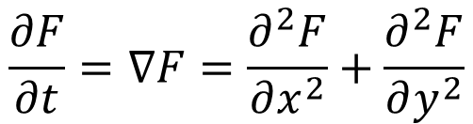
Gaussian Filtering, Heat Flow
$$F\left(x,y,σ\right)=F(x,y)∗G(0,σ)$$
Hot Pixel
Heat Flow
$$\frac{∂F}{∂t}=∇F=\frac{∂^{2}F}{∂x^{2}}+\frac{∂^{2}F}{∂y^{2}}$$
Cooler Pixels

Slide 10
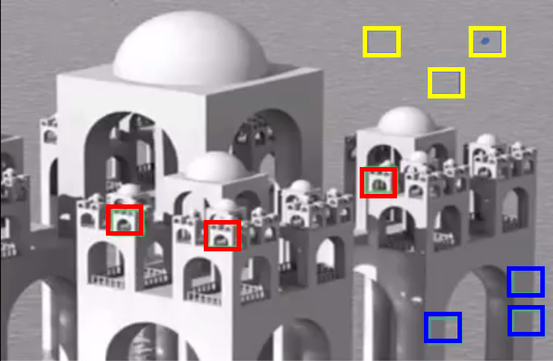
Non-local means
Not going to average in a local neighborhood
Average between very hot and very cold pixels is not good
It takes a mean of all pixels in the image, weighted by how similar these pixels are to the target pixel
"A non-local algorithm for image denoising". Computer Vision and Pattern Recognition, 2005

Slide 11
Median Filter
Input image
3x3 Mean Filter output
3x3 Median Filter output

Slide 12
Median Filter
Normally used to reduce noise in an image
Does not simply replace the pixel value with the mean of neighbouring pixel values
It replaces it with the median of those values
First sort all the pixel values from the surrounding neighbourhood into numerical order
Replace the pixel being considered with the middle pixel value.

Slide 13
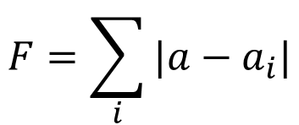
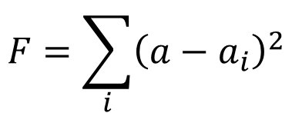
Example of median filtering
123 | 125 | 126 | 130 | 140
122 | 124 | 126 | 127 | 135
118 | 120 | 150 | 125 | 134
119 | 115 | 119 | 123 | 133
111 | 116 | 110 | 120 | 130
115 | 119 | 120 | 123 | 124 | 125 | 126 | 127 | 150
$$F=\sum_{i}{{\left(a−a_{i}\right)}^{2}}$$
$$F=\sum_{i}{|a−a_{i}|}$$
Mean Filter
Median Filter

Slide 14
Unsharp masking
Image sharpening technique
Enhances edges (and other high frequency components in an image)
Subtracts an unsharp, or smoothed, version of an image from the original image.
Commonly used in the photographic and printing industries for crispening edges

Slide 15






Unsharp masking: how it works
Let, $f(x,y)$ = the input image
$f_{smooth}(x,y)$ = the smoothened image (unsharp)
-
$$f\left(x,y\right)$$
Smooth
$$g\left(x,y\right)= f\left(x,y\right)−f_{smooth}(x,y)$$
+
-
+
$$f\left(x,y\right)$$
Smooth
$$g\left(x,y\right)$$
$$f_{sharp}\left(x,y\right)$$
+
+

Slide 16
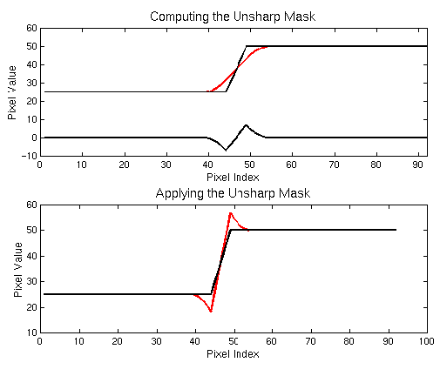
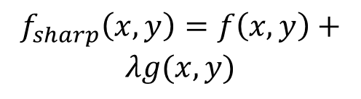

Unsharp Mask illustration
$$f_{sharp}\left(x,y\right)=f\left(x,y\right)+$$
$$λg(x,y)$$
$λ$ is a scaling constant

Slide 17
Biological motivation
Why are these light and dark over/undershoots so effective at increasing sharpness?
Unsharp mask is actually utilizing a trick performed by our own human visual system

Slide 18
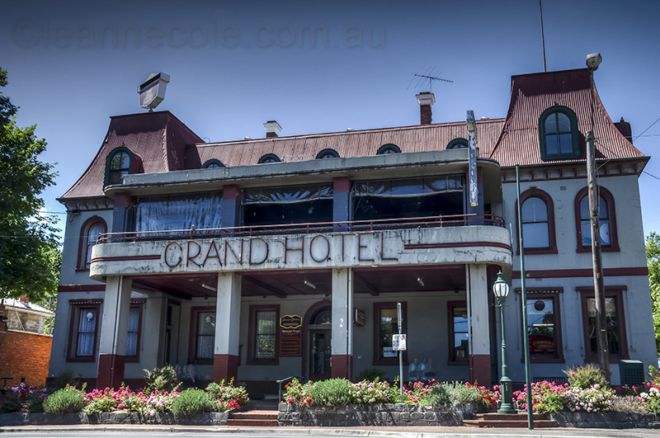
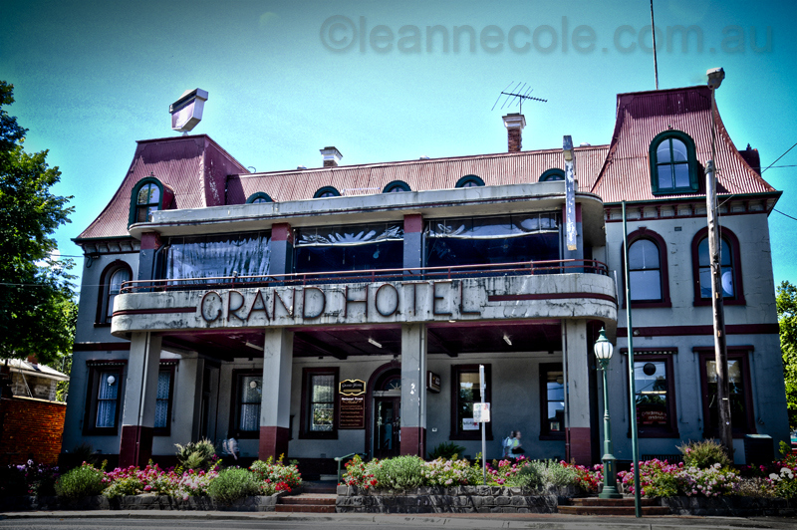
Complications
Unsharp masks are wonderful at sharpening images
Too much sharpening can also introduce “halo artifacts”
http://leannecolephotography.com/tag/halo-effect/

Slide 19
Alternate approaches of sharpening
Problems with Unsharp masking
Extremely sensitive to noise
Enhances high contrast areas more
Quadratic filters, weighted high-pass filter, Order statistics of Laplacian operator
Introduces artifacts and doesn’t enhance mid-contrast areas
Adaptive unsharp masking (Polesel et al., IEEE TIP, 2000)

Slide 20
Adaptive Unsharp Masking
Sharpening images in the presence of low noise levels
A method of re-defining a highpass filter
Does not perform enhancement in the smooth areas
Accomplishes the dual objective: noise amplification, overshooting details of certain areas

Slide 21
Objective
Increasing dynamics in smooth areas amplifies noise – so no emphasis
High contrast areas already have high local dynamics – Require low enhancement to avoid overshoot
Medium contrast areas require most enhancement

Slide 22


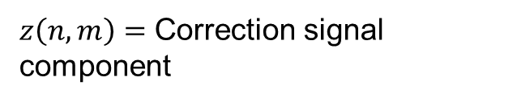

Solution
Use Adaptive Unsharp Masking- l varies according to predefined rules
$y\left(n,m\right)=$ Output image
$$y\left(n,m\right)=x\left(n,m\right)+λz(n,m)$$
$x\left(n,m\right)=$ Input image
$z\left(n,m\right)=$ Correction signal component
$$z_{x}\left(n,m\right)=2x\left(n,m\right)−x\left(n,m−1\right)−x(n,m+1)$$
$$z_{y}\left(n,m\right)=2x\left(n,m\right)−x\left(n−1,m\right)−x(n+1,m)$$
$$y\left(n,m\right)=x\left(n,m\right)+λ_{x}\left(n,m\right)z_{x}\left(n,m\right)+λ_{y}\left(n,m\right)z_{y}(n,m)$$
$λ_{x}\left(n,m\right),λ_{y}(n,m)=$ Scaling factor for the two components at $(n,m)$

Slide 23

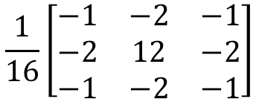

Implementation using mask
Sum of a collection of edge directional kernels.
0 | 0 | 0
-2 | 2 | 0
0 | 0 | 0
-1 | 0 | 0
0 | 1 | 0
0 | 0 | 0
0 | -2 | 0
0 | 2 | 0
0 | 0 | 0
0 | 0 | -1
0 | 1 | 0
0 | 0 | 0
$$\frac{1}{16}\left[\begin{matrix}−1 & −2 & −1 \\ −2 & 12 & −2 \\ −1 & −2 & −1\end{matrix}\right]$$
0 | 0 | 0
0 | 2 | -2
0 | 0 | 0
0 | 0 | 0
0 | 1 | 0
0 | 0 | -1
0 | 0 | 0
0 | 2 | 0
0 | -2 | 0
0 | 0 | 0
0 | 1 | 0
-1 | 0 | 0
$$x\left(n,m\right)$$
Dir. Mask
Threshold
Sum
$$z\left(n,m\right)$$

Slide 24
Highboost Filter
An extension of highpass filter
Prevent loss of low frequency components
Restore visual details in an image
An offset is added to the filtered image

Slide 25


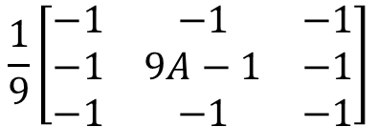


Highboost Filter
$$f_{h}\left(x,y\right)=f\left(x,y\right)−f_{l}(x,y)$$
$$f_{hb}\left(x,y\right)=Af\left(x,y\right)−f_{l}(x,y)$$
$$=\left(A−1\right)f\left(x,y\right)+(f\left(x,y\right)−f_{l}\left(x,y\right))$$
$$=\left(A−1\right)f\left(x,y\right)+f_{h}(x,y)$$
$$\frac{1}{9}\left[\begin{matrix}−1 & −1 & −1 \\ −1 & 9A−1 & −1 \\ −1 & −1 & −1\end{matrix}\right]$$
Spatial mask for high-boost filter

Slide 26
Thank you
Next Lecture: Enhancement in Frequency Domain

