Slide 1

CS654: Digital Image Analysis
Lecture 20: Image Enhancement in Frequency Domain

Slide 2
Recap of Lecture 19
Spatial filtering
Mean Filter
Non-Local Mean Filter
Median Filter
Unsharp Masking
Adaptive Unsharp Masking

Slide 3
Outline of Lecture 20
Image Enhancement in Frequency Domain
Low Pass Filtering
High pass Filtering
Butterworth Filtering
Gaussian Filtering
Homomorphic Filtering

Slide 4
Introduction
Frequency is the rate of repetition of certain periodic events
Variation of image brightness with its position in space
Fourier transform is reversible
Fourier filtering or Frequency domain filtering
Convolution in spatial domain = Multiplication in Frequency domain

Slide 5
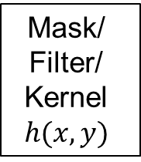
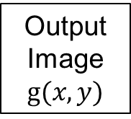
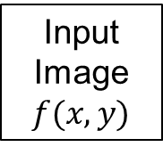
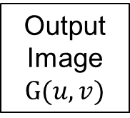
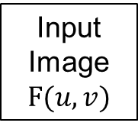
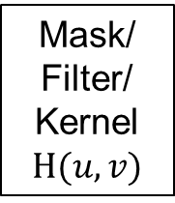
Frequency domain Enhancement Pipeline
Spatial Domain
Frequency Domain
Mask/ Filter/ Kernel
$$h(x,y)$$
Mask/ Filter/ Kernel $H(u,v)$
DFT
Output Image $G(u,v)$
Multiply
Input Image $f(x,y)$
Input Image $F(u,v)$
DFT
Output Image $g(x,y)$
IDFT

Slide 6


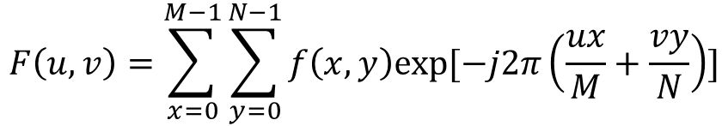

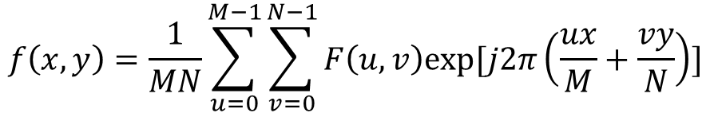

A quick recap of DFT in 2D
Forward transformation (DFT)
$$F\left(u,v\right)=\sum_{x=0}^{M−1}{\sum_{y=0}^{N−1}{f\left(x,y\right)exp⁡[−j2π\left(\frac{ux}{M}+\frac{vy}{N}\right)]}}$$
$f(x,y)$ is an image of dimension $M×N$
$$0≤u≤M−1,0≤v≤N−1$$
Inverse transformation (IDFT)
$$f\left(x,y\right)=\frac{1}{MN}\sum_{u=0}^{M−1}{\sum_{v=0}^{N−1}{F\left(u,v\right)exp⁡[j2π\left(\frac{ux}{M}+\frac{vy}{N}\right)]}}$$
$F(u,v)$ is the DFT image
$$0≤x≤M−1,0≤y≤N−1$$

Slide 7
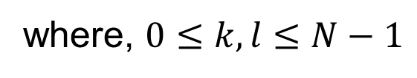
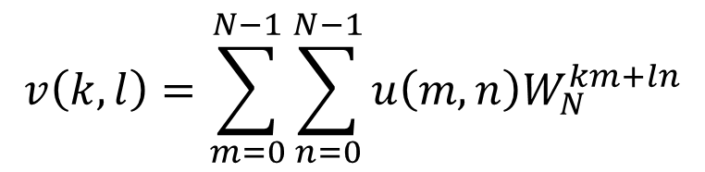
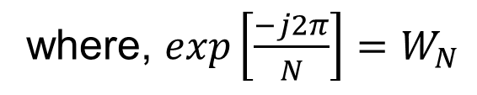
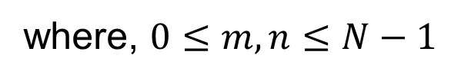
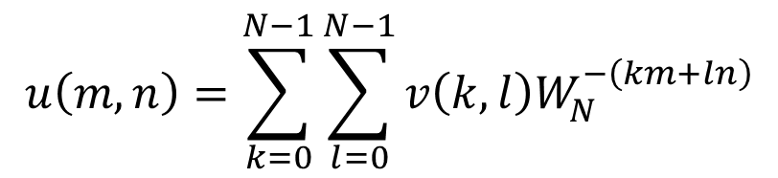
2-D DFT
Forward transformation
$$v\left(k,l\right)=\sum_{m=0}^{N−1}{\sum_{n=0}^{N−1}{u\left(m,n\right)W_{N}^{km+ln}}}$$
where, $0≤k,l≤N−1$
Reverse transformation
$$u\left(m,n\right)=\sum_{k=0}^{N−1}{\sum_{l=0}^{N−1}{v\left(k,l\right)W_{N}^{−\left(km+ln\right)}}}$$
where, $0≤m,n≤N−1$
where, $exp\left[\frac{−j2π}{N}\right]=W_{N}$

Slide 8
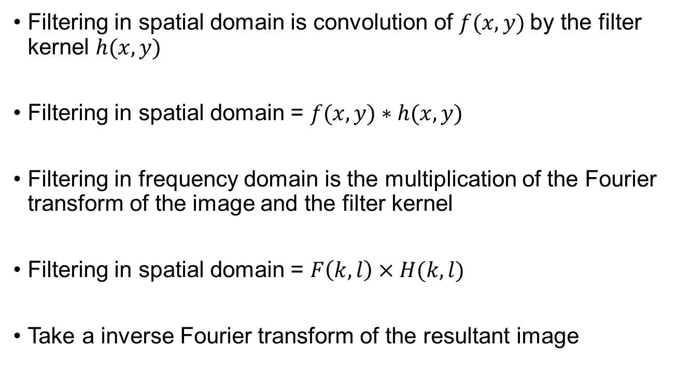
Frequency domain filtering
Filtering in spatial domain is convolution of $f(x,y)$by the filter kernel $h(x,y)$
Filtering in spatial domain = $f(x,y)∗h(x,y)$
Filtering in frequency domain is the multiplication of the Fourier transform of the image and the filter kernel
Filtering in spatial domain = $F\left(k,l\right)×H(k,l)$
Take a inverse Fourier transform of the resultant image

Slide 9

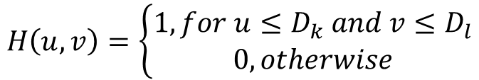

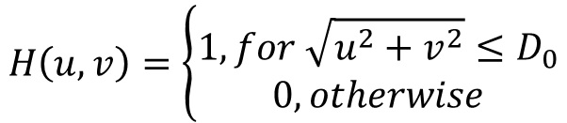



Low pass filtering
Non-seperable
$$v$$
$$H\left(u,v\right)=\left\{\begin{aligned}1, for \sqrt{u^{2}+v^{2}}≤D_{0} \\ 0, otherwise\end{aligned}\right.$$
$$D_{0}$$
$$u$$
Seperable
$$v$$
$$H\left(u,v\right)=\left\{\begin{aligned}1, for u≤D_{k} and v≤D_{l} \\ 0, otherwise\end{aligned}\right.$$
$$u$$

Slide 10
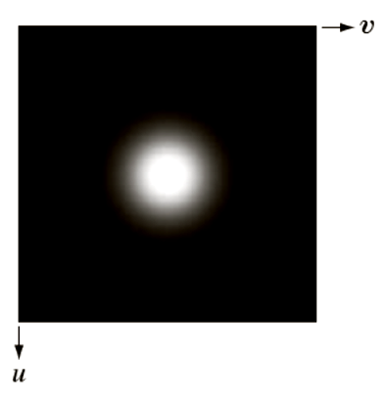

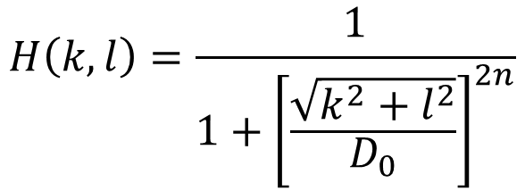

Butterworth filter
Images: Gonzalez & Woods, 3rd edition
Transfer function for 2D Butterworth filter
$$H\left(k,l\right)=\frac{1}{1+{\left[\frac{\sqrt{k^{2}+l^{2}}}{D_{0}}\right]}^{2n}}$$
$n$= order of the Butterworth filter
$D_{0}$= Cut-off frequency

Slide 11
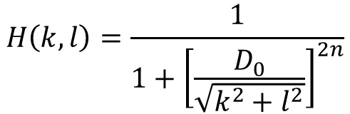
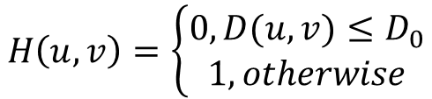
High-pass Filters
Complementary to LP Filters
Butterworth High-Pass filter
$$H\left(u,v\right)=\left\{\begin{aligned}0, D(u,v)≤D_{0} \\ 1, otherwise\end{aligned}\right.$$
Ideal High Pass Filter (IHPF)
$$H\left(k,l\right)=\frac{1}{1+{\left[\frac{D_{0}}{\sqrt{k^{2}+l^{2}}}\right]}^{2n}}$$
Butterworth High Pass Filter (BHPF)

Slide 12
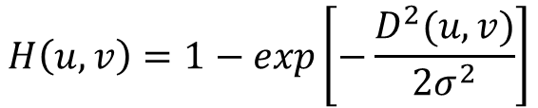
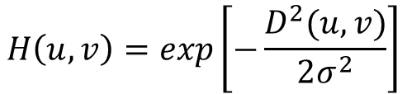
Gaussian Filters (Low-pass, High-pass)
Popular for removing ringing effect
Transfer function for 2-D Gaussian LPF (GLPF)
Transfer function for 2-D Gaussian HPF (GHPF)
$$H\left(u,v\right)=exp\left[−\frac{D^{2}(u,v)}{2σ^{2}}\right]$$
$$H\left(u,v\right)=1−exp\left[−\frac{D^{2}(u,v)}{2σ^{2}}\right]$$

Slide 13
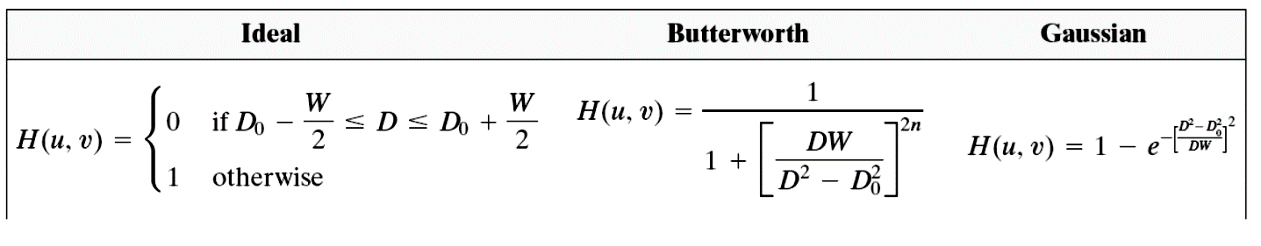
Selective filtering
Operate on a given range of frequencies
Bandpass, Band reject
Band-reject filter

Slide 14






Homomorphic Filter
$$f\left(x,y\right)=f_{i}\left(x,y\right)∗f_{r}(x,y)$$
$f_{i}\left(x,y\right)$= Illumination component
$f_{r}\left(x,y\right)$= Reflectance component
$$z\left(x,y\right)=\ln{f(x,y)}$$
$$=\ln{f_{i}\left(x,y\right)+\ln{f_{r}(x,y)}}$$
$$Z\left(u,v\right)=F_{i}\left(u,v\right)+F_{r}(u,v)$$
Fourier transformation of input signal
Let, $H(u,v)$= the filer to be applied on $Z\left(u,v\right)$, then
$$S\left(u,v\right)={H(u,v)F}_{i}\left(u,v\right)+{H(u,v)F}_{r}(u,v)$$
Transformed image
After Inverse Fourier Transformation
$$s\left(x,y\right)={f′}_{i}\left(x,y\right)+{f^{′}}_{r}\left(x,y\right)⇒g\left(x,y\right)=\exp\left[f_{i}^{′}\left(x,y\right)\right].exp⁡[f_{r}^{′}(x,y)]$$

Slide 15
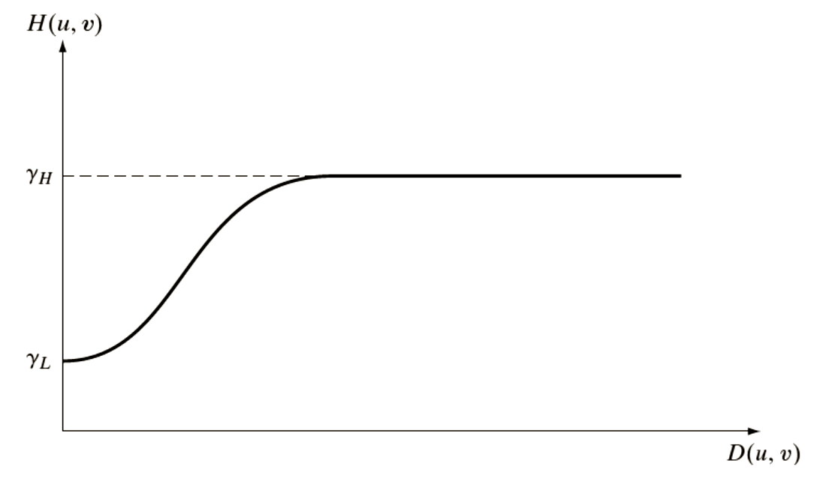

Homomorphic Filter Design
Images: Gonzalez & Woods, 3rd edition
$$γ_{L}<1;γ_{H}>1$$

Slide 16
Example
Images: Gonzalez & Woods, 3rd edition

Slide 17
Thank you
Next Lecture: Image Restoration

