Slide 1

CS654: Digital Image Analysis
Lecture 21: Image Restoration

Slide 2
Recap of Phase 1
Image: acquisition, digitization
Geometric Transformations: Interpolation techniques
Image Transforms (spatial to frequency domain)
Image Enhancement (spatial and frequency domain)

Slide 3
Outline of Lecture 21
Image restoration vs. enhancement
What is restoration
Image restoration model
Continuous, discrete formulation
Point spread function
Noise

Slide 4
Image restoration
It refers to the minimization or removal of the known degradations in an image.
De-blurring, noise filtering, correction of geometric distortion etc.
Original image
Blurred input image
Restored image

Slide 5
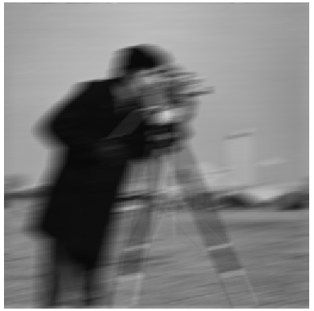
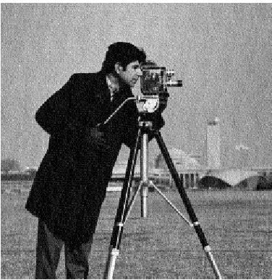
Restoration vs. Enhancement
ENHANCEMENT
RESTORATION

Slide 6
Causes of Common degradation
Sensor noise (poor illumination, long exposer)
Improper focusing (out of focus image)
Geometric restoration
Lense
Irregular movement of the sensor
Atmospheric turbulence
…

Slide 7
Assumptions
Degradation function must be a linear system
The system is homogeneous
The system is shift invariant

Slide 8







Linear position invariant degradation
$$g\left(x,y\right)=H\left[f\left(x,y\right)\right]+η(x,y)$$
$$g\left(x,y\right)=H\left[f\left(x,y\right)\right]$$
Assume $η\left(x,y\right)=0$
$H$ is a Linear system
$$H\left[af_{1}\left(x,y\right)+bf_{2}(x,y)\right]=aH[f_{1}\left(x,y\right)]+bH[f_{2}\left(x,y\right)]$$
If $a=b=1$; Additivity property
If $f_{2}(x,y)=0$; Homogeneity property
$H$ is a Position Invariant
$$H\left[f(x−α,y−β)\right]=g\left(x−α,y−β\right)]$$

Slide 9
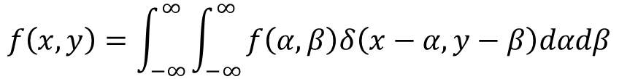

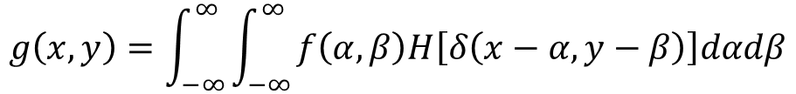
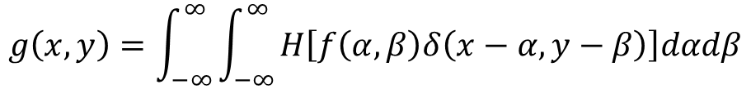
Image formation in continuous domain
$$f\left(x,y\right)=\int_{−∞}^{∞}{\int_{−∞ }^{∞}{f\left(α,β\right)δ\left(x−α,y−β\right)dαdβ}}$$
$$g\left(x,y\right)=H[f\left(x,y\right)]=H\left[\int_{−∞}^{∞}{\int_{−∞ }^{∞}{f\left(α,β\right)δ\left(x−α,y−β\right)dαdβ}}\right]$$
$$g\left(x,y\right)=\int_{−∞}^{∞}{\int_{−∞ }^{∞}{H\left[f\left(α,β\right)δ\left(x−α,y−β\right)\right]dαdβ}}$$
Additivity property
$$g\left(x,y\right)=\int_{−∞}^{∞}{\int_{−∞ }^{∞}{f\left(α,β\right)H\left[δ\left(x−α,y−β\right)\right]dαdβ}}$$
Homogeneity
property
$$h\left(x,y,α,β\right)=H\left[δ\left(x−α,y−β\right)\right]$$
Impulse response of H

Slide 10
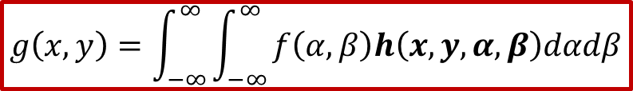
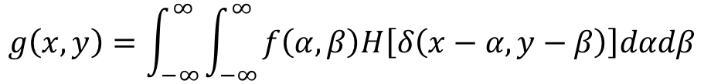
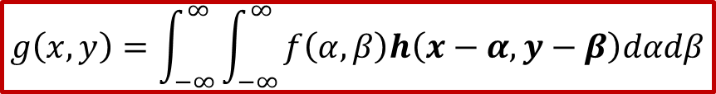
Image formation in continuous domain
$$g\left(x,y\right)=\int_{−∞}^{∞}{\int_{−∞ }^{∞}{f\left(α,β\right)H\left[δ\left(x−α,y−β\right)\right]dαdβ}}$$
$$g\left(x,y\right)=\int_{−∞}^{∞}{\int_{−∞ }^{∞}{f\left(α,β\right)h\left(x,y,α,β\right)dαdβ}}$$
A linear system is characterized by its impulse response
$$g\left(x,y\right)=\int_{−∞}^{∞}{\int_{−∞ }^{∞}{f\left(α,β\right)h\left(x−α,y−β\right)dαdβ}}$$
Position Invariant

Slide 11
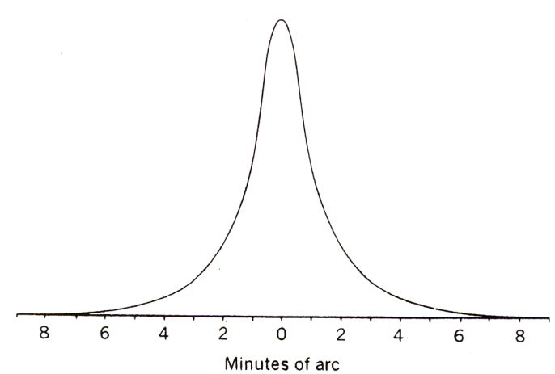
Point Spread Function
scene
Optical
System
image
Ideally, the optical system should be a Dirac delta function.
However, optical systems are never ideal.
Optical
System
point source
point spread function
Point spread function of Human Eyes

Slide 12



PSF “A Point source”
$$h\left(x,y,α,β\right)$$
$$I_{1}(x_{1},y_{1})$$
$$I_{2}(x_{2},y_{2})$$

Slide 13
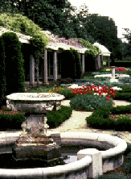



Point Spread Function
normal vision
myopia
hyperopia
Astigmatism
Images by Richmond Eye Associates

Slide 14
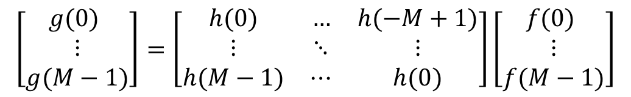
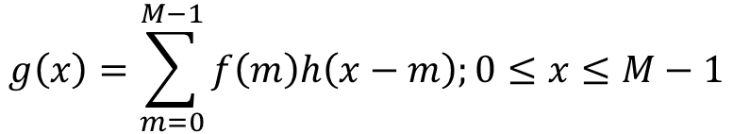



Discrete formulation
$$g\left(x\right)=\sum_{m=0}^{M−1}{f\left(m\right)h\left(x−m\right);0≤x≤M−1}$$
1-D case:
Matrix notation:
$$\left[\begin{matrix}g\text{(0)} \\ ⋮ \\ g(M−1)\end{matrix}\right]=\left[\begin{matrix}h(0) & … & h(−M+1) \\ ⋮ & ⋱ & ⋮ \\ h(M−1) & ⋯ & h(0)\end{matrix}\right]\left[\begin{matrix}f\text{(0)} \\ ⋮ \\ f(M−1)\end{matrix}\right]$$
$$g$$
$$H$$
$$f$$

Slide 15
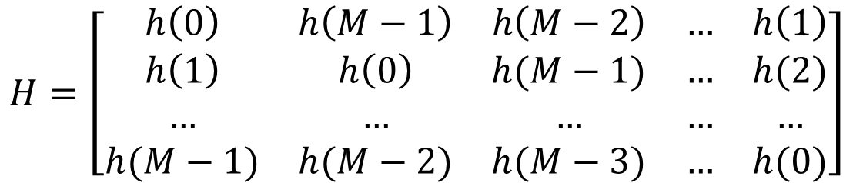
Circulant Matrix
Assume $H$ to be periodic, with periodicity$M$
$$H=\left[\begin{matrix}h\left(0\right) & h\left(M−1\right) & h\left(M−2\right) & … & h\left(1\right) \\ h\left(1\right) & h\left(0\right) & h(M−1) & … & h(2) \\ … & … & … & … & … \\ h(M−1) & h(M−2) & h(M−3) & … & h(0)\end{matrix}\right]$$
Each row vector is rotated one element to the right relative to the preceding row vector

Slide 16


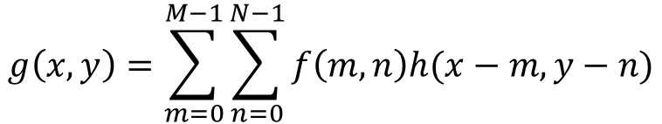



Extension to 2-D
$$g\left(x,y\right)=\sum_{m=0}^{M−1}{\sum_{n=0}^{N−1}{f\left(m,n\right)h(x−m,y−n)}}$$
$f\left(x,y\right)$ and $h(x,y)$ are of dimension $M×N$
Matrix notation:
$$g=Hf+η$$
$f:$ Vector of dimension $MN$
$η:$ Vector of dimension $MN$
$H:$Matrix of dimension $MN×MN$

Slide 17
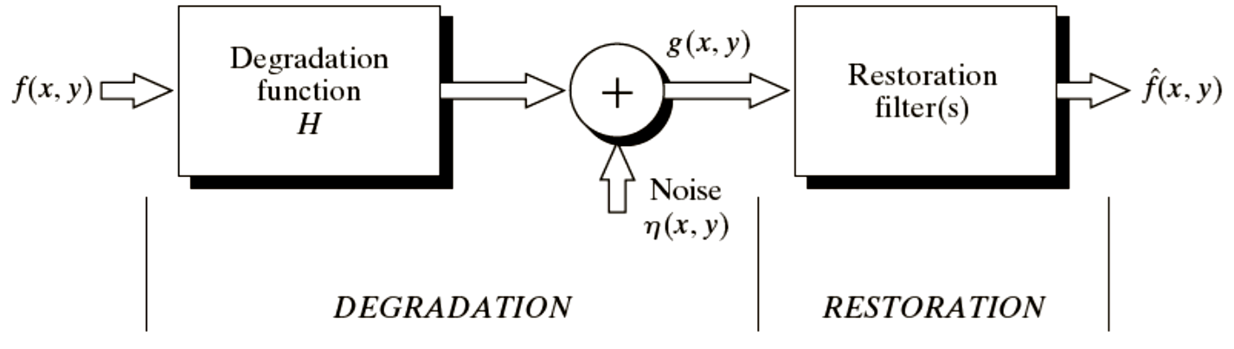








A model restoration process
$$g\left(x,y\right)=$$
$$f(x,y)$$
$$∗$$
$$H(x,y)$$
$$+$$
$$η(x,y)$$
$$g\left(x,y\right)→ \hat{f}(x,y)$$
Target
$$\hat{f}(x,y)≅f(x,y)$$

Slide 18
Noise models
Statistical behavior of the grey-level values
Can be modeled as a random variable with a specific PDF
Gaussian noise
Rayleigh noise
Gamma noise
Exponential noise
Uniform noise
Impulse (salt & pepper) noise

Slide 19
Gaussian noise
The PDF of a Gaussian noise is given by
p(z)
z

Slide 20
Rayleigh noise
The PDF of a Rayleigh noise is given by
p(z)
The mean and variance are given
and
a
z
Application areas: MRI images, Underwater images

Slide 21
Gamma noise
The PDF of a Gamma noise is given by
p(z)
K
The mean and variance are given
and
z

Slide 22
Exponential noise
The PDF of a Exponential noise is given by
p(z)
a
The mean and variance are given
and
z
Note: It is a special case of Gamma PDF, with b=1.

Slide 23
Uniform noise
The PDF of a Uniform noise is given by
p(z)
All noise is present within this interval
The mean and variance are given
and
a
b
z

Slide 24
Application of Uniform noise
a
b
Quantization
Predictive coding

Slide 25
Impulse (salt-and-pepper) noise
The PDF of a (bipolar) impulse noise is given by
p(z)
a
b
z

Slide 26
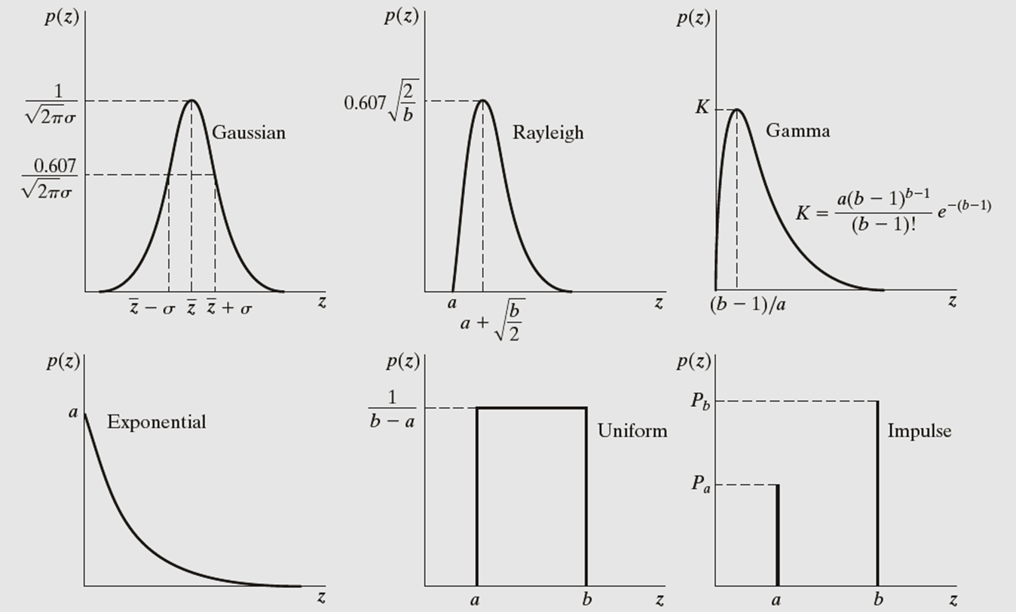
Summary of different noise models

Slide 27
Thank you
Next Lecture: Image Restoration

