Slide 1

CS654: Digital Image Analysis
Lecture 22: Image Restoration

Slide 2
Recap of Lecture 21
Image restoration in presence of only noise
Image restoration in presence of only degradation
Observation, experimentation and mathematical modeling
Motion blur
Restoration by inverse filtering

Slide 3
Outline of Lecture 22
Inverse filtering and its problems
Pseudo Inverse filtering
Constrained image restoration problem

Slide 4






Inverse filtering (error minimization)
2D Discrete Domain Representation
$$g=Hf+η$$
Error function: $\hat{f}=g−(Hf+η)$
$$\hat{f}=g−Hf$$
Neglecting the noise component
Approximate least square error:
$$J(\hat{f})={\left\|g−H\hat{f}\right\|}^{2}$$
Unconstrained error minimization
$$J\left(\hat{f}\right)=g^{2}+H^{2}{\hat{f}}^{2}−2gH\hat{f}$$
Differentiate w.r.to $\hat{f}$ and equate to zero

Slide 5
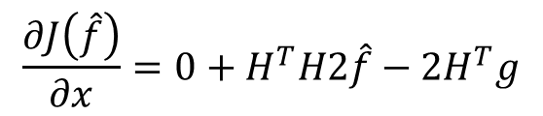
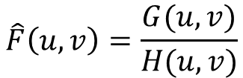



Inverse filtering (error minimization)
$$J\left(\hat{f}\right)=g^{2}+H^{2}{\hat{f}}^{2}−2gH\hat{f}$$
$$\frac{∂J\left(\hat{f}\right)}{∂x}=0+H^{T}H2\hat{f}−2H^{T}g$$
Differentiate w.r.to $\hat{f}$
$$⇒ =−2H^{T}\left(g−H^{T}\hat{f}\right)$$
Equating to zero
$$H^{T}H\hat{f}=H^{T}g, ⇒\hat{f}={\left(H^{T}H\right)}^{−1}H^{T}g=H^{−1}g$$
$$\hat{F}\left(u,v\right)=\frac{G(u,v)}{H(u,v)}$$
In frequency domain
$1/H(u,v)$ does not necessarily exist. If $H(u,v)=0$or is close to zero, it may not be computationally possible to compute $1/H(u,v)$
It doesn't perform well when used on noisy images.

Slide 6
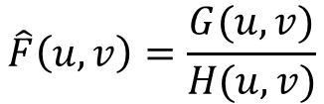
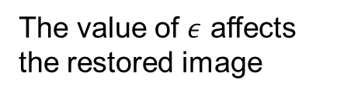
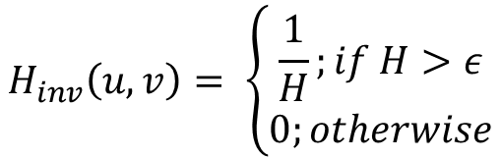
Pseudo inverse filtering
Equation of inverse filter in frequency domain
$$\hat{F}\left(u,v\right)=\frac{G(u,v)}{H(u,v)}$$
Spectrum of the PSF
Simulated impulse
Impulse response
Pseudo inverse filter
$$H_{inv}\left(u,v\right)= \left\{\begin{aligned}\frac{1}{H};if H>ε \\ 0;otherwise\end{aligned}\right.$$
The value of $ε$ affects the restored image

Slide 7







SVD approach to Pseudo-Inverse
Image restoration model
$$G=Hf+η$$
$H$ can be decomposed into Eigen matrices using SVD
Columns of $U$ are Eigen vectors of $HH^{T}$
$$H=UDV^{T}$$
Rows of $V^{T}$ are Eigen vectors of $H^{T}H$
Diagonal of $D$ are the square root of Eigen values of $HH^{T}$
Pseudo-inverse of $H$ can be written as
$$A^{+}={\left(A^{∗}A\right)}^{−1} A^{∗}$$
$$⇒H^{+}=VD^{−1}U^{T}$$

Slide 8

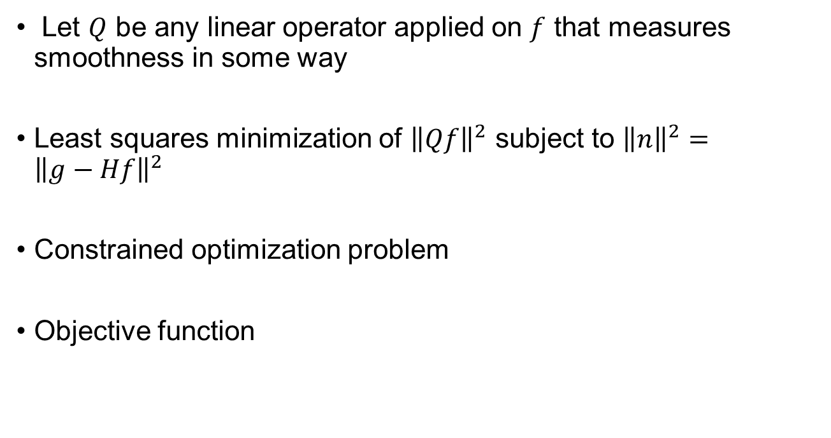

Constrained image restoration
Let $Q$ be any linear operator applied on $f$ that measures smoothness in some way
Least squares minimization of ${\left\|Qf\right\|}^{2}$ subject to ${\left\|n\right\|}^{2}={\left\|g−Hf\right\|}^{2}$
Constrained optimization problem
Objective function
$$α=Lagrange multiplier$$
$$J\left(f\right)={\left\|Qf\right\|}^{2}+α\left({\left\|g−Hf\right\|}^{2}−{\left\|n\right\|}^{2}\right)$$
Smoothness
Restoration

Slide 9

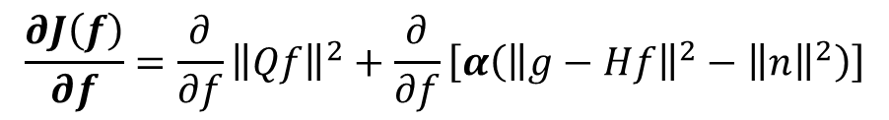



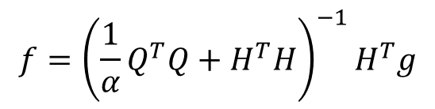


Minimization of error
$$J\left(f\right)={\left\|Qf\right\|}^{2}+α\left({\left\|g−Hf\right\|}^{2}−{\left\|n\right\|}^{2}\right)$$
$$\frac{∂J\left(f\right)}{∂f}={\frac{∂}{∂f}\left\|Qf\right\|}^{2}+\frac{∂}{∂f}\left[α\left({\left\|g−Hf\right\|}^{2}−{\left\|n\right\|}^{2}\right)\right]$$
$$=2Q^{T}Qf+2αH^{T}Hf−2αH^{T}g$$
$$f={\left({\frac{1}{α}Q}^{T}Q+H^{T}H\right)}^{−1}H^{T}g$$
Equating to zero
If $α$ is large
$$f≈{\left(H^{T}H\right)}^{−1}H^{T}g⇒H^{−1}g$$
Emphasize restoration
If $α$ is small
$$f≈{\left(Q^{T}Q\right)}^{−1}H^{T}g$$
Emphasize smoothness

Slide 10
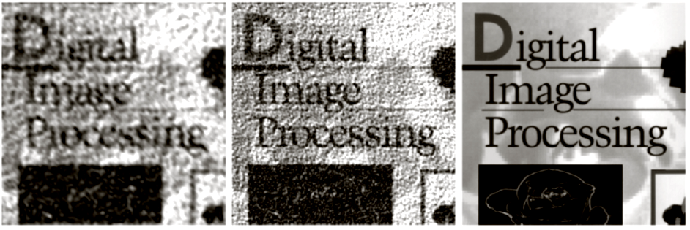
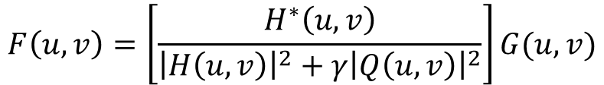

Constrained Restoration
By applying Fourier transform matrices to both sides
$$F\left(u,v\right)=\left[\frac{H^{∗}\left(u,v\right)}{{\left|H\left(u,v\right)\right|}^{2}+γ{\left|Q\left(u,v\right)\right|}^{2}}\right]G(u,v)$$
$$γ=\frac{1}{α}$$
$F, G, H and Q$are the Fourier transforms of $f, g, h and q$respectively
Constrained restoration results with Q = Laplacian and different γ values

Slide 11

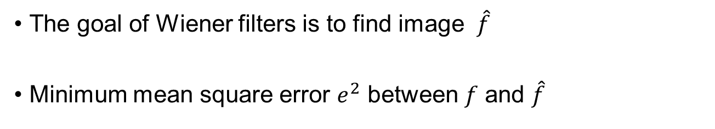
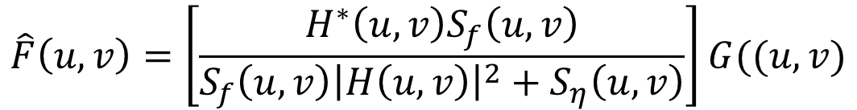
Wiener Filters
The goal of Wiener filters is to find image $\hat{f}$
Minimum mean square error $e^{2}$ between $f$ and $\hat{f}$
$$e^{2}=E\left\{{\left(f−\hat{f}\right)}^{2}\right\}$$
Assume: noise is zero mean and uncorrelated with the image
$$\hat{F}\left(u,v\right)=\left[\frac{H^{∗}\left(u,v\right)S_{f}\left(u,v\right)}{S_{f}\left(u,v\right){\left|H\left(u,v\right)\right|}^{2}+S_{η}\left(u,v\right)}\right]G((u,v)$$

Slide 12
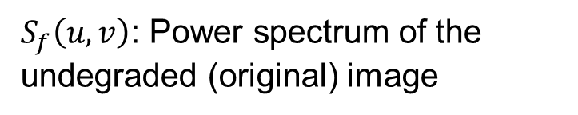
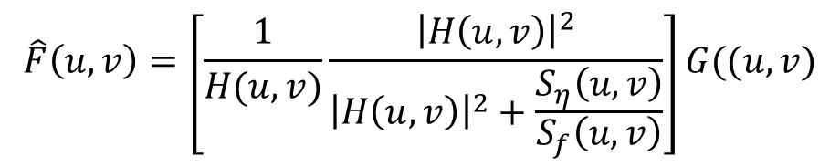

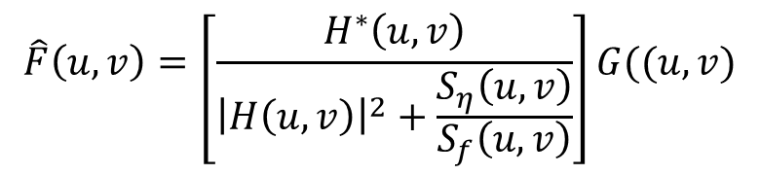



Weiner Filter
$$\hat{F}\left(u,v\right)=\left[\frac{H^{∗}\left(u,v\right)}{{\left|H\left(u,v\right)\right|}^{2}+\frac{S_{η}\left(u,v\right)}{S_{f}\left(u,v\right)}}\right]G((u,v)$$
Product of a complex quantity with its conjugate is equal to the magnitude of the complex quantity squared
$$\hat{F}\left(u,v\right)=\left[\frac{1}{H(u,v)}\frac{{\left|H\left(u,v\right)\right|}^{2}}{{\left|H\left(u,v\right)\right|}^{2}+\frac{S_{η}\left(u,v\right)}{S_{f}\left(u,v\right)}}\right]G((u,v)$$
$H\left(u,v\right)$: Degradation function
$S_{η}\left(u,v\right)$: Power spectrum of the noise
$H^{∗}\left(u,v\right)$: Complex conjugate of $H\left(u,v\right)$
$S_{f}\left(u,v\right)$: Power spectrum of the undegraded (original) image
${\left|H\left(u,v\right)\right|}^{2}$: $H^{∗}\left(u,v\right)H\left(u,v\right)$

Slide 13
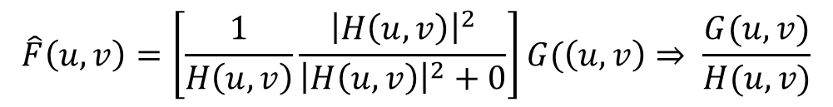
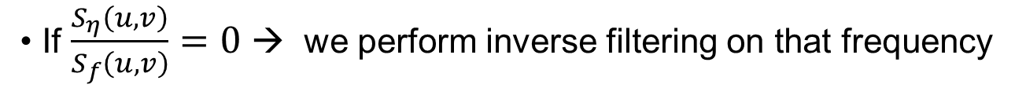
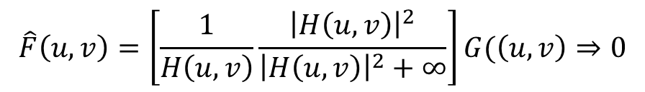
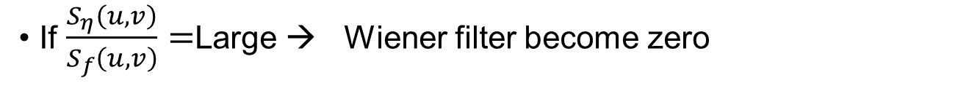
Weiner filter
If $\frac{S_{η}\left(u,v\right)}{S_{f}\left(u,v\right)}=0$ → we perform inverse filtering on that frequency
$$\hat{F}\left(u,v\right)=\left[\frac{1}{H\left(u,v\right)}\frac{{\left|H\left(u,v\right)\right|}^{2}}{{\left|H\left(u,v\right)\right|}^{2}+0}\right]G(\left(u,v\right)⇒ \frac{G(u,v)}{H(u,v)}$$
If $\frac{S_{η}\left(u,v\right)}{S_{f}\left(u,v\right)}=$Large → Wiener filter become zero
$$\hat{F}\left(u,v\right)=\left[\frac{1}{H\left(u,v\right)}\frac{{\left|H\left(u,v\right)\right|}^{2}}{{\left|H\left(u,v\right)\right|}^{2}+∞}\right]G(\left(u,v\right)⇒0$$

Slide 14
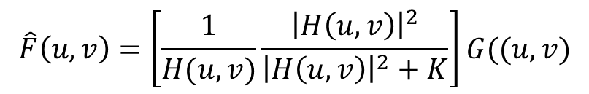
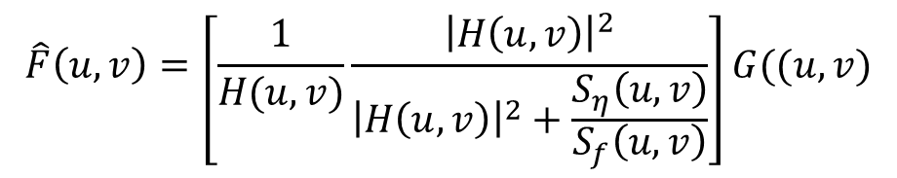
Weiner Filter
Approximation of Weiner filter
$$\hat{F}\left(u,v\right)=\left[\frac{1}{H(u,v)}\frac{{\left|H\left(u,v\right)\right|}^{2}}{{\left|H\left(u,v\right)\right|}^{2}+\frac{S_{η}\left(u,v\right)}{S_{f}\left(u,v\right)}}\right]G((u,v)$$
$$\hat{F}\left(u,v\right)=\left[\frac{1}{H(u,v)}\frac{{\left|H\left(u,v\right)\right|}^{2}}{{\left|H\left(u,v\right)\right|}^{2}+K}\right]G((u,v)$$
$K$: Specified constant that is added to all terms of ${\left|H\left(u,v\right)\right|}^{2}$

Slide 15
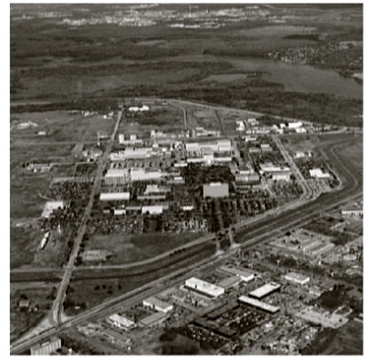
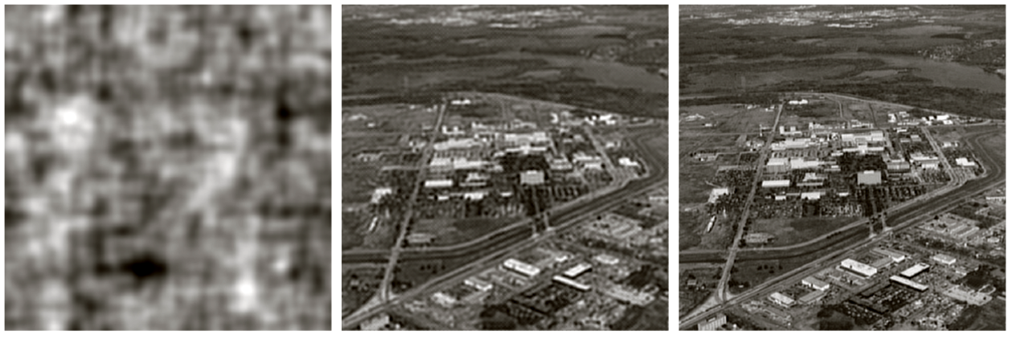
Example
Input image
Full inverse
Radially limited
Weiner Filter

Slide 16
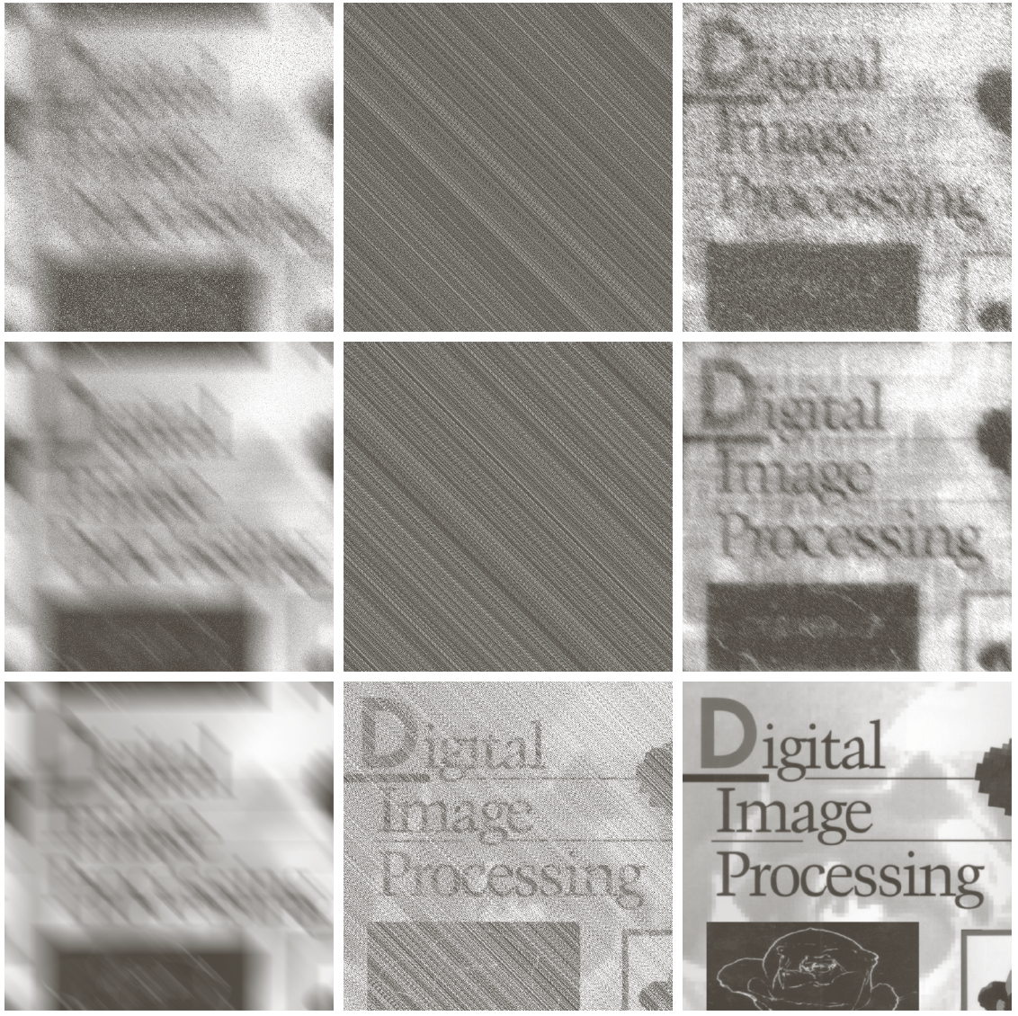
Example
Noise + Motion
Inverse
Weiner
Noise

Slide 17
Conclusion
We considered several algebraic approaches to image restoration
Constrained restoration imposes smoothness constraints and does well when noise is present
Wiener filters model the noise/signal ratio to obtain a minimum mean square error restoration image

