Slide 1

CS654: Digital Image Analysis
Lecture 24: Introduction to Image Segmentation: Edge Detection
Slide credits: Derek Hoiem, Lana Lazebnik, Steve Seitz, David Forsyth, David Lowe, Fei-Fei Li, Guillermo Sapiro

Slide 2
Recap of Lecture 23
Image restoration
Pseudo Inverse filtering
Constrained image restoration problem
Weiner filter

Slide 3
Outline of Lecture 24
Image segmentation
Edge based segmentation
Edge detection techniques
Edge detection operators
Challenges and solutions

Slide 4
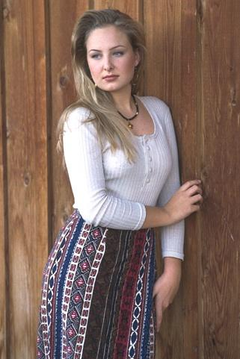
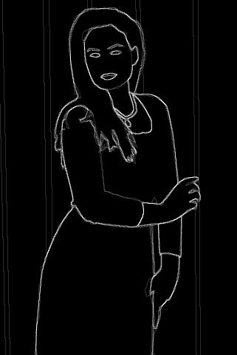
Image segmentation
http://www.eecs.berkeley.edu/Research/Projects/CS/vision/bsds/

Slide 5
Segmentation and Grouping
What: Segmentation breaks an image into groups over space and/or time
Why:
Tokens are
The things that are grouped (pixels, points, surface elements, etc., etc.)
Top down segmentation
tokens grouped because they lie on the same object
Bottom up segmentation
tokens belong together because of some local affinity measure
Bottom up/Top Down need not be mutually exclusive
Motivation:
Object recognition
3D modeling
Content representation
Relationship of sequence/ set of tokens
Always for a goal or application

Slide 6
Different approaches
Image Segmentation
Region based
Boundary based
Edge based

Slide 7
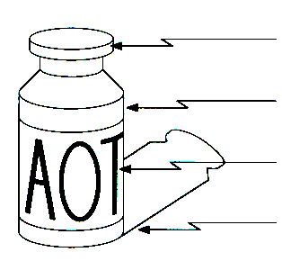
Origin of Edges
Edges are caused by a variety of factors
Surface normal discontinuity
Depth discontinuity
Surface color discontinuity
Illumination discontinuity
Source: Steve Seitz

Slide 8
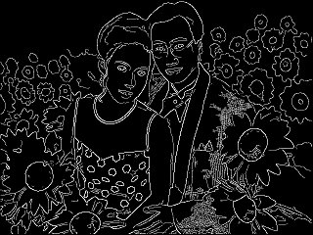
Why finding edges is important
Group pixels into objects or parts
Cues for 3D shape
Guiding interactive image editing

Slide 9
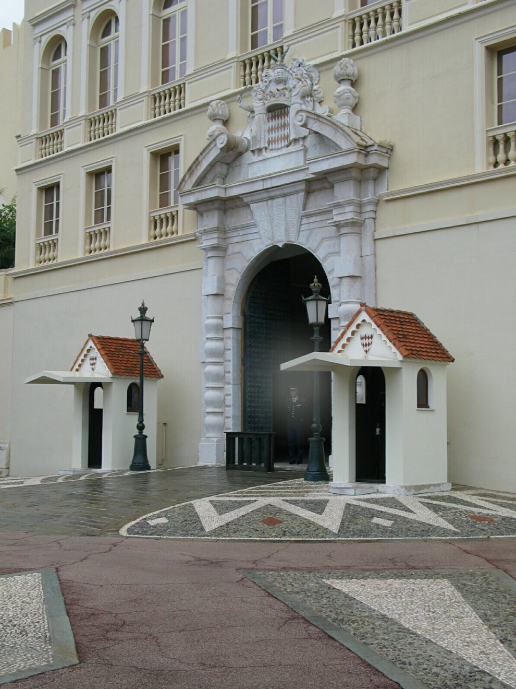
Closeup of edges

Slide 10
Closeup of edges

Slide 11
Stages in edge detection
Smoothing
Enhancement
Localization
Detection

Slide 12

Characterizing edges
An edge is a place of rapid change in the image intensity function
intensity function (along horizontal scanline)
image
first derivative
edges correspond to extrema of derivative

Slide 13

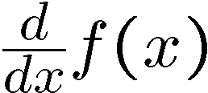
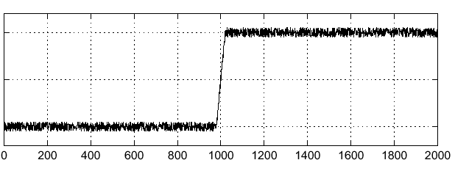
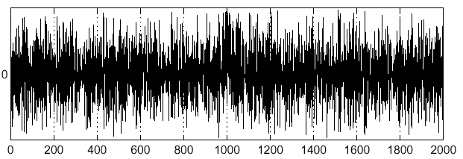
Effects of noise
Consider a single row or column of the image
Plotting intensity as a function of position gives a signal
Where is the edge?
Source: S. Seitz
Notes:
How to fix?

Slide 14
Effects of noise
Difference filters respond strongly to noise
Image noise results in pixels that look very different from their neighbors
Generally, the larger the noise the stronger the response
What can we do about it?
Source: D. Forsyth

Slide 15
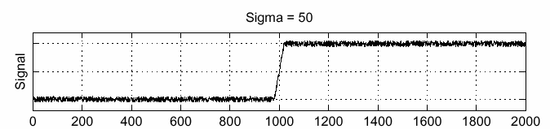
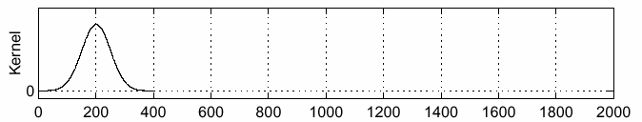
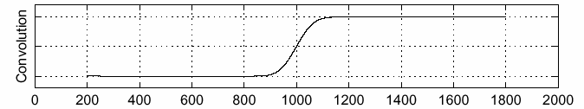
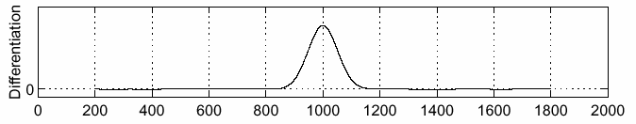
Solution: smooth first
f
g
f * g
To find edges, look for peaks in
Source: S. Seitz

Slide 16
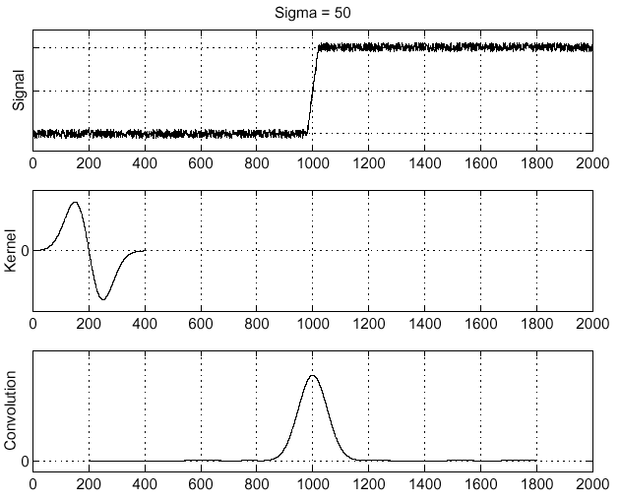
Derivative theorem of convolution
Differentiation is convolution, and convolution is associative:
This saves us one operation:
f
Source: S. Seitz

Slide 17
Derivative of digital image
First order derivative
Zero: areas of constant intensity
Non-zero: at the onset of an intensity step or ramp
Non-zero: along ramps
Second derivative
Zero: constant areas
Non-zero: at the onset and end of step or ramp
Zero: along ramp of constant slope
Step
Ramp
Spike
Roof

Slide 18
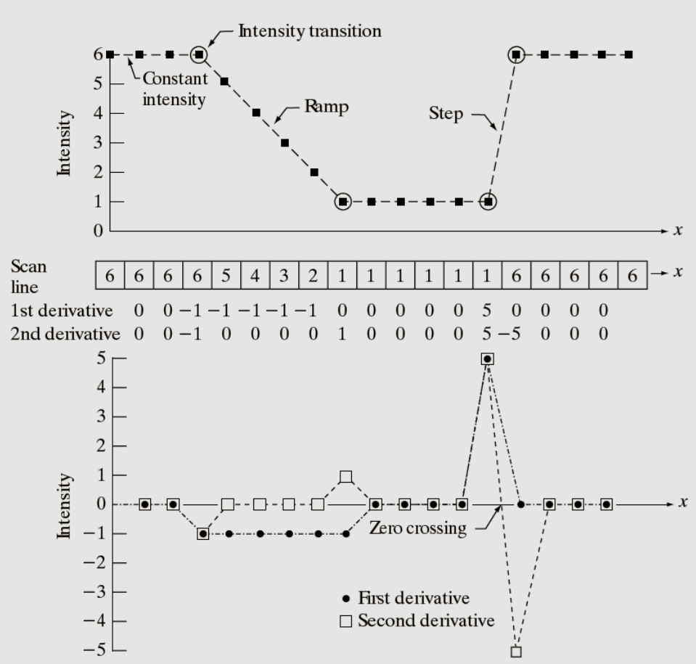


Example
Image: Gonzalez and Woods, 3rd Ed.
First order derivative
$$\frac{∂f}{∂x}=f\left(x+1\right)−f(x)$$
Second order derivative
$$\frac{∂^{2}f}{∂x^{2}}=f\left(x+1\right)+f\left(x−1\right)−2f(x)$$

Slide 19
Types of Edge Detectors
Edge detection algorithms
Derivative
Template matching
Gaussian Derivative
Pattern fit approach

Slide 20







First order edge detectors
Roberts Edge detector
Prewitt Edge detector
$$\frac{∂f}{∂x}=f\left(i,j\right)−f(i+1,j)$$
$$M_{x}=\left[\begin{matrix}1 & 0 \\ 0 & −1\end{matrix}\right]$$
$$\frac{∂f}{∂x}=f\left(i+1,j\right)−f(i,j+1)$$
$$M_{y}=\left[\begin{matrix}0 & 1 \\ −1 & 0\end{matrix}\right]$$
$$\frac{∂f}{∂x}={(a}_{2}+ca_{3}+a_{4})−(a_{0}+ca_{7}+a_{6})$$
$$\left[\begin{matrix}a_{0} & a_{1} & a_{2} \\ a_{7} & [i,j] & a_{3} \\ a_{6} & a_{5} & a_{4}\end{matrix}\right]$$
$$\frac{∂f}{∂x}={(a}_{6}+ca_{5}+a_{4})−(a_{0}+ca_{1}+a_{2})$$

Slide 21
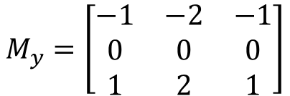

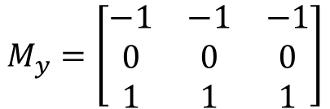

First order edge detectors
Prewitt Edge detector
Set c=1
Sobel Edge Detector
Set c=2
$$M_{x}=\left[\begin{matrix}−1 & 0 & 1 \\ −1 & 0 & 1 \\ −1 & 0 & 1\end{matrix}\right]$$
$$M_{y}=\left[\begin{matrix}−1 & −1 & −1 \\ 0 & 0 & 0 \\ 1 & 1 & 1\end{matrix}\right]$$
$$M_{x}=\left[\begin{matrix}−1 & 0 & 1 \\ −2 & 0 & 2 \\ −1 & 0 & 1\end{matrix}\right]$$
$$M_{y}=\left[\begin{matrix}−1 & −2 & −1 \\ 0 & 0 & 0 \\ 1 & 2 & 1\end{matrix}\right]$$

Slide 22











Mask based edge detection
Smooth the input image $\hat{f}\left(x,y\right)=f\left(x,y\right)∗G\left(x,y\right)$
${\hat{f}}_{x}\left(x,y\right)=\hat{f}\left(x,y\right)∗M_{x}\left(x,y\right)$
${\hat{f}}_{y}\left(x,y\right)=\hat{f}\left(x,y\right)∗M_{y}\left(x,y\right)$
$|∇f|=\left|{\hat{f}}_{x}\left(x,y\right)\right|+|{\hat{f}}_{y}\left(x,y\right)|$
$θ=\tan^{−1}{\frac{{\hat{f}}_{x}\left(x,y\right)}{{\hat{f}}_{y}\left(x,y\right)}}$
$If magn(x, y)>T,then possible edge point$
$$f_{y}$$
$$∇f$$
$$y+1$$
38 | 66 | 65
14 | 35 | 64
12 | 15 | 42
$$θ$$
$$y$$
$$f_{x}$$
$$y−1$$
$$x−1$$
$$x$$
$$x+1$$

Slide 23
Some practical issues
Isotropic nature of gradient operators
The differential masks act as high-pass ﬁlters which tend to amplify noise – reduce noise (low pass filter)
The noise suppression-localization tradeoff
How should we choose the threshold
Edge thinning and linking are required to obtain good contours

Slide 24
Criteria for optimal edge detection
Good detection
minimize the probability of false positives (detect non-edges as edge)
false negatives(missing real edges)
Good localization
Single response constraint
minimize the number of local maxima around the true edge

Slide 25
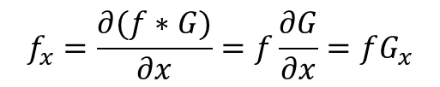
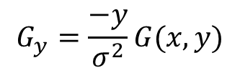
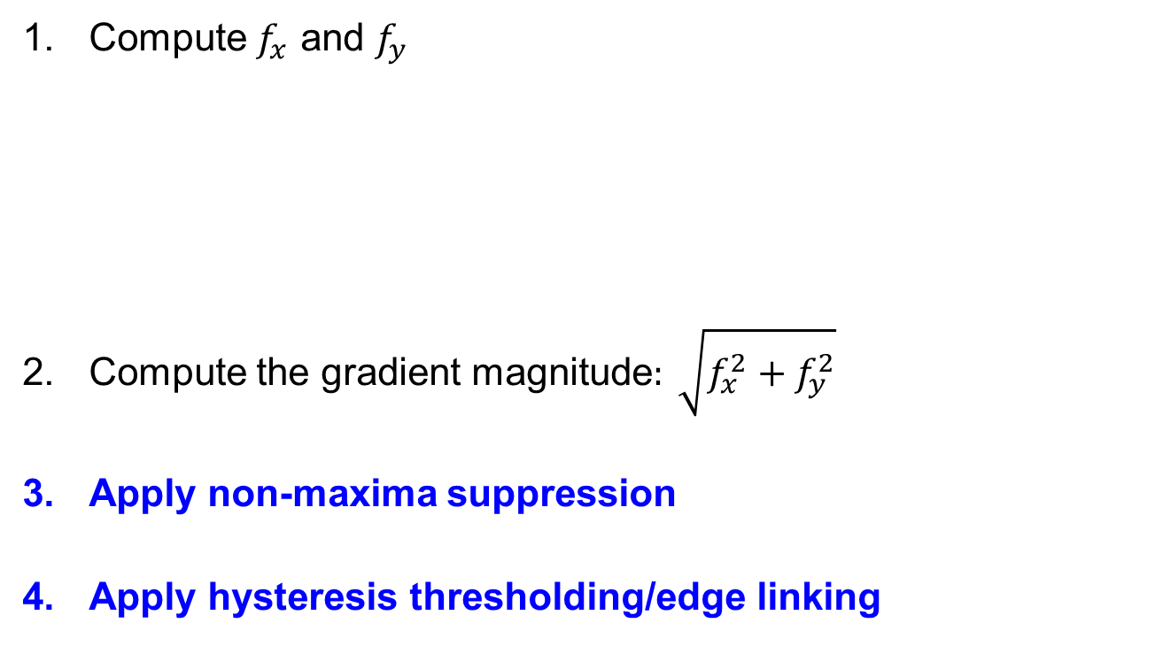
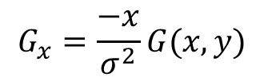
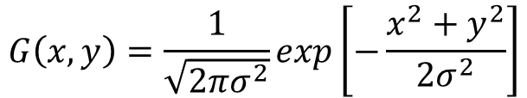
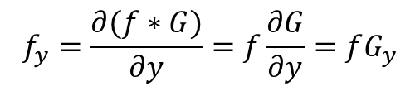
Canny edge detector
Compute $f_{x}$ and $f_{y}$
Compute the gradient magnitude$: \sqrt{f_{x}^{2}+f_{y}^{2}}$
Apply non-maxima suppression
Apply hysteresis thresholding/edge linking
$$f_{x}=\frac{∂(f∗G)}{∂x}=f\frac{∂G}{∂x}=fG_{x}$$
$$f_{y}=\frac{∂(f∗G)}{∂y}=f\frac{∂G}{∂y}=fG_{y}$$
$$G\left(x,y\right)=\frac{1}{\sqrt{2πσ^{2}}}exp\left[−\frac{x^{2}+y^{2}}{2σ^{2}}\right]$$
$$G_{x}=\frac{−x}{σ^{2}}G(x,y)$$
$$G_{y}=\frac{−y}{σ^{2}}G(x,y)$$

Slide 26
Non-Maximal Suppression
Find the local maxima of the gradient magnitude
Magnitudes at the points of greatest local change remain
All values along the direction of the gradient that are not peak values of a ridge are suppressed.
For each pixel (x,y) do:
if magn(i, j)<magn(i1, j1) or magn(i, j)<magn(i2, j2) then
IN(i, j) = 0
else
IN(i, j) = magn(i, j)

Slide 27
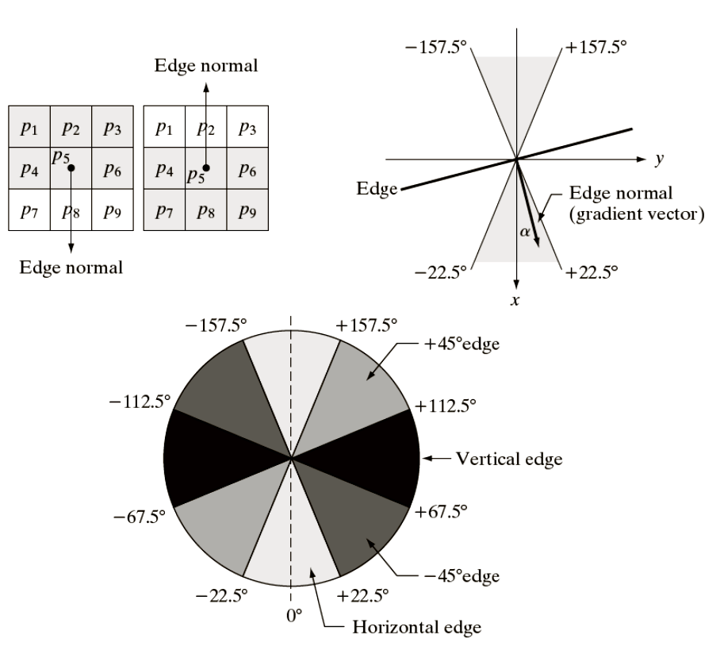
Non-maximal suppression
Image: Gonzalez and Woods, 3rd Ed.

Slide 28
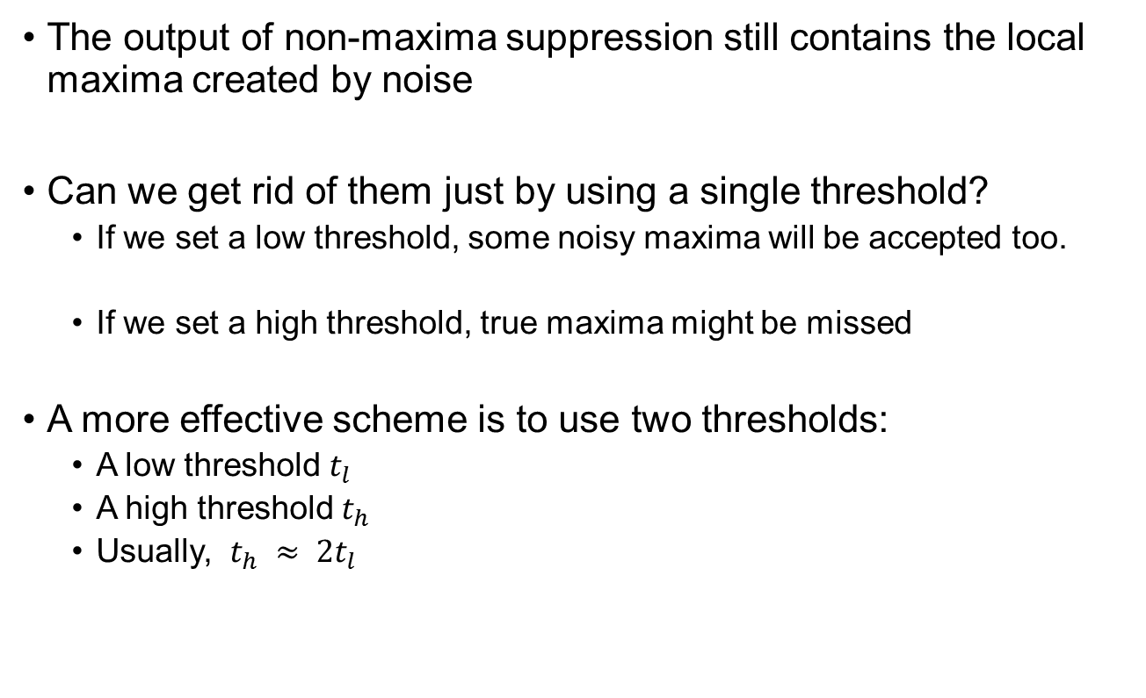
Hysteresis thresholding/Edge Linking
The output of non-maxima suppression still contains the local maxima created by noise
Can we get rid of them just by using a single threshold?
If we set a low threshold, some noisy maxima will be accepted too.
If we set a high threshold, true maxima might be missed
A more effective scheme is to use two thresholds:
A low threshold $t_{l}$
A high threshold $t_{h}$
Usually, $t_{h} ≈ 2t_{l}$

Slide 29
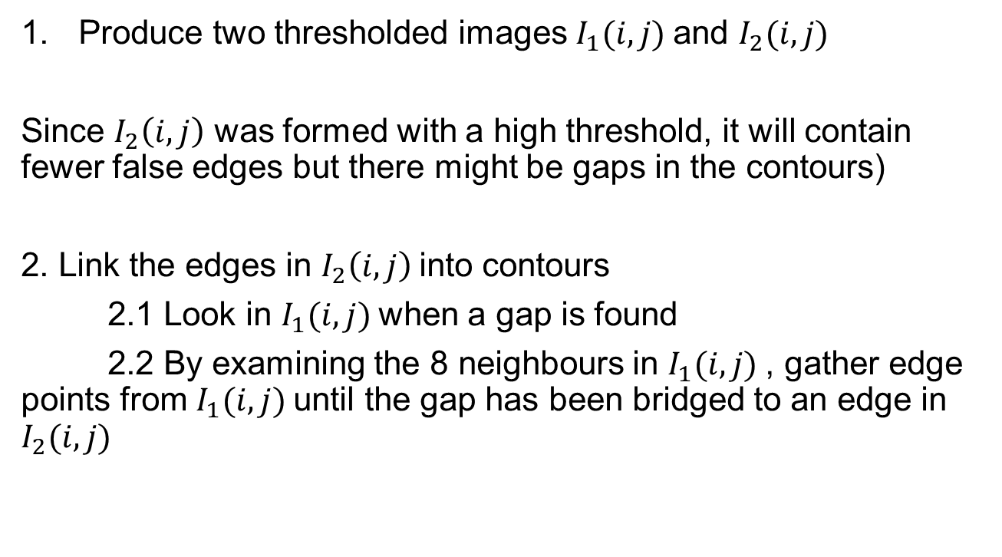
Algorithm
Produce two thresholded images $I_{1}(i, j)$and $I_{2}(i, j)$
Since $I_{2}\left(i, j\right)$ was formed with a high threshold, it will contain fewer false edges but there might be gaps in the contours)
2. Link the edges in $I_{2}\left(i, j\right)$into contours
2.1 Look in $I_{1}(i, j)$when a gap is found
2.2 By examining the 8 neighbours in $I_{1}(i, j)$, gather edge points from $I_{1}(i, j)$until the gap has been bridged to an edge in $I_{2}(i, j)$

Slide 30

Example

Slide 31
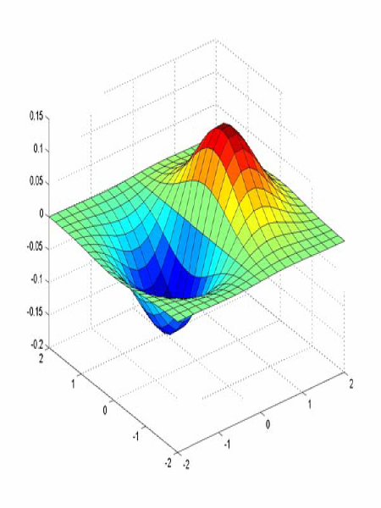
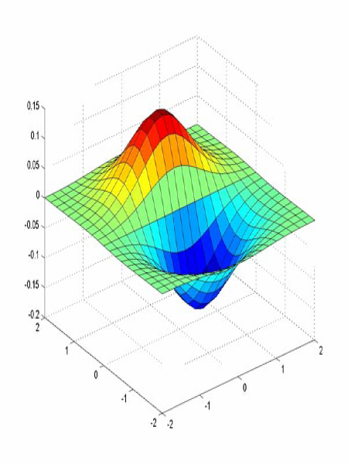
Derivative of Gaussian (DoG) filter
x-direction
y-direction

Slide 32
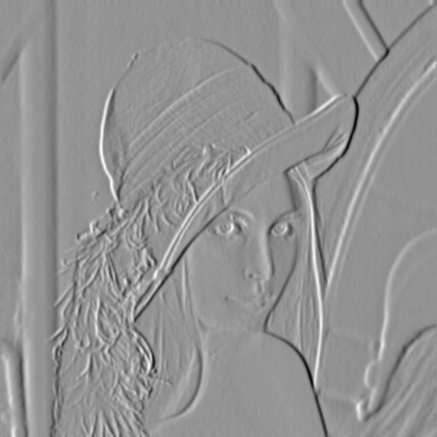
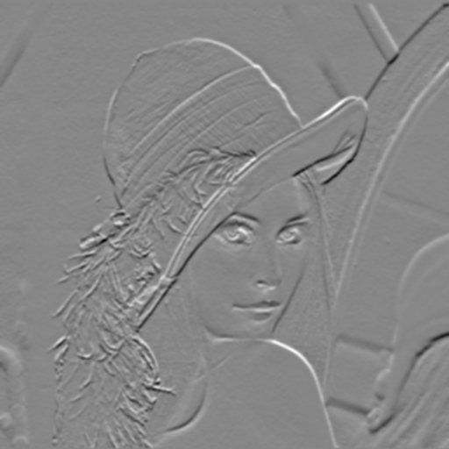
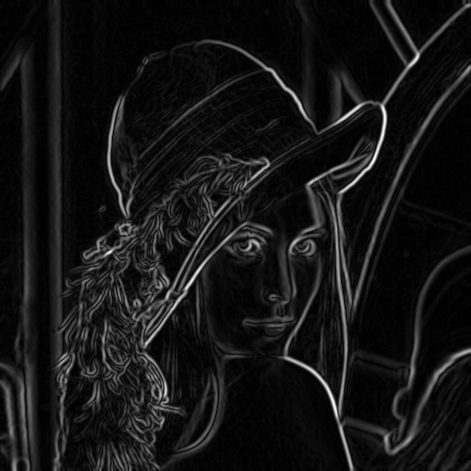
Compute Gradients (DoG)
X-Derivative
of Gaussian
Y-Derivative
of Gaussian
Gradient
Magnitude

Slide 33
Before Non-max Suppression

Slide 34
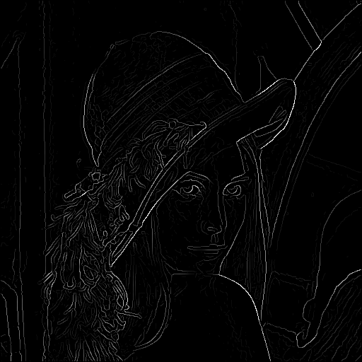
After non-max suppression

Slide 35
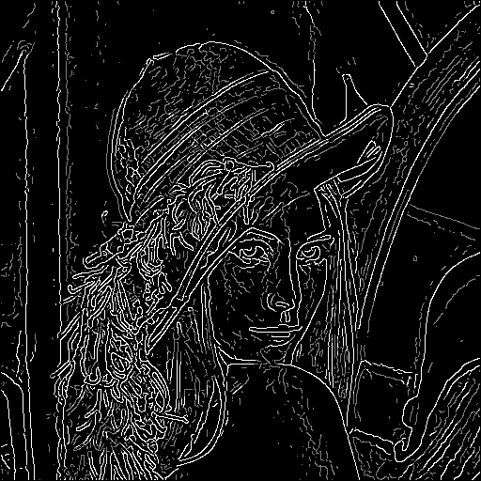
Hysteresis thresholding
Threshold at low/high levels to get weak/strong edge pixels
Do connected components, starting from strong edge pixels

Slide 36
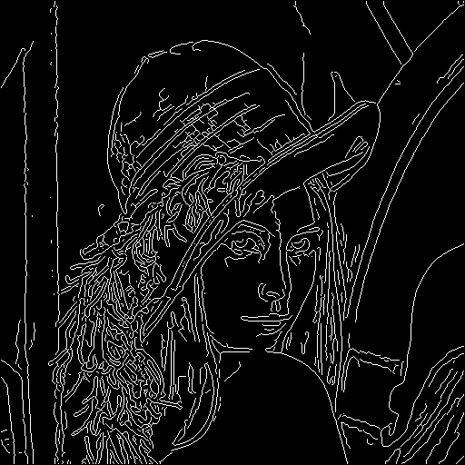
Final Canny Edges

Slide 37
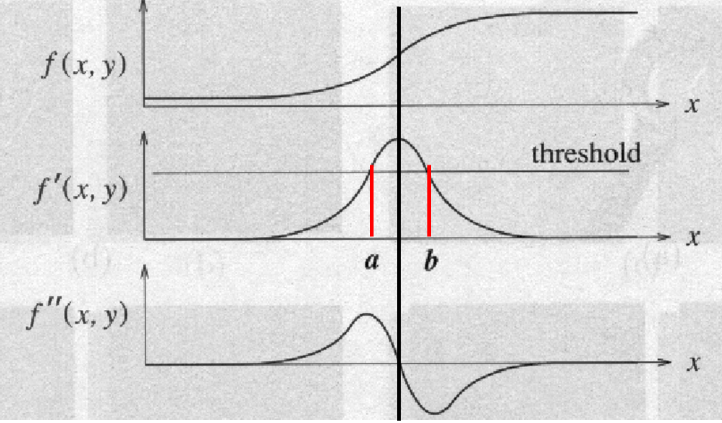
Second order edge detectors
Edge points can be detected by ﬁnding the zero-crossings of the second derivative

Slide 38

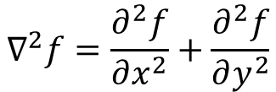
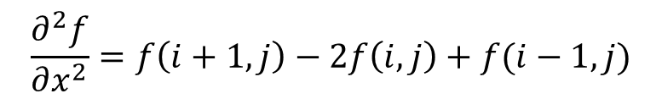
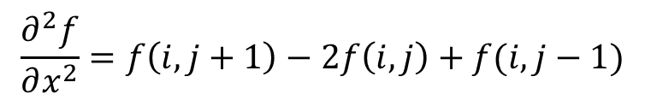
The Laplacian
0 | 1 | 0
1 | -4 | 1
0 | 1 | 0
$$∇^{2}f=\frac{∂^{2}f}{∂x^{2}}+\frac{∂^{2}f}{∂y^{2}}$$
$$Approximating ∇^{2}f$$
1 | 1 | 1
1 | -8 | 1
1 | 1 | 1
$$\frac{∂^{2}f}{∂x^{2}}=f\left(i,j+1\right)−2f\left(i,j\right)+f(i,j−1)$$
$$\frac{∂^{2}f}{∂x^{2}}=f\left(i+1,j\right)−2f\left(i,j\right)+f(i−1,j)$$
-1 | 2 | -1
2 | -4 | 2
-1 | 2 | -1
$$∇^{2}f=−4f\left(i,j\right)+f\left(i,j+1\right)+f\left(i,j−1\right)+f\left(i+1,j\right)+f(i−1,j$$

Slide 39
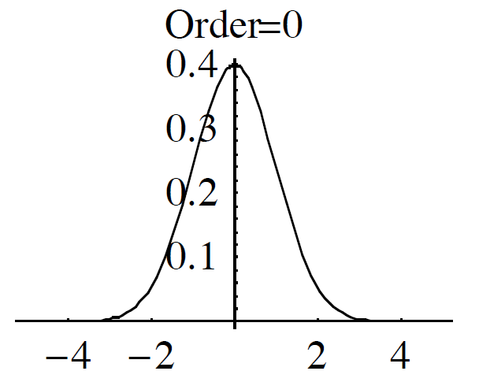
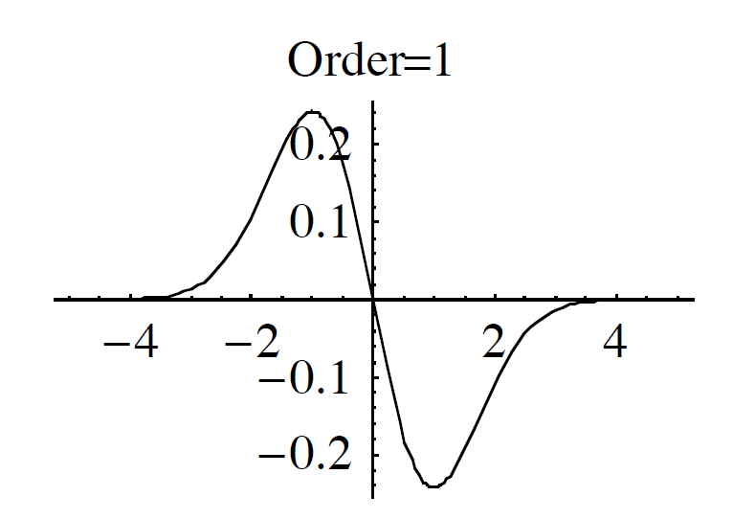
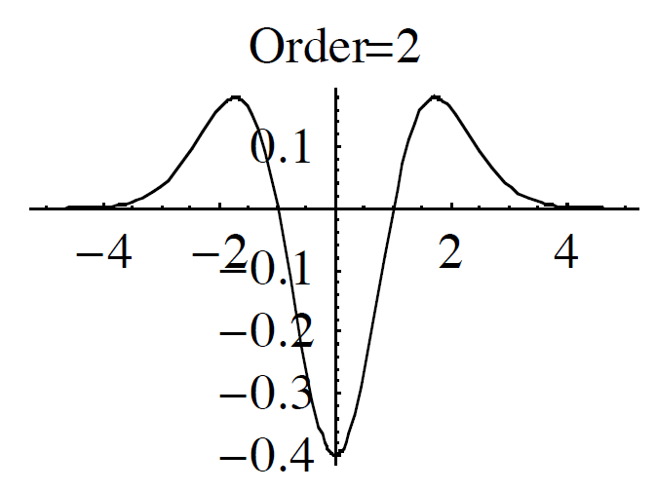
Derivative of Gaussian
Order = 0
Order = 1
Order = 2
Laplacian of Gaussian (LoG)

Slide 40

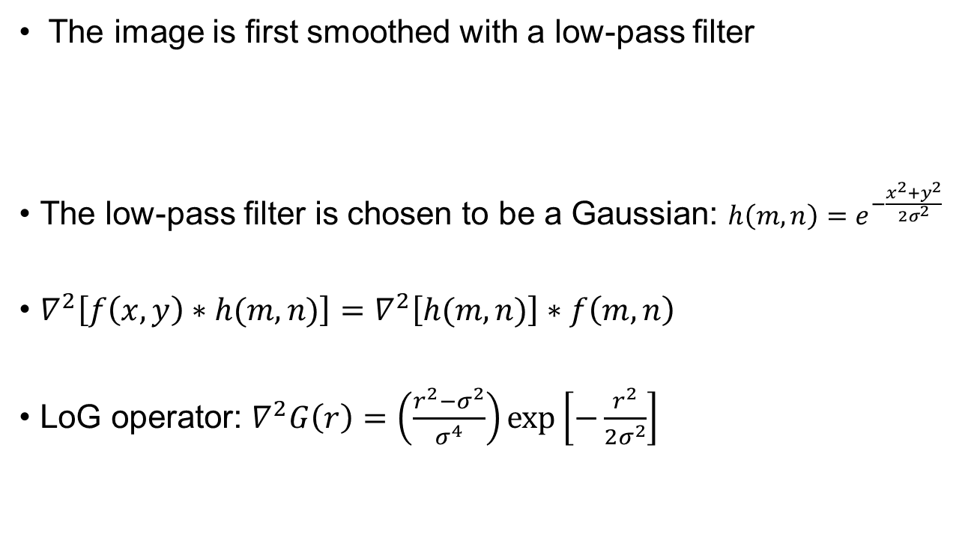
The Laplacian-of-Gaussian (LOG)
The image is ﬁrst smoothed with a low-pass ﬁlter
The low-pass ﬁlter is chosen to be a Gaussian: $h\left(m,n\right)=e^{−\frac{x^{2}+y^{2}}{2σ^{2}}}$
$∇^{2}\left[f\left(x,y\right)∗h(m,n)\right]=∇^{2}\left[h(m,n)\right]∗f\left(m,n\right)$
LoG operator: $∇^{2}G\left(r\right)=\left(\frac{r^{2}−σ^{2}}{σ^{4}}\right)\exp\left[−\frac{r^{2}}{2σ^{2}}\right]$
$$g\left(m,n\right)=f\left(m,n\right)∗h(m,n)$$

Slide 41
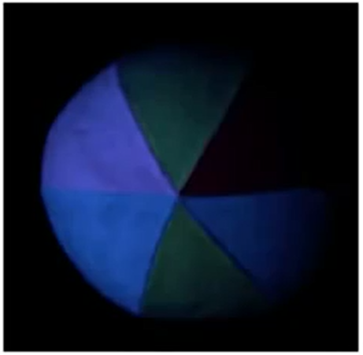
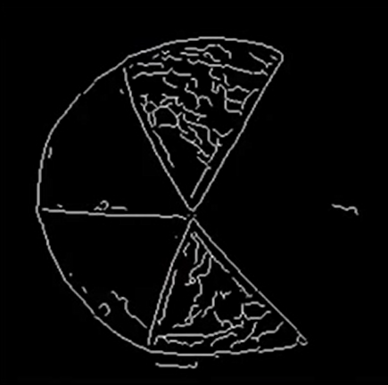
Image segmentation

Slide 42
Thank you
Next Lecture: Line and Curve Detection

