Slide 1

CS654: Digital Image Analysis
Lecture 25: Hough Transform
Slide credits: Guillermo Sapiro, Mubarak Shah, Derek Hoiem

Slide 2
Recap of Lecture 24
Introduction to image segmentation
Top down and bottom up segmentation
Edge based segmentation
First order derivative operators
Second order derivative operator
DoG, LoG

Slide 3
Outline of Lecture 25
Preprocessing Edge Images
Edge Tracking Methods
Fitting Lines and Curves to Edges
The Hough Transform

Slide 4
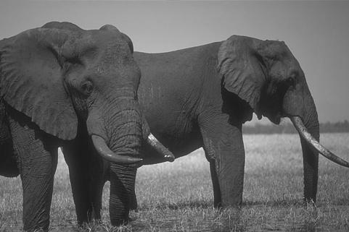
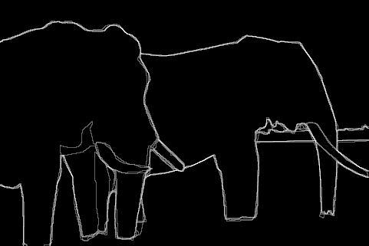
Boundaries of Objects
Marked by many users
http://www.eecs.berkeley.edu/Research/Projects/CS/vision/grouping/segbench/bench/html/images.html

Slide 5
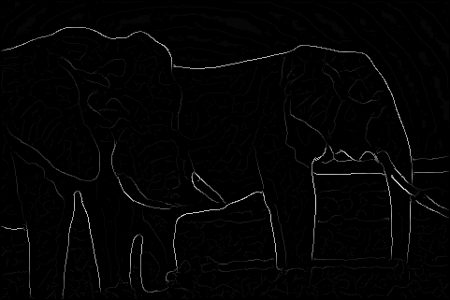
Boundaries of Objects from Edges
Brightness Gradient (Edge detection)
Missing edge continuity, many spurious edges

Slide 6
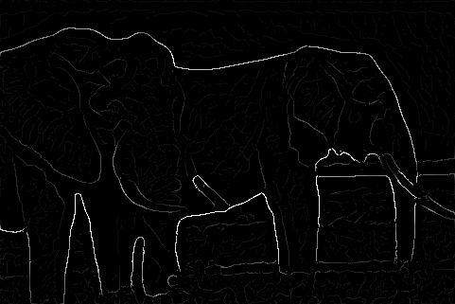
Boundaries of Objects from Edges
Multi-scale Brightness Gradient
But, low strength edges may be very important

Slide 7
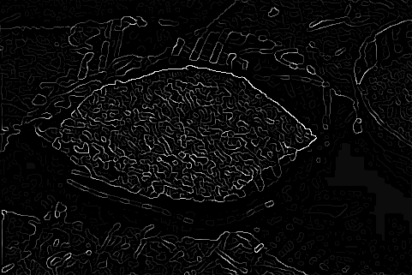
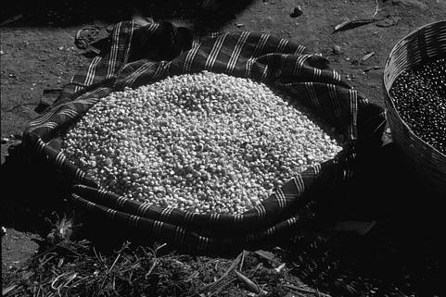
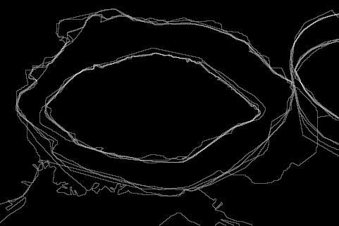
Boundaries of Objects from Edges
Machine Edge Detection
Image
Human Boundary Marking

Slide 8
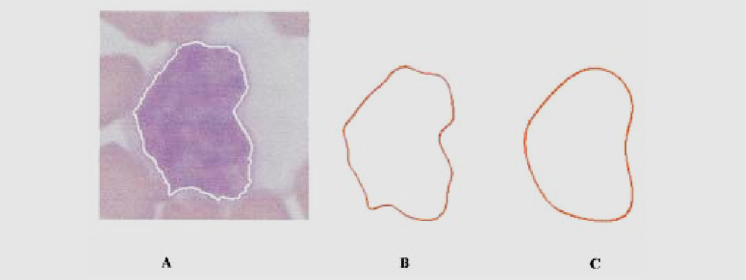
Boundaries in Medical Imaging
Detection of cancerous regions.
[Foran, Comaniciu, Meer, Goodell, 00]

Slide 9
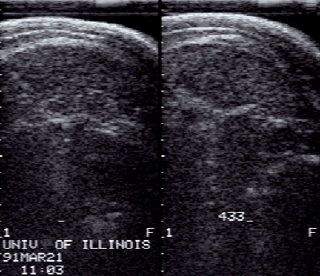
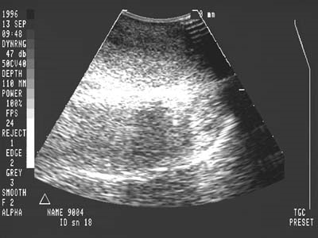
Boundaries in Ultrasound Images
Hard to detect in the presence of large amount of speckle noise

Slide 10
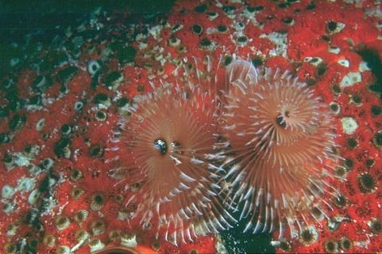
Boundaries of Objects
Sometimes hard even for humans!

Slide 11
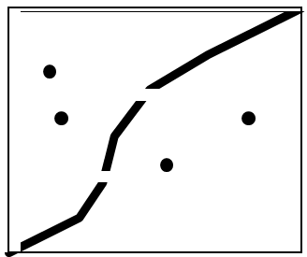
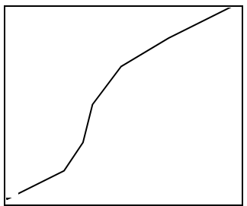
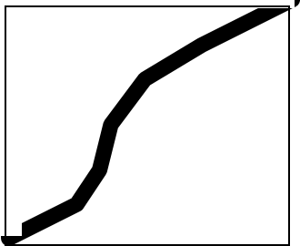
Preprocessing Edge Images
Edge detection
and Thresholding
Noisy edge image
Incomplete boundaries
Image
Shrink and Expand
Thinning

Slide 12
How to fit a line
Least squares Fit (over constraint)
There are more equations than unknowns
Many points two unknowns
RANSAC (constraint)
Number of equations are equal to the number of unknowns
Two points, one line
Hough Transform (under constraint)
There are fewer equations than unknowns
One equation, two unknowns

Slide 13
Fitting Lines to Edges (Least Squares)
Given: Many pairs
Find: Parameters
Minimize: Average square distance:

Slide 14
Fitting Lines to Edges (Least Squares)
Minimize: Average square distance:
Using:
Note:

Slide 15
Curve Fitting
Find Polynomial:
that best fits the given points
Minimize:
Using:
Note: is LINEAR in the parameters (a, b, c, d)

Slide 16
RANSAC (Random Sampling and Consensus)
Randomly select two points to fit a line
Find the error between the estimated solution and all other points.
If the error is less than tolerance, then quit, else go to step (1).

Slide 17
Line Grouping Problem
Slide credit: David Jacobs

Slide 18
This is difficult because of:
Extraneous data: clutter or multiple models
We do not know what is part of the model?
Can we pull out models with a few parts from much larger amounts of background clutter?
Missing data: only some parts of model are present
Noise
Cost:
It is not feasible to check all combinations of features by fitting a model to each possible subset

Slide 19

Hough Transform
Several Lines
• How do we Know which points belong to
which lines?
Elegant method for direct object recognition
Edges need not be connected
Complete object need not be visible
Key Idea: Edges VOTE for the possible model

Slide 20
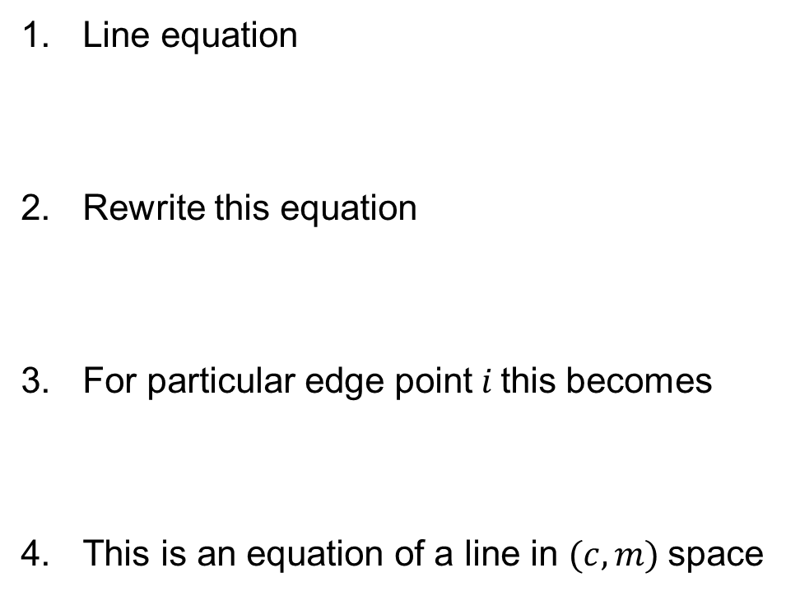
Line Fitting: Hough Transform
Line equation
Rewrite this equation
For particular edge point$i$this becomes
This is an equation of a line in $(c,m)$space

Slide 21
Image and Parameter Spaces
Equation of Line:
Find:
Consider point:
Image Space
Parameter space also called
Hough Space
Parameter Space

Slide 22
Line Detection by Hough Transform
Algorithm:
Quantize Parameter Space
Create Accumulator Array
Set
For each image edge increment:
If lies on the line:
Find local maxima in
Parameter Space
 | 1 |  |  |  |  |  | 1
 |  | 1 |  |  |  | 1
 |  |  | 1 |  | 1
 |  |  |  | 2
 |  |  | 1 |  | 1
 |  | 1 |  |  |  | 1
 | 1 |  |  |  |  |  | 1

Slide 23
Better Parameterization
NOTE:
Large Accumulator
More memory and computations
Improvement:
Line equation:
Here
Given points find
(Finite Accumulator Array Size)
Image Space
?
Hough Space Sinusoid
Hough Space

Slide 24
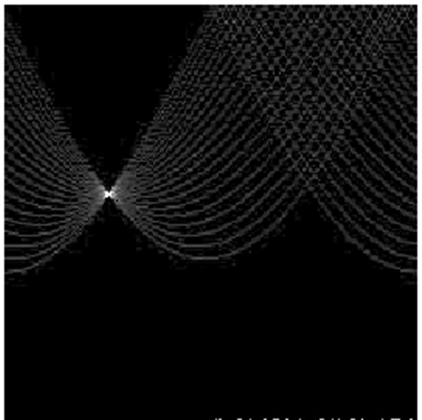
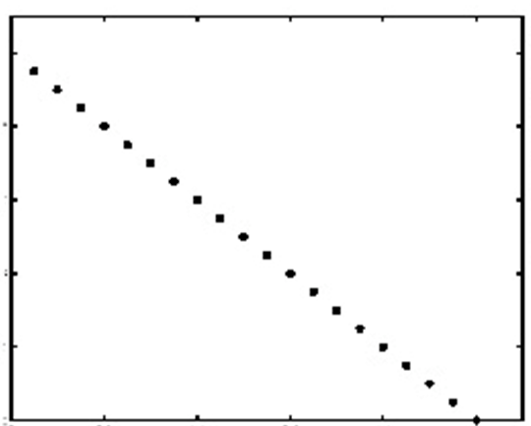


$$θ$$
$$ρ$$
Image space
Votes
Horizontal axis is θ, vertical is rho.
Notes:
Figure 15.1, top half. Note that most points in the vote array are very dark, because they
get only one vote.

Slide 25
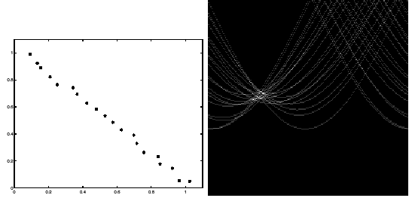
Image space
votes
Notes:
This is 15.1 lower half

Slide 26
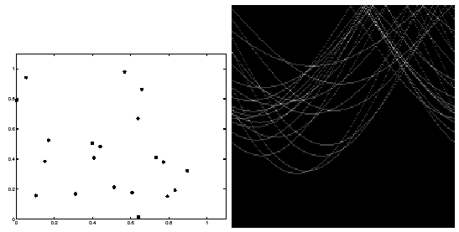
Image space
votes
Notes:
15.2; main point is that lots of noise can lead to large peaks in the array

Slide 27
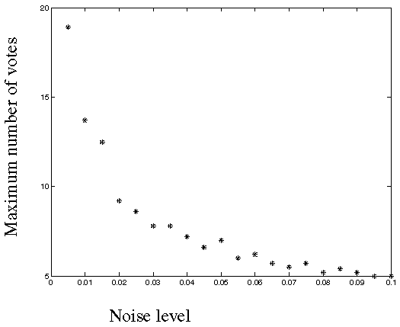
Fewer votes land in a single bin when noise increases.
Notes:
This is the number of votes that the real line of 20 points gets with increasing noise (figure15.3)

Slide 28
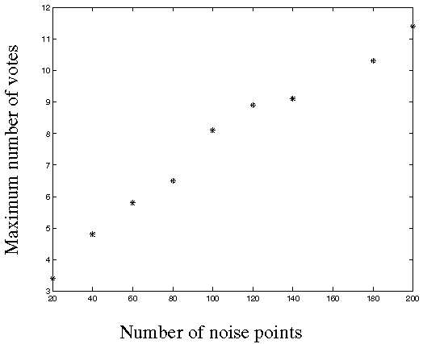
Adding more clutter increases number of bins with false peaks.
Notes:
Figure 15.4; as the noise increases in a picture without a line, the number of points in the max cell goes
up, too

Slide 29
Mechanics of the Hough transform
Difficulties
how big should the cells be?
too big, and we merge quite different lines;
too small, and noise causes lines to be missed)
How many lines?
Count the peaks in the Hough array
Treat adjacent peaks as a single peak
Which points belong to each line?
Search for points close to the line
Solve again for line and iterate

Slide 30
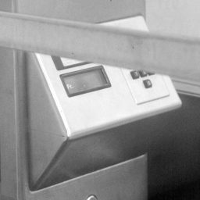
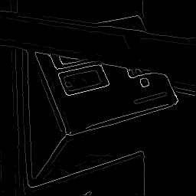
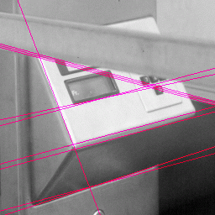

Real World Example
Original
Edge Detection
Found Lines
Parameter Space

Slide 31






Finding Circles by Hough Transform
Equation of Circle:
$$y$$
$$(x_{i},y_{i})$$
If radius is known:
(2D Hough Space)
$$r$$
$$b$$
Accumulator Array
$$a$$
$$x$$
Image space

Slide 32








Finding Circles by Hough Transform
Equation of Circle:
$$y$$
$$b$$
$$(x_{i},y_{i})$$
$$r$$
$$b$$
$$a$$
$$x$$
Image space
Hough Space
$$a$$
If radius is known:
(2D Hough Space)
Accumulator Array

Slide 33






Finding Circles by Hough Transform
Equation of Circle:
$$y$$
$$(x_{i},y_{i})$$
$$r$$
$$b$$
If radius is not known: 3D Hough Space!
Use Accumulator array
$$a$$
$$x$$
Image space
What is the surface in the Hough space?

Slide 34








Using Gradient Information
Gradient information can save lot of computation:
Edge Location
Edge Direction
$$y$$
Assume radius is known:
$$y$$
$$(x_{i},y_{i})$$
$$φ_{i}$$
$$x$$
$$r$$
$$(a,b)$$
$$x$$
Need to increment only one point in Accumulator!!

Slide 35
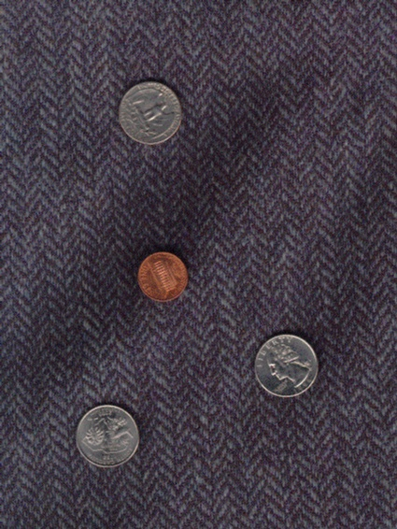
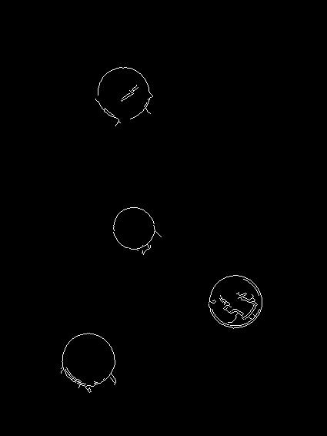
Finding Coins
Original
Edges (note noise)

Slide 36
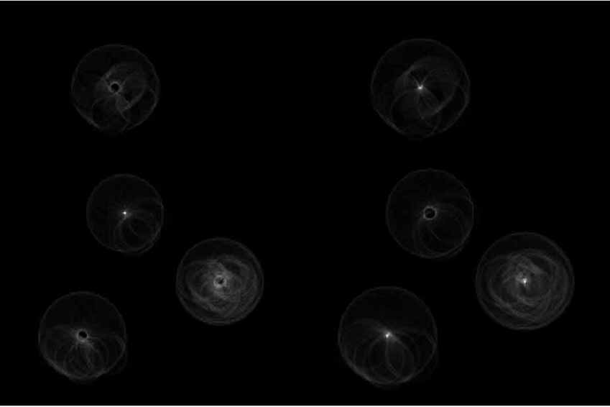
Finding Coins (Continued)
Pennies
Quarters

Slide 37
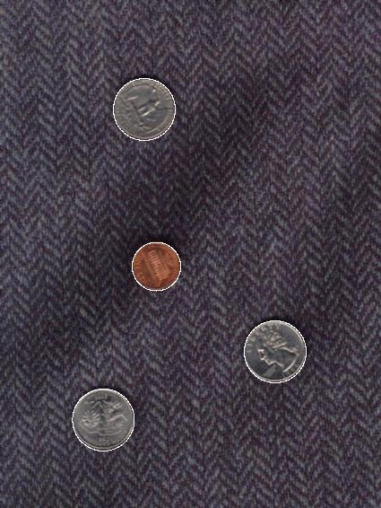
Finding Coins (Continued)
Note that because the quarters and penny are different sizes, a different Hough transform (with separate accumulators) was used for each circle size.
Coin finding sample images from: Vivek Kwatra

Slide 38
Generalized Hough Transform
Model Shape NOT described by equation
Requires training
Object of known shape
Generate model
R-table
Similar approach to line and circle fitting during detection

Slide 39

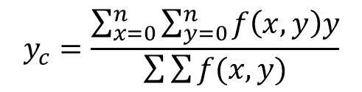

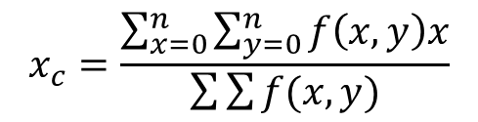


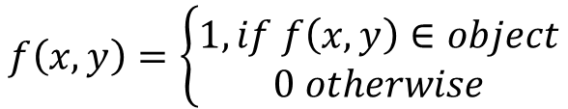

Generating R Table
Compute centroid
For each pixel compute r
Find edge orientation
Construct a table of angle and r values
$$x_{c}=\frac{\sum_{x=0}^{n}{\sum_{y=0}^{n}{f\left(x,y\right)x}}}{\sum{\sum{f(x,y)}}}$$
$$y_{c}=\frac{\sum_{x=0}^{n}{\sum_{y=0}^{n}{f\left(x,y\right)y}}}{\sum{\sum{f(x,y)}}}$$
$$f\left(x,y\right)=\left\{\begin{aligned}1, if f\left(x,y\right)∈object \\ 0 otherwise\end{aligned}\right.$$
$$(x_{c},y_{c})$$
$$y′$$
$$x′$$
$$φ$$
$$(x,y)$$

Slide 40
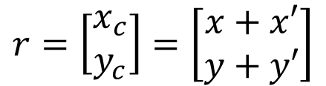


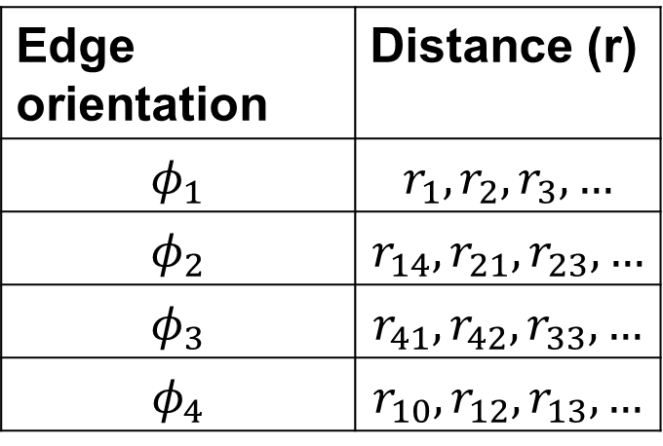



Generating R-table
$$r=\left[\begin{matrix}x_{c} \\ y_{c}\end{matrix}\right]=\left[\begin{matrix}x+x′ \\ y+y′\end{matrix}\right]$$
Edge orientation | Distance (r)
$$φ_{1}$$ | $$r_{1}, r_{2}, r_{3},…$$
$$φ_{2}$$ | $$r_{14}, r_{21}, r_{23},…$$
$$φ_{3}$$ | $$r_{41}, r_{42}, r_{33},…$$
$$φ_{4}$$ | $$r_{10}, r_{12}, r_{13},…$$
$$(x_{c},y_{c})$$
$$y′$$
$$x′$$
$$φ$$
$$(x,y)$$

Slide 41
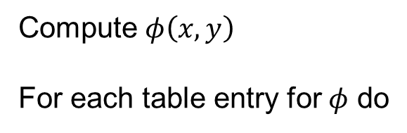


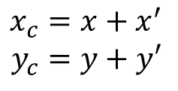
GHT Algorithm
Quantize the parameter space $P\left[x_{c}^{min},…, x_{c}^{max};y_{c}^{min},…, y_{c}^{max}\right]$
For each edge point $(x,y)$ do
Find the local maxima in the parametric space
Compute $φ\left(x,y\right)$
For each table entry for $φ$ do
$$x_{c}=x+x^{′}$$
$$y_{c}=y+y′$$
$$P\left[x_{c},y_{c}\right]=P\left[x_{c},y_{c}\right]+1$$

Slide 42












Scale and Rotation Invariance
Transformed coordinate
$$x^{′′}=s_{x}\left(x^{′}cosθ+y^{′}sinθ \right)$$
$$(x_{0},y_{0})$$
$$y^{′′}=s_{y}\left({−x}^{′}sinθ+y^{′}cosθ\right)$$
$$y′$$
$$x′$$
$$φ$$
$$(x,y)$$
Modified centroid location
$$x_{0}={x+s}_{x}\left(x^{′}cosθ+y^{′}sinθ \right)$$
Rotation angle = $θ$
$$y_{0}={y+s}_{x}\left(x^{′}cosθ+y^{′}sinθ \right)$$
Scale along x= $s_{x}$
Scale along y= $s_{y}$

Slide 43
Hough Transform: Comments
Works on Disconnected Edges
Relatively insensitive to occlusion
Effective for simple shapes (lines, circles, etc)
Trade-off between work in Image Space and Parameter Space
Handling inaccurate edge locations:
Increment Patch in Accumulator rather than a single point

Slide 44
Thank you
Next Lecture: Region based segmentation

