Slide 1

CS654: Digital Image Analysis
Lecture 31: Image Morphology: Dilation and Erosion

Slide 2
Recap of Lecture 30
Color image processing
Color model
Conversion of color models
Color image processing
Color enhancement, retouching, pseudo-coloring

Slide 3
Outline of lecture 31
Image morphology
Set theoretic interpretation
Dilation
Erosion
Duality
Opening and Closing

Slide 4
Introduction
Study of the form, shapes, structure of artifacts
Archaeology, astronomy, biology, linguistic, geomorphology, mathematical morphology, ….
Image processing
Extract image components
representation and description of region shape,
boundaries, skeletons, and the convex hull

Slide 5
Binary Morphology
Morphological operators are used to prepare binary images for object segmentation/recognition
Binary images often suffer from noise (specifically salt-and-pepper noise)
Binary regions also suffer from noise (isolated black pixels in a white region).
Can also have cracks, picket fence occlusions, etc.
Dilation and erosion are two binary morphological operations that can assist with these problems.

Slide 6
Goals of morphological operations
Simplifies image data
Preserves essential shape characteristics
Eliminates noise
Permits the underlying shape to be identified and optimally reconstructed from their distorted, noisy forms

Slide 7
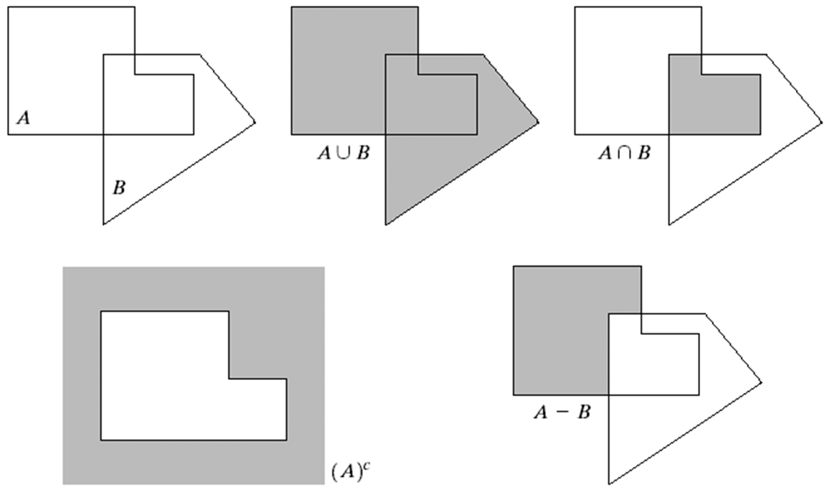
Some Basic Concepts from Set Theory

Slide 8

Preliminaries
Reflection
Translation
The reflection of a set $B,$ denoted as $\hat{B}$, defined as
$$\hat{B}=\{w|w=−b, for b∈B\}$$

Slide 9
Example: Reflection and Translation
Reflection
Translation

Slide 10
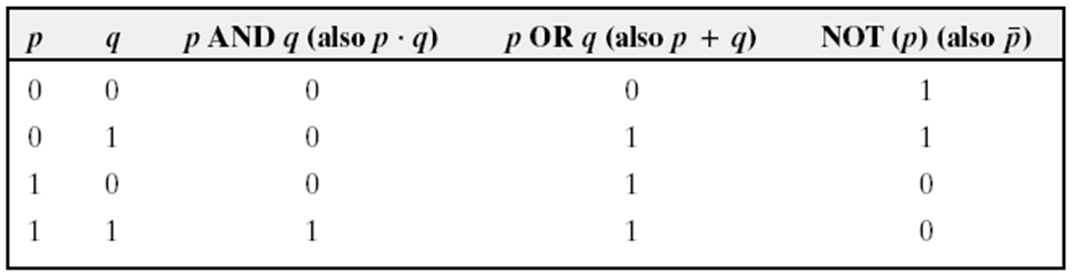
Logical operations on Binary images

Slide 11
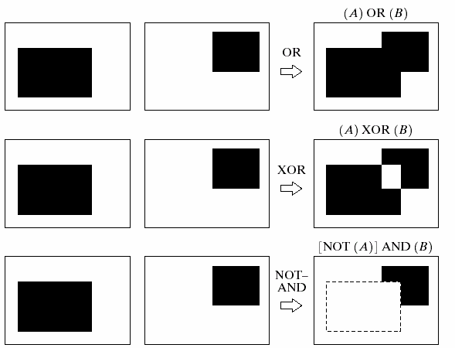
Logical operations on Binary images
A
B

Slide 12
Structure elements (SE)
Small sets or sub-images used to probe an image under study for properties of interest
origin

Slide 13
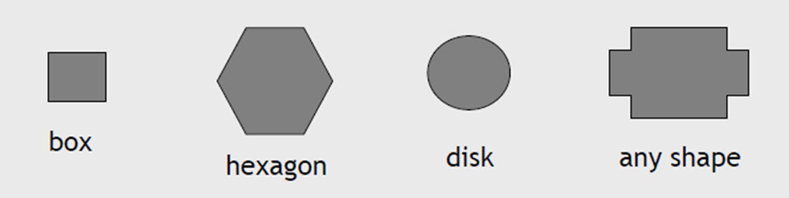
Libraries of Structuring Elements
Application specific structuring elements created by the user

Slide 14


Notation
x
-2 -1 0 1 2
-2 -1 0 1 2
B
y
A special set :
the structuring element
Origin at center in this case, but not necessarily centered nor symmetric
X
No necessarily compact
nor filled
3*3 structuring element

Slide 15
Examples: Structuring Elements
Accommodate the entire structuring elements when its origin is on the border of the original set A
Origin of B visits every element of A
At each location of the origin of B, if B is completely contained in A, then the location is a member of the new set, otherwise it is not a member of the new set.

Slide 16

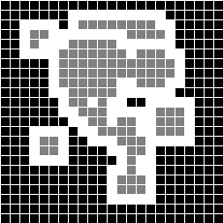
Dilation
x = (x₁,x₂) such that if we center B on them, then the so translated B intersects X.
X
difference
dilation
B

Slide 17
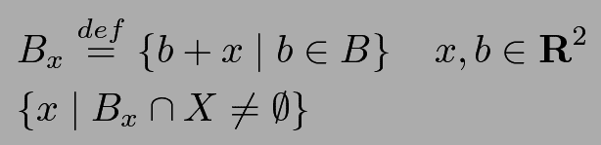

Mathematical formulation
Dilation : x = (x₁,x₂) such that if we center B on them, then the so translated B intersects X.
How to formulate this definition ?
1) Literal translation
2) Better : from Minkowski’s sum of sets
$$X⨁\hat{B}$$
Another Mathematical definition of dilation uses the concept of Minkowski’s sum

Slide 18
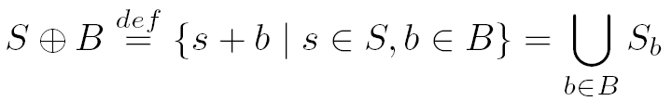
Minkowski’s Sum
l
Minkowski’s Sum
l

Slide 19
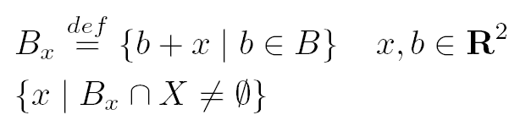
Another view of Dilation
Dilation :
l
Dilation

Slide 20
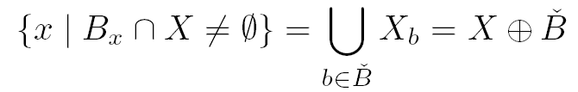


Dilation is not the Minkowski’s sum
Dilation
l
l
l
Dilation
b
b
b
b

Slide 21
Dilation explained pixel by pixel
Denotes origin of A i.e. its (0,0)
Denotes origin of B i.e. its (0,0)
B
•
•
•
•
•
•
•
•
•
•
•
•
•
•
•
•
A

Slide 22
Dilation explained by shape of A
Shape of A repeated without shift
B
•
•
•
•
•
•
•
•
•
•
•
•
•
•
•
•
A
Shape of A repeated with shift

Slide 23
Properties of Dilation
Fills in valleys between spiky regions
Increases geometrical area of object
Sets background pixels adjacent to object's contour to object's value
Smoothens small negative grey level regions

Slide 24
Dilation versus translation
Let A be a Subset of and .
The translation of A by x is defined as:
The dilation of A by B can be computed as the union of translation of A by the elements of B
x is a vector

Slide 25
Dilation versus translation, illustrated
Shift vector (0,0)
Element (0,0)
Shift vector (0,1)
•
•
•
•
B
•
•
•
•
•
•
•
•
•
•
•
•
•
•
•
•
•

Slide 26
Dilation using Union Formula
Center of the circle
This circle will create one point
This circle will create no point

Slide 27




Example of Dilation with various sizes of structuring elements
Structuring
Element
Pablo Picasso, Pass with the Cape, 1960

Slide 28
Mathematical Properties of Dilation
Commutative
Associative
Extensivity
Dilation is increasing

Slide 29
Illustration of Extensitivity of Dilation
A
•
•
B
•
•
•
•
Replaced with
•
•
•
•
•
•
Here 0 does not belong to B and A is not included in A⊕ B
•
•

Slide 30
More Properties of Dilation
Translation Invariance
Linearity
Containment
Decomposition of structuring element

Slide 31
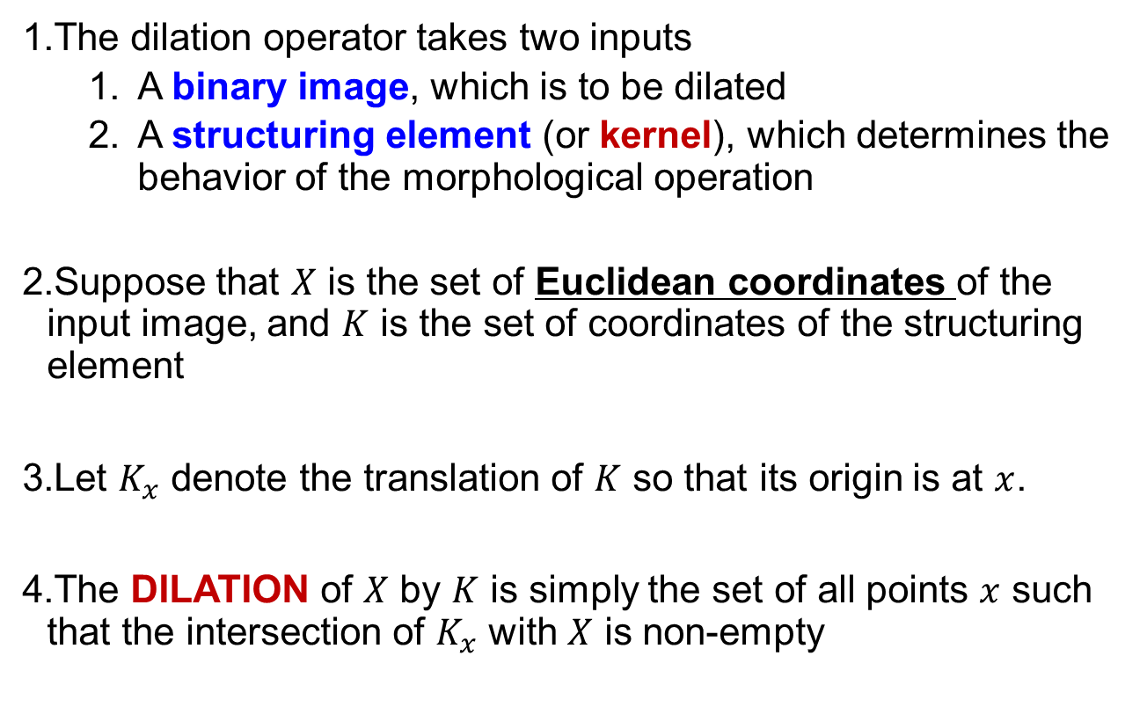
Dilation (Summary)
The dilation operator takes two inputs
A binary image, which is to be dilated
A structuring element (or kernel), which determines the behavior of the morphological operation
Suppose that $X$ is the set of Euclidean coordinates of the input image, and $K$ is the set of coordinates of the structuring element
Let $K_{x}$ denote the translation of $K$ so that its origin is at $x$.
The DILATION of $X$ by $K$ is simply the set of all points $x$ such that the intersection of $K_{x}$ with $X$ is non-empty

Slide 32

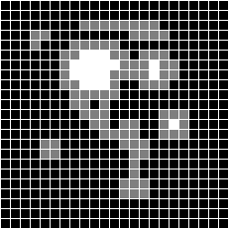
Erosion
x = (x₁,x₂) such that if we center B on them, then the so translated B is contained in X.
difference
Erosion

Slide 33


Notation for Erosion
Erosion : x = (x₁,x₂) such that if we center B on them, then the so translated B is contained in X.
How to formulate this definition ?
1) Literal translation
Erosion
2) Better : from Minkowski’s substraction of sets
Minkowski’s substraction

Slide 34
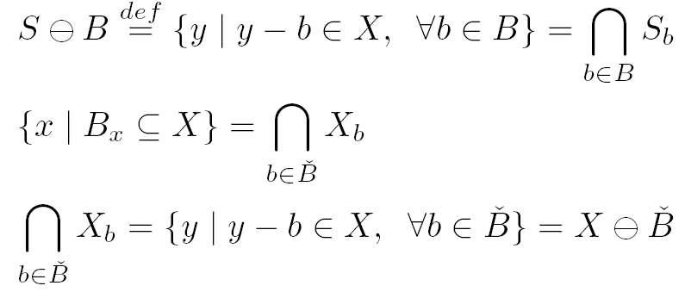
Minkowski’s substraction of sets
Minkowski’s substraction of sets
Erosion

Slide 35
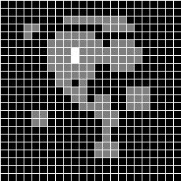
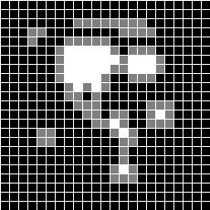


Erosion with other structuring elements

Slide 36
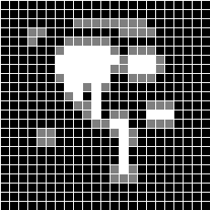
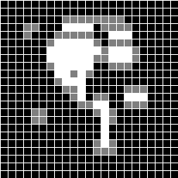


Erosion with other structuring elements
Did not belong to X
⊆
⊇
When the new SE is included in old SE then a larger area is created

Slide 37
Erosion explained pixel by pixel
A
•
•
B
•
•
•
•
•
•
•
•
•
•
•
•

Slide 38
How It Works?
During erosion, a pixel is turned on at the image pixel under the structuring element origin only when the pixels of the structuring element match the pixels in the image
Both ON and OFF pixels should match.
This example erodes regions horizontally from the right.

Slide 39
Mathematical Definition of Erosion
Erosion is the morphological dual to dilation.
It combines two sets using the vector subtraction of set elements.
Let denotes the erosion of A by B

Slide 40
Erosion in terms of other operations:
Erosion can also be defined in terms of translation
In terms of intersection
Observe that vector here is negative

Slide 41
Reminder - this was A
•
•
•
•
•
•
•
•

Slide 42
Erosion: intersection and negative translation
Observe negative translation
Because of negative shift the origin is here
•
•
•
•
•
•
•
•
•
•
•
•
•
•
•
•
•
•
•
•
•
•

Slide 43
Erosion formula and intuitive example
Center of B is here and adds a point
Center here will not add a point to the Result

Slide 44


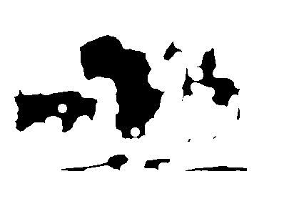
Example of Erosions with various sizes of structuring elements
Structuring
Element
Pablo Picasso, Pass with the Cape, 1960

Slide 45
Properties of Erosion
Erosion is not commutative!
Extensivity
Erosion is dereasing
Chain rule

Slide 46
Properties of Erosion
Translation Invariance
Linearity
Containment
Decomposition of structuring element

Slide 47
Duality: erosion and dilation
One acts on image foreground and the other does the same for the image background.
, the reflection of B, is defined as
Erosion and Dilation Duality Theorem
Observe negative value which is mirror image reflection of B
Similar but not identical to De Morgan rule in Boolean Algebra

Slide 48
Erosion (Summary)
To compute the erosion of a binary input image by the structuring element
For each foreground pixel superimpose the structuring element
If for every pixel in the structuring element, the corresponding pixel in the image underneath is a foreground pixel, then the input pixel is left as it is
Otherwise, if any of the corresponding pixels in the image are background, however, the input pixel is set to background value

Slide 49
Erosion

Slide 50
Erosion as Dual of Dilation
Erosion is the dual of dilation
i.e. eroding foreground pixels is equivalent to dilating the background pixels.

Slide 51
Duality Relationship between erosion and dilation
Easily visualized on binary image
Template created with known origin
Template stepped over entire image
similar to correlation
Dilation
if origin == 1 -> template unioned
resultant image is large than original
Erosion
only if whole template matches image
origin = 1, result is smaller than original
Another look at duality

Slide 52
Erosion example with dilation and negation
We want to calculate this
We dilate with negation

Slide 53
Erosion
.. And we negate the result
We obtain the same thing as from definition

Slide 54

Common structuring elements shapes
= origin
x
y
disk
circle
segments 1 pixel wide
Note that here :
points

Slide 55
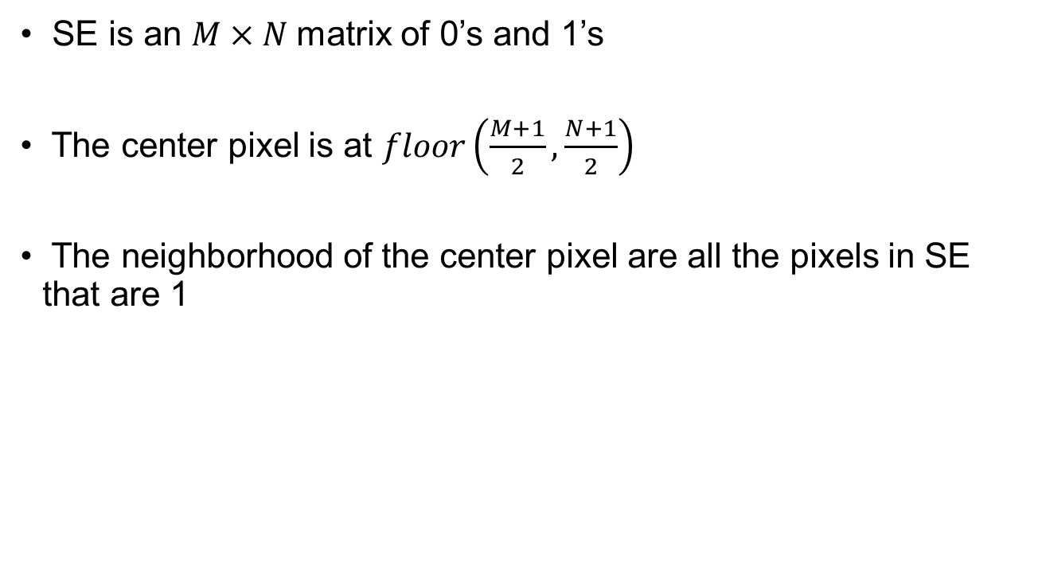
Morphology using Generalized SE
SE is an $M×N$matrix of 0’s and 1’s
The center pixel is at $floor\left(\frac{M+1}{2},\frac{N+1}{2}\right)$
The neighborhood of the center pixel are all the pixels in SE that are 1
1 | 0 | 1
0 | 1 | 0
1 | 0 | 1

Slide 56
Morphology using Generalized SE
For each pixel in the input image, examine the neighborhood as specified by the SE
Erosion: If EVERY pixel in the neighborhood is on (i.e. 1), then output pixel is also 1
Dilation: If ANY pixel in the neighborhood is on (i.e. 1), then output pixel is also 1
Yet another look at Duality Relationship between erosion and dilation

Slide 57


Edge detection using Morphology
Original image
Edge detection results

Slide 58
Thank you
Next Lecture: Image Morphology

